Slide 1
AAPT 2012 Winter Meeting
  Ontario, California
  February 4th – 8th 2012

Slide 2
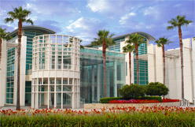
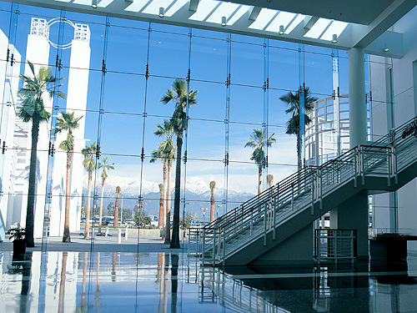
Location: Ontario
Convention Center
40 miles east of LA via the 10 Freeway
Adjacent to Ontario International Airport
http://www.ontariocc.com/about/photo_gallery/

Slide 3
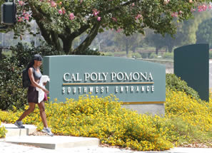
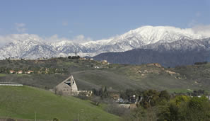
Workshops at
Cal Poly Pomona
  http://www.csupomona.edu/about.php

Slide 4
Meeting Theme
The Wave Nature of Light & Matter
  2012 is the 150th anniversary of Maxwell’s equations and the 75th anniversary of the Davisson-Germer Nobel Prize. California is known for its water waves, so join us to explore the physics of waves and entertainment.

Slide 5
Meeting Highlights
  Over 40 Workshops
  Over 60 Invited and Contributed Sessions
  Poster Sessions
  Over 20 Area Committee Meetings

Slide 6
Meeting Highlights
  Opening Reception
  Exhibit of Physics Related Books and Materials
  Networking Opportunities
  See Old Friends
  Meet New Friends

Slide 7
Meeting Plenary Speakers
  Ron Henderson (Dream Works)
  Kip Thorne
  Richard Muller
  Brian Greene (Richtmyer Award)
  Symposium On Educational Policy

Slide 8
Monday, February 6th
  A special program and a special reduced rate for high school physics teachers who have never been to a national meeting. Details will be available by early November. See www.aapt.org or your section rep.

Slide 9
Travel to Ontario
  Ontario International Airport (ONT) is just a few blocks from the convention center and conference hotels.
  Alternate airports are
    John Wayne/Orange County (SNA) (45 miles)
    Los Angeles International (LAX) (50 miles)
    Bob Hope/Burbank (BUR) (40 miles)

Slide 10
Travel to Ontario
  Avis car rental is offering a discount to all AAPT Winter Meeting attendees. Please call Avis directly at 800-331-1600 or visit their website and use the Avis Worldwide Discount (AWD) number J945158. The discount is effective from 7 days before the conference to 7 days after.

Slide 11
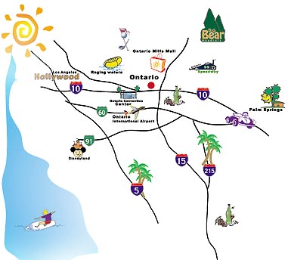
Or If You Plan To Drive

Slide 12
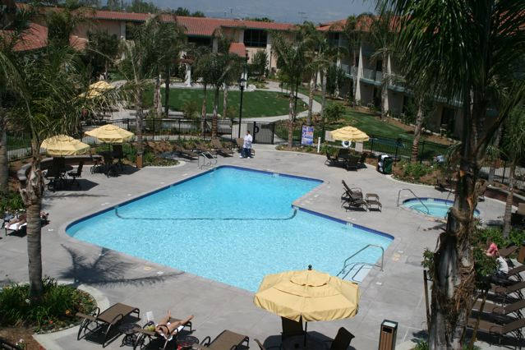
Conference Hotels
Doubletree Hotel
$139 per night
Free WiFi
Free Parking
Complimentary shuttle from Airport
3-Diamond resort-like property

Slide 13
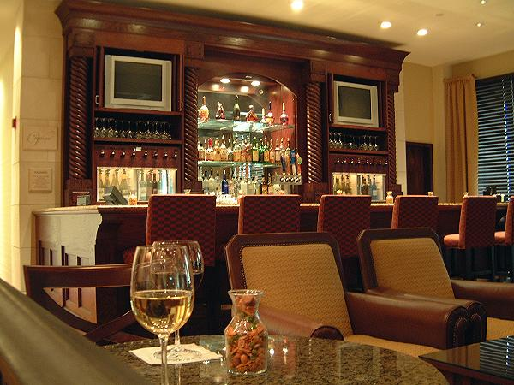
Doubletree Hotel
On-Site Food and Drink
Starbuck’s
Convenience Store
Porter’s Prime Steakhouse
Misty’s Lounge
Vineyards Wine Bar

Slide 14
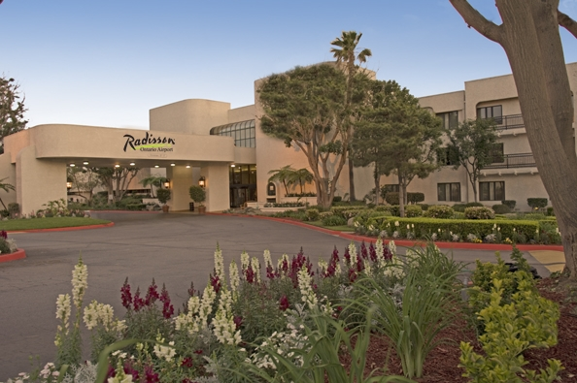
Conference Hotels
Radisson Hotel
$135 per night
Free WiFi
Free Parking
Complimentary continental breakfast
Complimentary shuttle from Airport

Slide 15
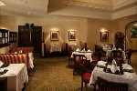
Radisson Hotel
On-Site Food and Drink
Pacific Grille (fresh California cuisine)
D Street Bar & Grill
Pacific Express Deli, featuring sandwiches, croissants, snacks and Starbucks© coffee

Slide 16
Conference Hotel
It is important to patronize the conference hotel because $20 of your nightly bill goes to the convention center to offset AAPT’s facilities bill. If you do stay in another Ontario hotel, please consider sending AAPT a $20 per night tax-deductible contribution to offset the Convention Center cost.

Slide 17
Ontario – A great base for a
California winter vacation
Ocean beaches within 50 miles
Three ride/ski areas within 50 miles
Disneyland 35 miles
Hollywood 45 miles
Temecula Valley Wine Country 55 miles
San Diego, Palm Springs, Joshua Tree are day trips

Slide 18
Hope to see you there!
To register for the Winter Meeting go to www.aapt.org and following the links through “National Meeting.”

