Slide 1

DIY Cellphone Spectrometer for Online Physics and Astronomy Labs
Brian Geislinger
AAPT Winter Meeting
Atlanta, GA
February 19, 2017

Slide 2
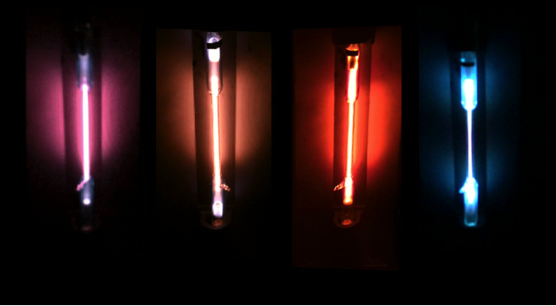
Background
Began developing fully online astronomy course
  Non-science majors
  One semester survey
Online labs are always tricky
  Use Nebraska Astronomy Applet Project for many labs (http://astro.unl.edu/naap/)
  Didn’t want to do a virtual spectroscopy lab
    Needs to be low intervention
    Interactive
    Real-world
    Make use of modern technology

Slide 3
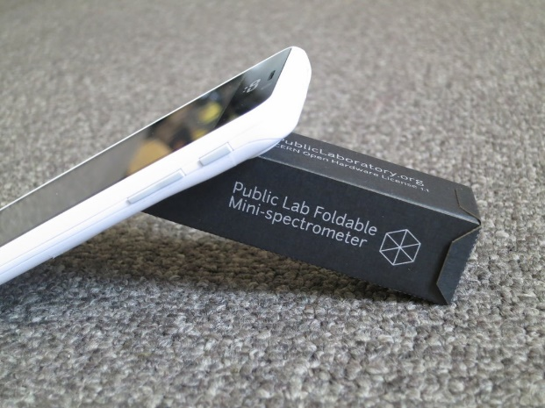
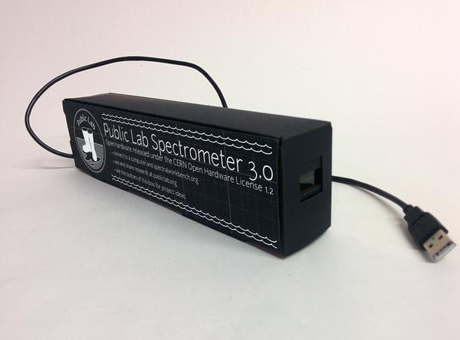
PublicLab Cellphone Spectrometer and Desktop Spectrometer
DIY Papercraft spectrometer
  DVD-R used as diffraction grating
  Cellphone camera or HD webcam to capture spectra
Open source hardware design (CERN Open Hardware License 1.1)
Can be built yourself
Or can purchase a die-cut and pre-creased kit for less than $15 (cellphone model)
Desktop model is more involved (less than $50)

Slide 4
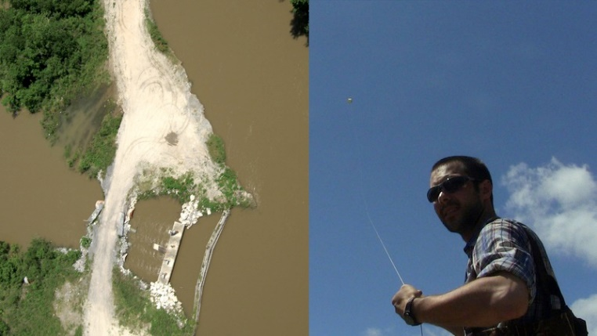
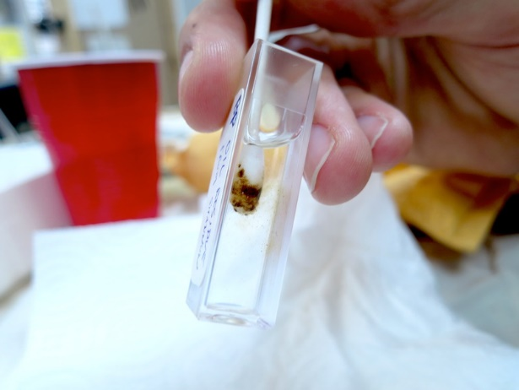
PublicLab.org
A DIY community science organization
  Non-profit
  Dedicated to creating “citizen scientists”
  Open-source community – both for hardware and software
Developed out of desire to monitor environmental hazards
  Deepwater Horizon Gulf oil spill in 2010
Cheap, easily built data-collection devices
  Weather balloon mapping and surveillance
  Air quality analysis
  Spectroscopic analysis tools
    Emission
    Absorption (using 405-nm laser pointer light source)

Slide 5
Online Astronomy Spectroscopy
Students need to be able to complete with minimal intervention
Spectroscopic “Treasure Hunt”
Give them suggestions for light sources
  CFLs vs LEDs vs incandescent
  Mercury vapor vs Sodium vapor street lamps
  Neon signs
Only requirement is for them to find different spectra for each submission

Slide 6
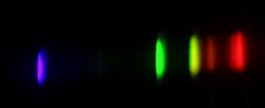
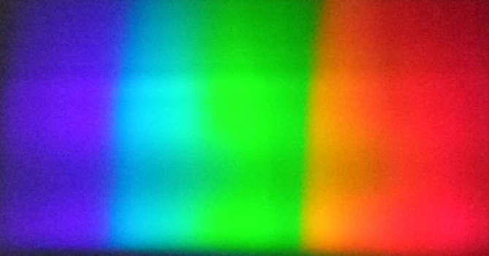
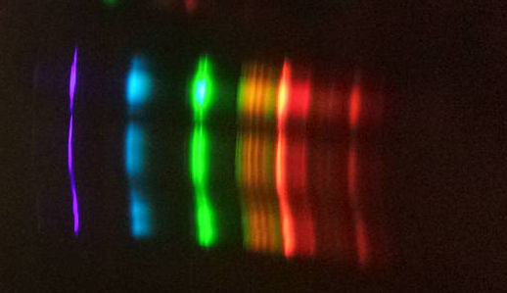
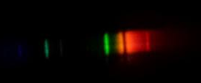
Source 1 | Paste picture of spectra here:
Mercury Vapor
Brightest color
Blue and Green
Emission, Absorption or Continuous spectra
Emission
Notes
Street light in town. Struggled with focus on this one.
Source 2 | Paste picture of spectra here:
UV Grow Light
Brightest color
Even Brightness
Emission, Absorption or Continuous spectra
Continuum
Notes
This light was over a grow table in our garden cottage
Source 3 | Paste picture of spectra here:
Fluorescent Light (curly bulb)
Brightest color
I feel like the Green is brightest
Emission, Absorption or Continuous spectra
Emission
Notes
The fluorescent was my favorite spectra I captured!
Source 6 | Paste picture of spectra here:
Sodium Vapor
Brightest color
Red/orange
Emission, Absorption or Continuous spectra
Emisson (With an absortion line in the orange)
Notes
I was unsure how to label this one as there is an absorption line, but it fit more closely with an emission spectrum

Slide 7
Physics Spectroscopy
RSPEC software works well ($100+)
PublicLab software:
  http://spectralworkbench.org
Online software and tools
  Live capture and analysis
  Clever calibration using CFL (for quantitative analysis)
Cloud account and storage
  Comparison searching
  Spectroscopic cataloging
Some problems:
  Software is still under development
  Calibration changes if you move spectrometer
Ultimate Goal:
  Private (school) server
  For students only
  Students can share and discuss their findings

Slide 8
Spectral Workbench Demo

Slide 9
Conclusions
Extremely low-cost spectroscopy solution for online classes
Easy to construct for students
Students can explore emission spectroscopy at home with little intervention
Use their own cellphone cameras to complete lab exercise
Potential for software analysis

