Slide 1
Exhibitor/Sponsorship Overview

Slide 2
Gold: Presenting Sponsor
One Available
Gold: Presenting Sponsor $9,000
Banners on Conference Page
Expo Page Placement Linking to Sponsor Page
Three Dedicated Emails to Registrants (One Pre-Meeting & Two Post-Meeting)
Logos integrated into Virtual Coffee Breaks + Poster Sessions
Two Commercial Workshops (Pre-Recorded)
Larger Logo in Virtual Background Used by Speakers
Larger Logo in AAPT Emails to Attendees
Pre-Roll Ads In Plenaries/Other Live Events
Verbal Mention in Plenaries, Opening, and Closing
Two Journal Article Download Ad, The Physics Teacher*
Online Banner Campaign: Contextual or The Physics Teacher*
One Full Page Ad, The Physics Teacher*
*Advertising cannot be used as a credit on existing ad campaigns and must be reserved before September 30, 2020. Subject to approval.

Slide 3
Silver & Bronze Sponsorship Packages
Four Available (Silver) & Nine Available (Bronze)
Silver: Supporting Sponsor $5,000 (Four Available)
Banners on Conference Page
Expo Page Placement Linking to Sponsor Page
Two Dedicated Emails to Registrants (One Pre-Meeting & One Post-Meeting)
Logos integrated into Virtual Coffee Breaks + Poster Sessions
One Commercial Workshop (Pre-Recorded)
Small Logo in Virtual Background Used by Speakers
Small Logo in AAPT Emails to Attendees
One Journal Article Download Ad, The Physics Teacher*
Bronze $2,200 (Nine Available)
Banners on Conference Page
Expo Page Placement Linking to Sponsor Page
One Dedicated Email to Registrants (Pre-Meeting)
Logos integrated into Coffee Breaks + Poster Sessions
*Advertising cannot be used as a credit on existing ad campaigns and must be reserved before September 30, 2020. Subject to approval.

Slide 4
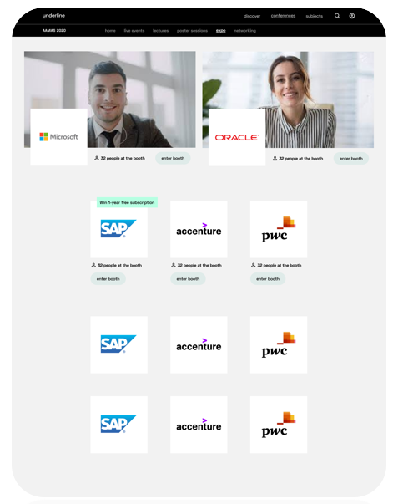
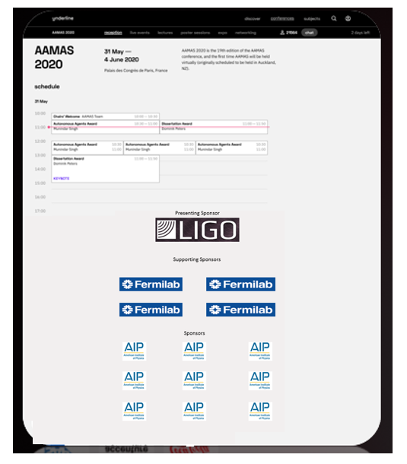
Conference Page & Expo Page Banners
All Sponsor Levels
Conference Home Page
Expo Home Page

Slide 5
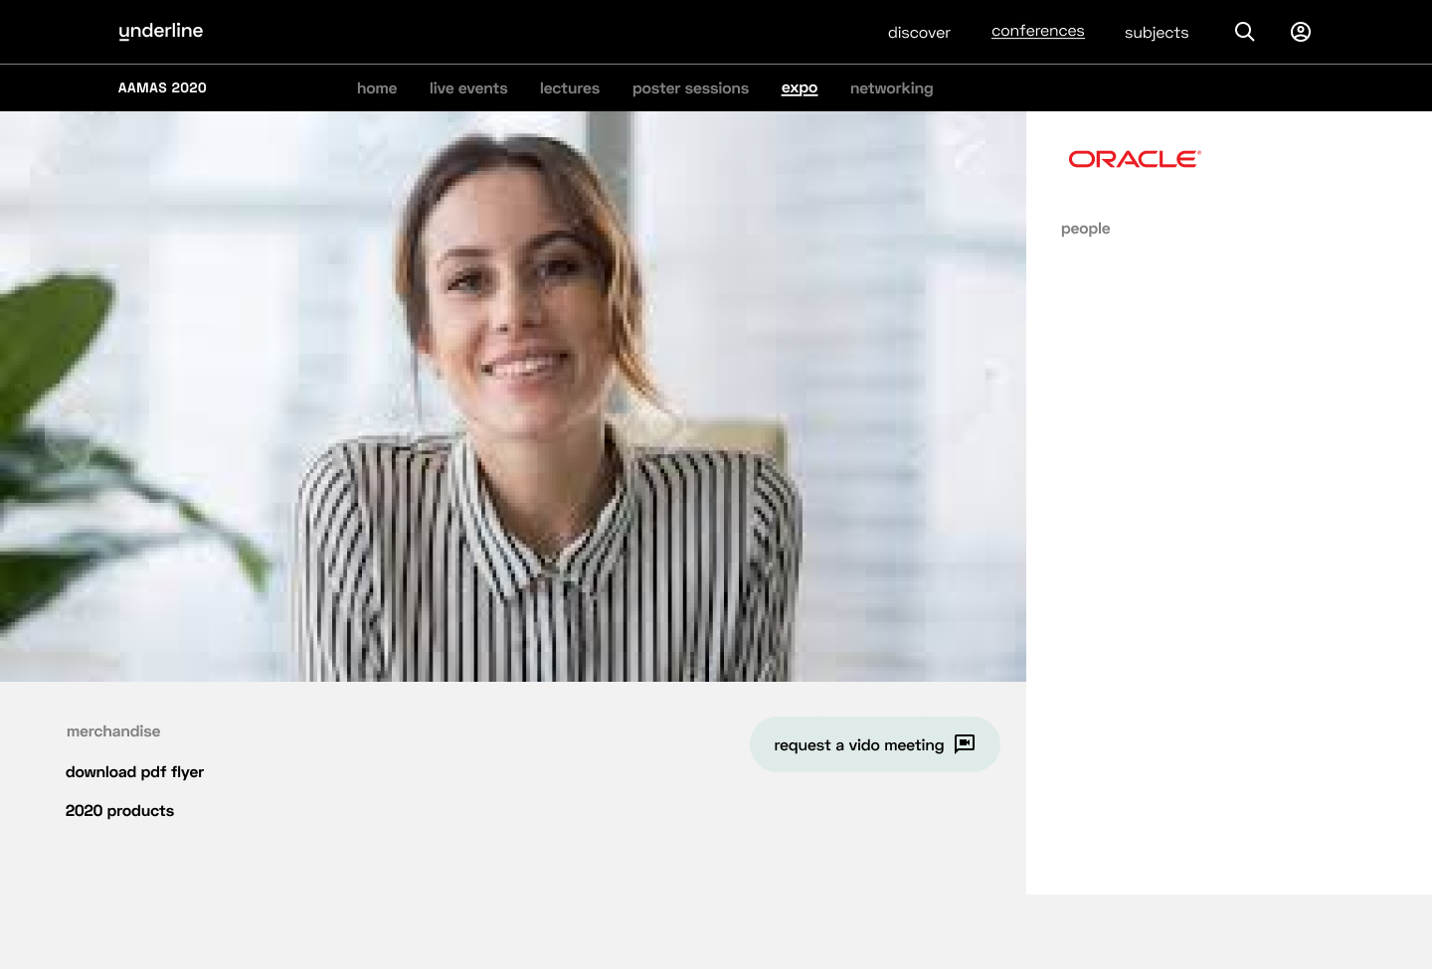
Exhibitor Page
All Sponsor Levels
Video
Social Links
Links to PDF, White Paper
Attendee Chat Function
Link to Website
Link to Workshops

Slide 6
Logos In Speakers Virtual Background
Gold Presenting Sponsor & Silver Supporting Sponsor Only
Presenting Sponsor
Supporting Sponsors
The final format of logo presentation has not been set yet. Use this illustration as a potential example. Logos will appear only in the introduction and not be present throughout the presentation.

Slide 7
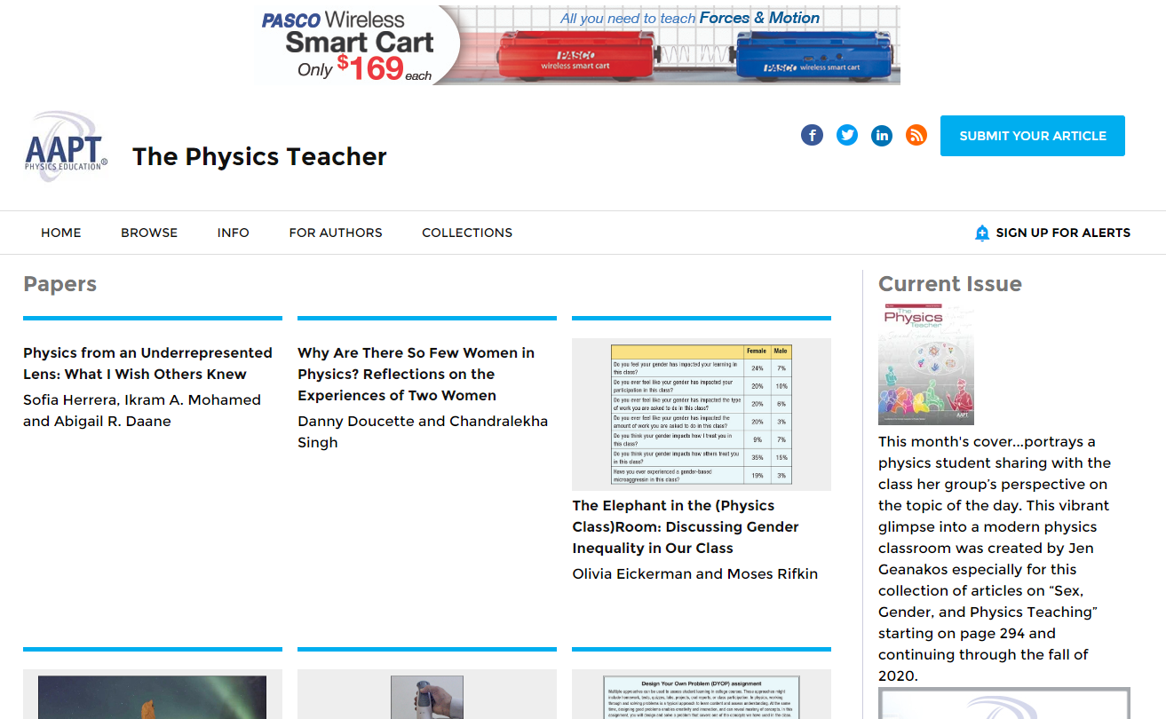
Online & Print Campaigns in AAPT Publications
Gold Presenting Sponsor & Silver Supporting Sponsor Only
*Online & print ads cannot be used to replace current paid campaigns. Other restrictions apply.

Slide 8
Package Comparison
Gold (Presenting Sponsor) |  | Silver (Supporting) |  | Bronze
Presenting Sponsor Recognition |  | Banners on Conference Page |  | Banners on Conference Page
Banners on Conference Page |  | Expo Page Placement Linking to Sponsor Page |  | Expo Page Placement Linking to Sponsor Page
Expo Page Placement Linking to Sponsor Page |  | Two Dedicated Emails to Registrants (One Pre-Meeting & One Post-Meeting) |  | One HTML Email to Registrants (Pre-Meeting)
Three Dedicated Emails to Registrants (One Pre-Meeting & Two Post-Meeting) |  | Logos integrated into Virtual Coffee Breaks + Poster Sessions |  | Logos integrated into Coffee Breaks + Poster Sessions
Logos integrated into Virtual Coffee Breaks + Poster Sessions |  | One Commercial Workshop (Pre-Recorded)
Two Commercial Workshops (Pre-Recorded) |  | Small Logo in Virtual Background Used by Speakers
Largest Logo in Virtual Background Used by Speakers |  | Small Logo in AAPT Emails to Attendees
Largest Logo in AAPT Emails to Attendees |  | One Journal Article Download Ad, The Physics Teacher*
Pre-Roll Ads In Plenaries/Other Live Events
Verbal Mention in Plenaries, Opening, and Closing
Two Journal Article Download Ads, The Physics Teacher*
Online Banner Campaign: Contextual or The Physics Teacher*
One Full Page Ad, The Physics Teacher*
Highlighted items are exclusive to specific level

