Slide 1
What will I do when I get back to the office?

Slide 2
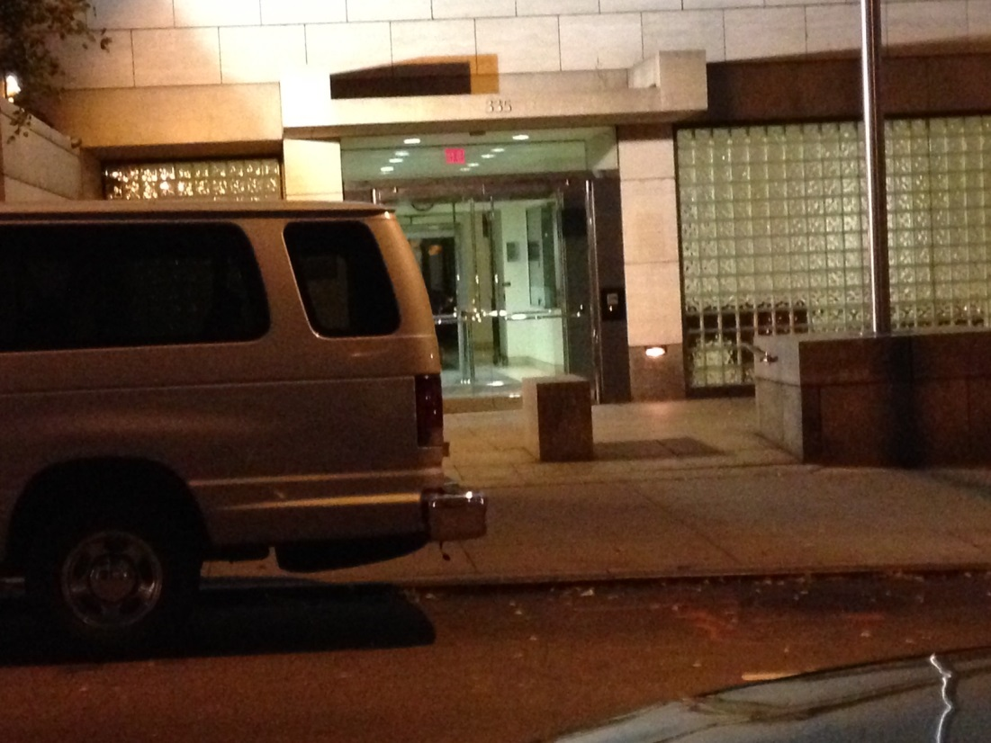
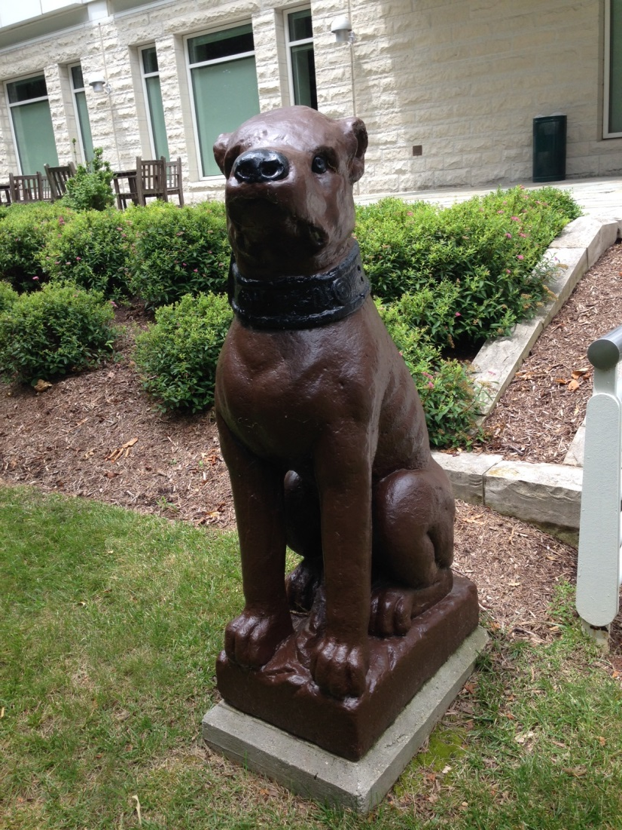
Gog

Slide 3
Slides from NFW
aapt.org -> Programs -> New Faculty

Slide 4
Introductory Physics for the Life Sciences
www.compadre.org/ipls

Slide 5
Reflective Teaching

Slide 6
Agenda
Individually – decide on one goal, decide on one strategy to achieve that goal – then send yourself an email, text message, Tweet, etc.
Organize into groups according to strategies
Groups articulate about how that strategy moves students towards meeting that goal
Decide what resources are necessary
Plan for formative and summative assessment
Decide about the politics: getting resources, getting “permission”, reporting to others…

Slide 7
Strategies
Peer instruction/TPS
Whiteboards
Simulations
JiTT
Sequences of Questions to construct models
Group problem solving
Tutorials
Context rich problems
Other

