Slide 1


Highlighting PER - The Journey from Traditional Instruction to Active Learning
Laurie McNeil
Dept. of Physics & Astronomy
Univ. of North Carolina at Chapel Hill
Notes:
My journey, which begins at a similar place as yours (but will take a different route). Another title could be, “I’m not a physics education researcher, but I play one on TV.” You participate in many sessions about specific active learning methods, all backed up with rigorous research on their rationale and effectiveness. This is not such a session. It’s about how and why I came to realize that I needed to change the way I teach.

Slide 2

Beginning
tracydiziere.com
…and beginning to excel
Notes:
From teaching as I was taught to teaching like a scientist

Slide 3

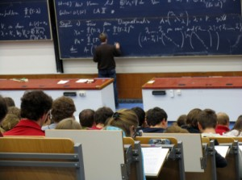
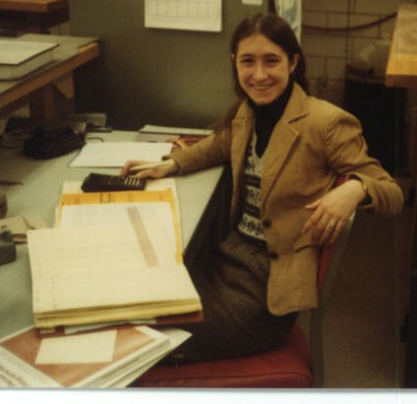
Ordinary path to professorship
“Played school” as a child
www.Masterfile.com
Typical lecture-based undergrad education
www.universitylanguage.com
One year as TA in grad school (almost no training)

Slide 4
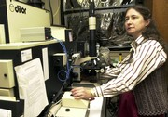
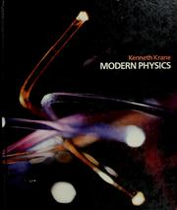
After postdoc, arrived at UNC as Assistant Professor in 1984, began to establish research program
Given instruction in how to teach:
You are teaching Modern Physics. Here is the textbook. The class meets in 247 Phillips Hall.

Slide 5
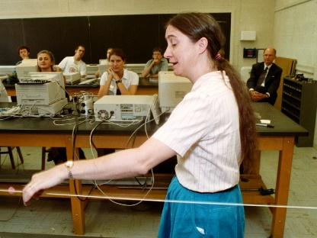
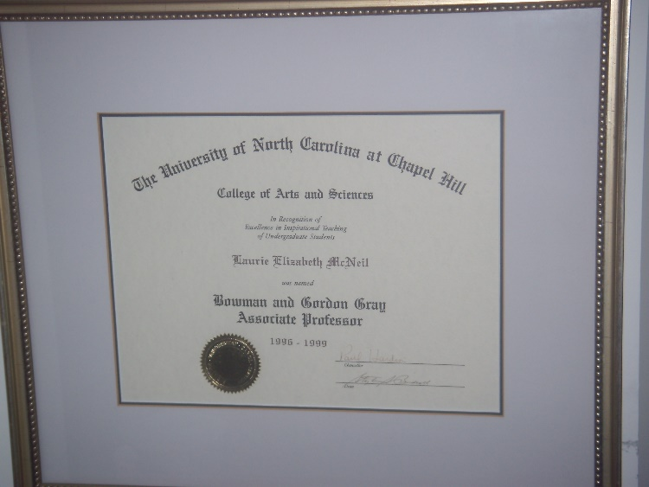
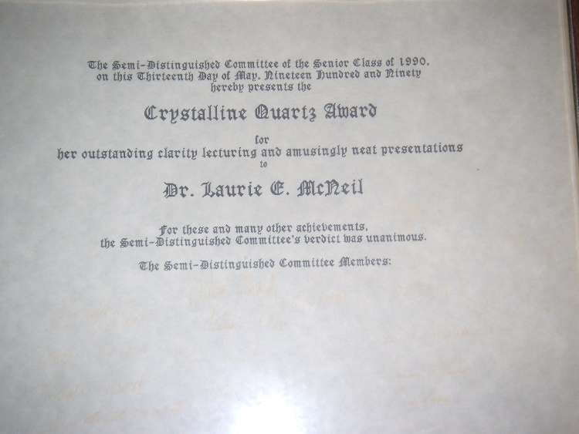
Became a “successful” teacher
Formal award:
Bowman and Gordon Gray Term Professorship
1996-99
“for excellence in inspirational teaching of undergraduate students”
College of Arts & Sciences
Informal award:
Crystalline Quartz Award
“for her outstanding clarity lecturing and amusingly neat presentations”
Senior physics majors, class of 1990

Slide 6

Awakening
www.approachyouractions.com
…and awakening to responsibility

Slide 7
Discovering Physics Education Research
1999: National Task Force on Undergraduate Physics (NTFUP)
“Revitalization” of undergraduate physics programs
The SPIN-UP report
http://www.aapt.org/Programs/projects/ntfup/index.cfm
Notes:
All bachelor’s going up while physics was going down

Slide 8
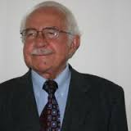


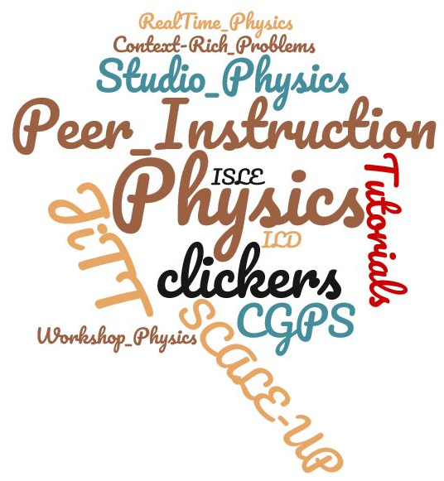
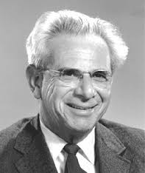


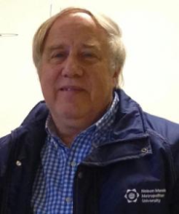


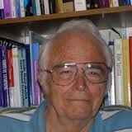
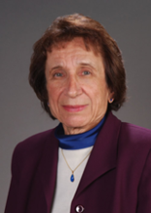
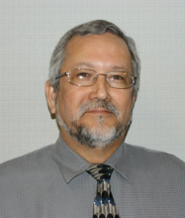

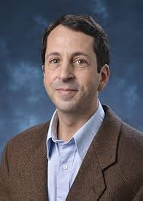

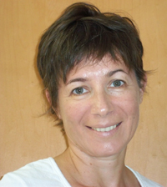

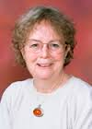


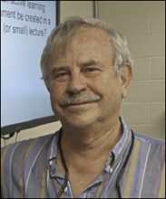
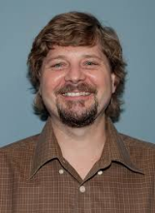

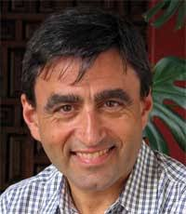

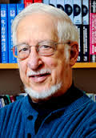
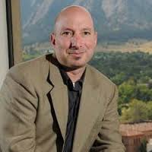
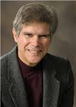


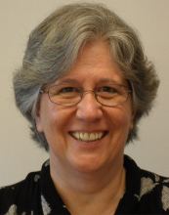
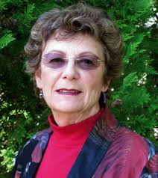

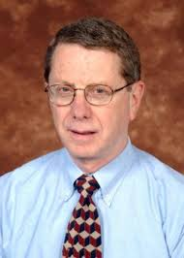
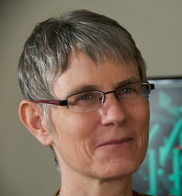

NTFUP brought close contact with PER specialists and their research
To continue to teach without using methods proven to be effective would constitute academic malpractice.
Notes:
You will meet some of these people this week, and learn about the work of others. And I came to the conclusion…
It would be like measuring resistance with a two-point circuit, ignoring lead resistance.

Slide 9

Learning
zapytaj.onet.pl/CBOSZ
…and learning about learning

Slide 10
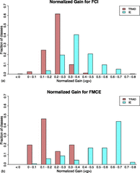
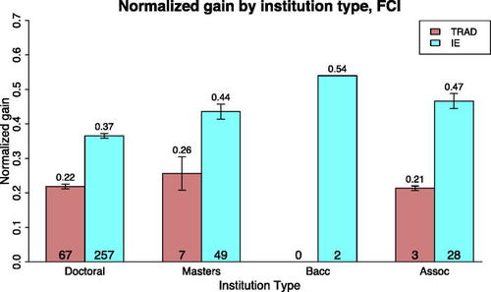
The big picture
Active learning (of any kind) is more effective than traditional lecturing, regardless of class size, institution type, incoming SAT scores, etc. (45,000 students in 600 classes)
Von Korff et al., Am. J. Phys. 84 (2016)

Slide 11
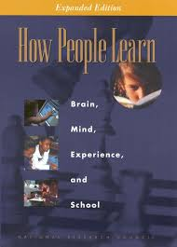
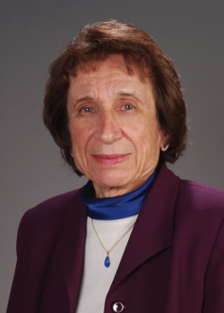
What the research tells us
Teaching by telling doesn’t work.
Algorithmic facility does not imply conceptual understanding.
Novice learners have preconceptions which must be specifically addressed in order to change them.
Scientific reasoning is not inborn.
The map is not the territory, and map-reading is not inborn either.
Understanding requires organizing knowledge in a way that facilitates application; this must be explicitly taught.
Available for free at https://www.nap.edu
With abundant thanks to Lillian McDermott, see Am. J. Phys. 61, 295 (1993)
Notes:
You will hear a lot about specific techniques, each of which has been developed and tested using rigorous PER methods. I want to talk about the more general ideas that inform my thinking about teaching, which are distilled from cognitive science research as well as discipline-specific education research. Book was produced by the National Academy in 2000.

Slide 12
Teaching by telling doesn’t work
But I learned that way!
No, you engaged with the material--doing homework problems, working through lecture notes, discussing with peers, questioning your comprehension, confronting difficulties and resolving them
Even if you had learned that way, your students are not you. Only 5% of physics majors become physics professors, and the fraction of “younger you” in an intro physics class is even smaller.
But I tell my students the correct physics, and they succeed in the course!
Have you asked them to explain what they understand, or is the exam your only measure?
Are they able to apply ideas in a variety of contexts? How do you know?
Notes:
You may learn from telling in the sense that you can say it back, but that doesn’t mean that you understand it or can apply the idea in some other context.

Slide 13
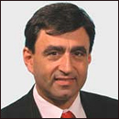
Algorithms ≠ understanding
Students can learn to solve standard quantitative problems without understanding the concepts behind them.
39% of students in a Harvard physics class did substantially worse on this question!
Calculate the current in the 2-Ω resistor and the potential difference between points P and Q.
If the lightbulbs are identical, do the following increase, decrease, or stay the same when the switch is closed?
12 V
4 Ω
Q
A
B
C
2 Ω
Intensity of bulbs A and B
Intensity of bulb C
Current in circuit
Voltage drop across each bulb
P
6 Ω
8 V
From Eric Mazur, see Peer Instruction: A User’s Manual

Slide 14
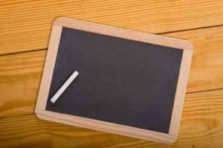


Students are not blank slates
Students have mental models about how the world works; these must be specifically addressed in order to change them.
www.emergentman.com
A large truck collides head-on with a small compact car. During the collision
the truck exerts a greater amount of force on the car than the car exerts on the truck.
the car exerts a greater amount of force on the truck than the truck exerts on the car.
neither exerts a force on the other, the car gets smashed simply because it gets in the way of the truck.
the truck exerts a force on the car but the car does not exert a force on the truck.
the truck exerts the same amount of force on the car as the car exerts on the truck.
From the FCI: Hestenes, Wells & Swackhamer, Phys. Teacher 30 (1992)
Notes:
A question from the Force Concept Inventory. Students do not come into the classroom empty, waiting to be filled with physics knowledge. They already know a lot of things simply from living in the world. Unfortunately a lot of what they know isn’t true, or isn’t true in the way they think it is. They have formed mental models about how the world works (though they may not be aware of the models they use), and if those models are not explicitly confronted, the students will not change their thinking.

Slide 15
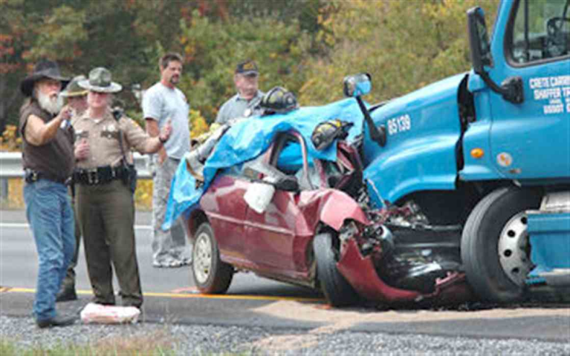
Students are not blank slates
Novice learners have preconceptions which must be specifically addressed in order to change them.
www.emergentman.com
A large truck collides head-on with a small compact car. During the collision
the truck exerts a greater amount of force on the car than the car exerts on the truck.
Kingsport Times-News
Before instruction 75-80% of students choose A.
After traditional instruction ~65% of students still choose A!
From the FCI: Hestenes, Wells & Swackhamer, Phys. Teacher 30 (1992)
Notes:
PER has uncovered many such preconceptions and determined how they fit into a coherent (though incorrect) worldview. Specific remedies have been developed and tested.

Slide 16
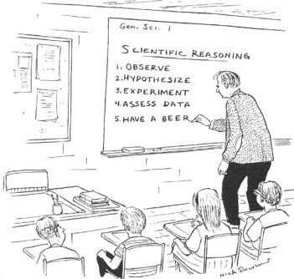
Scientific reasoning is not inborn.
Though children are “born scientists,” scientific reasoning at the level we aspire to for our students involves multiple higher-order thinking skills.
Systematic hypothesis-testing
Drawing conclusions based on valid evidence
Thinking in terms of abstractions or symbols
Thinking in terms of proportions and probabilities
Thinking about multiple variables or dimensions at once
This does not come automatically!

Slide 17
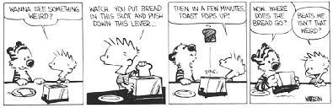
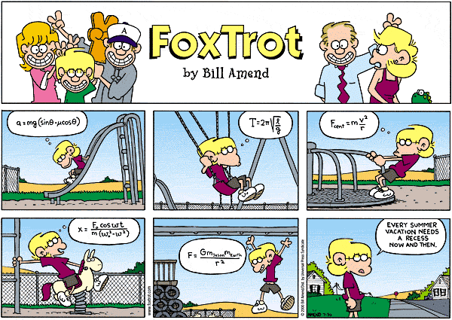
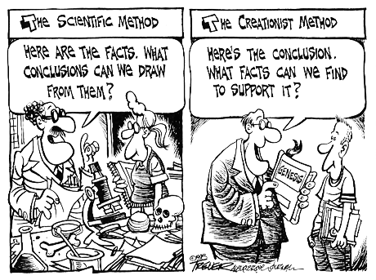
Scientific reasoning is not inborn.
Scientific reasoning is often absent in everyday life
…with a few exceptions
Notes:
Thinking like a physicist does not come naturally, to children or to adults.

Slide 18
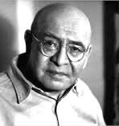
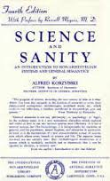
The map is not the territory
The map is not the territory, the word is not the thing it describes.
Alfred Korzybski

Slide 19

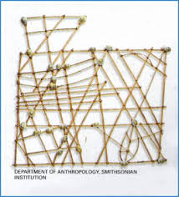


The map is not the territory
Map
Territory

Slide 20
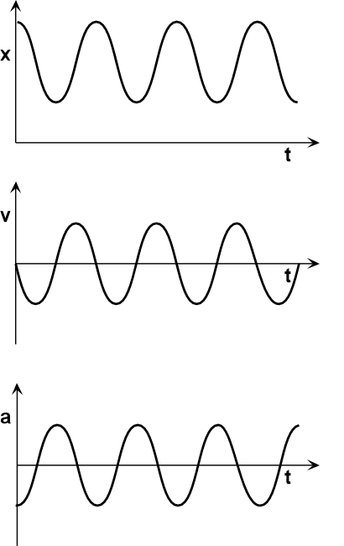
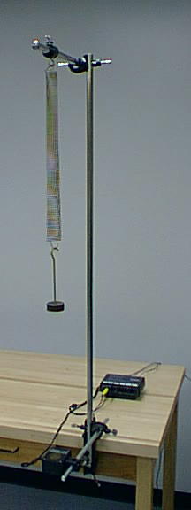
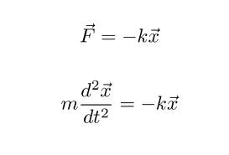
The map is not the territory
Map-reading isn’t inborn either
Territory
Map

Slide 21

Knowledge organization is not automatic
Facts (and equations) are not knowledge--understanding requires organizing knowledge in coherent way.
Gisela Kassoy

Slide 22
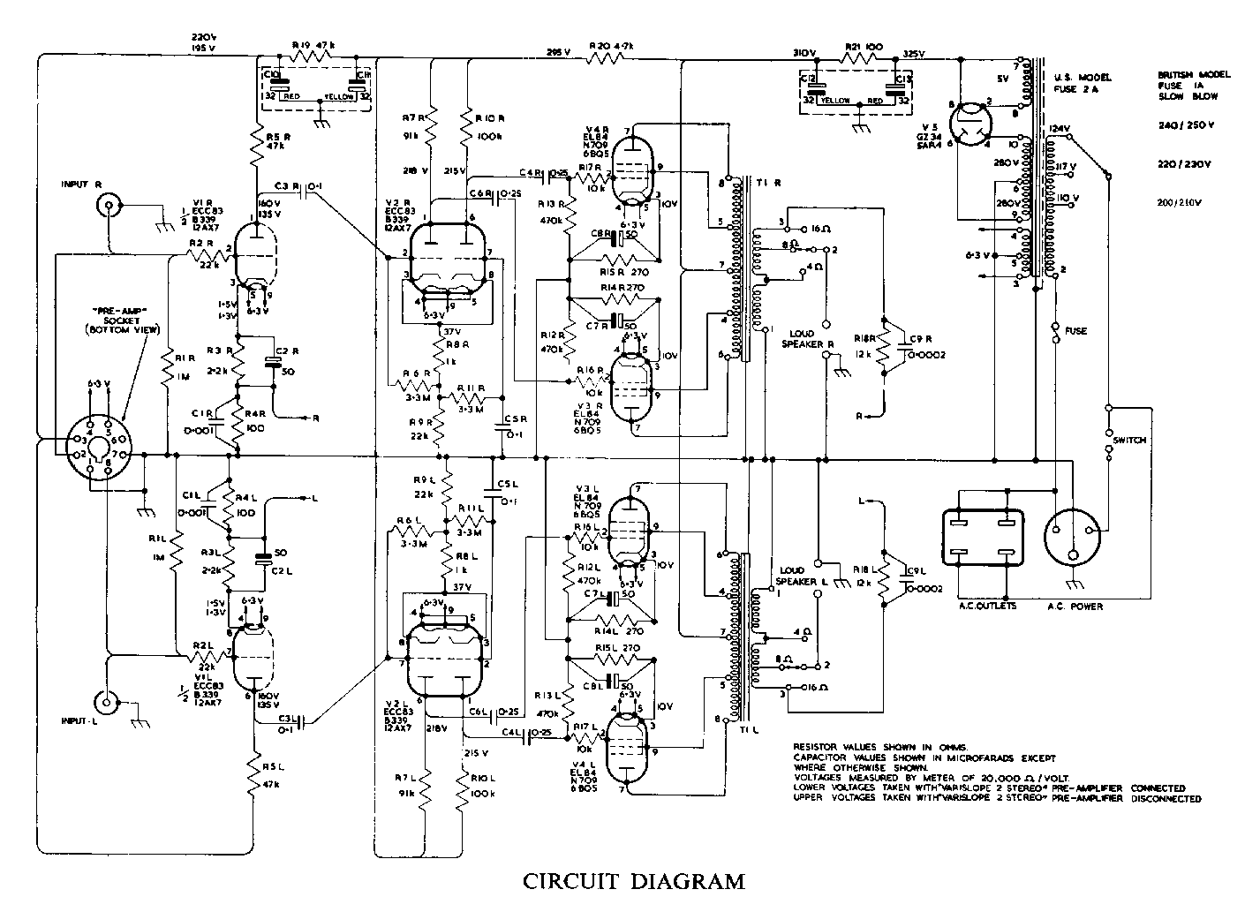
Knowledge organization is not automatic
Expert (but not novice) electronics technicians reproduced large portions of diagram after exposure of a few seconds
Experts organized diagram into “chunks,” e.g. “amplifier,” “filter”
Experts could not reproduce a random collection of elements
Egan & Schwartz, Memory & Cognition 7 (1979)
Notes:
Novice physics learners do not automatically connect one idea to another. Things that are obviously related to you are not obvious to them. They may organize by surface features, i.e. “block on a plane” (or worse, “square on a triangle”) rather than “conservation of energy.”

Slide 23
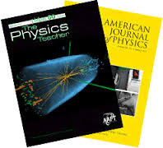
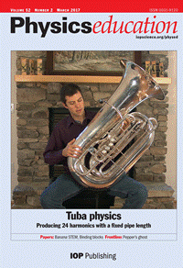

What else PER gives us
Content knowledge is not enough—we also need pedagogical content knowledge
Student difficulties
Student mental models
Effective instructional strategies for a particular concept
Assessment methods
Notes:
“What did I say to make you think that!” We have to understand how our students think before we can teach them to think differently. PER research gives us that. All the techniques you will hear about are backed up by research on the students’ thinking and on the effectiveness of instructional strategies.

Slide 24
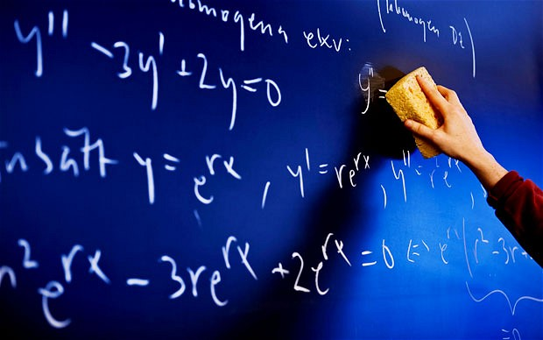
Doing
…and doing better

Slide 25
Evidence-based practices I have adopted
(so far)
Peer instruction
Frequent application of concepts (retrieval practice)
Immediate feedback (do they get it?)
Resets attention span
JiTT
Knowledge transfer before knowledge use
Advance warning of what students struggle with
Students feel their concerns are heard
Tutorials
Scaffolding for guided reasoning
Address preconceptions explicitly
PhET
Explore dependence on parameters

Slide 26
Evidence-based practices I have adopted
(so far)
Cooperative group problem-solving (Minnesota model)
Groups can solve more complex problems than individuals
Context-rich: estimation, assumptions, sense-making
Design from learning goals
What do I want the students to be able to do?
What class activities will lead to my desired outcomes?
How will I tell if I have succeeded?
Studio physics
Most class time spent working in small groups to apply concepts
“All of us are smarter than any of us”
“Whenever we don’t understand, we explain to each other”

Slide 27
Backwards design
Begin with learning goals
“After instruction, students should be able to…”
Active verbs: identify, construct, sketch, solve, distinguish, calculate, compare, determine, …
“Understand”: how will you tell that they are not just performing an algorithm?
Select class activities that will require students to apply knowledge step-by-step
Assess specific goals
Formative: retrieval practice
Summative: have they achieved what you hoped, i.e. did the activity work?

Slide 28
Studio physics
Lecturing reduced or eliminated
Reading assignment before class, with quiz (JiTT)
Instructor(s) is “guide on the side” rather than “sage on the stage”
All (or most) class time devoted to small group work
Experiments (often mini-)
Tutorials
Cooperative group problem solving
“Lightning round” for applications of math skills
Manipulate simulations
Multiple types of activities within a single class period
Activities provide “scaffolding” to guide concept development
Specific learning goals addressed

Slide 29
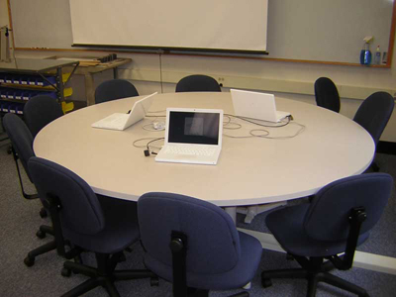
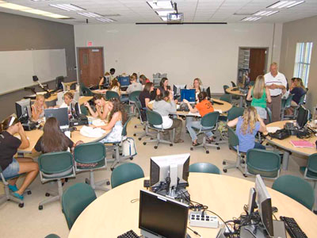




Studio physics cont.
Facilitated by rooms designed for group work
Pittsburgh
FSU
MIT
Can be done in traditional lab spaces
Notes:
Pause here for questions before going on to institutional reform

Slide 30

Doing more
…and doing more for more students
Notes:
My journey—they don’t have to do this (yet)

Slide 31

Getting my colleagues on board
Goals:
All introductory physics courses to be taught using research-validated interactive engagement methods
Common experience and expectations for all students in each course
Teamwork to reduce duplication of effort
Improved learning outcomes

Slide 32

What it took
One “physics manifesto”
Two NSF grants
Judicious use of teaching assignments
Four PER/AER colleagues
Building a library of activities
Ten years
“Physics Manifesto”
https://users.physics.unc.edu/~mcneil/physicsmanifesto.html

Slide 33

What else it took

Slide 34

What we have now: Lecture/Studio model
Weekly cycle:
Reading assignment with quiz, including “what was confusing?” (JiTT)
Class meetings (two sets each week)
Interactive lecture (all students) (Peer Instruction)
Studio session (multiple sections, 1 instructor per 30 students)
(Tutorials, Cooperative Group Problem Solving, lab experiments)
End-of-chapter HW (web-based, autograded)
Exams include conceptual and quantitative questions

Slide 35
What we have now: Lecture/Studio model
FCI and CSEM pre/post learning change
IPPS
IPLS
Learning gains on concept inventories are now significantly higher, with no loss of problem-solving ability!
David Guynn M.S. thesis

Slide 36
Studio activities for IPLS
http://paer.unc.edu/projects/ipls/

Slide 37


Guidance for your journey
Your students are like everybody else’s students
Try one or two things at first
Remember that effort can be painful (for you and your students)
Persevere—it will be better the second time (and the third)
www.ordnancesurvey.co.uk
Notes:
This is not about being at Harvard or UNC or Compass Direction State U. or a community college. It’s about how the human brain works.
Tell story of optics class semi-failure. Took long, involved, real-world HW problems and made them into in-class group activities along with some simple experiments. Students found that reading the book was not enough, they needed me to give them more guidance and explain things for them better. It would have been better to take some class time for lecturing and the rest for activities.

Slide 38


Guidance for your journey
Don’t reinvent the wheel
…or the flat tire
James Steidl
Laura Tiger

Slide 39



Guidance for your journey
Steal from the best
Implement methods in their totality
Novel isn’t always better
photo by ROMULO YANES
Johnsonville.com
https://static1.squarespace.com
Notes:
Don’t take a chicken recipe, substitute shrimp, and complain that after cooking it for an hour it was like rubber.

Slide 40


L’envoi
Teach like a scientist--you owe it to your students and to your own professionalism.
Do your “very goodest”--carry out your teaching duties as effectively as your circumstances allow—and they allow a lot more than you may think.
One must learn by doing the thing; though you think you know it, you have no certainty until you try.
Sophocles (Women of Trachis)
www.diocese-st-hyacinthe.qc.ca

