Slide 1
PhET Interactive Simulations
Effective classroom use
Michael Dubson
U. Colorado at Boulder
Physics Dept
NSF New Faculty Workshop, Nov 2017
COLORED CARDS READY?
PLEASE SIT AT FRONT TABLES

Slide 2
What is your PhET experience?
Have never used it.
B) Have looked at it, but never used it in a class
C) Have used it to teach a class.

Slide 3
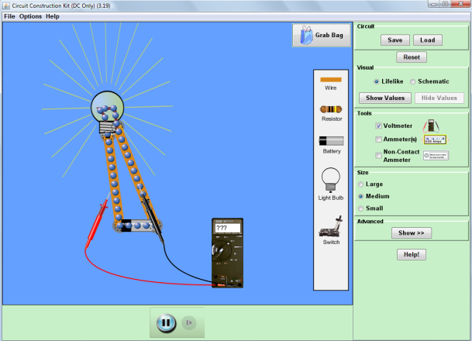
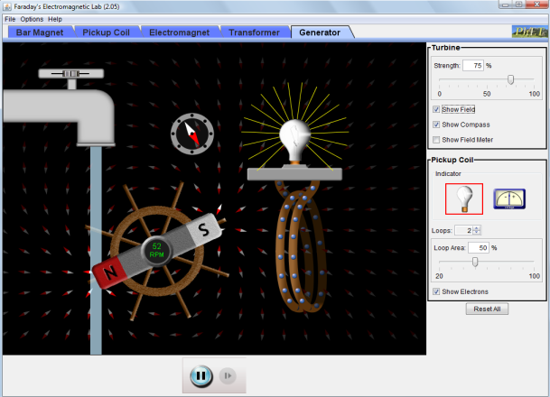
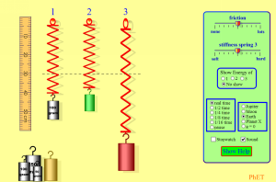
What is PhET?
Originally, the Physics Education Technology project.
Suite of >100 interactive sims for science education.
Research-based and user-tested.
HTML5, Flash, and Java, run in browser or offline.
Physics, Math, Chemistry, Earth Science, Biology.
All FREE. Source code available.
Notes:
We build and study interactive sims
Demo sims: CCK, Faraday (tabs), Build an atom (game), Buoyancy (3D)

Slide 4
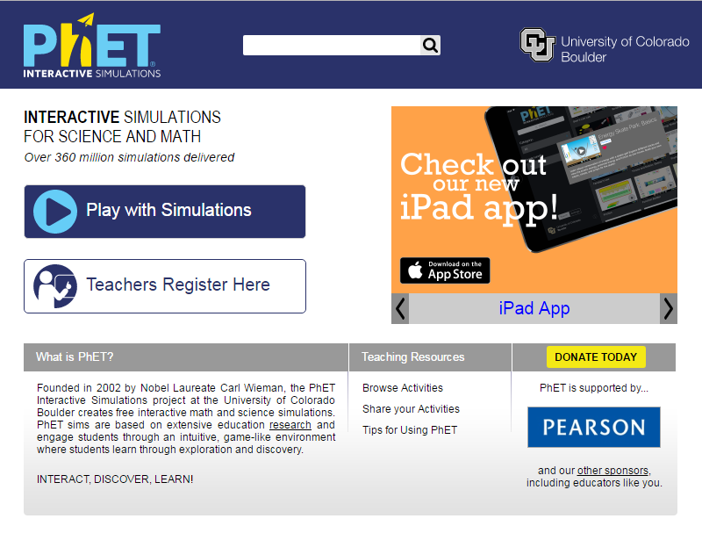
Where is PhET?
http://phet.colorado.edu
Notes:
Demo website

Slide 5
Examples:
Circuit Construction kit.
Masses and Springs.

Slide 6
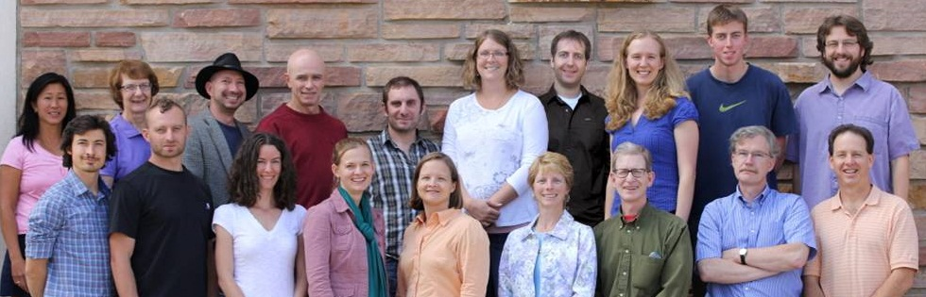
Who is PhET?
Founded by Carl Wieman, 2002
Part of the Physics Education Research Group at CU Boulder
University faculty, post-docs,
K-12 teachers, software developers
Prof. Kathy Perkins, CEO, education researcher, and grant-getter extraordinaire

Slide 7

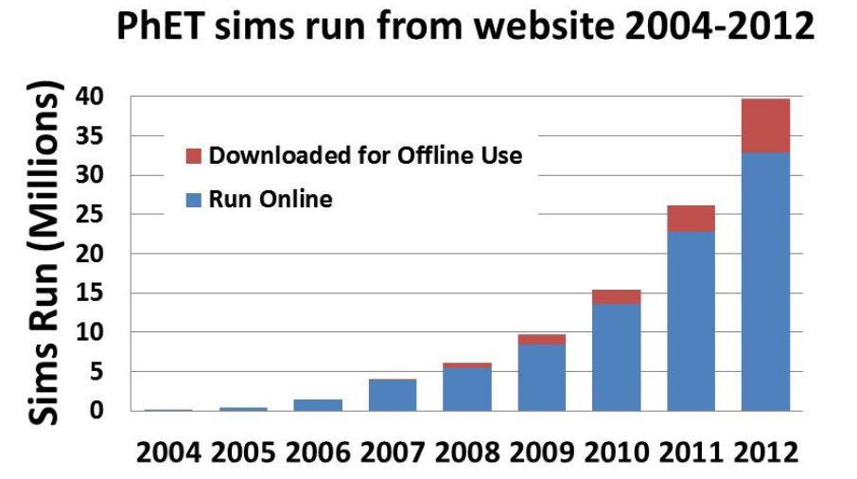
Accessible
Open-use License: Creative Commons - Attribution
Easy to translate for World-wide Use:
Over 3000 translations in 70 languages,
34% of use outside US
> 150 million sims run in 2016

Slide 8
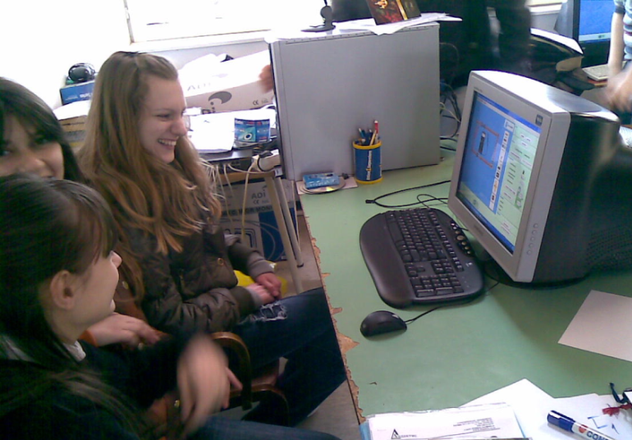
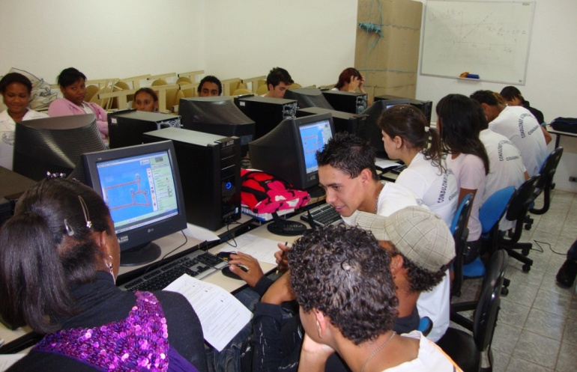
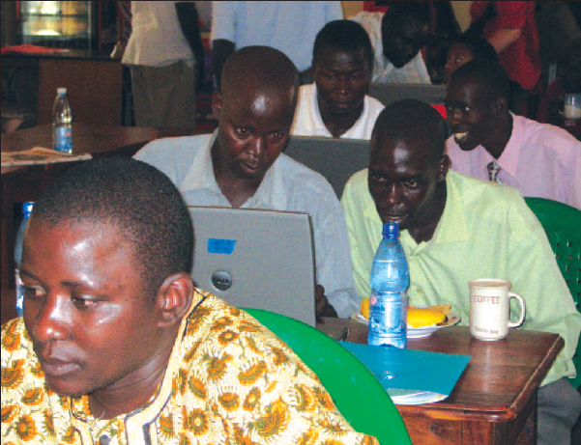
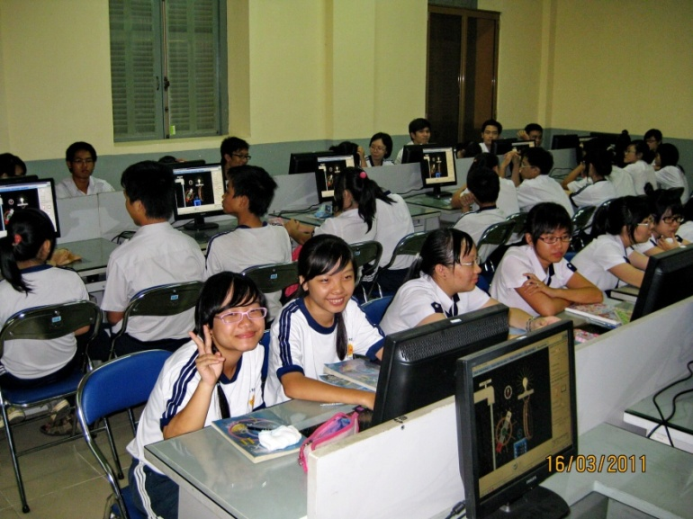
PhET around the world
Brazil
Serbia
Vietnam
Uganda
Notes:
Serbia, Vietnam, High school teachers in Uganda, Brazil

Slide 9
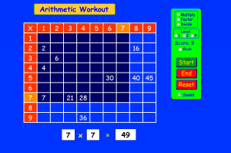
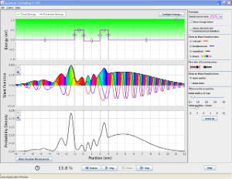
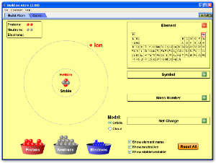
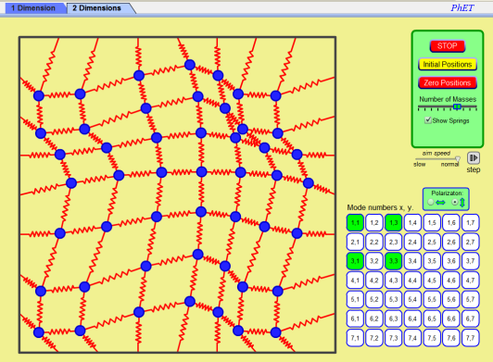
What is PhET’s intended audience?
Originally, college freshmen, physics sims
Now, grade school through grad school
sims are physics and math,
many chemistry, some earth science and biology
Arithmetic
Workout
QM Tunneling
Normal Modes
Build an Atom

Slide 10
How might you use these sims in your school?

Slide 11
Designed for versatile use
Pre-lecture assignment
Interactive Lecture Demonstration
Clicker Questions
In-class activity
Lab or Recitation
Homework
No silver bullet: context and activity critical

Slide 12
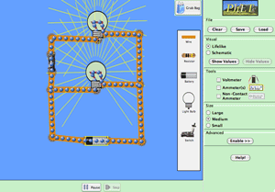
Versatile!
Make easy to use
Flexibility for you to
  Pick and choose which sims to use
  Customize use …
  to your environment and your learning goal
  Search database of activities (>500 by PhET or Teacher-users)
Circuit Construction Kit
CCK in grade school:
“Make the light bulb light”
CCK in college:
“Explain why the light dims when you turn the heater on”

Slide 13
Examples:
Friction
Energy Skate Park

Slide 14
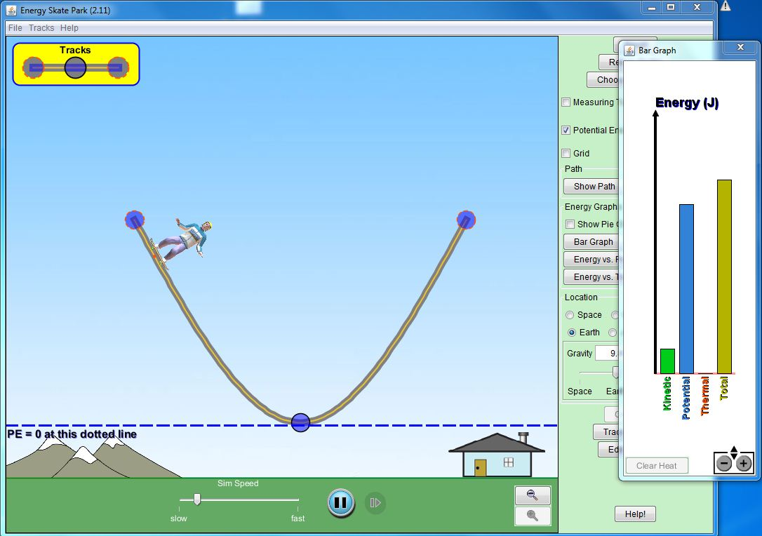
Example: Concept Tests
I move the zero of PE up to the starting point of the Skateboarder (skateboarder still starts from rest).
The total energy of the system is now:
A) Zero B) positive C) negative
D) Depends on the position of the skateboarder

Slide 15
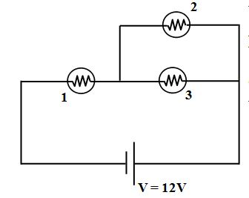
In the circuit, what happens to the brightness of bulb 1, when bulb 2 burns out? (When a bulb burns out, its resistance becomes infinite.)
A) Bulb 1 gets brighter
B) Bulb 1 gets dimmer.
C) Its brightness remains the same.
(Hint: What happens to the current from the battery when bulb 2 burns out.)

Slide 16
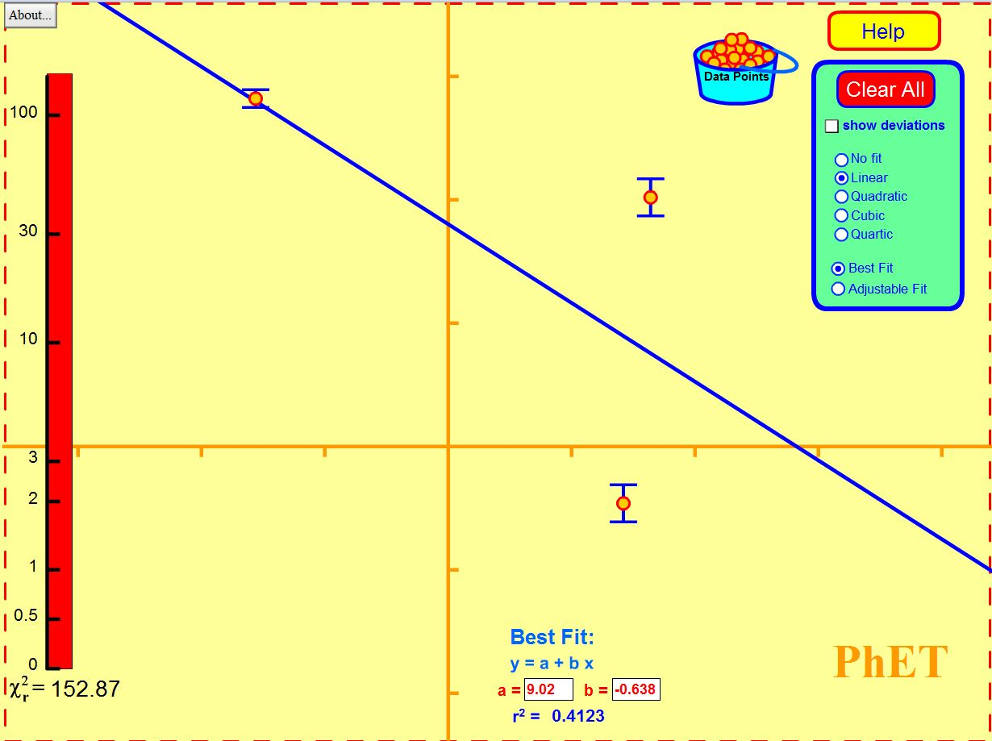
If we increase the error bar on the data point shown, what happens to the slope of the best-fit line?
It becomes more negative (line tilts CW).
It becomes less negative (line tilts CCW).
It does not change.

Slide 17
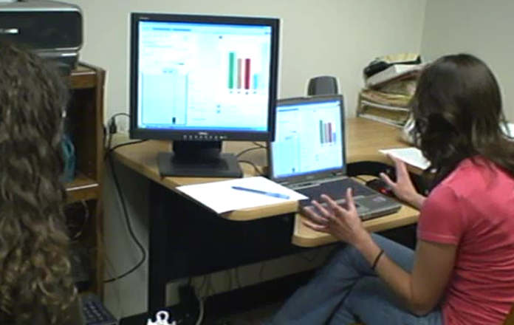
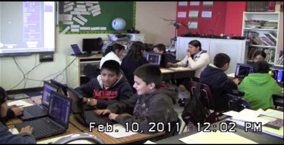
Why is PhET successful?
over 15 million sims run online per year
usage doubles every year
K-12 schools in every state, and over 900 different US colleges and universities
Translations into over 50 different languages
Diverse design team
User interviews
Classroom testing
Research-based

Slide 18
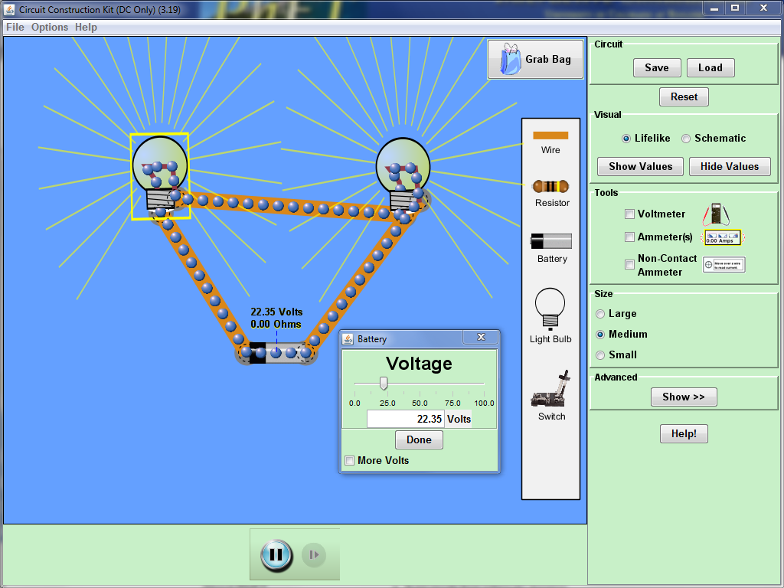
Design Philosophy
Inviting, intuitive interface, usable without instructions
Highly interactive: instant animated feedback as students explore
Accurate, dynamic visual representations; show the invisible
Allow actions that would be difficult or impossible in the real world
Game-like environment
Interface design that implicitly scaffolds inquiry

Slide 19
Research-Based Design supports inquiry-learning
Use accurate, dynamic visual representations
Show the invisible
Create a game-like environment
Make simulations highly interactive
Provide real-time, animated feedback as students play
Implicitly scaffold inquiry through design of controls and representations
Allow actions that would be difficult or impossible in the real world
Provide an intuitive interface, usable without instructions

Slide 20
PhET Design Process
2 – 12 months, ≈$50K/sim
Initial design
Final design
Research
Interviews
Classrooms
Redesign
Notes:
Start with research literature: How people learn, how students learn chemistry
Research informs our learning goal & initial design
After initial design, we interview students and often redesign the sim; interviews add to the research base
After redesign, we and others use the sims in classrooms; data adds to the research base

Slide 21
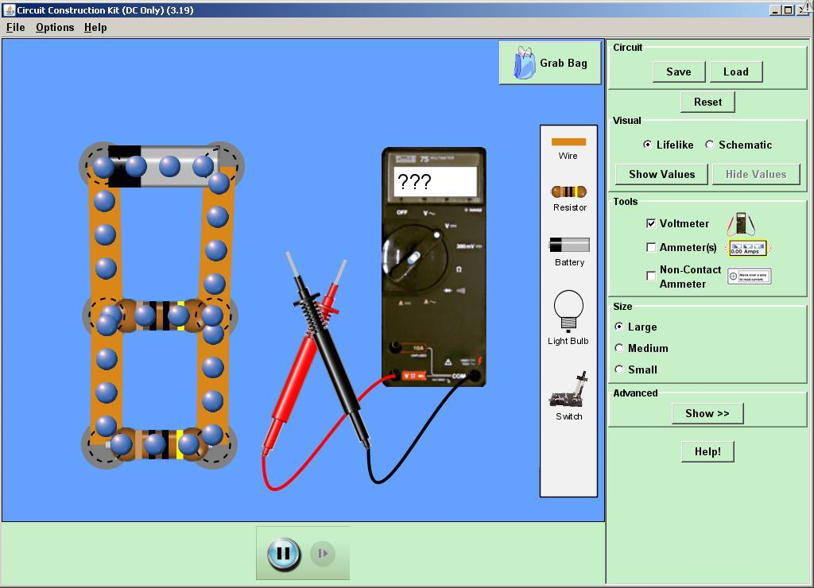
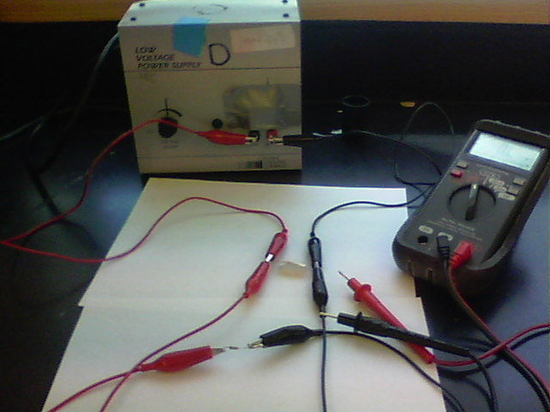
Compare these tools:
Your thoughts…

Slide 22
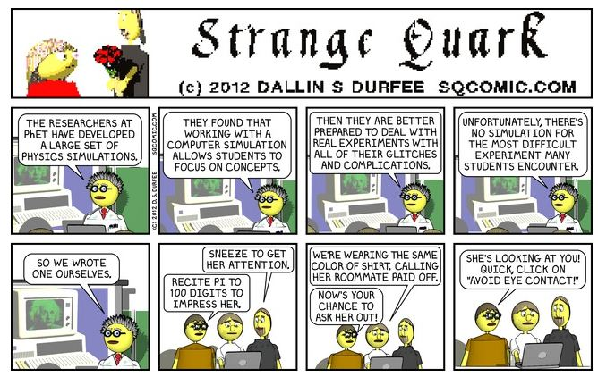
PhET in popular culture

Slide 23
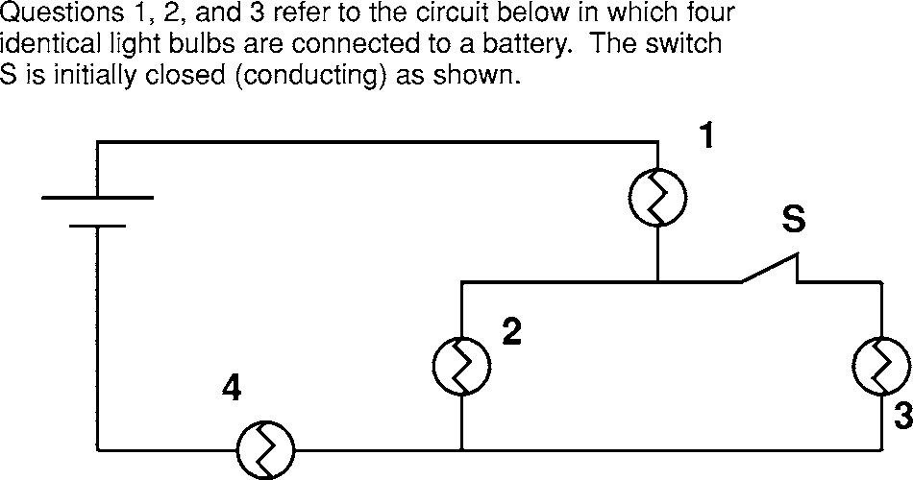
Can PhET sims replace real equipment?
They can, but we don’t think they should.
Meant to compliment, not replace with lab equipment.
Sims lack real-world “dirt” effects, allow students to focus on physics concepts.
Circuit Construction Kit vs. real circuits
“When learning about the real world is better done virtually.. “, N.D. Finkelstein et al., Phys. Rev. ST Phys. Educ. Res. 1, 010103, 2005.
Students who only used virtual circuits, did equally well on building real circuits final.
Sims allow risk-free,
rapid inquiry cycle.

Slide 24
Do students learn if I just tell them to play with a sim?
Seldom. Guided inquiry essential.
Large data-base of classroom-tested activities available on the PhET site.
What makes a good sim activity?
Minimum instruction.
Detailed procedures inhibit student exploration.
Clear Learning Goals
Give students the goal, not the procedure.

Slide 25
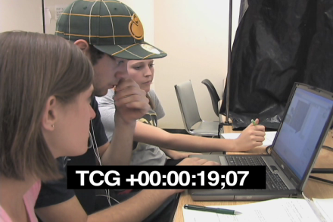
In-Class activity or Lab
Worse:
Better:
Give directions on how to use the sim
Result: Students are nervous, reluctant to try things, ask lots of questions about sim use, not learning goals.
Provide activity and do not offer any pointers on the sim itself
Result: Students explore uninhibitedly, quickly find/learn all the controls, become the “owner” of the sim.

Slide 26
Example Activity: Masses and Springs
5-10 minutes of play – No instructions.
Challenge 1: Using data from the sim, make a graph that shows whether or not the springs obey Hooke’s Law.
Challenge 2: What is the mass of the red weight?
Challenge 3: Determine the spring constant in two different ways: with your graph from (1) and with the stopwatch.

Slide 27
Cookbook directions (NOT effective):
Watch me while I show you the controls.
Measure the equilibrium extension of spring 1, for each of the 3 different known masses, and make a graph of stretch of the spring (on y-axis) vs. mass (on x-axis). From this, determine the spring constant k of the spring. Recall that F_{spring} = −kx, where x is the stretch of the spring. Don’t forget that weight is mg, where g = 9.8 m/s².

Slide 28
What would you like to see in PhET?
Sim ideas? New features? ??
Door Prize! : You can see NEW sims in
development, before they are published, at
http://www.colorado.edu/physics/phet/dev

Slide 29
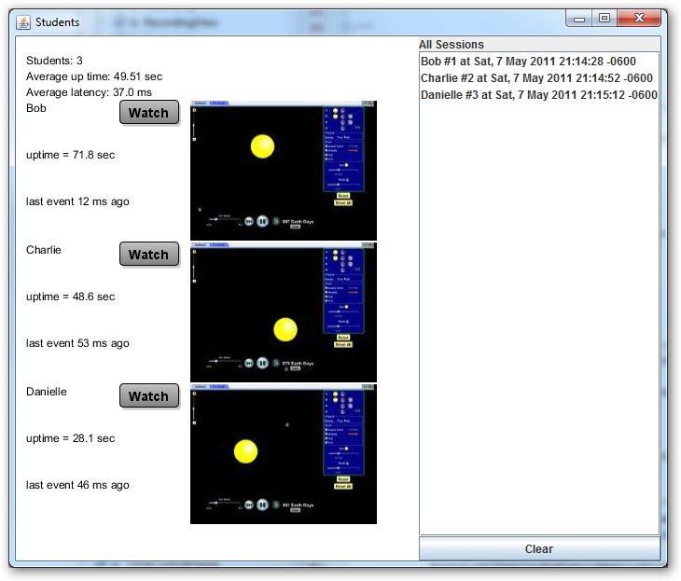
The Future…
More sims
Compatibility with iPad
Classroom sim sharing

Slide 30
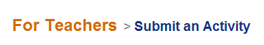
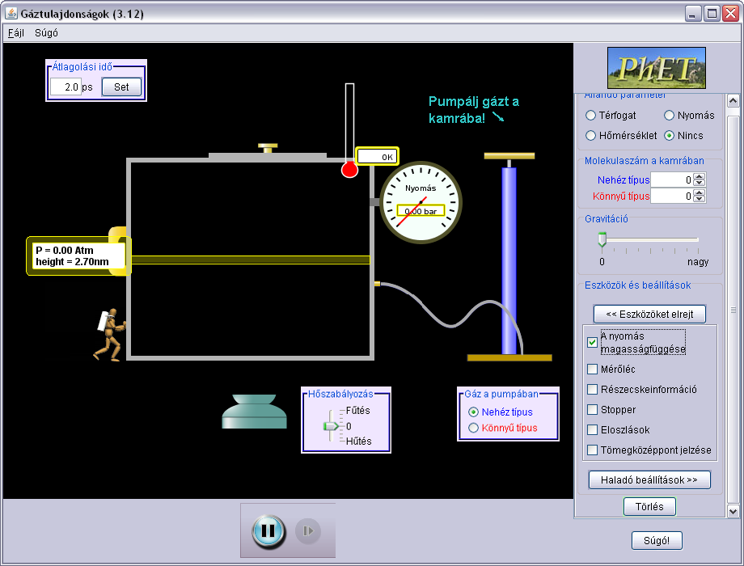
How can you contribute?
Report bugs
Send us your ideas
for new sims!
Email: phethelp@colorado.edu

Slide 31







How can PhET be free?
Current budget > $1M / year
NSF
Hewlett Foundation
The O’Donnell Foundation
King Saud University
University of Colorado
Carl Wieman & Sarah Gilbert

Slide 32
How can PhET stay free?
We’re not sure.
Major funding from grants not sustainable.
Seeking corporate sponsors, large and small donors.
Your advise or $$ gratefully accepted.

Slide 33
PhET Interactive Simulations
Suite of >100 interactive simulations
Physics , Chemistry , Math
Expanding into biology, earth science
Research-based and user-tested
Free! Online or downloadable. (~130 MB)
Easy to use and incorporate in class
http://phet.colorado.edu

Slide 34
Extra Slides Follow

Slide 35
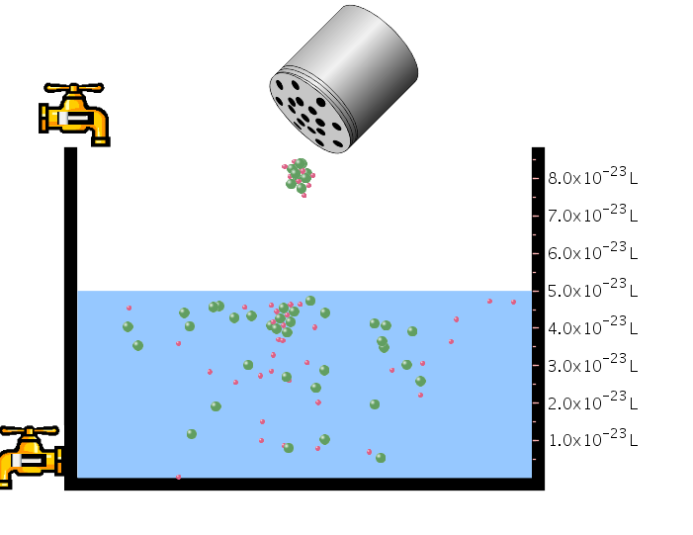
Designing Activities:
What do students learn in each activity?
Add 100 silver bromide pairs to the water. How many silver and bromide ions dissolve in the water? Repeat this for all salts.
Investigate different salts. What features do salts have in common, and how do salts differ from each other?

Slide 36
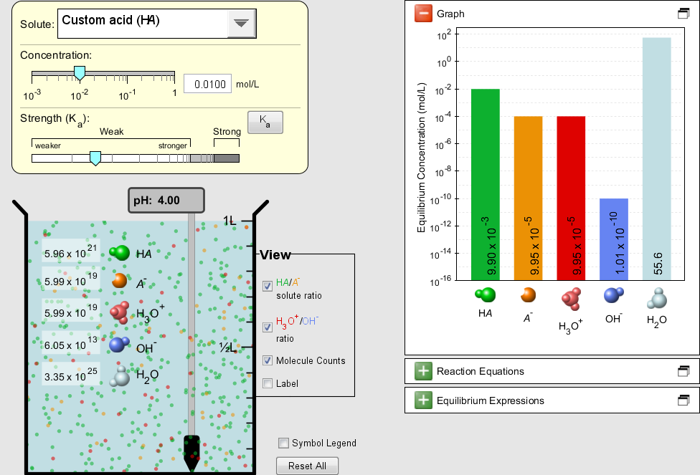
Old Acid-Base Solutions

Slide 37
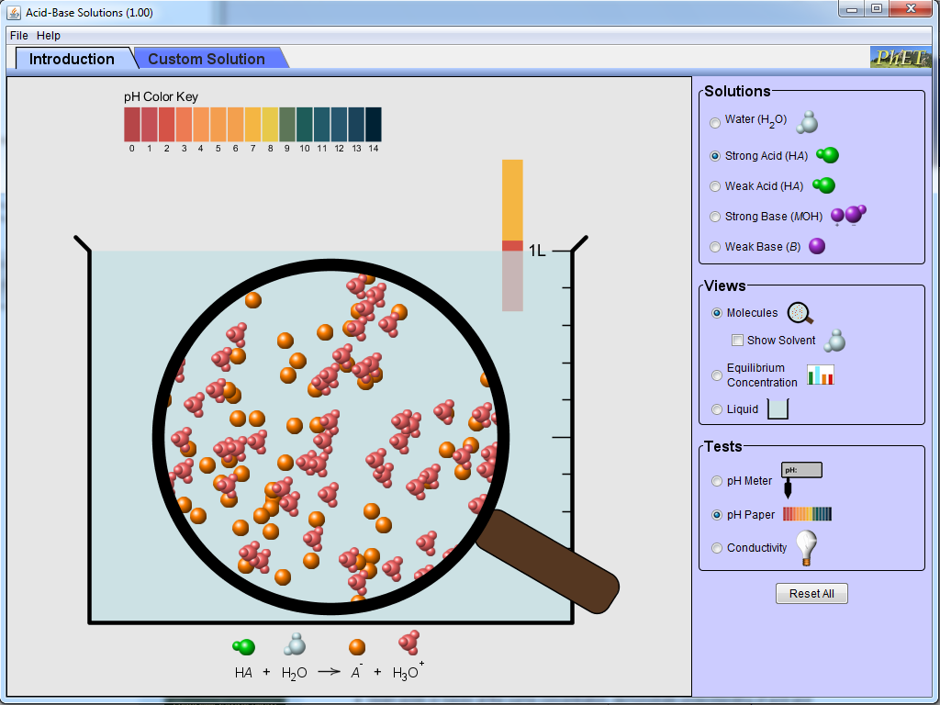
New Acid-Base Solutions
Why is this sim better?
Notes:
Get input from audience: Why is this sim better?
Matches how people learn:
Cognitive demand: Novices don’t know what to focus on. They treat everything equally important. Much more than short-term working memory can handle, overwhelming
Interactivity
Shows expert models
Construction of understanding
Related to students’ life

Slide 38
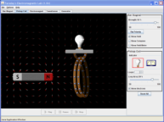
Interview Study:
Type of Guidance
Compared two types of guidance
Examined Student Behavior
Open Conceptual Questions +
Open Conceptual Questions
Guided Activity
In the “Bar Magnet” tab, identify all controls, …
What does the
“Strength” slider do?
Free exploration
of sim

Slide 39
Results
Guided Activity
Open Conceptual Questions
Student Mode:
Students answer question and wait for the next.
“OK, continue?”
“Is that sufficient for step 2?
Often don’t tie pieces together.
  Scientist-like Exploration:
  Explore via their own questioning
  “Oh, I wasn’t expecting that”
  “I was looking around to see if it was an effect of having more wires.”

Slide 40
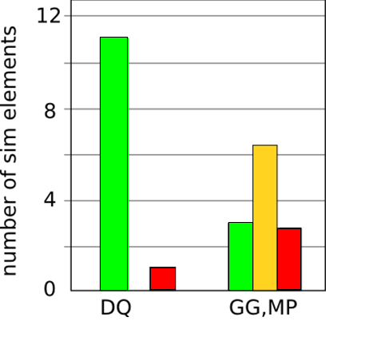
What did students explore?
12 features not mentioned in the Cookbook activity:
Explored
Just noticed
Not noticed
Open Q’s
Cookbook

