Slide 1
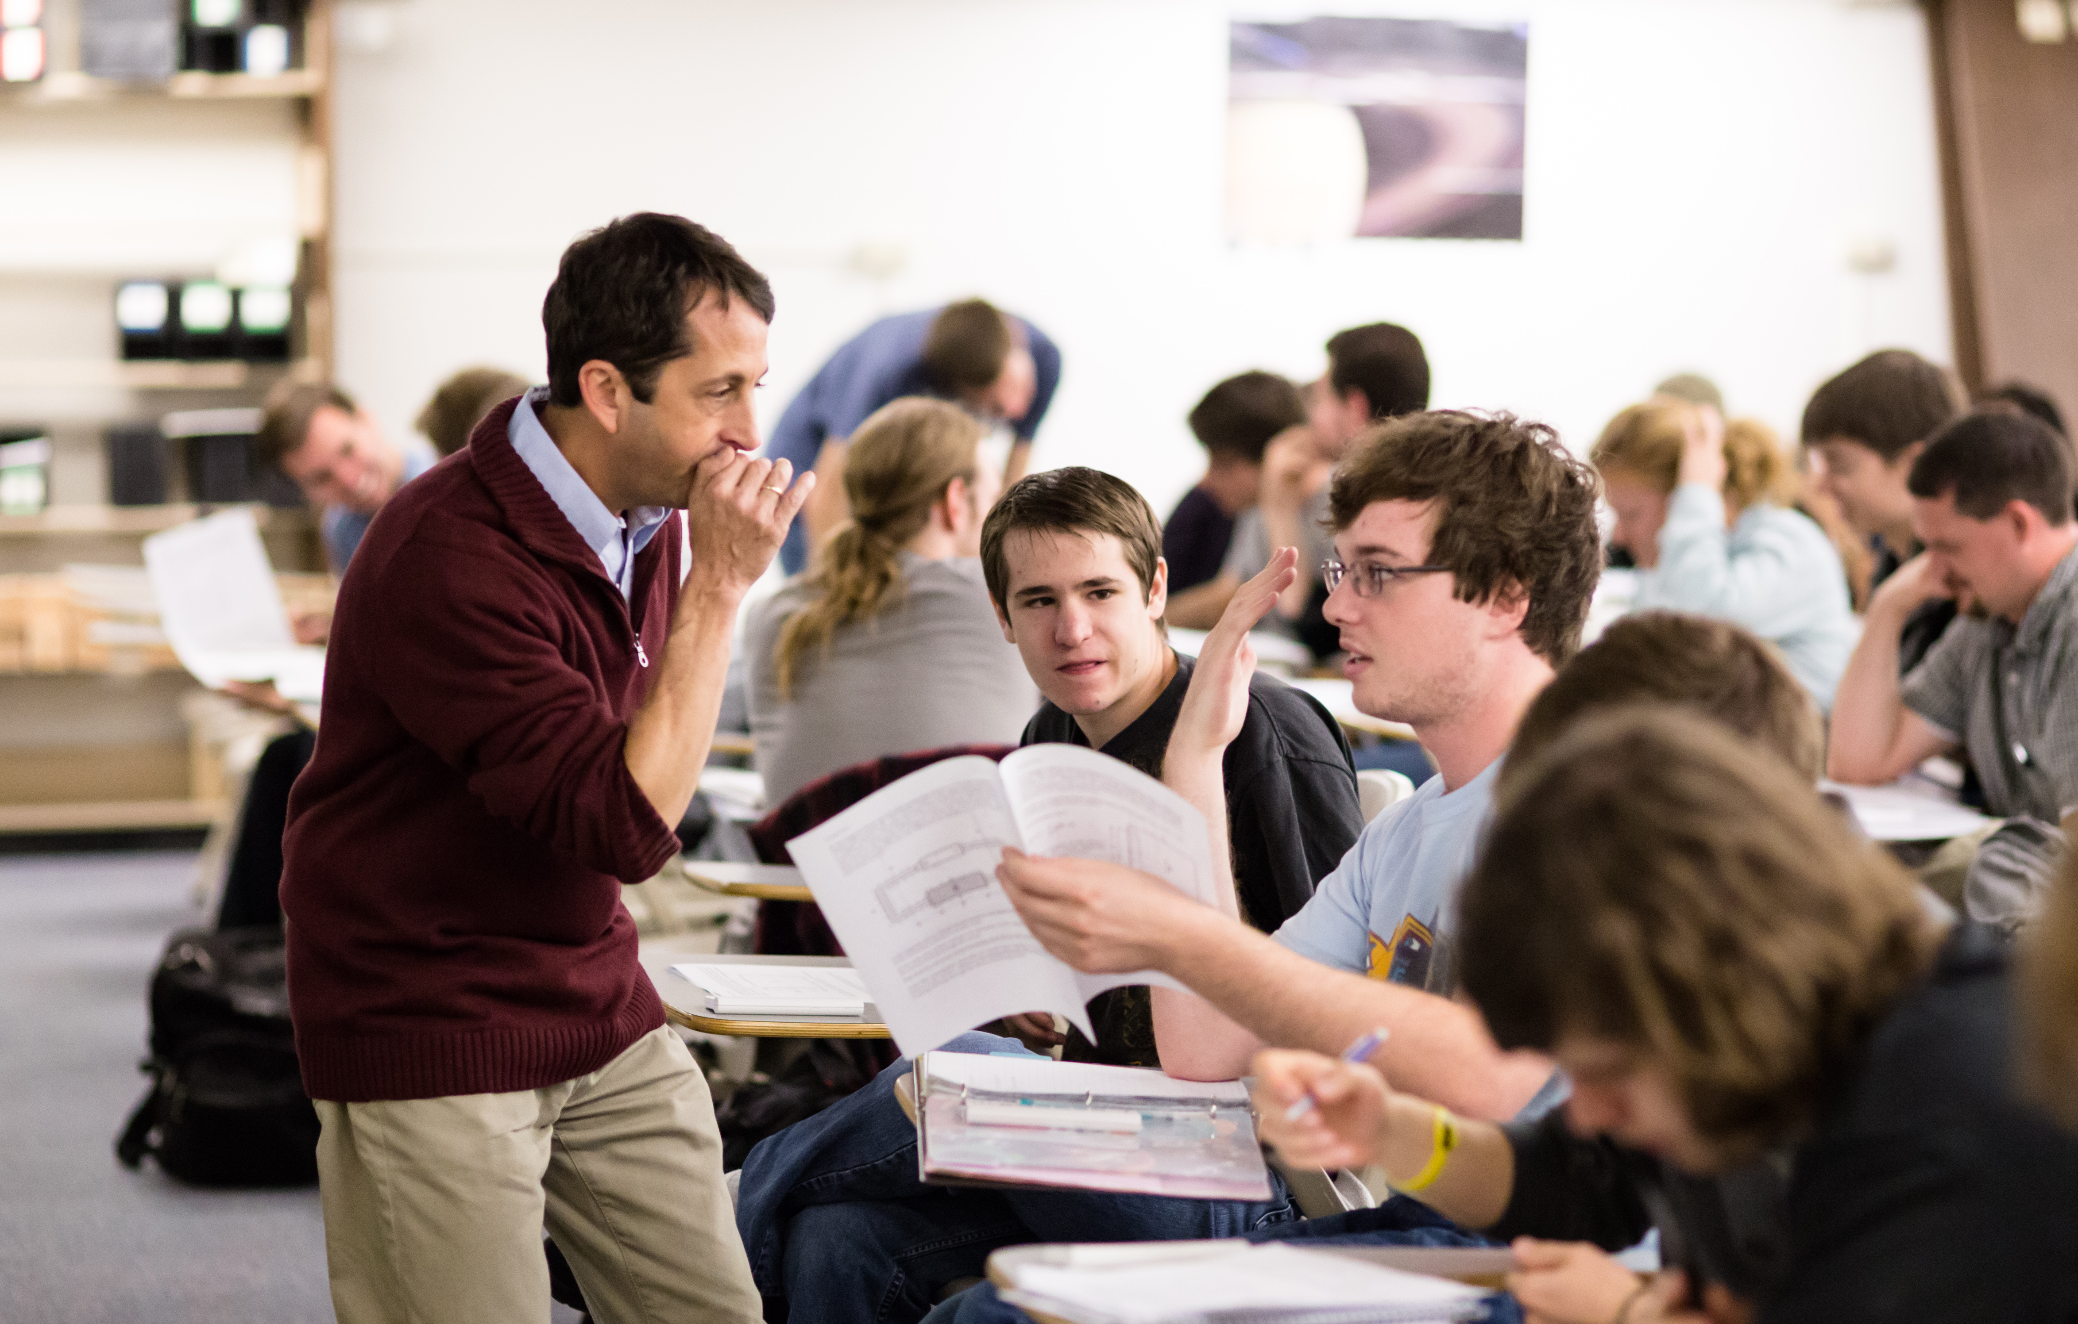
PER and Interactive Engagement: The Big Picture
Steven Pollock
Dep’t of Physics, CU Boulder
New Faculty Workshop 2016
Notes:
Colorado Learning and Teaching with Technology!
TO DO: Get #’s from Rache’s Perc paper on # faculty involved
To bring:
Hard copies of: 1 pager- shortened “learning goals”
Also sample concept tests
Also sample Tutorial
Also sample CUE
At most universities, including the University of Colorado, upper-division physics courses are taught using a traditional lecture approach that does not make use of many of the instructional techniques that have been found to improve student learning at the introductory level. We are transforming upper-division courses (E&M, quantum, and Classical Mechanics) using principles of active engagement and learning theory, guided by the results of observations, interviews, and analysis of student work at CU and elsewhere. I will outline these reforms including consensus learning goals, clicker questions, tutorials, modified homeworks, and more, as an example of what a transformed upper-division course can look like, and as a tool to offer insights into student difficulties in advanced undergraduate topics. We have examined the effectiveness of these reforms relative to traditional courses, based on grades, interviews, and attitudinal and conceptual surveys. Our results suggest that it is valuable to further investigate how physics is taught at the upper-division, and how education research may be applied in this context.

Slide 2








Physics Education Research at CU Boulder
Postdocs/ Scientists:
Stephanie Chasteen
Karina Hensberry
Katie Hinko
Emily Moore*
Ariel Paul
Qing Ryan
Joel Corbo
Daniel Reinholtz
Faculty:
Melissa Dancy
Michael Dubson
Noah Finkelstein
Heather Lewandowski
Valerie Otero
Robert Parson
Kathy Perkins
Steven Pollock
Carl Wieman*
Teachers / Partners / Staff:
Shelly Belleau, John Blanco
Kathy Dessau, Jackie Elser Kate Kidder, Sam Reid
Trish Loeblein, Chris Malley
Susan M. Nicholson-Dykstra
Oliver Nix, Jon Olson
Sara Severance
Funded by:
National Science Foundation
William and Flora Hewlett Foundation
American Association of Physics Teachers
Physics Teacher Education Coalition
American Institute of Physics
American Physical Society
National Math & Science Initiative
Howard Hughes Medical Institute
Grad Students:
Ian Her Many Horses
Mike Ross
Enrique Suarez
Ben Van Dusen
Bethany Wilcox
Simone Hyater-Adams
Rosemary Wulf
Jessica Hoy
+recent grads (4 PhD)
+ many participating faculty and LAs

Slide 3
Outline / Framing
What is PER?
Building on a base
Why bother?
Theoretical models & educational practices
Impacts
Introductory physics (results,replicability)
Upper division
Broader goals
Takeaways, connections to rest of NFW.
Notes:
Theory: Understanding role of e.g. Social Structures, Cognitive Overload, Preconceptions, etc.

Slide 4
What is Physics Education Research?
Studies by physicists of:
How do students learn?
How do we know they’re learning?
How do we help them learn?
Theory
Experiment
Application
Notes:
PER thesis has same elements as other sub-fields of physics:
- desgin of experiment,
- systems of model
- computtion/ predicion /analysis

Slide 5
Sample question
From FCI: Find it (and many others) on
http://physport.org
Force concept inventory, D. Hestenes, Physics Teacher 30 (1992)
Notes:
2010 students get it 53% correct on pretest,
A is most popular distractor, but C, D, and E are ALL well represented.

Slide 6
How hard was that question?
(For CU algebra-based students)
Very easy
Easy
Moderate/Difficult
Very difficult
How could I know this?
Randy Knight, “5 Easy Lessons”
Edward (Joe) Redish “Teaching Physics”
Arons “Teaching Introductory Physics”
http://physport.org
Force concept inventory, D. Hestenes, Physics Teacher 30 (1992)
Notes:
2010 students get it 53% correct on pretest, 73% on posttest, with a normalized gain of 0.41
A is most popular distractor, but C, D, and E are ALL well represented.

Slide 7
Force Concept Inventory (FCI) Learning gains
traditional lecture
Students are learning
~ ¼ of what they didn’t
already know!
Less Learning <g> More Learning
R. Hake, ”…A six-thousand-student survey…” AJP 66, 64-74 (‘98).
Notes:
7

Slide 8
Conventional model of teaching and learning: “transmitting knowledge”
=> lecture (efficient!)

Slide 9
FCI Learning gains
traditional lecture
interactive engagement
Less Learning <g> More Learning
R. Hake, ”…A six-thousand-student survey…” AJP 66, 64-74 (‘98).
Notes:
9

Slide 10
FMCE Learning gains
From “… a 50k student study” (2016)
traditional lecture
Interactive engagement
Less Learning <g> More Learning
Secondary Analysis of Teaching Methods in Introductory Physics: a 50k-Student Study
J Von Korff et al, Arxiv.org/pdf/1603.00516v1.pdf
Notes:
10

Slide 11
FCI/FMCE Learning gains
traditional lecture
interactive engagement
Visit per.colorado.edu/cts for resources!
CU for last 20 semesters
Less Learning <g> More Learning
S. Pollock and N. Finkelstein,
Phys. Rev. ST Phys. Educ. Res. 4, 010110 (2008)
Notes:
11

Slide 12
FCI/FMCE Learning gains
traditional lecture
interactive engagement
Clickers in lecture, Traditional Recitation
at CU
Less Learning <g> More Learning
S. Pollock and N. Finkelstein,
Phys. Rev. ST Phys. Educ. Res. 4, 010110 (2008)
Notes:
12

Slide 13
FCI/FMCE Learning gains
traditional lecture
interactive engagement
With Tutorials and LAs
Less Learning <g> More Learning
S. Pollock and N. Finkelstein,
Phys. Rev. ST Phys. Educ. Res. 4, 010110 (2008)
Notes:
13

Slide 14
Colorado learning gains (Physics 1)
Visit Per.colorado.edu/cts for resources!

Slide 15
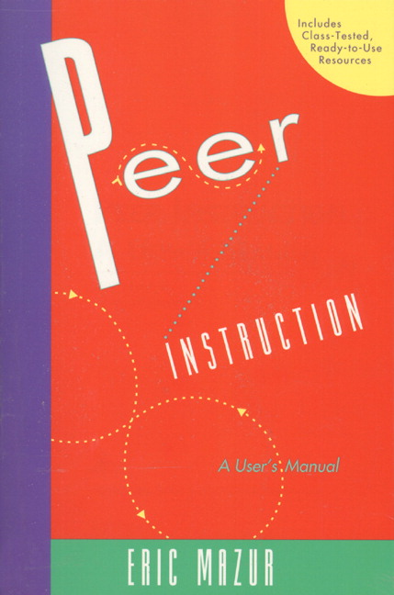
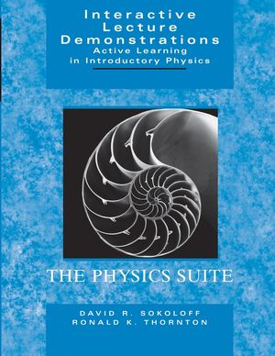
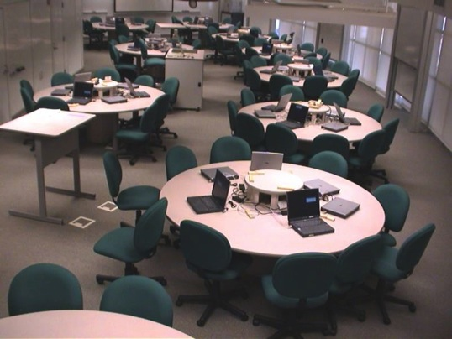
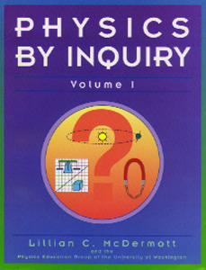
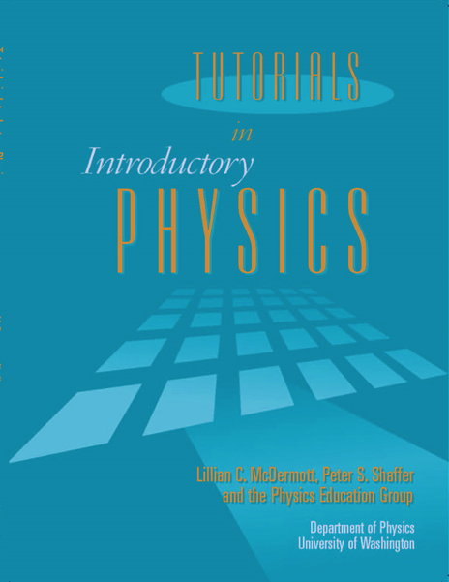
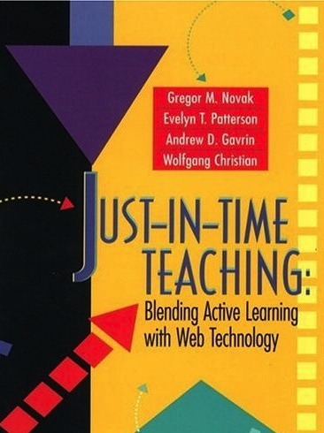
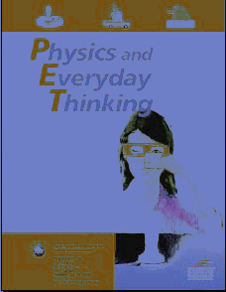
Many (research-validated) innovations
Notes:
15
Nationally, SEM departments at the university level are beginning to transform curricula from a traditional view of knowledge reproduction that takes students as passive recipients of knowledge, to a more recently accepted view that students actively construct knowledge based on their prior knowledge and previous experiences (Barr & Tagg, 1995). Many SEM researchers and educators have developed curricular and pedagogical approaches that have documented improved student learning, retention, interest, and attitudes in SEM (Crouch & Mazur, 2001; Redish, Saul, & Steinberg, 1997; Redish, 2003).

Slide 16
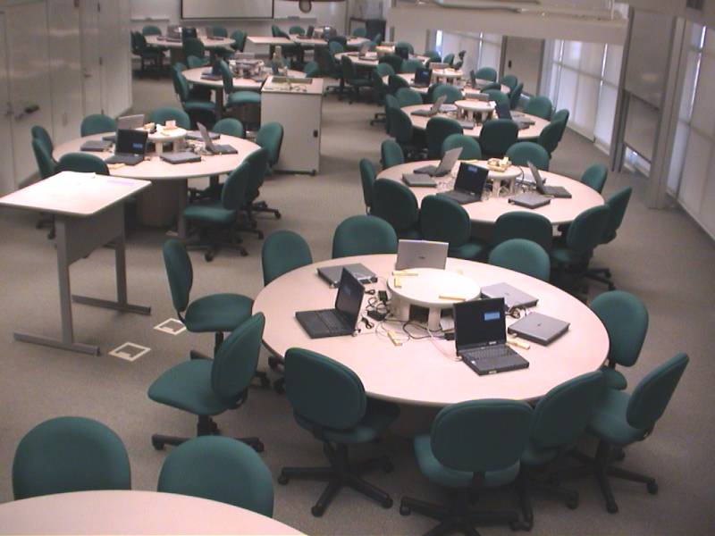
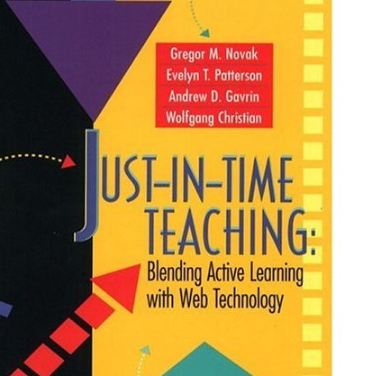
PER curricular innovations
ScaleUP Studio
Notes:
Nationally, SEM departments at the university level are beginning to transform curricula from a traditional view of knowledge reproduction that takes students as passive recipients of knowledge, to a more recently accepted view that students actively construct knowledge based on their prior knowledge and previous experiences (Barr & Tagg, 1995). Many SEM researchers and educators have developed curricular and pedagogical approaches that have documented improved student learning, retention, interest, and attitudes in SEM (Crouch & Mazur, 2001; Redish, Saul, & Steinberg, 1997; Redish, 2003).

Slide 17
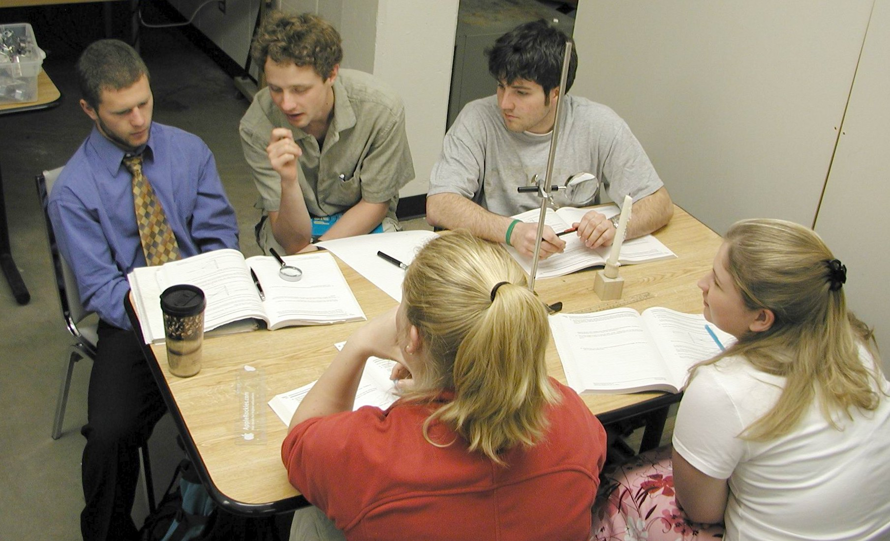
Tutorials in Introductory Physics
Reconceptualize Recitations
Materials
Classroom format / interaction
Instructional Role
L. McDermott et al, University of Washington

Slide 18
Why (physics) education?
Notes:
education is key mechanism for society to replicate itself –
In fact perhaps (depending upon definition) it is the ONLY mechanism
[already have a bias here --- starting with a lens on society!]
Might be embodyment of the Leslie’s meta-meta-goals… (e.g. why is she a teacher ).

Slide 19


Individual Empowerment
Societal Empowerment
Workforce / Economic Development
Notes:
For . . .
Possibly include images / sep slides
Goals of Education:
Individual empowerment (ability to engage in and see the world .. Undertand our relations with it and with each other).
- think critically analyze, synthesize, be liberated / free, engaged in and open to the world
Societial empowerment: actions to create a collectilvely functioning society: - founding of this country: democracy based on educated citizenry -- [other goals: social justic, mutual aide]
Workforce:
Really a subset of each of the above; however heralded so often, and may in fact be in concert or at odds with above (depending up on goals).

Slide 20
We have many educational goals
What’s hard about learning…. X?
What does it mean to learn physics?
What is the nature of science?
What factors impact retention?
How/do we differentially encourage or discourage groups from participating in physics?
…
Physical Review ST PER

Slide 21
What do students think it means to learn physics?
Assessing the “hidden curriculum” -
beliefs about physics and learning physics
Examples:
• “I study physics to learn knowledge that will be useful in life.”
• “To learn physics, I only need to memorize solutions to sample problems”
*Adams et al, “The Colorado Learning Attitudes about Science Survey”
Physical Review Special Topics, 2006
Notes:
Colorado Learning Attitudes about Science Survey

Slide 22
CLASS categories
Shift (%) (“reformed” class)
-6
-8
-12
-11
-10
-7
-17
+5
(All ±2%)
Real world connect...
Personal interest........
Sense making/effort...
Conceptual................
Math understanding...
Problem Solving........
Confidence................
Nature of science.......
Engineers: -12
Phys Male: +1
Phys Female: -16
Notes:
YES, those are NEGATIVE shifts. This is the common result!

Slide 23
Attitudes and Beliefs: Shift of “expert-like” responses after one term
BOTH trad and reformed
standard courses
Courses w. some focus on
developing expert beliefs
Courses w. major focus on
developing expert beliefs
Modeling building courses
Teaching
How physics instruction impacts students’ beliefs about learning physics: A meta-analysis of 24 studies
Adrian Madsen, Sarah B. McKagan, and Eleanor C. Sayre
Phys. Rev. ST Phys. Educ. Res. 11, 010115
Notes:
Green is MPEX.

Slide 24
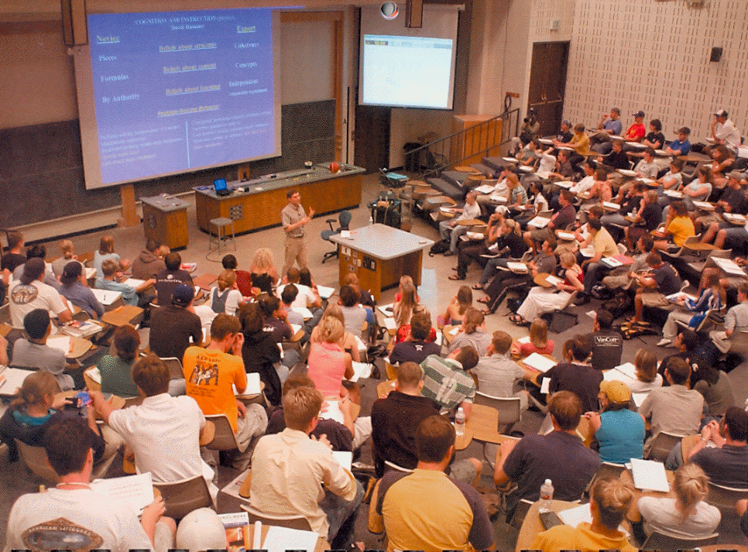

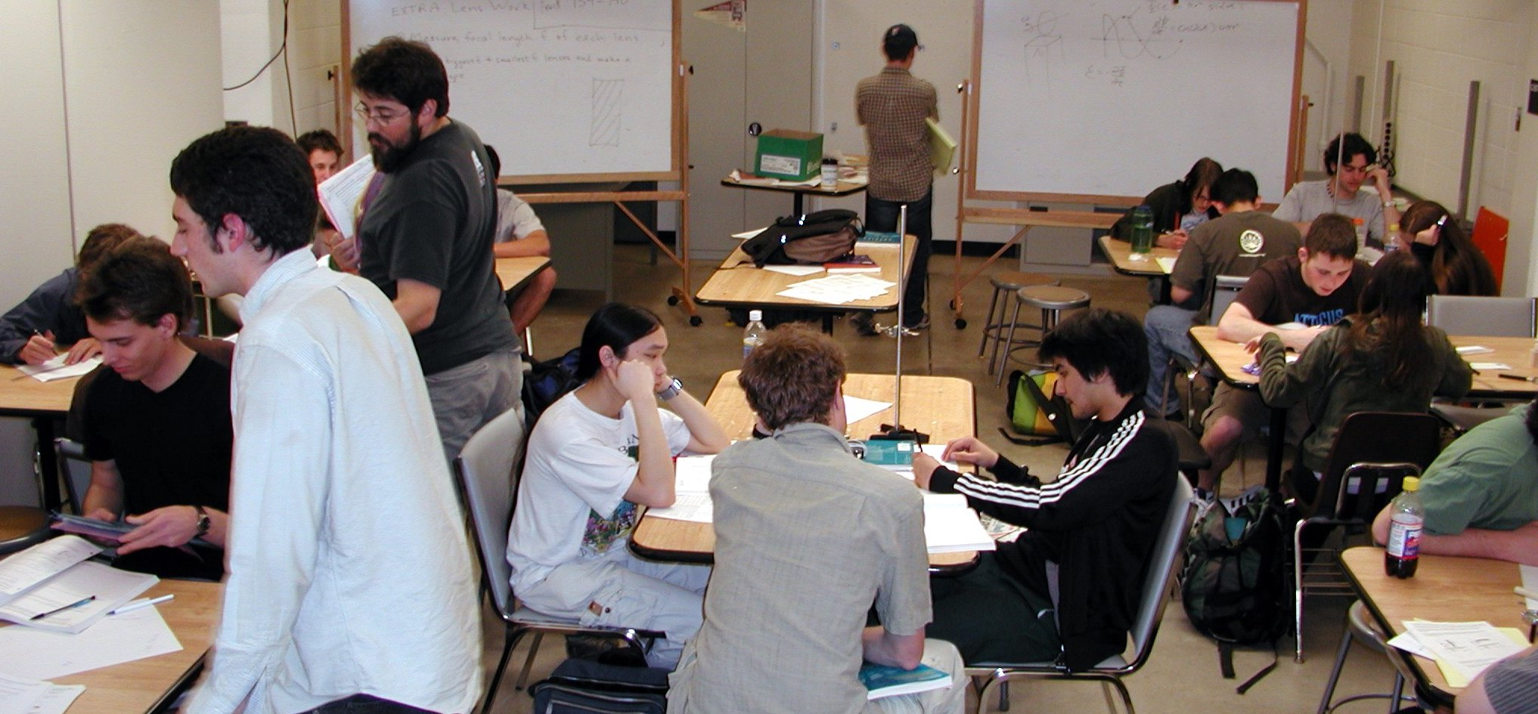
Why transform upper-division?
?
Lecture with clickers
Can our majors learn better from interactive techniques adapted from introductory physics?
Washington Tutorials
per.colorado.edu/sei
Notes:
Lower div changes - increase learning ---- Upper div - for the most part traditional (SLIDE CLICK)
Sense - stop coddling student.s We learned by lecture.
Good students will learn. Time to change major.
How people learn doesn’t change. Do better by students by trying.
E&M1 core courses - learn physics as major - highly valued

Slide 25
Upper-division conceptual test (CUE) score distribution
traditional lecture
interactive engagement
N_{tot}=540 at 5 Universities, (18 classes)
Chasteen, Perkins, Beale, Pollock, & Wieman, JCST 40 (4), 70, 2011 Chasteen et al., AJP 80, 923, 2012, PRSTPER 8 020108, 2012
Wilcox et al, PRPER 11, 020130, 2015

Slide 26
Student Difficulties
Recognizing and exploiting symmetry
Divergence and Stokes’ Theorems (visualizing, using)
… (lots more!)

Slide 27

Summary
We must know our audience.
Student attitudes and beliefs
are important
Active learning works!
Conceptual understanding
doesn’t come along for free
It’s about the learning.

Slide 28
Conclusions:
a science
Teaching is an Art
Teaching and Research
are not separate missions.
Teaching can be improved by scholarly study!
Notes:
Could view this as Teachig Tips – but there is no magic bullet. You will stop using these techniques if you don’t keep asking questions of your teaching….

Slide 29
Please visit PER.COLORADO.EDU
Questions?

