Slide 1


Learner-Centered Teaching in Physics and Astronomy
Dr. Edward Prather
University of Arizona
Center for Astronomy Education (CAE)
http://astronomy101.jpl.nasa.gov

Slide 2
Thanks and Support
NSF - “Collaboration of Astronomy Teaching Scholars (CATS)”
JPL’s NASA Exoplanet Exploration Public Engagement Program
AUI NRAO

Slide 3

NSF: Collaboration of Astronomy Teaching Scholars (CATS)
PI: Chris Impey (Univ. of Arizona); Co-Is: Ed Prather (Univ. of Arizona), Gina Brissenden (Univ. of Arizona), Kevin Lee (Univ. of Nebraska); Project Leads: Alex Rudolph (Cal Poly Pomona), Colin Wallace (Univ. of Arizona), Seth Hornstein (UC Boulder)
Kendall Anlian, Univ. of Arizona
Jessie Antonellis, Univ. of Arizona
Leilani Arthurs, CU Boulder
Duncan Brown, Syracuse Univ.
Sanlyn Buxner, Univ. of Arizona
David Consiglio, Bryn Mawr College
Steve Desch, Guilford Tech. CC
Doug Duncan, CU Boulder
Jeffrey Eckenrode, Univ. of Arizona
Tom English, Guilford Tech. CC
John Feldmeier, Youngstown State Univ.
Amy Forestell, SUNY New Paltz
Rica French, MiraCosta College
Adrienne Gauthier, Univ. of Arizona
Pamela Gay, SIU-Edwardsville
Dennis Hands, High Point Univ.
Kevin Hardegree-Ullman, Univ. of Arizona
Melissa Hayes-Gehrke, Univ. of Maryland
David Hudgins, Rockhurst Univ.
Jessica Kapp, Univ. of Arizona
John Keller, Cal Poly SLO
Julia Kregenow, Penn State
Michelle Krok, Univ of Alaska
Ran Kumada, Univ. of Arizona
Jacqueline Laird, Univ. of Arizona
Patrick Len, Cuesta College
Chris Lintott, Univ. of Oxford
Michael LoPresto, Henry Ford CC
Daniel Loranz, Truckee Meadows CC
Julie Lutz, Univ. of Washington
Danny Martino, Santiago Canyon College
Benjamin Mendelsohn, West Valley College
Ed Montiel, Univ. of Arizona
Peter Newbury, Univ. of British Columbia
Lee Powell, Texas Lutheran Univ.
Matthew Price, Ithaca College
Jordan Raddick, Johns Hopkins Univ.
Travis Rector, Univ. of Alaska
Paul Robinson, Westchester CC
Wayne Schlingman, Univ. of Arizona
Hannah Sugarman, Univ. of Arizona
Sébastien Cormier (San Diego College)
James Wysong Jr., Hillsborough CC
Todd Young, Wayne St. College

Slide 4
Take Home Messages
Research-validated interactive learning strategies can benefit ALL students in ALL classroom environments - BUT
The quality of our implementation is likely the most deterministic factor toward student achievement

Slide 5

Just the tip of the iceberg of what it takes to create a highly functioning interactive engagement classroom

Slide 6
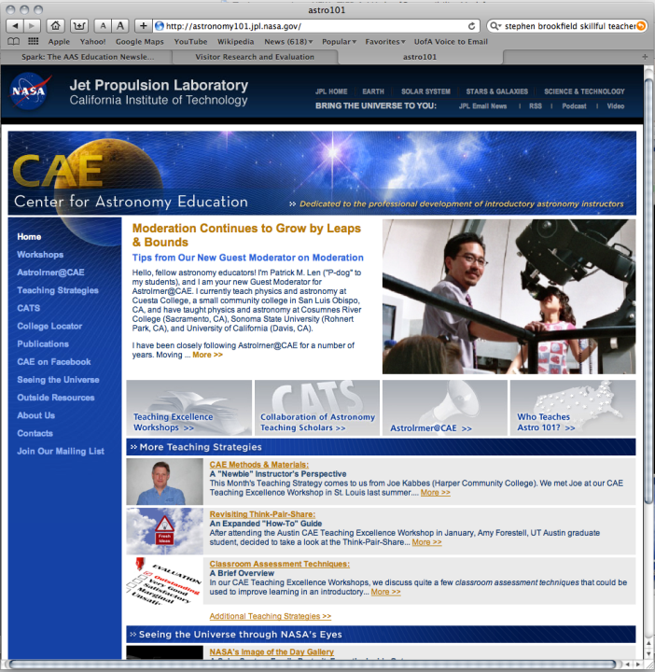

Slide 7
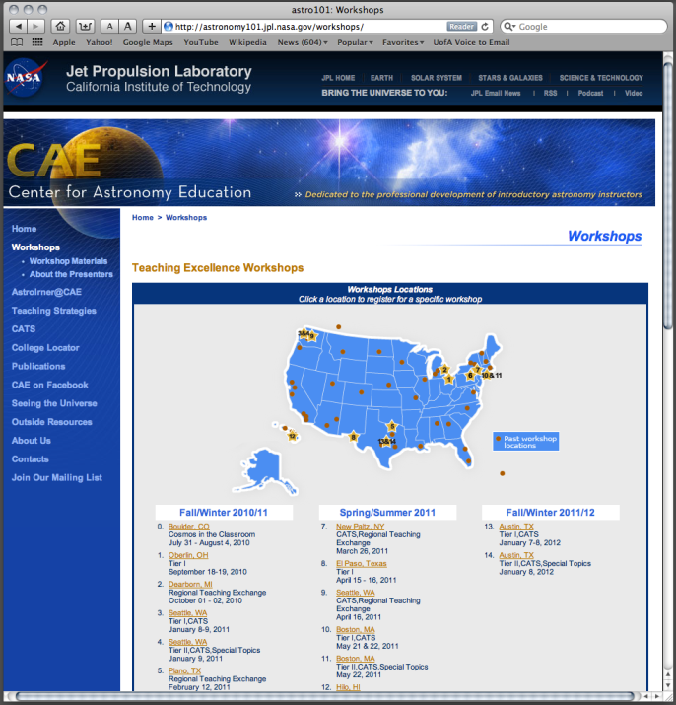

Slide 8
Session Organization
Background information on interactive teaching methods
An example of interactive teaching - “day in the classroom”
Engagement on interactive teaching strategies and their implementation into the different classroom environments

Slide 9
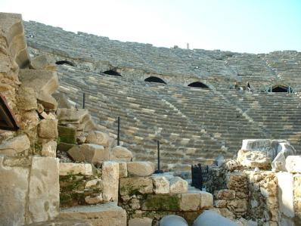

“Most ideas about teaching are not new, but not everyone knows the old ideas.” Euclid (300 B.C.)

Slide 10
“Lecture has often been described as the process of taking the information contained in the teachers notes and transferring them into the students notes without the information passing through the brains of either”

Slide 11
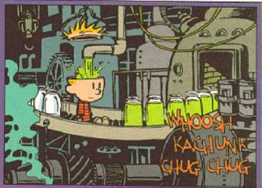
A Commonly Held Inaccurate Model of Teaching and Learning
Your discipline content
Bill Watterson,
Calvin and Hobbs

Slide 12


Slide 13
adapted from “How People Learn”
Students enter the classroom with preconceptions about how the world works. If their initial understanding is not fully engaged, they may fail to grasp new concepts in meaningful ways that last beyond the purposes of an exam.
To fully develop competence, students must:
(1) have a deep foundation of factual knowledge, (2) understand the interrelationships among facts and ideas in the context of a conceptual framework, and (3) organize knowledge in ways that facilitate retrieval and application
A “metacognitive” approach to instruction can help students learn to take control of their own learning and monitor progress.
How People Learn: Brain, Mind, Experience, and School (Expanded Edition),
National Research Council, National Academy Press, 2000.
Notes:
Metacognition refers to thinking about cognition (memory, perception, calculation, association, etc.) itself or to think/reason about one's own thinking.
Metacognition involves two types of knowledge: 1) explicit, conscious, factual knowledge; and 2) implicit/unconscious knowledge.
Metacognition also refers to a level of thinking that involves active control over the process of thinking that is used in learning situations. Planning the way to approach a learning task, monitoring comprehension, and evaluating the progress towards the completion of a task: these are skills that are metacognitive in their nature. The theory that metacognition has a critical role to play in successful learning means it is important that it be demonstrated by both students and teachers.

Slide 14

Class Response System—Medium Tech

Slide 15

Force Concept Inventory (FCI)
1. A downward force of gravity.
2. A force exerted by the rope pointing from A to O.
3. A force in the direction of the boy’s motion.
4. A force pointing from O to A.
Which of the above forces is (are) acting on the boy when he is at position A?
(A) 1 only.
(B) 1 and 2.
(C) 1 and 3.
(D) 1, 2, and 3.
(E) 1, 3, and 4.

Slide 16
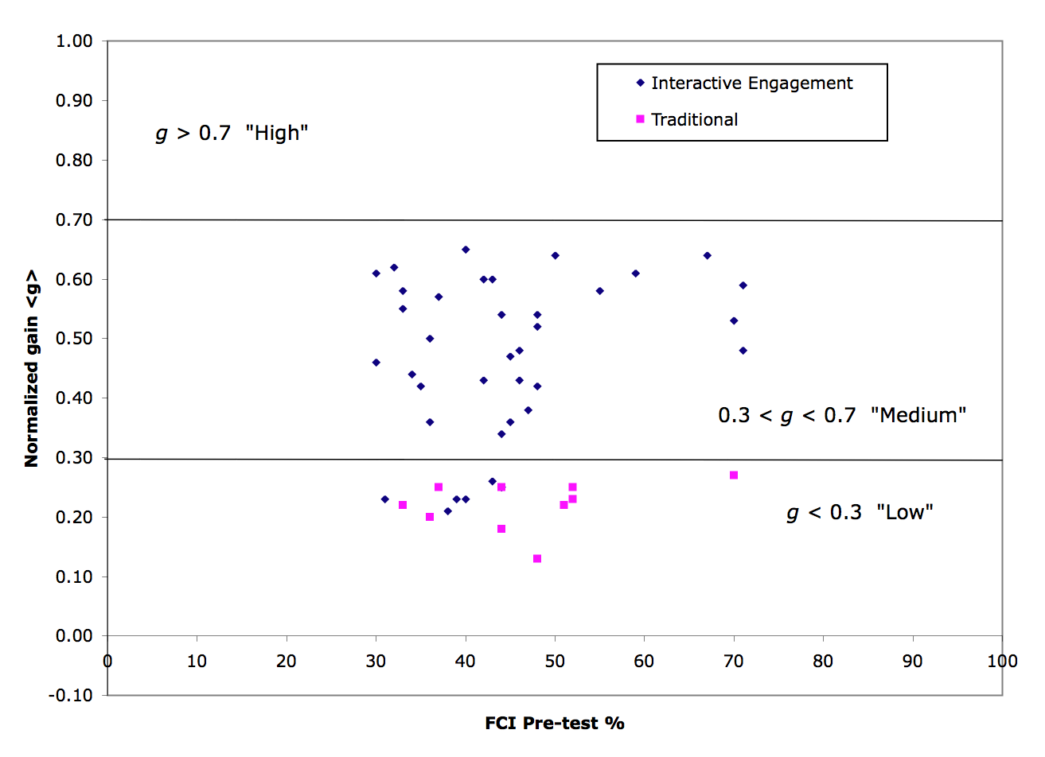
Results from a 6000 student study of Physics Students – Hake AJP 1998
R. Hake, “…A six-thousand-student survey…” AJP 66, 64-74 (1998).

Slide 17
Reformed Class
Two 50 minute lectures per week
  Focused on introducing concepts using active engagement instructional strategies and on interactive, collaborative problem solving
  Minimal derivations of equations
Each student also attends one of ten 50 minute recitation sections per week
  Led by graduate TA with assistance from undergraduate peer instructors
  Students work on collaborative tutorials, which promote reasoning abilities and problem solving skills
Instructor experienced in astronomy and physics education research, but teaching PHYS 141 for the first time
Traditional Class
Three 50 minute lectures per week
  Focused on introducing concepts and on instructor-led modeling of problem solving
  Many derivations of equations
Instructor experienced in teaching PHYS 141 and widely regarded by faculty and students as an excellent lecturer

Slide 18

COPUS data from UA Calc-Physics Course

Slide 31
Does your class intellectually engage your students and deepen their conceptual understanding and critical thinking ability or does it re-enforce the memorization of facts and declarative knowledge?
Bloom’s Taxonomy of Educational Objectives
evaluation
synthesis
analysis
application
comprehension
declarative knowledge
The Role of Assessment in the Development of the College Introductory Astronomy Course A "How-to" Guide for Instructors. Astronomy Education Review, 1(1), 1-24, 2002. G. Brissenden, T.F. Slater, and R. Mathieu.

Slide 32
What Can I do Besides Lecture to Engage Students in their Learning?
Ask students questions (not all questions are equal)
Use interactive videos, demonstrations, animations, and simulations
In-class writing (with or without discussion)
  Muddiest Point
  Summary of Today's Main Points
  Writing Reflections
  Think-Pair-Share or PeerInstruction
Small Group Interactions
  Concept Maps
  Case Studies
  Sorting Tasks
  Ranking Tasks
  Lecture-Tutorials
Student Debates (individual/group)
Whole Class Discussions

Slide 33
If a Picture is worth a thousand words, then what is a real-world, first-hand, experience worth?
Audience participation is strongly
encouraged
Demos are sometimes
life-threatening
“Eventually, Billy came to dread his father’s lectures over all other forms of punishment”

Slide 34
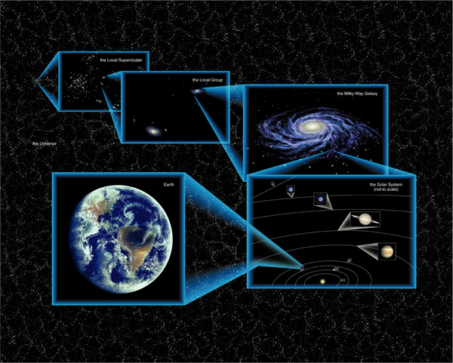

Slide 35
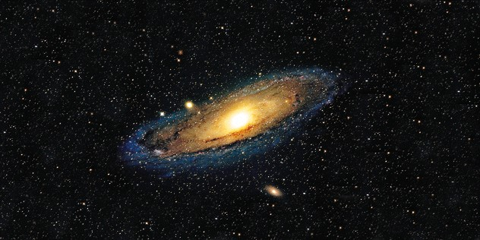

Slide 36
The above image of the Andromeda Galaxy shows what the galaxy:
is actually like right now
will look like in the future
once looked like in the past
more than one of the above is correct

Slide 37
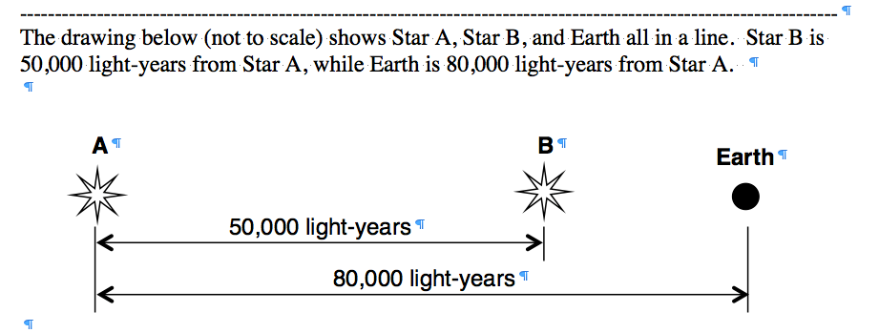
From which of the two Stars do we receive information that occurred the furthest back in time?
Star A
Star B
They both give us information about the same period of time in the universe.

Slide 38
If both Stars are born at the same time, and the light from Star A has just reached the location of Star B, then how old does Star B appear to us on Earth?
30,000 years old
50,000 years old
80,000 years old
130,000 years old
None of the above are correct

Slide 39
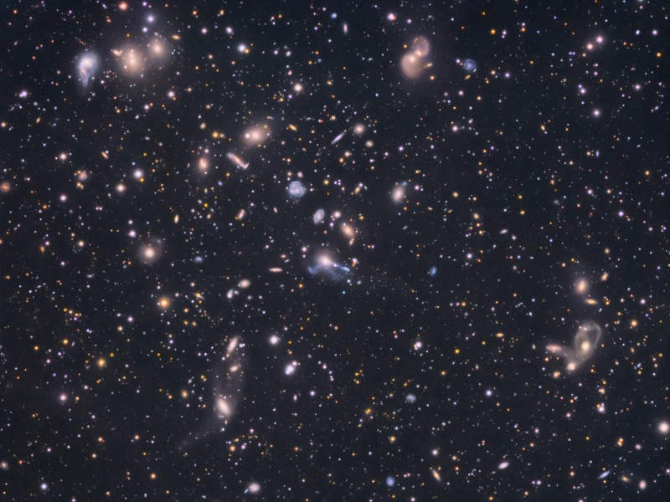

Slide 40
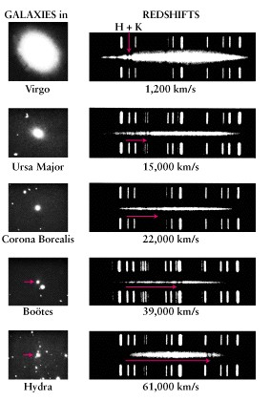
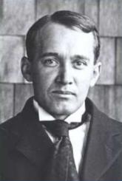
Light from distant galaxies is redshifted!
In 1903, Vesto Slipher was the first to measure the redshift of a spiral nebula (now known as a galaxy) and realize that this meant they were moving away from us at a very high speed.

Slide 41
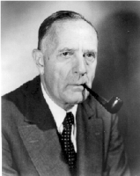
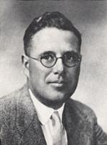
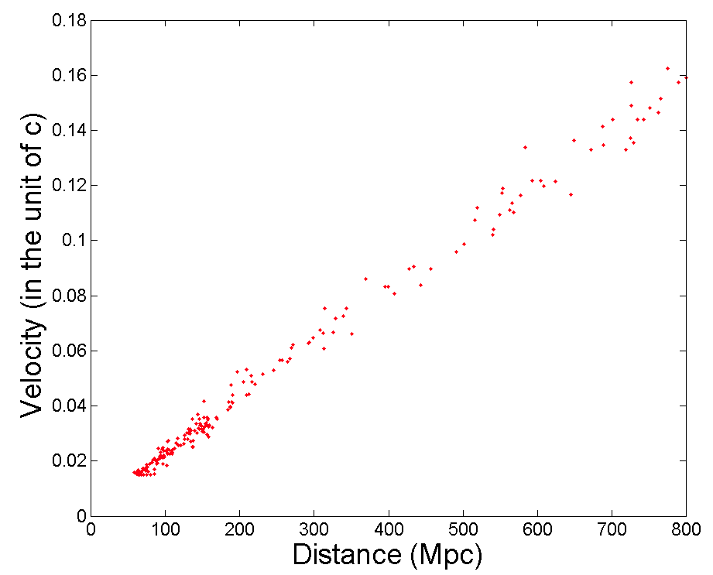
In 1929, Edwin Hubble and Milton Humason combined observations of the recessional velocities and distances to galaxies to create the “Hubble-Plot”!
Velocity
Distance

Slide 42
Interpreting the Hubble Plot – Talk to your partner, what is this plot telling us about the Universe? What are the units of the slope of this Graph?
THE UNIVERSE IS EXPANDING
Velocity
Distance

Slide 43
The farther the galaxy is from us, the faster the galaxy is moving away from us!
THE UNIVERSE IS EXPANDING
Velocity
Distance

Slide 44
The slope of this line is an indication of how fast the universe is expanding and how old the universe is.
The steeper the slope the faster the universe is expanding.
A universe that is expanding quickly will reach its current size in a short(er) amount of time (a young universe).
Velocity
Distance

Slide 45
These graphs represent three different sets of observations of our universe.

Slide 46
The steeper the ______the _____ the Universe is and _____the rate of ______.

Slide 47
Draw a Hubble Plot for the observations made by a person in Galaxy “Y.” Be sure to indicate where Galaxies X, Z and the Milkyway Galaxy will be on your new Hubble Plot.
Z
X
Y

Slide 48
A
B
C
D
E

Slide 49
What Can I do Besides Lecture to Engage Students in their Learning?
Ask students questions (not all questions are equal)
Use interactive videos, demonstrations, animations, and simulations
In-class writing (with or without discussion)
  Muddiest Point
  Summary of Today's Main Points
  Writing Reflections
  Think-Pair-Share or Peer Instruction
Small Group Interactions
  Concept Maps
  Case Studies
  Sorting Tasks
  Ranking Tasks
  Lecture-Tutorials
Student Debates (individual/group)
Whole Class Discussions

Slide 50
A note about Flipped, Hybrid, and Just in Time Teaching (JITT)……
http://the8blog.wordpress.com/2013/07/02/flipping-for-flipping/
http://blog.peerinstruction.net/
http://webphysics.iupui.edu/jitt/what.html

Slide 51
Think-Pair-Share (TPS) aka Peer Instruction:
A questioning in the classroom technique that makes use of a combination of conceptually challenging multiple choice questions, and classroom feedback designed to increase student-to-student discourse and provide insight into students’ learning for you and them
Crouch, C. H. & Mazur, E. 2001, “Peer Instruction: Ten Years of Experience and Results,” American Journal of Physics, 69(9), 970, 2001
Development and Application of a Situated Apprenticeship Approach to Professional Development of Astronomy Instructors, Prather, E. E., and Brissenden, G. The Astronomy Education Review, 7(2), 2008
Clickers as Data Gathering Tools and Students’ Attitudes, Motivations, and Beliefs on Their Use in this Application, Prather, E. E., Brissenden, G., The Astronomy Education Review, 8 (1), 2009 .

Slide 52
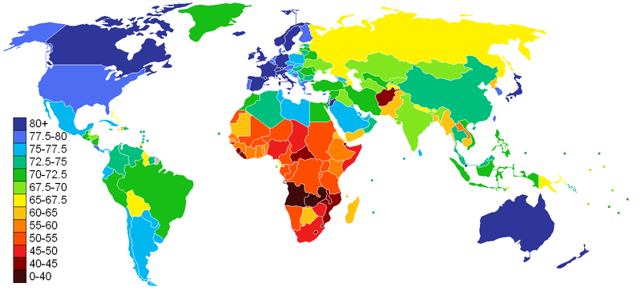
What does this chart represent?
Work with your partner and write a multiple choice question that would provoke a thoughtful discussion amongst students about this false color map?

Slide 53
Could any of the items listed below be represented
by this false color image?
Average household income
Infant mortality rate
Emission of Greenhouse gasses
Average life expectancy
Percent of citizenry with a college degree

Slide 54

Average household income
Infant mortality rate
Emission of Greenhouse gasses
Average life expectancy
Percent of citizenry with a college degree
How many of the listed items could be represented by this false color image?
Only one
Two
Three
Four
All are possible

Slide 55
CHART OF AVERAGE LIFE EXPECTANCY
Rank the continents, from greatest to least “average” life expectancy.

Slide 56

CHART OF AVERAGE LIFE EXPECTANCY
Which of the following is the correct ranking of the continents, from greatest to least “average” life expectancy.
North America, Australia, Europe, South America, Asia, Africa
Africa, Asia, South America, Europe, North America, Australia
Australia, North America, Europe, South America, Asia, Africa
Europe, Australia, North America, South America, Asia, Africa
None of the above is correct

Slide 57
Around which object does the Moon orbit?
  Earth
  Mars
  Jupiter
  Saturn

Slide 58
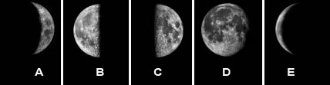
If the moon is in the waxing gibbous phase today, how many of the moon phases shown above (A-E) would the moon go through during the next 10 days.
Only one
Two
Three
More than three
None

Slide 59
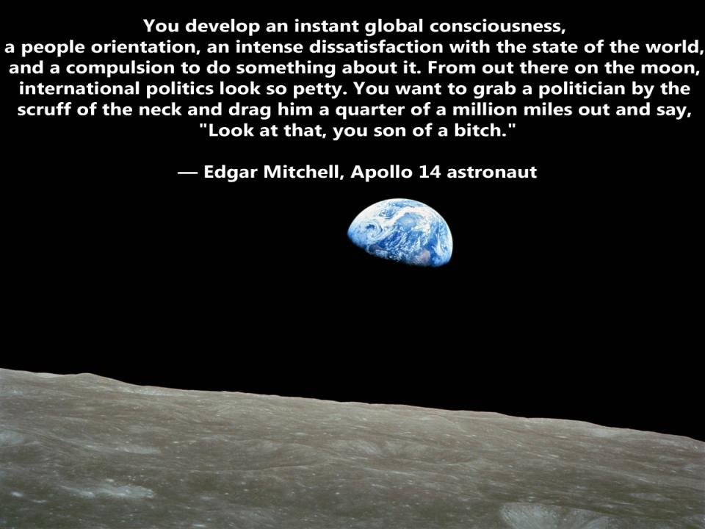
What would the phase of the moon be?
Waxing crescent
Third Quarter
Waxing Gibbous
Waning Crescent
Waning Gibbous

Slide 60
How many of the locations (A-F) would be experiencing Summer?
only one
two
three
four
all the positions are are experiencing Summer.

Slide 61
When was the expansion rate of the universe faster, at the time when light first left the object identified by Point Z or when we received the light from this object?
Z

Slide 62
Earth
A
Orbit of star
+20
Radial Velocity
D
B
Time
-20
Orbit of planet
C
Given the location marked with the orange dot on the star's radial velocity curve, at what location in the planet's orbit would you expect the planet to be?

Slide 63
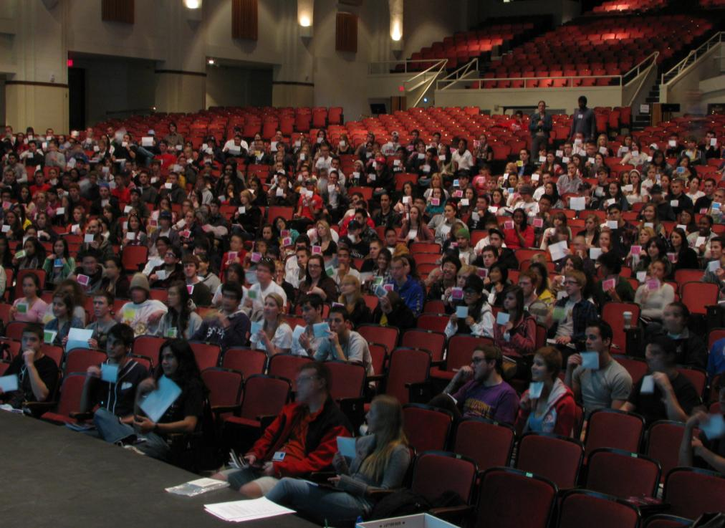

Slide 64
Which of the following is the correct ranking for the size of the objects A-E, from largest to smallest.
  A) E=A>C=B>D
  B) D>B=C>A>E
  D=B>C>A=E
  D>B>C>A>E
  E>A>C=B>D
10,000
1,000
D
100
10
C
B
Luminosity (solar units)
1
A
.1
.01
E
.001
.0001
20,000 10,000 5,000
Temperature (K)

Slide 65

Which of the following is the best ranking (from greatest to least), for the gravitational force exerted on asteroids 1, 2 and 3 by their partner asteroids?
1
d = 1
m = 3
3>2>1
3=2>1
3>2=1
1=2>3
3=1>2
m = 5
2
d = 1
m = 3
m = 5
3
d = 1
m = 5
m = 5

Slide 66
In what direction would the net (total) force on the spacecraft point if it were coasting very quickly toward the Moon when at Position B (note that Position B is exactly halfway between Earth and the Moon)?
  toward the Moon
  toward Earth
  Since the force on the spacecraft by Earth is equal to the force on the spacecraft by the Moon, the net (total) force would be zero and not point in either direction.

Slide 67
If both Stars are born at the same time, and the light from Star A has just reached the location of Star B, then how old does Star B appear to us on Earth?
30,000 years old
50,000 years old
80,000 years old
130,000 years old
None of the above are correct

Slide 68
Earth
A
Orbit of star
+20
Radial Velocity
D
B
Time
-20
Orbit of planet
C
Given the location marked with the orange dot on the star's radial velocity curve, at what location in the planet's orbit would you expect the planet to be?

Slide 69
Idealized (& shorthand) Implementation of Think-Pair-Share
Create a cognitively engaging multiple-choice question that challenges students’ thinking and has the ability to foster deep discussion amongst your students.
Present question to students.
Ask students to "think" individually about the question (and find the best answer).
Have students anonymously and simultaneously vote on their answer to the question.
Decide if students should “share” their answers with each other. If so then…
Ask students to “pair” with someone next to them and to “share” their answers with each other with the goal of trying to convince their partner that their own answer is the correct one.
“Turn to your neighbor and convince them that you are right, if you have the same answer that does not mean you are right, so be sure to explain your reasoning”
Again have students anonymously and simultaneously vote on their answer to the question.
Debrief the results and correct answer to your students.

Slide 70
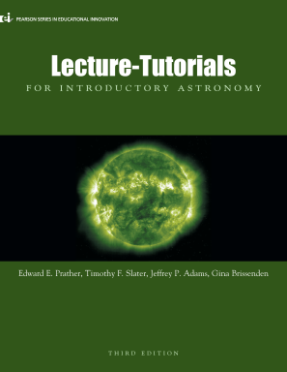
Lecture-Tutorials:
Post-lecture, pencil and paper activities, that use a Socratic-dialogue driven, highly-structured collaborative learning methodology to help students elicit, confront and resolve their naïve beliefs and reasoning difficulties, and improve their critical thinking skills and develop scientifically robust conceptual models.
Research on a Lecture-Tutorial Approach to Teaching Introductory Astronomy for Non–Science Majors, Prather, E. E.; Slater, T. F.; Adams, J. P.; Bailey, J. M.; Jones, L. V.; Dostal, J. A., Astronomy Education Review, 3(2) 2005
Clickers as Data Gathering Tools and Students’ Attitudes, Motivations, and Beliefs on Their Use in this Application, Prather, E. E., and Brissenden, G., Astronomy Education Review, 8(1), 2009.

Slide 71
A
B
C
D
E

Slide 72
Lecture Tutorial : Hubble’s Law
Work with a partner!
Read the instructions and questions carefully.
Discuss the concepts and your answers with one another. Take time to understand it now!!!!
Come to a consensus answer you both agree on.
If you get stuck or are not sure of your answer, ask another group.

Slide 73
Idealized Classroom Implementation
Professor lectures for approximately 20 minutes on core ideas of the topic to prepare students for working on the learning activity.
Students are posed conceptually challenging questions on the presented lecture material to set the stage for the collaborative learning activity to come.
Class is divided into pairs or small groups and instructed to work collaboratively and reach consensus on the questions presented during the activity.
Instructor circulates through the room listening to student conversations and works with student groups only if hands are raised.

Slide 74
Idealized Classroom Implementation
Instructor provides time-stamps approximately every 5-8 minutes to maintain overall class progress.
When approximately 70% of students are on last part/page of the activity, instructor asks students to raise their hand if they are on the last part/page or done, then says “You’ve got a few more minutes.”
Instructor “debriefs” the activity interactively, working with the students to highlight the difficulties in reasoning and common errors.
Instructor returns to lecture mode on next course topic.

Slide 75
The Hubble Plot at Left was made by an observer in the Milky Way Galaxy. Draw a Hubble Plot for an observer in Galaxy Y? Be sure to identify where A, Z and the Milky Way galaxies are on your new plot.
Z
Y
X

Slide 76
From which of the Galaxies (X-Z) do we receive light that took the longest amount of time to reach Earth?
Z
Y
X

Slide 77
When was the expansion rate of the universe faster, at the time when light first left the object identified by Point Z or when we received the light from this object?
Z

Slide 78
This Hubble Plot shows a universe whose expansion rate is constant / not constant. The slope of the line in this Hubble Plot is steeper / flatter for very distant objects compared to nearby objects. The light we receive from very distant objects tells us what the universe was like a long time ago / close to our time, while the light we receive from nearby objects tells us what the universe was like a long time ago / close to our time. Since the expansion rate of the universe that we determine from observing really distant objects is faster / slower compared to the expansion rate we determine from observing nearby objects, this means that this Hubble Plot shows a universe whose expansion rate increases / decreases as time goes on.

Slide 79
A
B
C
D
E

Slide 80
Lecture-Tutorials:
Post-lecture, pencil and paper activities, that use a Socratic-dialogue driven, highly-structured collaborative learning methodology to help students elicit, confront and resolve their naïve beliefs and reasoning difficulties, and improve their critical thinking skills and develop scientifically robust conceptual models.
Research on a Lecture-Tutorial Approach to Teaching Introductory Astronomy for Non–Science Majors, Prather, E. E.; Slater, T. F.; Adams, J. P.; Bailey, J. M.; Jones, L. V.; Dostal, J. A., Astronomy Education Review, 3(2) 2005
Clickers as Data Gathering Tools and Students’ Attitudes, Motivations, and Beliefs on Their Use in this Application, Prather, E. E., and Brissenden, G., Astronomy Education Review, 8(1), 2009.

Slide 81
Implementing Small Group In-Class Activities
Why would you choose to incorporate active learning strategies into an existing course?
How do you motivate students to do in-class activities—at the beginning of your course and throughout the semester?
Why does it matter if the students talk to each other and come to consensus?
What do you need to do, prior to creating your lecture, so that you create an effective PRE-activity lecture? What should your lecture include? What should your lecture not include?
What do you do while your students are doing the in-class activity?
How do you manage and communicate time limits while students are doing your in-class activities
How do you estimate how long the activity will take?

Slide 82
Implementing Small Group In-Class Activities
When/Why should you ask a group member to read the question they are working on aloud to you?
When/Why should you answer a group’s question with another question?
When/Why should you ask one member of a group what the other student in their group wrote or what they were thinking when they wrote their answer?
When/Why should you pause the entire class to discuss a particular question?
When/Why should you ask your students to work with a different partner?
What do you do with a group that is clearly not working together?
What do you do with a group of students that is not even working?

Slide 83
Implementing Small Group In-Class Activities
Is it okay to end the in-class activities even if everyone is not done?
What are effective and in-effective ways to debrief in-class activities?
How do you make your students realize what activity content they are accountable for on the exam and whether or not they need to do some more studying?
When or why should you, or should you not, provide solutions to in-class activities?

Slide 84
Help People.
If you can’t help them,
at least try not to hurt them.
The Dalai Lama

Slide 85
The Results from our Research to Validate the Effectiveness of Lecture-Tutorials.
100
75
72%
Percent
Correct
50
52%
( N ~ 100 )
25
30%
0
Pretest
Post-Lecture
Post-Lecture Tutorial
Research on a Lecture-Tutorial Approach to Teaching Introductory Astronomy for Non–Science Majors, Prather, E. E.; Slater, T. F.; Adams, J. P.; Bailey, J. M.; Jones, L. V.; Dostal, J. A., Astronomy Education Review, 3(2) 2005

Slide 86
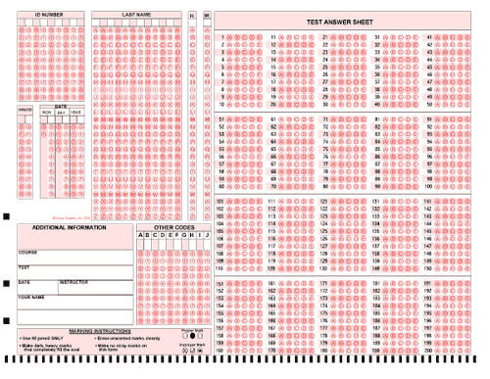
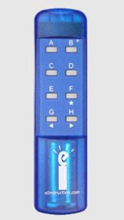

Slide 87
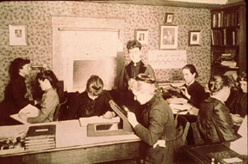
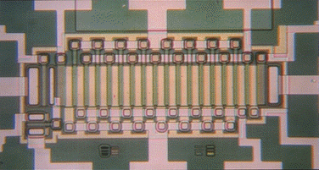

Slide 88
The Results from our Research to Validate the Effectiveness of Lecture-Tutorials: Using Clickers.
100
75
80%
Percent
Correct
50
62%
(pre: nA=132,nB=49)
(post: n=177)
25
25%
0
Pretest
Post-Lecture
Post-Lecture Tutorial
Clickers as Data Gathering Tools and Students’ Attitudes, Motivations, and Beliefs on Their Use in this Application, Prather, E. E., and Brissenden, G., Astronomy Education Review, 8(1), 2009.
Notes:
Note there is a higher percentage of correct answers when we used clickers.

Slide 89
CAE National Study
Almost 4000 students
31 institutions
36 instructors
69 different sections
  Section sizes vary from <10 to 180
  (now with sections >750!)

Slide 90
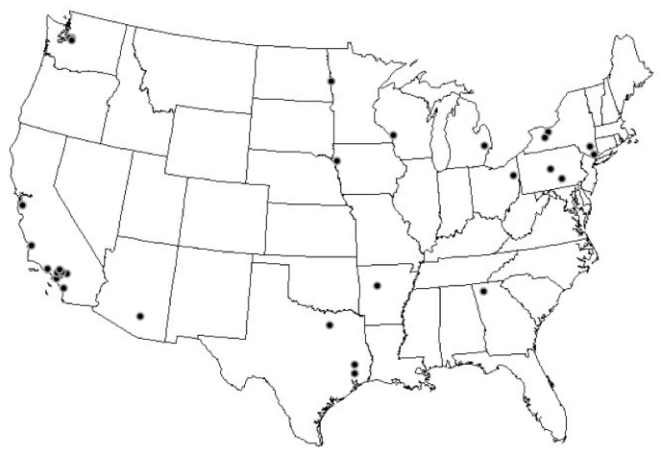
This was a truly national study

Slide 91
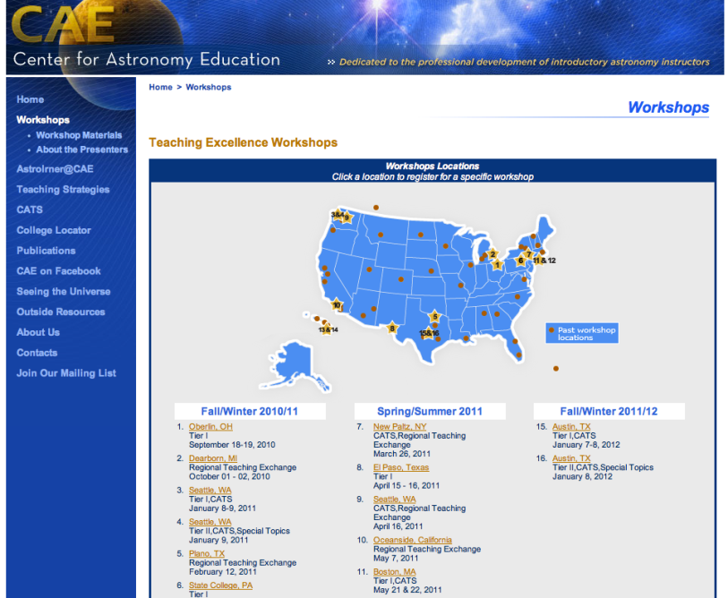
CAE National Professional Development Program

Slide 92
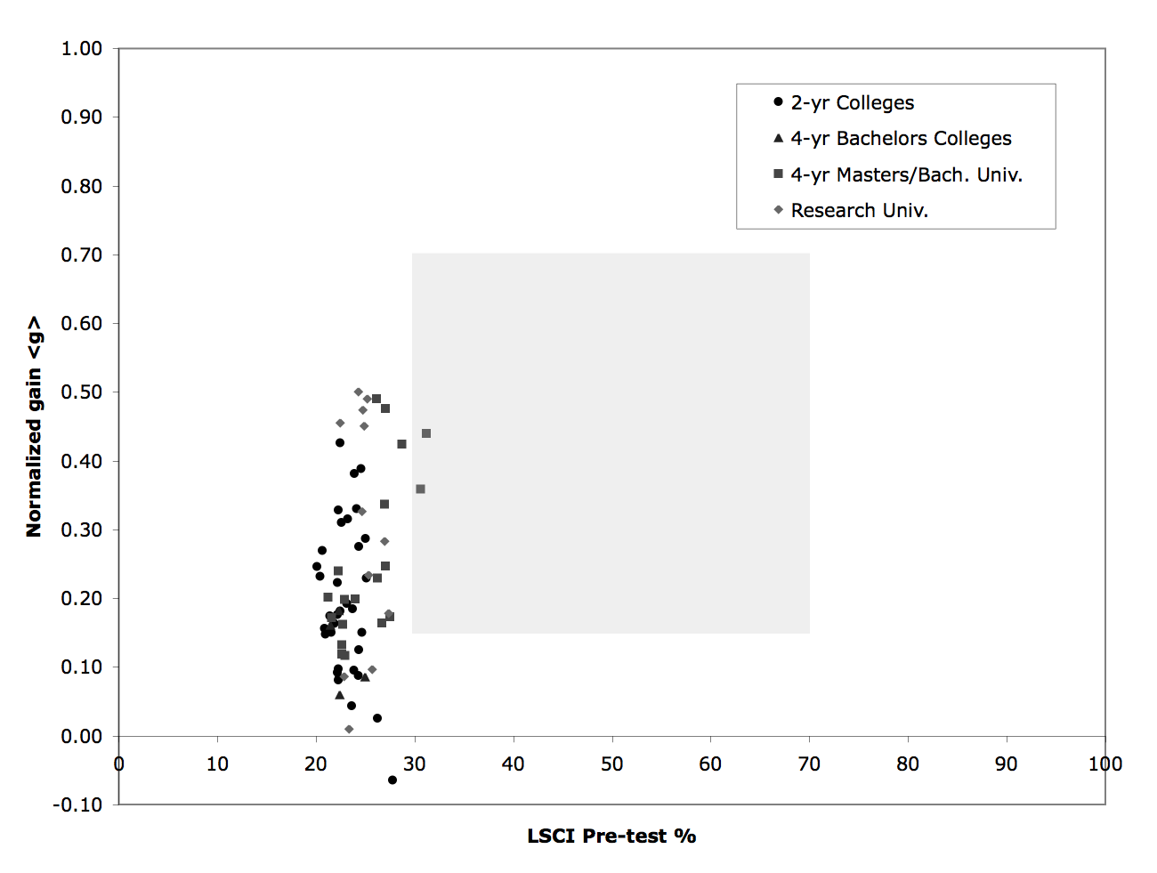

Slide 94
Instructor Surveys
To assess the level of interactivity in each classroom, we asked each instructor to fill out a survey detailing how they spent their class time
This survey was used to construct an “Interactivity Assessment Score” (IAS) based on what percentage of total class time is used for interactive activities

Slide 95
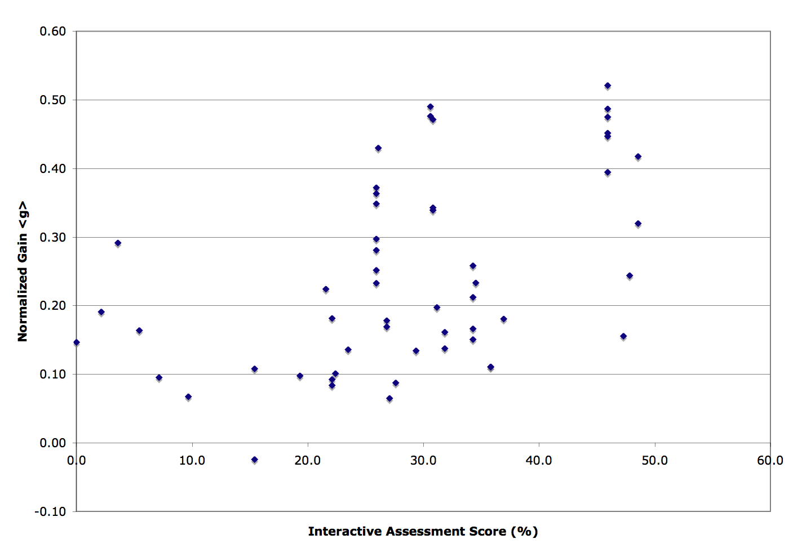

Slide 96
Medium level <g> > 0.30

Slide 97
Higher IAS (>25%)
<g>avg = 0.29
Lower IAS (<25%)
<g>avg = 0.13

Slide 98
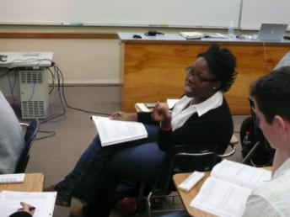
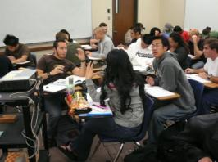
Demographic Survey
We also asked 15 demographic questions to allow us to determine how such factors as
  Gender
  Ethnicity
  English as a native language
  Parental education
  Overall GPA
  Major
  Number of prior science courses
  Level of mathematical preparation
interact with instructional context to influence student conceptual learning
This survey also gives us a snapshot of who is taking Astro 101 in the US

Slide 99
We conducted a full multivariate modeling analysis of our data
We confirm that the level of interactivity is the single most important variable in explaining the variation in gain, even after controlling for all other variables

Slide 101
The take home message Part I:
The results of our investigation reveal that the positive effects of interactive learning strategies apply equally to men and women, across ethnicities, for students with all levels of prior mathematical preparation and physical science course experience, independent of GPA, and regardless of primary language. These results powerfully illustrate that all categories of students can benefit from the effective implementation of interactive learning strategies.

Slide 102
The take home message Part II
Implementation is the most important factor to success in student learning.
More work on professional development of faculty is needed if we are to see wide spread adoption and proper implementation of research-validated instructional strategies.

Slide 103
Item Response Theory (IRT)

Slide 104
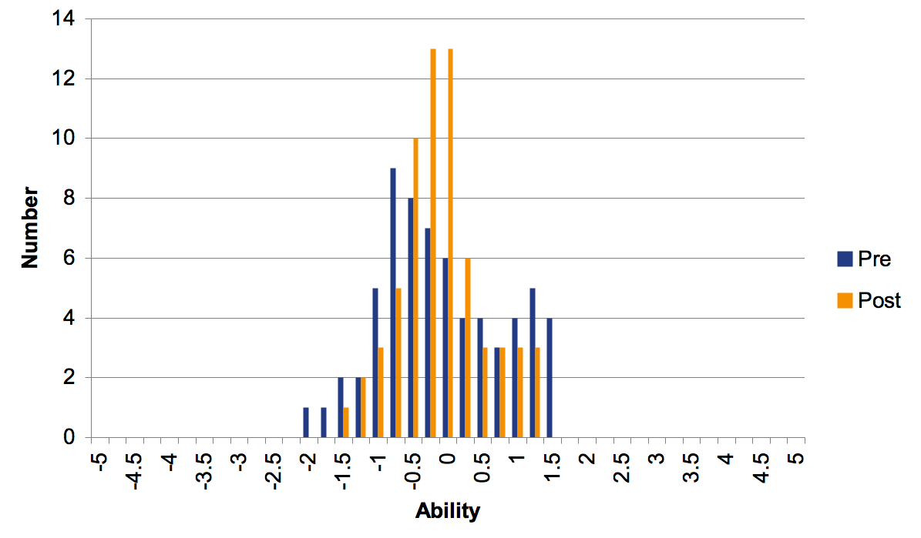
Single Course Ability Histogram

Slide 105
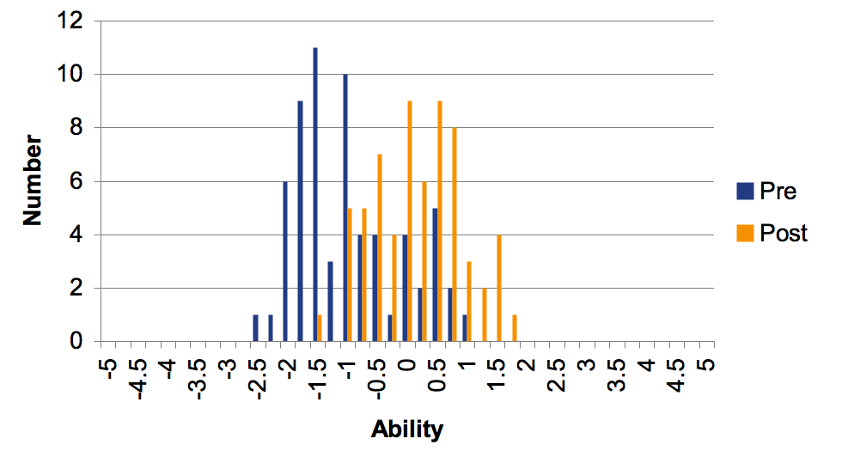
Single Course Ability Histogram

Slide 106
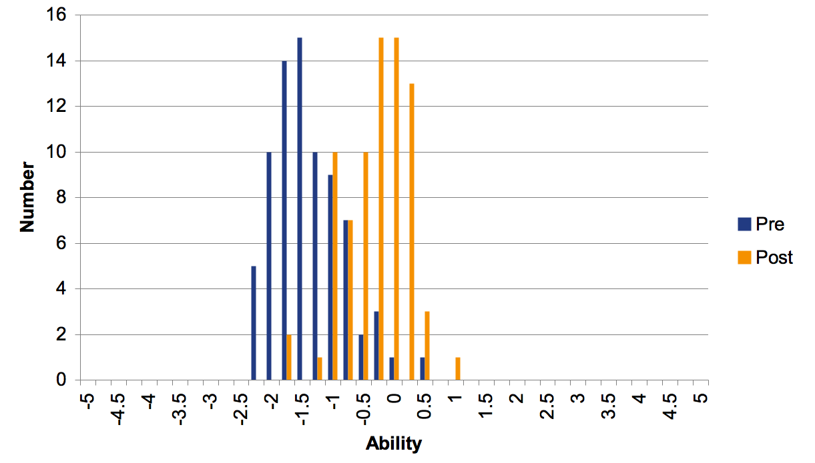
Single Course Ability Histogram

Slide 107
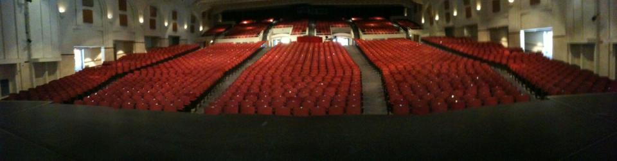
Centennial Hall Performing Arts Theater at University of Arizona

Slide 108
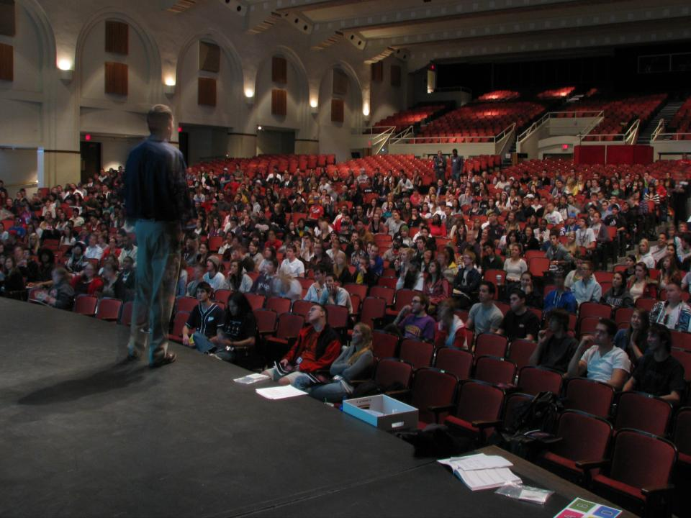

Slide 109

Techniques for all classes

Slide 110
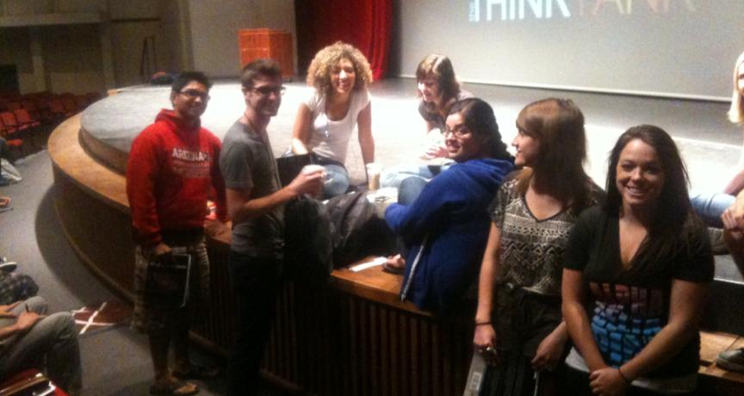
Ambassadors – of science in our society, our nations future leaders

Slide 111
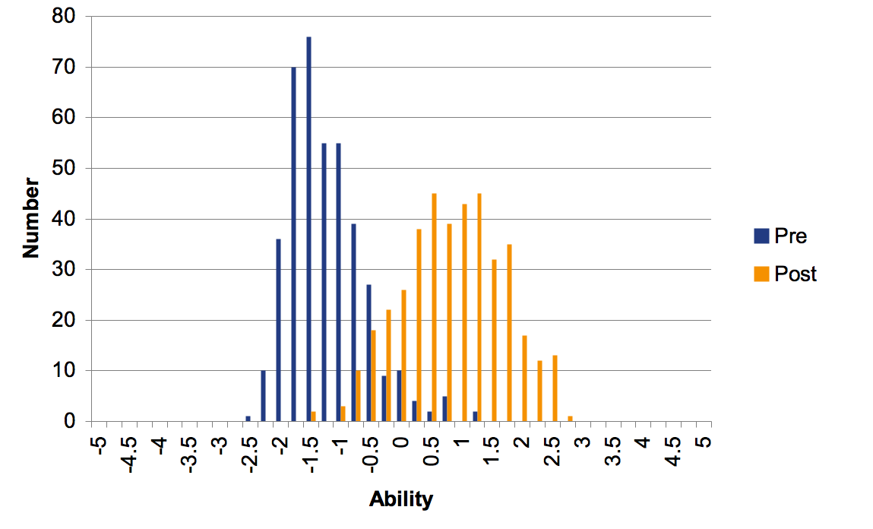
Mega Course Ability Histogram

