Slide 1
Think – Pair - Share
Dr. Edward Prather
University of Arizona
Center for Astronomy Education (CAE)
http://astronomy101.jpl.nasa.gov

Slide 2
Think-Pair-Share (TPS) aka Peer Instruction:
A questioning in the classroom technique that makes use of a combination of conceptually challenging multiple choice questions, and classroom feedback designed to increase student-to-student discourse and provide insight into students’ learning for you and them
Crouch, C. H. & Mazur, E. 2001, “Peer Instruction: Ten Years of Experience and Results,” American Journal of Physics, 69(9), 970, 2001
Development and Application of a Situated Apprenticeship Approach to Professional Development of Astronomy Instructors, Prather, E. E., and Brissenden, G. The Astronomy Education Review, 7(2), 2008
Clickers as Data Gathering Tools and Students’ Attitudes, Motivations, and Beliefs on Their Use in this Application, Prather, E. E., Brissenden, G., The Astronomy Education Review, 8 (1), 2009 .

Slide 3
Idealized (& shorthand) Implementation of Think-Pair-Share
Create a cognitively engaging multiple-choice question that challenges students thinking and has the ability to foster deep discussion amongst your students.
Present question to students.
Ask students to "think" individually about the question (and find the best answer)
Have students anonymously and simultaneously vote on their answer to the question.
Decide if students should "share” their answers with each other. Is so then…
Ask students to “pair” with someone next to them and to “share” their answers with each other with the goal of trying to convince their partner that their own answer is the correct one.
“Turn to your neighbor and convince them that you are right, just because you have the same answer that does NOT mean you are right, so be sure to explain your reasoning”
Again have students anonymously and simultaneously vote on their answer to the question.
Debrief the results and correct answer to your students.

Slide 4
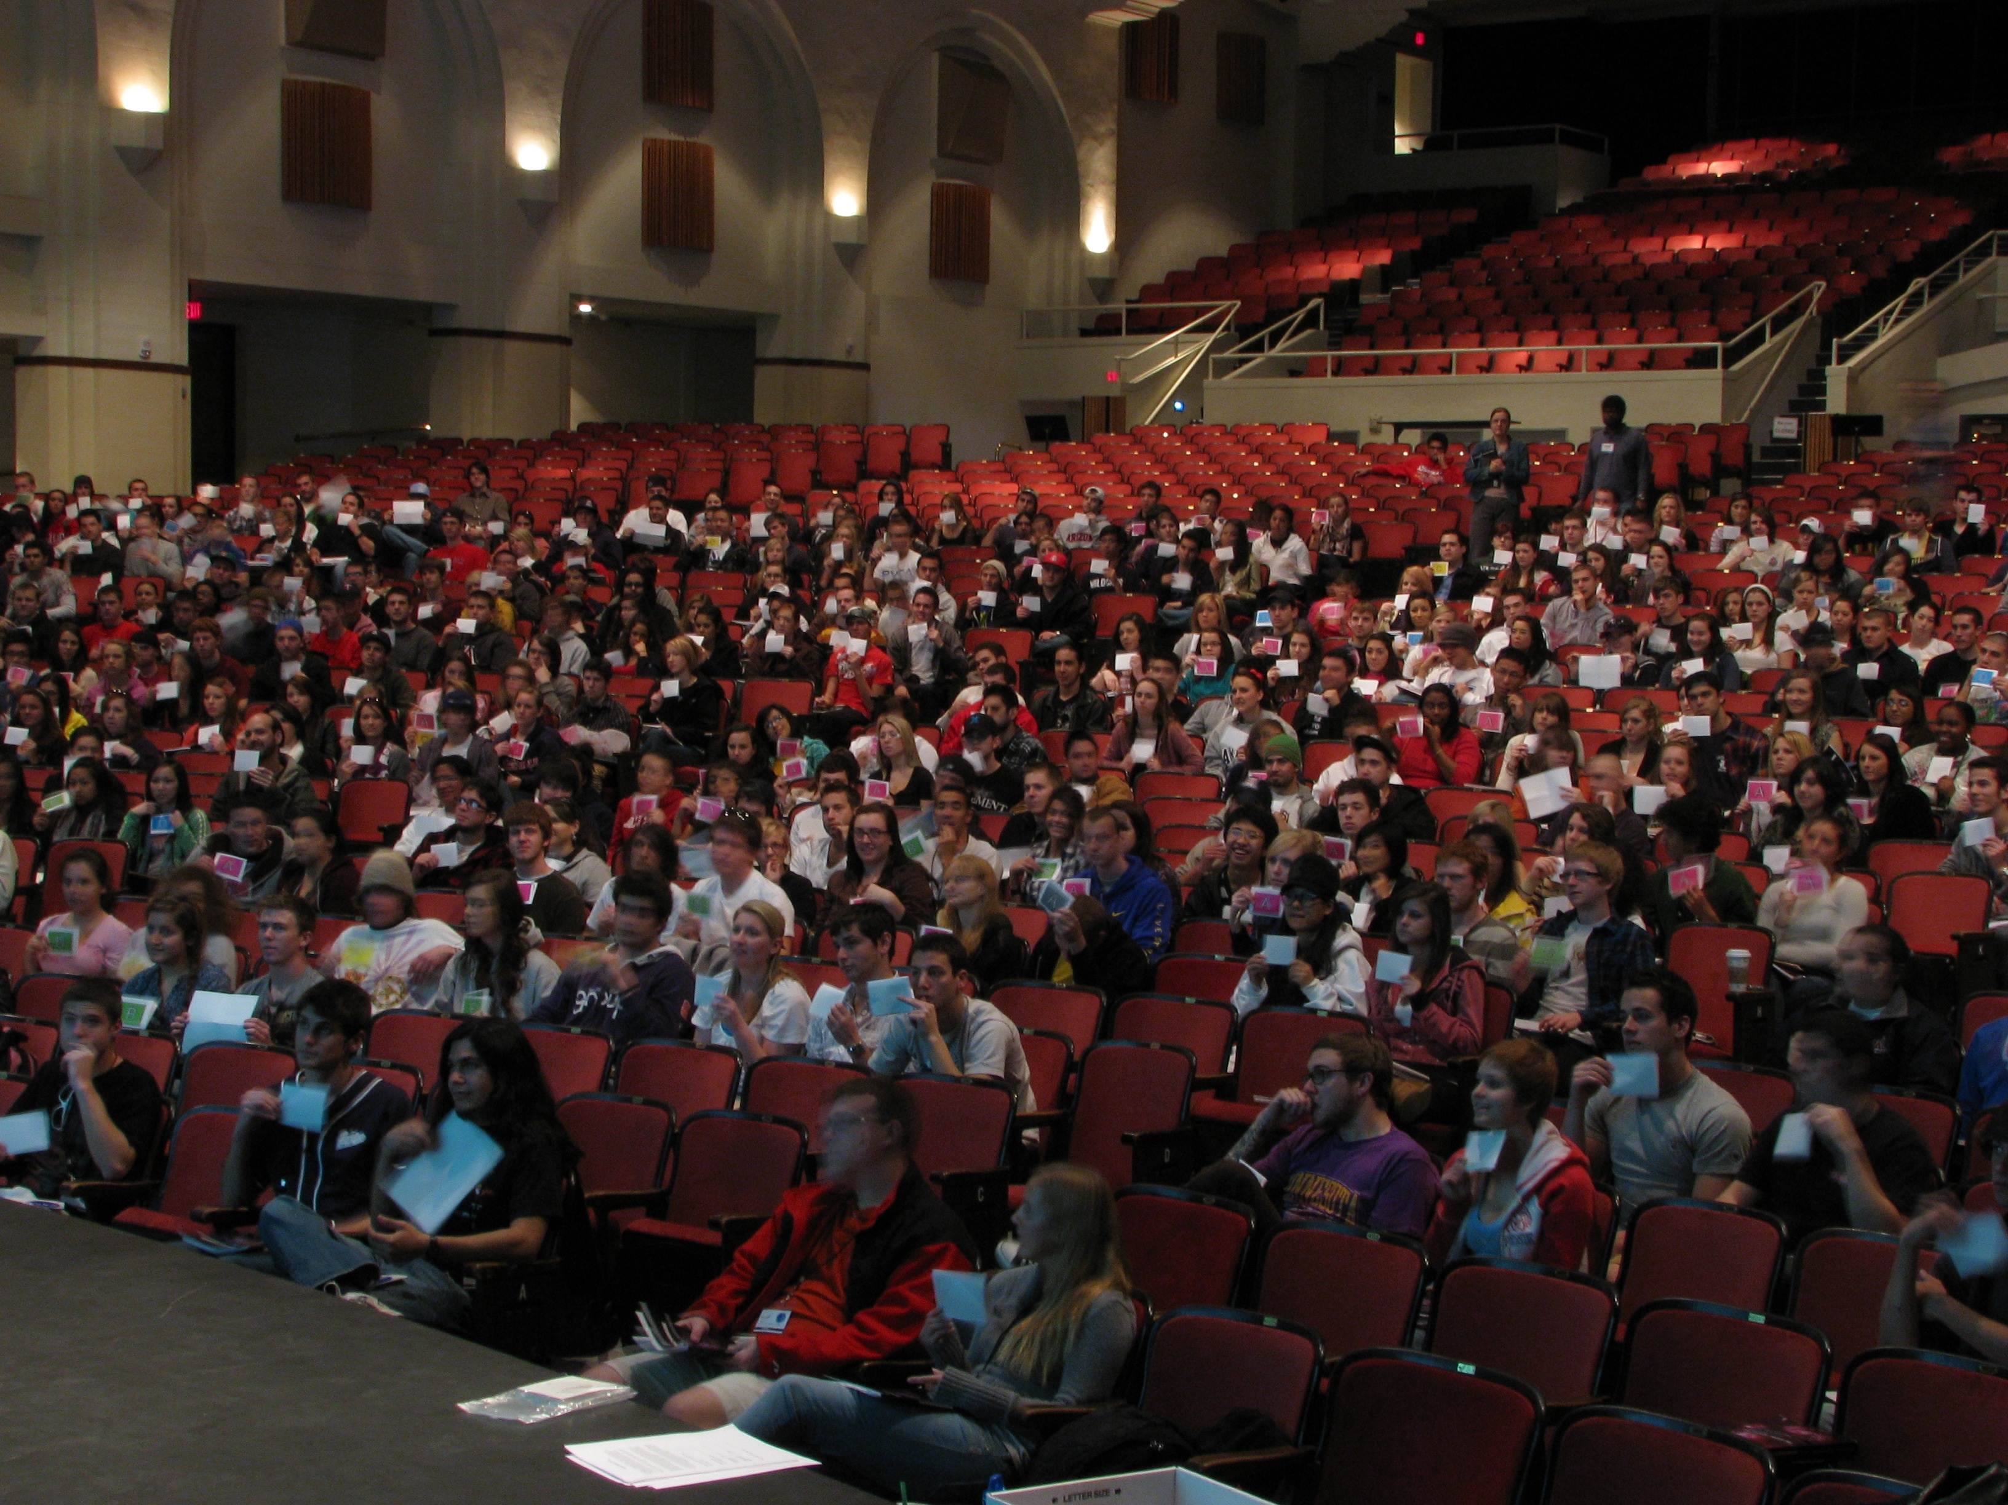
Techniques for all classes

Slide 5
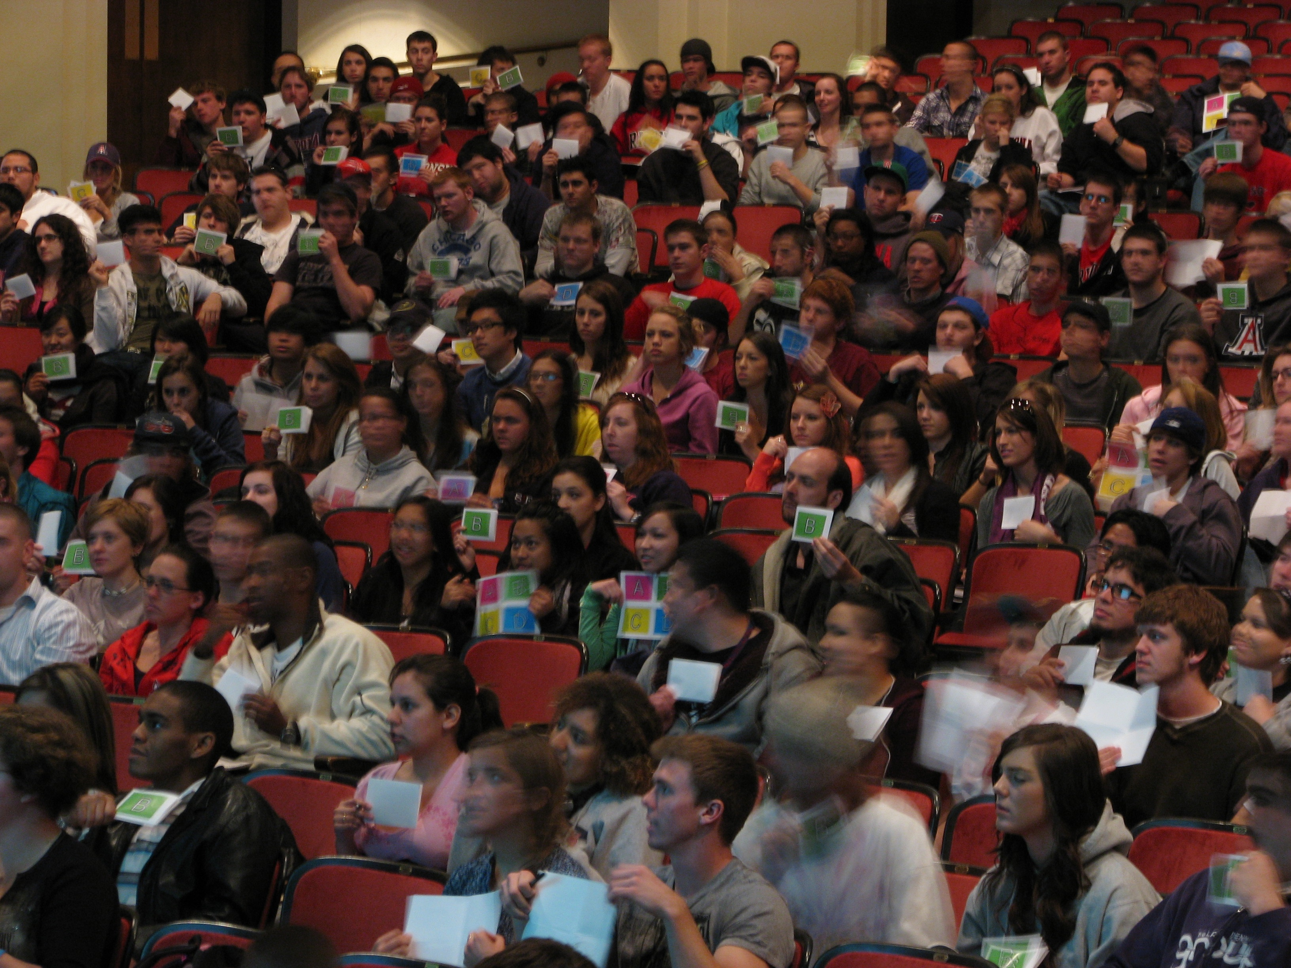

Slide 6
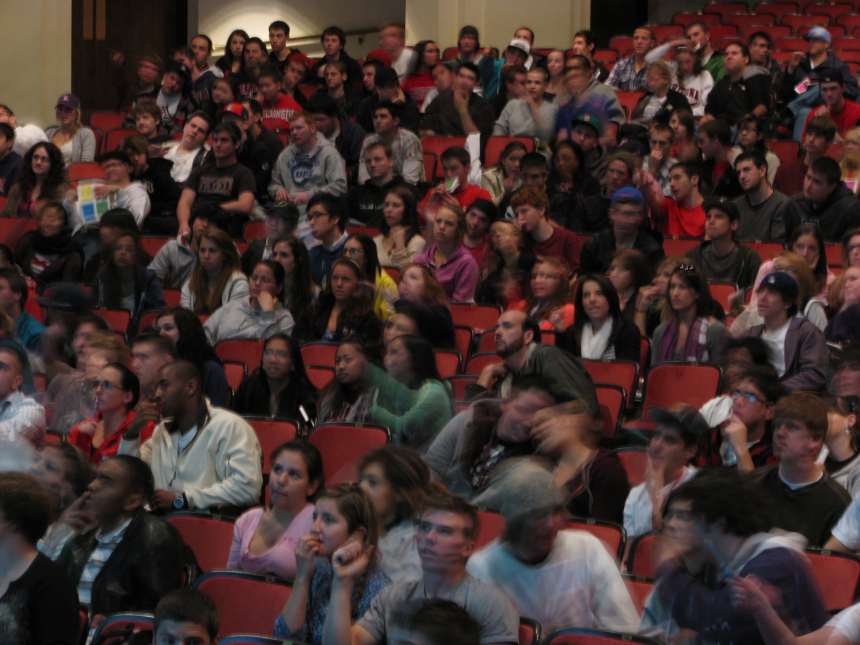

Slide 7
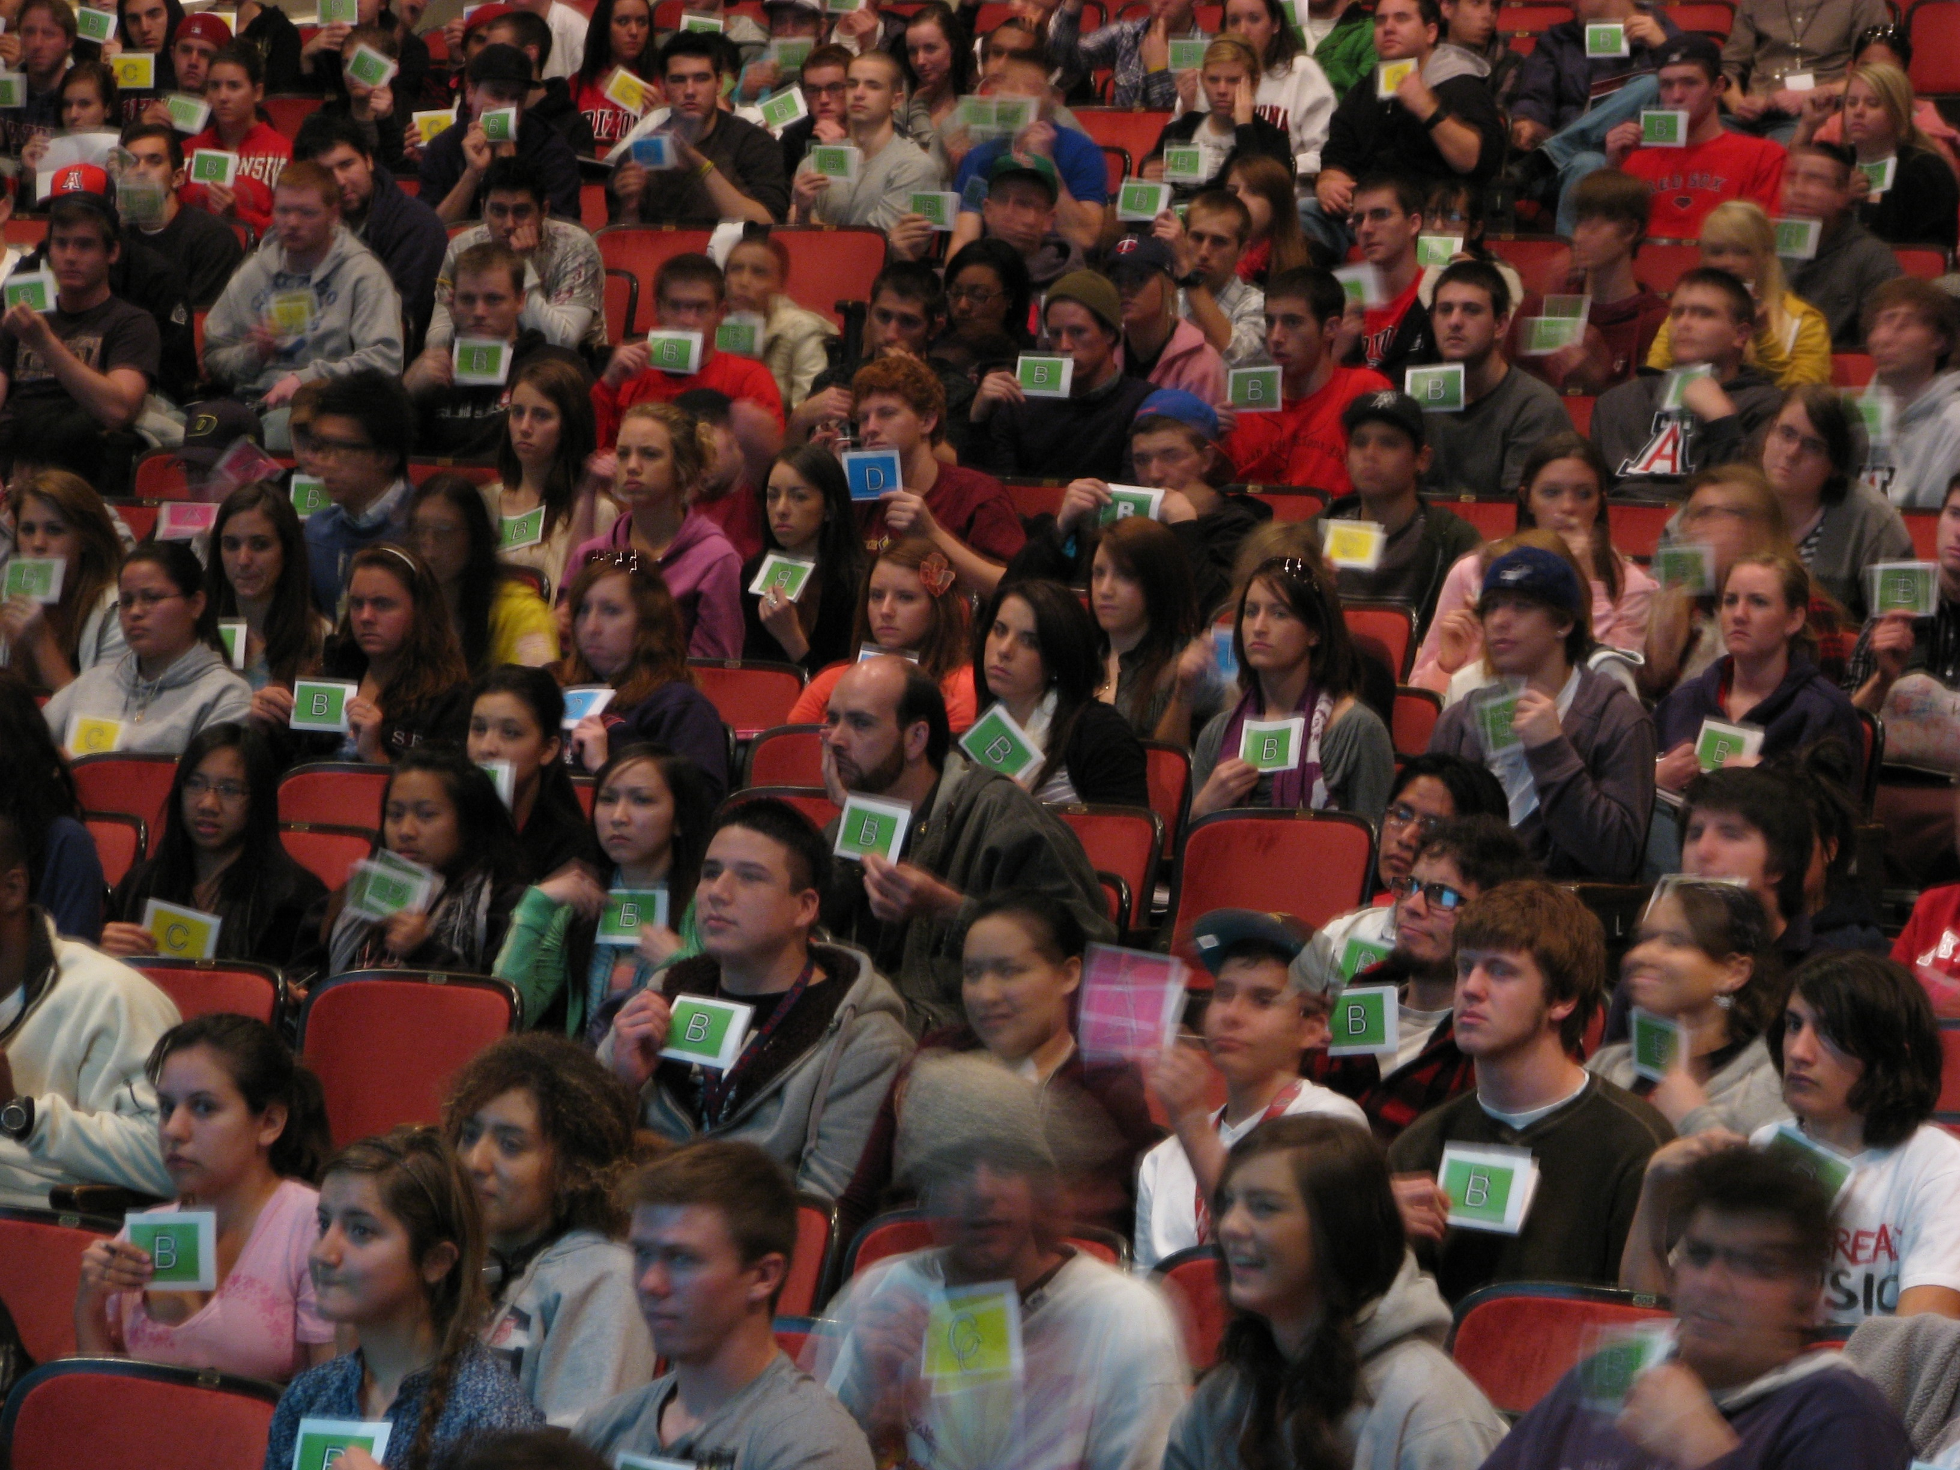

Slide 8
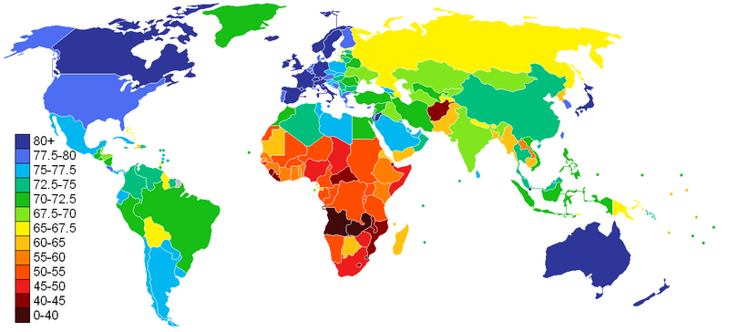
What does this chart represent?
Work with your partner and write a multiple choice question that would provoke a thoughtful discussion amongst students about this false color map?

Slide 9
Could any of the items listed below be represented
by this false color image?
Average household income
Infant mortality rate
Emission of Greenhouse gasses
Average life expectancy
Percent of citizenry with a college degree

Slide 10
Average household income
Infant mortality rate
Emission of Greenhouse gasses
Average life expectancy
Percent of citizenry with a college degree
How many of the listed items could be represented by this false color image?
Only one
Two
Three
Four
All are possible

Slide 11
CHART OF AVERAGE LIFE EXPECTANCY
Ranking the continents, from greatest to least “average” life expectancy.

Slide 12
CHART OF AVERAGE LIFE EXPECTANCY
Which of the following in the correct ranking of the continents, from greatest to least “average” life expectancy.
Australia, North America, Europe, South America, Asia, Africa
North America, Australia, Europe, South America, Asia, Africa
Africa, Asia, South America, Europe, North America, Australia
Europe, Australia, North America, South America, Asia, Africa
None of the above is correct

Slide 13
Idealized (& shorthand) Implementation of Think-Pair-Share
Create a cognitively engaging multiple-choice question that challenges students thinking and has the ability to foster deep discussion amongst your students.
Present question to students.
Ask students to "think" individually about the question (and find the best answer)
Have students anonymously and simultaneously vote on their answer to the question.
Decide if students should "share” their answers with each other. Is so then…
Ask students to “pair” with someone next to them and to “share” their answers with each other with the goal of trying to convince their partner that their own answer is the correct one.
“Turn to your neighbor and convince them that you are right, just because you have the same answer that does NOT mean you are right, so be sure to explain your reasoning”
Again have students anonymously and simultaneously vote on their answer to the question.
Debrief the results and correct answer to your students.

Slide 14
Before
After
v_{A,f}
A
1
2
v_{A,i}
v_{B,f}
1
2
B
v_{A,i}
v_{A,f}
v_{B,f}
1
2
1
2
v_{A,i}
C
2
v_{A+B,f}
1
1
2

Slide 15

Which of the following is the best ranking (from greatest to least), for the gravitational force exerted on asteroids 1, 2 and 3 by their partner asteroids?
1
d = 1
m = 3
3>2>1
3=2>1
3>2=1
1=2>3
3=1>2
m = 5
2
d = 1
m = 3
m = 5
3
d = 1
m = 5
m = 5

Slide 16
How many of the Earth locations marked with an “X” would be experiencing Winter?
Only one
Two
Three
Four
All Five
Sunlight
X
X
X
X
X

Slide 17
How many of the locations (A-F) would be experiencing Winter?
only one
two
three
four
all the positions
are experiencing
Summer.

Slide 18
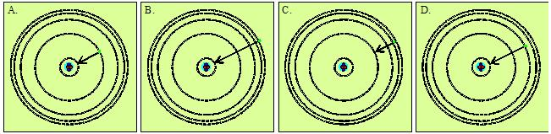
Which atom has absorbed light with the shortest wavelength?
E. None of the above

Slide 19
Which atom will emit light with the longest wavelength?
E. None of the above

Slide 20
Which of these atoms:
A
B
e-
e-
e-
C
D
E
e-
e-
e-

Slide 21
Earth
A
Orbit of star
+20
Radial Velocity
D
B
Time
-20
Orbit of planet
C
Given the location marked with the orange dot on the star's radial velocity curve, at what location (A-D) would you expect to find the planet?

Slide 22
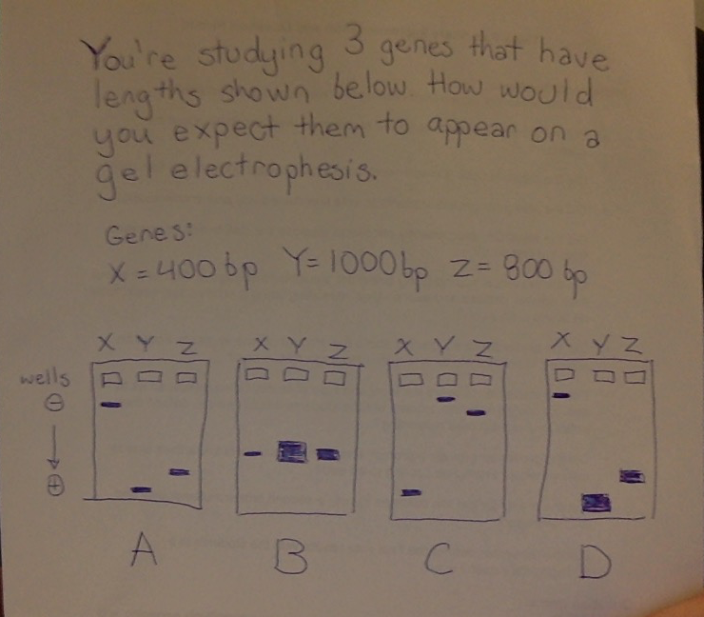

Slide 23

Your friend is interested in whether gluten causes weight gain in rats. He measured gluten metabolites in 3 randomly selected rats and their weights. The heaviest rats had the most metabolites, so he concludes gluten caused weight gain.
How many of the topics below could you use to convince him he needs more evidence?
Sample size
Correlation vs. causation
Temporality
Sampling bias
0
1
2
3
4

Slide 24



The following represent samples from a population of moths before and after the industrial revolution. Which scenario is most likely?
A
B
C
D

Slide 25
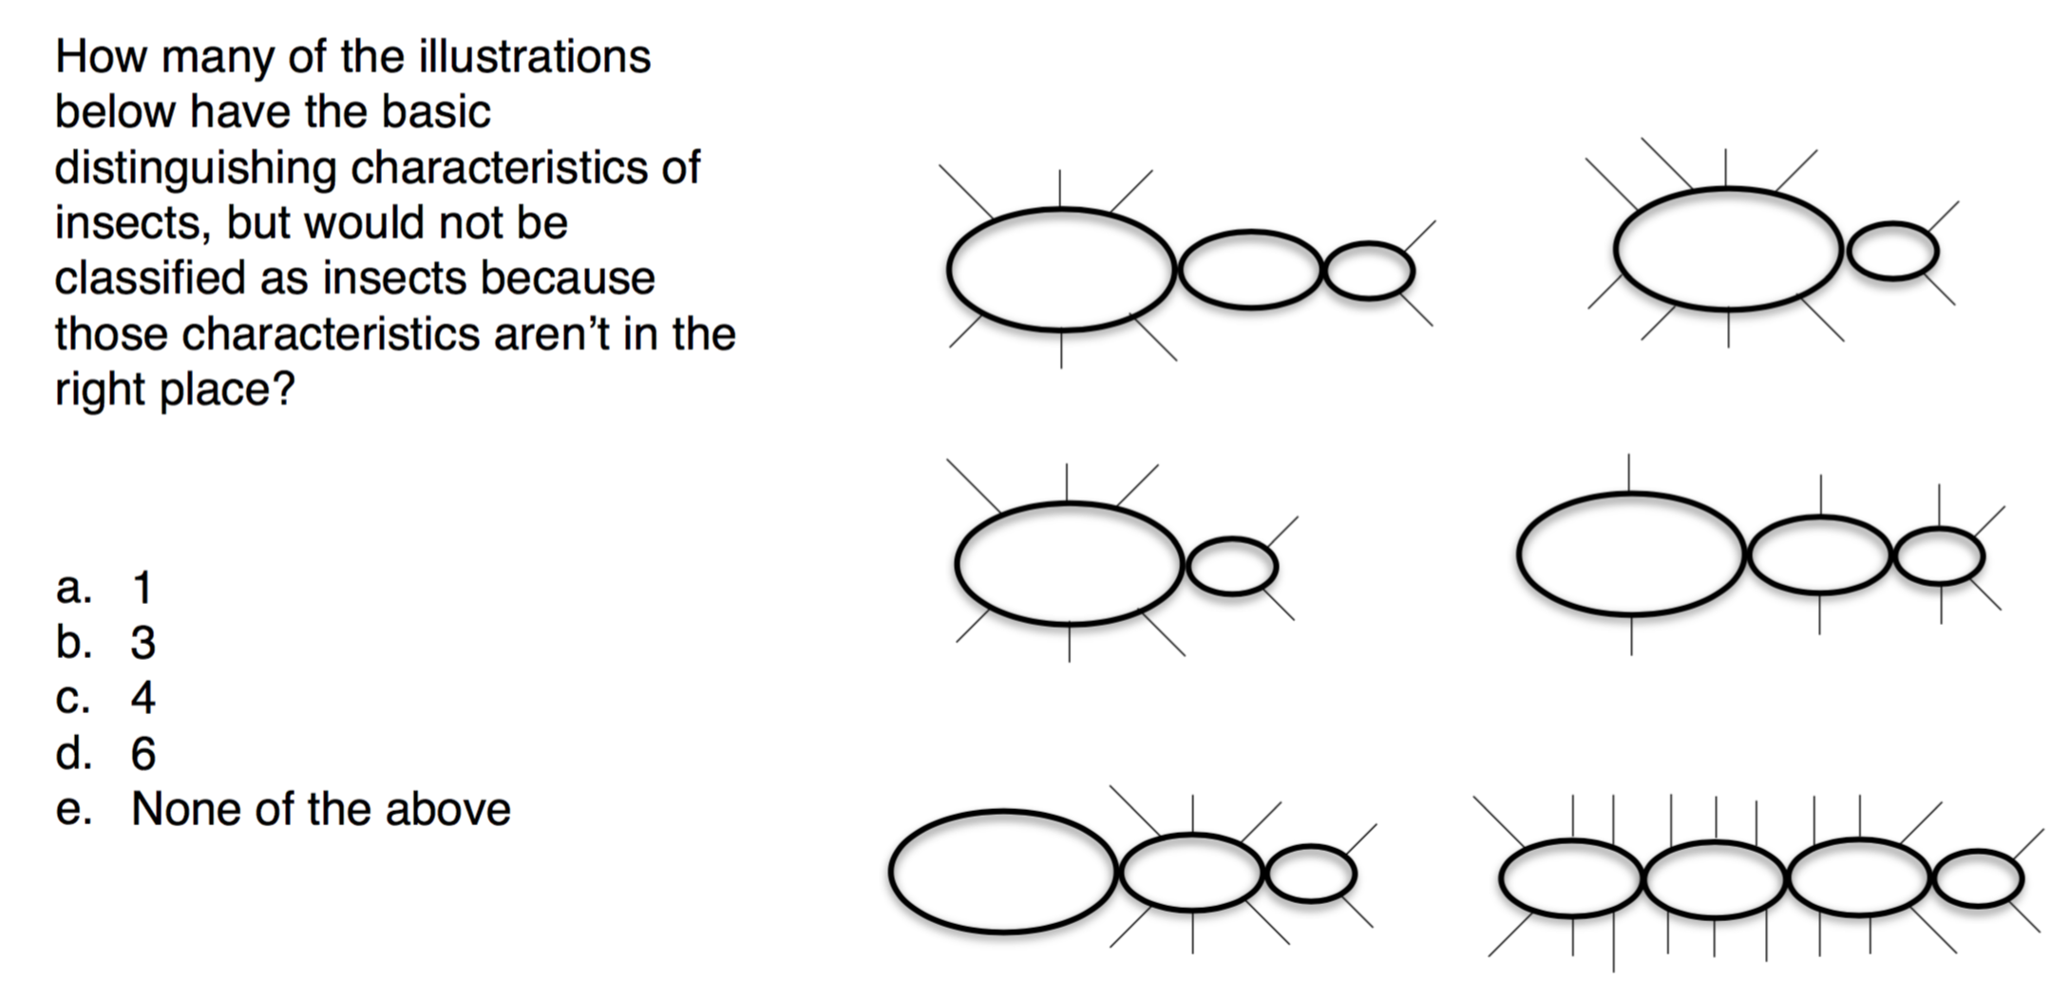

Slide 26
