Slide 1
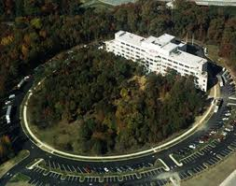
Active Learning with
Interactive Lecture Demonstrations and RealTime Physics labs
New Faculty Workshop
June 23, 2015
David Sokoloff, University of Oregon
Ronald Thornton, Tufts University

Slide 2
Being from the University of Oregon and a native born Oregonian since 1978 I am required to say . . .

Slide 3
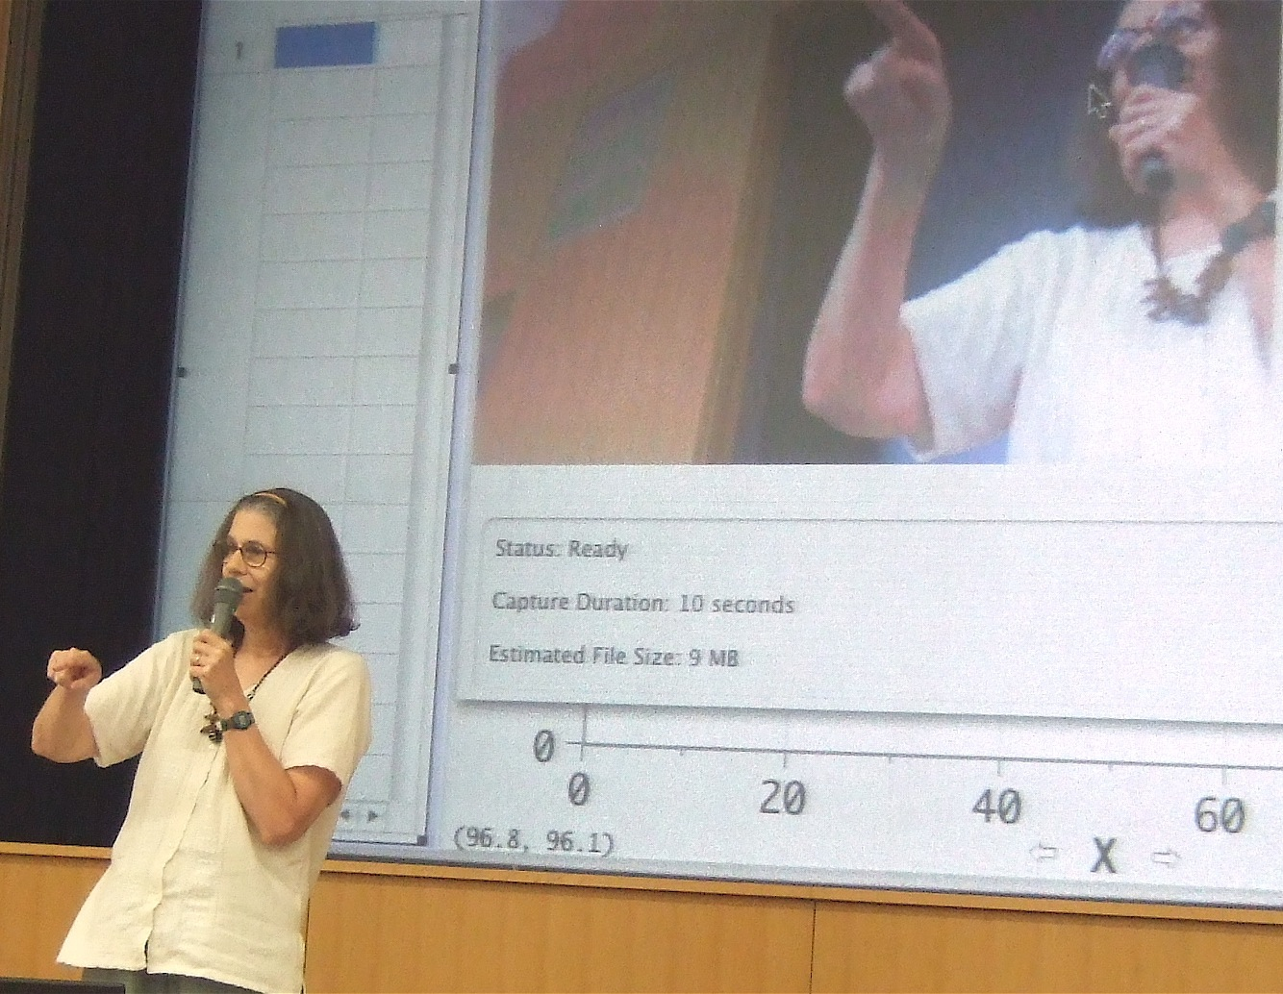

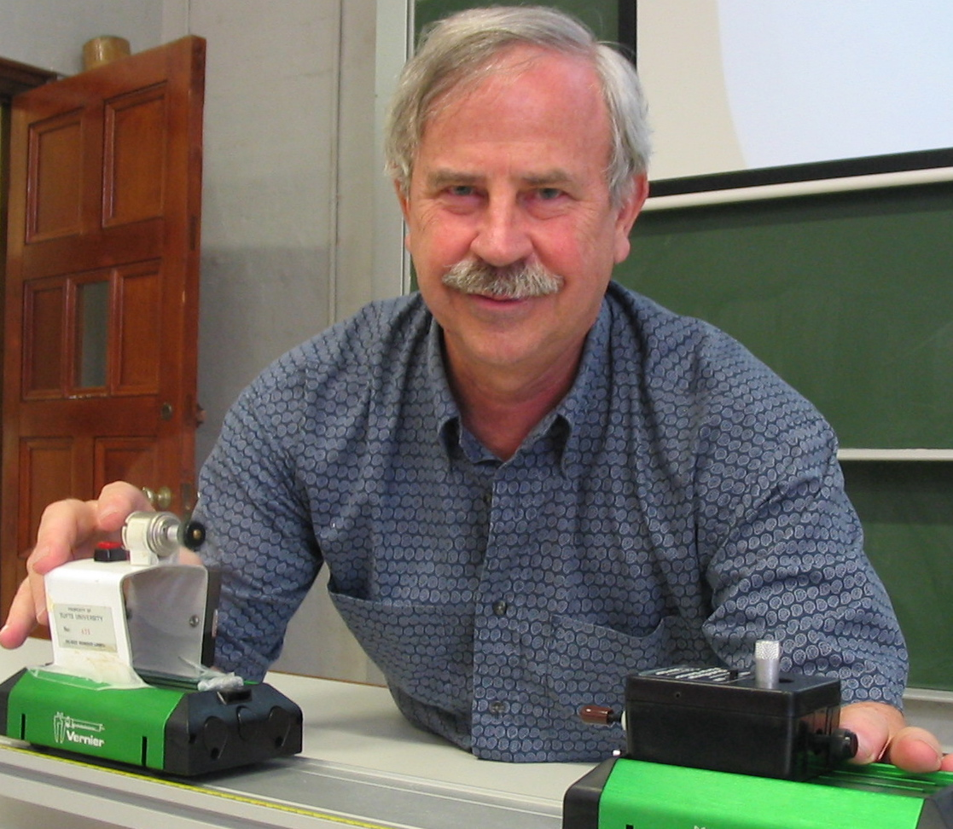
Priscilla Laws
Dickinson College
29 years of physics education research, development and dissemination.
Winner of the 2010 APS Excellence in Physics Education Award
Ronald Thornton
Tufts University
David Sokoloff University of Oregon

Slide 4


U.S. Department of Education
FUND FOR THE IMPROVEMENT OF
POST-SECONDARY EDUCATION (FIPSE)
Thank you to:

Slide 5
The Problem
    Students come into the introductory physics course at the high school or college level with definite views (often wrong) about physics concepts based on their experiences.
    Physics education research shows that the vast majority of students will leave a traditional introductory physics course with the same (incorrect) views, and little understanding of physics concepts.
    Research done in many forms (student interviews, open-ended questions, short-answer questions, well-designed multiple choice questions) reaches the same conclusion.
    Result appears to be consistent for traditional methods of instruction, regardless of the skill of the instructor.

Slide 6

How can they
possibly not learn from my perfectly logical, sublimely entertaining lectures!?

Slide 7
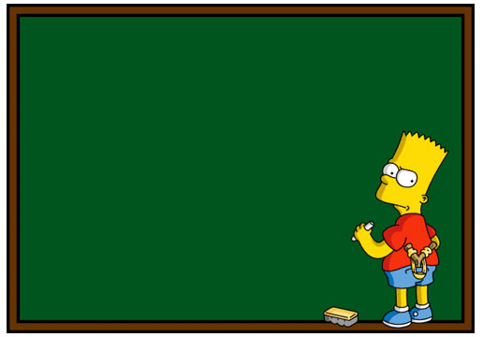
I will not learn concepts in physics class
I will not learn concepts in physics class
I will not learn concepts in physics class
I will not learn concepts in physics class
I will not learn concepts in physics class
I will not learn concepts in physics class

Slide 8
The Force and Motion Conceptual Evaluation (FMCE)-Research Based Alternative to the FCI
Described in detail in the papers in the additional readings section for this session, on your flash drive.
Uses multiple choice questions based on previous research using open-ended assessments and interviews.
Questions asked in a number of different forms and contexts.
Makes possible tracking of student progress and persistence of learning for varied student populations from a variety of institutions.
.

Slide 9
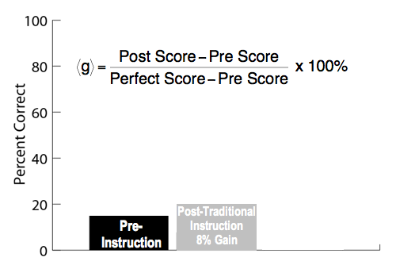

Slide 11

“Underachiever . . .
and proud of it, man!”

Slide 12
The Proposed Solution . . .
Active Learning environments
complementing but not replacing more quantitative work.

Slide 13
Active Learning in the Laboratory:
RealTime Physics labs
You will work on an example in the breakout sessions.

Slide 14
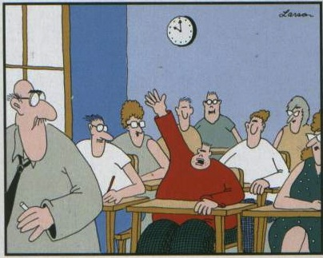
“Prof. Sokoloff, may I be excused?
My brain is full!”
But most students spend the majority of their time in a lecture, often a large one!

Slide 15
Can an active learning environment be created in a large (or small) lecture?
Yes, through the use of Interactive Lecture Demonstrations (ILDs)

Slide 16
Example of
ILDs in Mechanics
  You will be our introductory physics class for the next 15 minutes or so.
  We will show you demonstrations and ask you to make predictions on a Prediction Sheet, found in your folder. Note that predictions are never graded, but you will receive 1 point out of the 100 points for this class for participating today.
  Then we will ask you to discuss your predictions with your nearest neighbor(s), and see if your small group can reach a consensus on the prediction.
  Finally, we will do the demonstrations with the results displayed. We will ask for volunteers to discuss what you observe with the whole group.

Slide 17
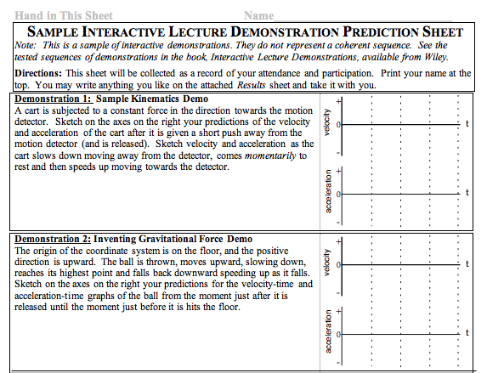
Find this ILD Prediction Sheet in your packet:

Slide 19
Interactive Lecture Demonstrations (ILDs)
    Describe the demonstration and do it for the class without results displayed.
    2. Ask students to record individual predictions on the Prediction Sheet.
    3. Have the class engage in small group discussions.
    Elicit common student predictions from the whole class.
    Students record final prediction on the Prediction Sheet (which will be collected).
    6. Carry out the demonstration and display the results.
    7. Ask a few students to describe the results and discuss them in the context of the demonstration. Students may fill out the Results Sheet.
    8. If appropriate, discuss analogous physical situations with different "surface" features..
This procedure is followed for each of the short lecture demonstrations in each ILD sequence.

Slide 20
What does an ILD look like in a large lecture class?

Slide 21

Demonstration 3: The cart has equal and opposite forces acting on it. The frictional force is very small and can be ignored. The cart is given a quick push away from the motion detector and released. Sketch on the axes your predictions of the velocity and acceleration of the cart after it is released.
Tufts Physics 1, algebra-trig. based physics (approximately 170 students) Fall 98

Slide 22
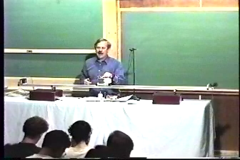

Slide 23
Passive vs. Active Learning Environments
Passive Learning | Active Learning
Instructor’s role is authority. | The physical world is the authority. Instructor’s role is guide.
Students' naïve beliefs not challenged. | Learning cycle: prediction/ observation/comparison. Challenges students’ beliefs.
Collaboration with peers often discouraged. | Collaboration and shared learning with peers is encouraged.
Experimental results are often presented as facts in lecture. | Results from real experiments are observed in understandable ways—often in real time with microcomputer-based tools.
Laboratory work, if any, is used to confirm theories "learned" in lecture. | Laboratory work is used to learn basic concepts.

Slide 24
Passive vs. Active Learning Environments
Passive Learning | Active Learning
Instructor’s role is authority. | The physical world is the authority. Instructor’s role is guide.
Students' naïve beliefs not challenged. | Learning cycle: prediction/ observation/comparison. Challenges students’ beliefs.
Collaboration with peers often discouraged. | Collaboration and shared learning with peers is encouraged.
Experimental results are often presented as facts in lecture. | Results from real experiments are observed in understandable ways—often in real time with microcomputer-based tools.
Laboratory work, if any, is used to confirm theories "learned" in lecture. | Laboratory work is used to learn basic concepts.

Slide 25
Passive vs. Active Learning Environments
Passive Learning | Active Learning
Instructor’s role is authority. | The physical world is the authority. Instructor’s role is guide.
Students' naïve beliefs not challenged. | Learning cycle: prediction/ observation/comparison. Challenges students’ beliefs.
Collaboration with peers often discouraged. | Collaboration and shared learning with peers is encouraged.
Experimental results are often presented as facts in lecture. | Results from real experiments are observed in understandable ways—often in real time with microcomputer-based tools.
Laboratory work, if any, is used to confirm theories "learned" in lecture. | Laboratory work is used to learn basic concepts.

Slide 26
Passive vs. Active Learning Environments
Passive Learning | Active Learning
Instructor’s role is authority. | The physical world is the authority. Instructor’s role is guide.
Students' naïve beliefs not challenged. | Learning cycle: prediction/ observation/comparison. Challenges students’ beliefs.
Collaboration with peers often discouraged. | Collaboration and shared learning with peers is encouraged.
Experimental results are often presented as facts in lecture. | Results from real experiments are observed in understandable ways—often in real time with microcomputer-based tools.
Laboratory work, if any, is used to confirm theories "learned" in lecture. | Laboratory work is used to learn basic concepts.

Slide 27
Passive vs. Active Learning Environments
Passive Learning | Active Learning
Instructor’s role is authority. | The physical world is the authority. Instructor’s role is guide.
Students' naïve beliefs not challenged. | Learning cycle: prediction/ observation/comparison. Challenges students’ beliefs.
Collaboration with peers often discouraged. | Collaboration and shared learning with peers is encouraged.
Experimental results are often presented as facts in lecture. | Results from real experiments are observed in understandable ways—often in real time with computer-based tools.
Laboratory work, if any, is used to confirm theories "learned" in lecture. | Laboratory work is used to learn basic concepts.

Slide 28
Passive vs. Active Learning Environments
Passive Learning | Active Learning
Instructor’s role is authority. | The physical world is the authority. Instructor’s role is guide.
Students' naïve beliefs not challenged. | Learning cycle: prediction/ observation/comparison. Challenges students’ beliefs.
Collaboration with peers often discouraged. | Collaboration and shared learning with peers is encouraged.
Experimental results are often presented as facts in lecture. | Results from real experiments are observed in understandable ways—often in real time with computer-based tools.
Laboratory work, if any, is used to confirm theories "learned" in lecture. | Laboratory work is used to learn basic concepts.

Slide 29
Some confuse “active learning” and “hands-on”
Active learning requires much, much more than hands-on!
Examples:
Doing the most fun, exciting and compelling lab experiment (or lecture demonstration) is hands-on, but is not active learning if the students are not engaged by predictions and discussion.
Eric Mazur’s Peer Learning usually involves no hands-on, yet it is active learning.
Hands-on/Minds-on is more accurate.

Slide 30
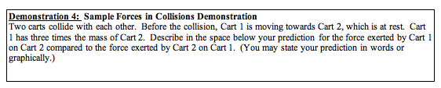
Another Mechanics ILD Example

Slide 31
Example of
ILDs on RC Circuits
  Then I will

Slide 32
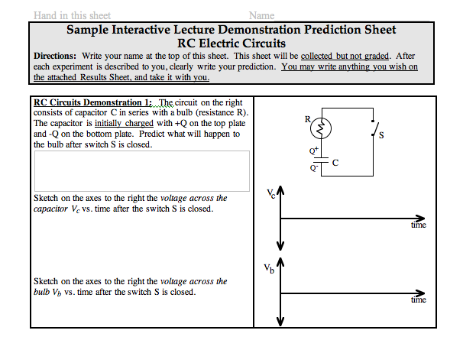
Note: The sheets I’ve given you would never be used in class. Real ILDs are sequenced sets of demonstrations.

Slide 34
Do students learn concepts from ILDs?

Slide 35
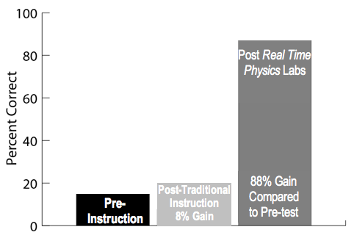
FMCE Results
Post ILDs
74% Gain

Slide 36
FMCE Normalized Gains at Some Other Institutions

Slide 37
Characteristics of the Curricula that Make Them Effective
Making predictions requires students to consider their beliefs before making observations of the physical world. The ILDs build upon the knowledge that students bring into the course.
With ILDs, the process of prediction, defending the prediction in a small group, and writing down the prediction engages students. They want to know the result of the demonstration.
The disequilibrium set up by the difference between prediction and observation inspires effective learning opportunities.
Student knowledge is constructed from observations of the physical world, thus building students’ confidence as scientists.
Conclusion from recent research of Mazur’s Physics Education Research (PER) group: “if you don’t have students make a prediction before doing a demonstration, the majority can’t even describe the outcome of the demonstration correctly.”

Slide 38
Choosing ILD Experiments
  Simple, single concept experiments that build on each other.
  Students must trust the apparatus and the results.
  Many of our most treasured lecture demonstrations are too complex for much learning to result. They could be broken down into smaller pieces, and presented as ILDs.

Slide 39
Modes of ILD Use
  Introduction of concepts.
  Review or clarification of concepts.
  In place of or in conjunction with lab activities.

Slide 40
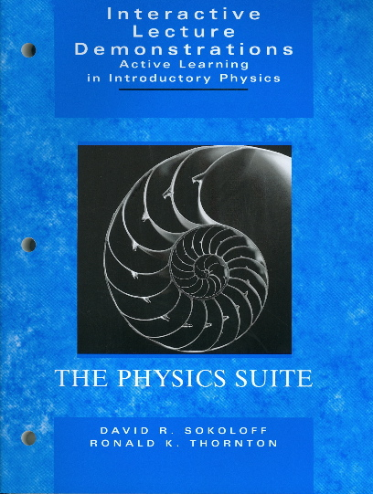
Contains everything you need to do ILDs on 28 different topics:
Student Prediction and Results Sheets which can be copied for students
Instructor’s Guide for each set of ILDs
Teacher Preparation Notes
8-Step Process . . .
suitable for framing
Free from your Wiley rep.

Slide 41
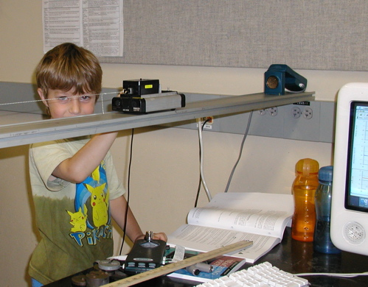
End
In the Small Group Sessions you will do an activity from RealTime Physics: Active Learning Labs, and have an opportunity to ask questions.

Slide 42
Active Learning Workshops:
June 18-20: 2.5 day course, Portland, OR
July 26: AAPT College Park, ½ day workshop
January, 2016: AAPT New Orleans, ½ day
June, 2016: 2.5 day course, East Coast?

Slide 43
Active Learning with
Interactive Lecture Demonstrations and RealTime Physics labs
New Faculty Workshop
June 23, 2015
Small group breakout session

Slide 44
Activity Based Physics Suite
Published by John Wiley & Sons
RealTime Physics Laboratories (RTP) (3rd Edition in January)
Interactive Lecture Demonstrations (ILDs)
Workshop Physics (WP)
University of Maryland Tutorials (UMD-TUT)
Explorations in Physics (EiP)
Understanding Physics (UP) (2nd Edition of text being written)
Physics with Video Analysis (Published by Vernier Software)

Slide 45
Active learning materials with the same design principles for the various parts of the course: lecture, lab, recitation . . .
Many examples of how to do this on Redish’s book.
Philosophy of the Physics Suite:
you combine them in the way that fits your institution and students.

Slide 46
RealTime Physics: Active Learning Labs
A series of lab modules that use computer-based tools to help students develop important physics concepts while acquiring vital laboratory skills. Besides using computer sensors, computers are used for basic mathematical modeling, data analysis and some simulations. RTP labs use the learning cycle of prediction, observation and comparison, and have been demonstrated to enhance student learning of physics concepts.

Slide 47
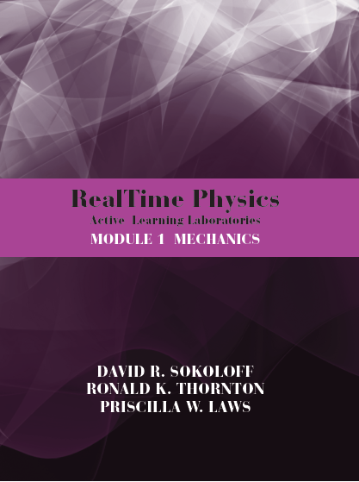
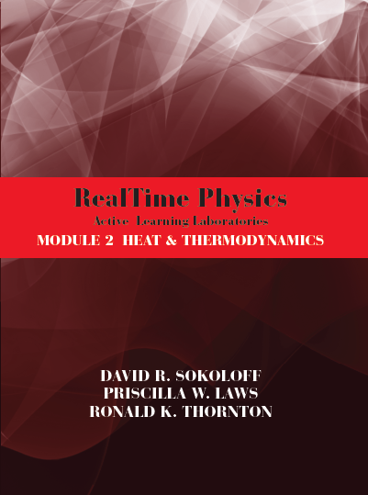
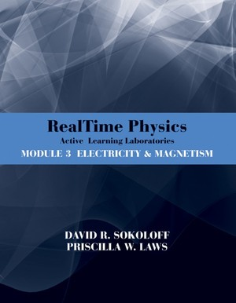
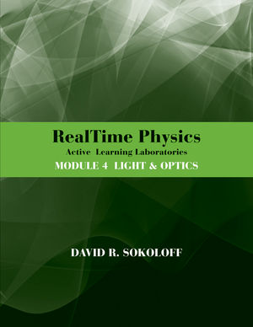
    There are four RTP modules published by Wiley
    Module 1: Mechanics
    Module 2: Heat and Thermodynamics
    Module 3: Electricity and Magnetism
    Module 4: Light and Optics

Slide 48
3rd Edition!
Module 3 now Electricity and Magnetism (rather than just electric circuits).
Use of interactive video analysis in several new labs.

Slide 49
    Characteristics of
    RealTime Physics Labs
    Guide students to construct physical models based on observations of the physical world.
    Labs are sequenced, and build upon previous knowledge. Students learn the essential concepts in an area of physics.
    Fit within the traditional structure of the introductory course.
    Include pre-lab preparation sheets and homework designed to reinforce concepts and skills.
    Are compatible with most computer data acquisition systems.
    Instructor’s Guide for each module available from Wiley.

Slide 50
Example of Low-Tech
RTP Activity on Image Formation
    Research evidence shows that students don't understand that an infinite number of rays emanate from each point on an object, and that for a perfect lens, all rays from a single point on an object that are incident on the lens will be focused to the same point on the image.
    In this activity, two miniature light bulbs are used as two discrete object point sources of light.
    A cylindrical lens is used to visualize in 2 dimensions.

Slide 52
Do students learn concepts from the
RealTime Physics
Image Formation activities?

Slide 53
Image Formation Questions from the
Light and Optics Conceptual Evaluation
Questions 1-6 refer to the picture on the right. A stamp is placed to the left of the lens, and its image is formed on a screen to the right of the lens, as shown.
Choose the correct answer for each question.

Slide 54
Image Formation Questions from the
Light and Optics Conceptual Evaluation
Questions 1-6 refer to the picture on the right. A stamp is placed to the left of the lens, and its image is formed on a screen to the right of the lens, as shown.
Choose the correct answer for each question.
Questions ask what will happen to the image if changes are made, e.g., block half the lens, block half the object, remove the lens . . .

Slide 56
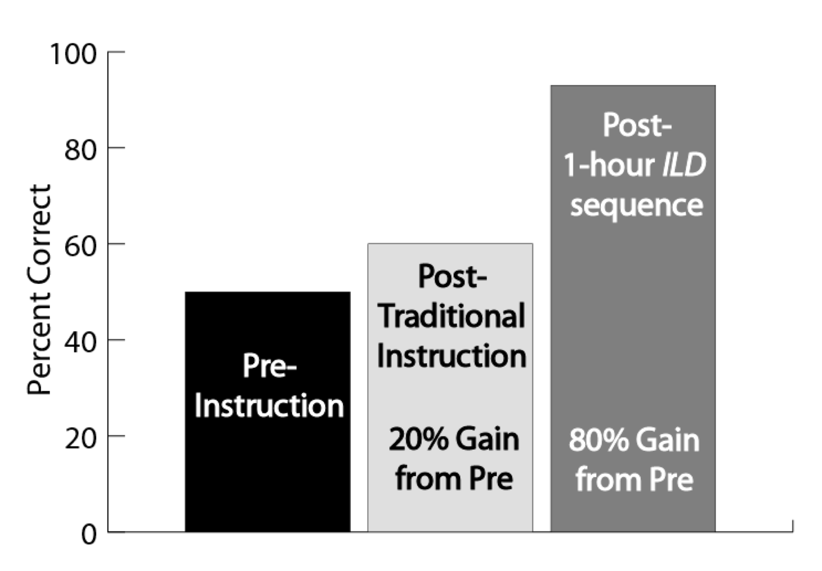
Post RTP Image Formation Activity
90% Gain from Pre

Slide 57
51. In the picture below, the object is to the left of the lens, at a distance from the lens that is larger than the focal length. The image is formed on a screen to the right of the lens as shown. Four rays of light are shown leaving points on the object. Continue those four rays through the lens to the screen.
lens
object
image on screen
focal point

Slide 58
51. In the picture below, the object is to the left of the lens, at a distance from the lens that is larger than the focal length. The image is formed on a screen to the right of the lens as shown. Four rays of light are shown leaving points on the object. Continue those four rays through the lens to the screen.
lens
object
image on screen
focal point
After traditional instruction 33% correct
After one lecture of ILD 76% correct
64% normalized gain

Slide 59
51. In the picture below, the object is to the left of the lens, at a distance from the lens that is larger than the focal length. The image is formed on a screen to the right of the lens as shown. Four rays of light are shown leaving points on the object. Continue those four rays through the lens to the screen.
lens
object
image on screen
focal point
After traditional instruction 33% correct
After RTP 76% correct
64% normalized gain

Slide 60
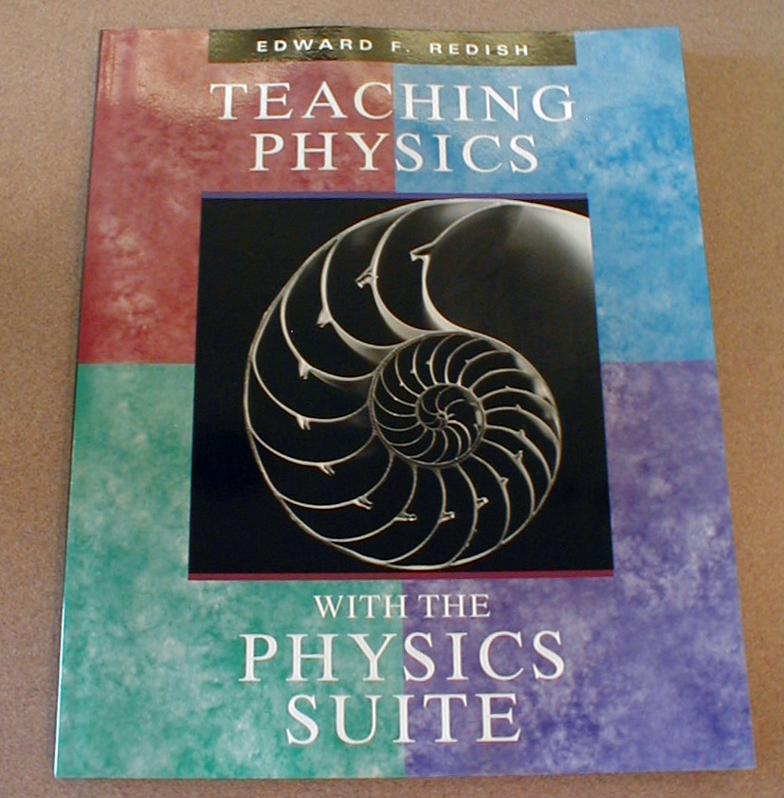
Guide to the Suite
Background readings on physics education research
How to implement in classes
Ways of combining Suite materials
Action research
Free from your Wiley rep., or:
http://umdperg.pbworks.com/w/page/10511199/Joe%20Redish

Slide 61
Example of Use of the Suite:
PHYS 201,2,3 at University of Oregon
(Algebra/Trig Based General Physics)
    Completely traditional course structure:
      3 lecture hours/week
      1 hour/week small group (recitation hour)
      Lab is a separate course—3 hours/week
      The difference is how these times are used

Slide 62
Interactive Lecture Demonstrations (ILDs)
  One lecture/week
  Emphasis is on conceptual learning
  Use materials from the book Interactive Lecture Demonstrations
  Participation (attendance) is required
  ILDs can also be done with “clicker”

Slide 63
RealTime Physics labs
    Labs are RealTime Physics
    8 labs/quarter or 24/year
    Combination of Modules 1-4
    Only 50% of the students are enrolled in the lab

Slide 64
Collaborative
Problem Solving Tutorials
      Small group meeting is Collaborative Problem Solving Tutorial
      See Molly Johnson, AJP 69(7), July 2001, pp. S2-S11
      Attendance required
      Context-rich problems, structured groups
      Materials not currently part of the Suite

Slide 65
Has Content of Course Changed?
No!
My syllabus today looks very much like 20 years ago.
Same topics covered as before.
More emphasis on some topics, less on others.

Slide 66

Engage your students in the learning process!

Slide 67

The End

Slide 68
Characteristics of the Computer-Based Tools That Make Them Effective
    They are easy to use, and don’t require a long learning curve.
    They are flexible and versatile, designed to be independent of the experiments performed.
    They are usable in experiments with different levels of sophistication, with relatively high accuracy.
    Results of experiments are displayed in clear, understandable ways, often in real time. Students can appeal to the displayed results to justify their conclusions.
    Designed to enable students to observe physical phenomena directly and clearly, and to learn from their observations.

