Slide 1
Beyond the First Year
Steve Turley
Brigham Young University
New Faculty Workshop, June 2017

Slide 2
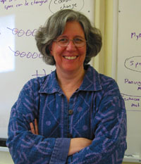
Credits
Corinne Manogue and the Paradigms Team, Oregon State University
  With support from DUE at NSF
Many advanced students over the years

Slide 3
White Boards
Ask for melamine from your local hardware store
“Shower stuff” usually gets you the right material
Size
  Personal
  Group
  Wall

Slide 4
Purpose of Education
Institutionally
In Physics

Slide 5
The Purpose of Education
—Implications
To be able to work with others.
To feel safe and help others to feel safe to participate and to take risks.
To be able to communicate effectively.
To be able to do complex problem-solving.
To do sensemaking.
To exercise reflective judgement.

Slide 6
Reflective Judgment
“…the ability to understand the nature of ill-structured problems and to construct solutions for them.” —King & Kitchner
Stages:
  Pre-reflective: knowledge from authority
  Quasi-reflective: knowledge is uncertain
  Reflective: evaluation of proposed solutions
http://www.umich.edu/~refjudg/index.html

Slide 7
Reflective Judgment/Sense-Making
order of magnitude?
dimensions?
type of “beast”?
limiting cases?
symmetry?
time dependence?
How do I decide what is correct?
Does this answer conflict with something else I “know?”
Is this the problem I should be solving?

Slide 8
Reflective Judgment
How do we structure/implement our curriculum so as to encourage our students to engage in this reflection?
How do we structure/implement our departments so as to encourage ourselves to engage in this reflection?
Why is this important?

Slide 9
The Hidden Curriculum:
Where Do You Find the Following?
Speaking
Writing
Community Building
Professional Identification
Career Development
Non-academic Careers
Future Teachers
Modern Topics
Courses, Advising, SPS, Projects, Research, Senior Thesis, Internships, Special Days?

Slide 10
Upper Division Courses
In what ways are lower division and upper division courses and students similar?
What characteristics are different?
What would you like to accomplish in you upper division courses?
  Explicit
  Indirect
Notes:
Story of PS100/Graduate Quantum

Slide 11
Path from Novice to Expert
Moving away from templates
Using advanced notation
Dividing complicated problems into manageable parts
Harmonic reasoning
Increased confidence
Reflective reasoning

Slide 12
Problem Solving
Novice
Expert
How do I use this method to solve problems?
How do I get from this step to the next step?
How will I know if this works?
What else can I do if this won’t work?

Slide 13
Teaching Principles
Making everyone feel comfortable in the classroom
  Own it
  Relationships
Have courage to be comfortable in your own skin, be transparent
Use results of PER
Make pedagogy a community practice
  Other faculty
  Advanced students
Increase the bandwidth from students to you

Slide 14
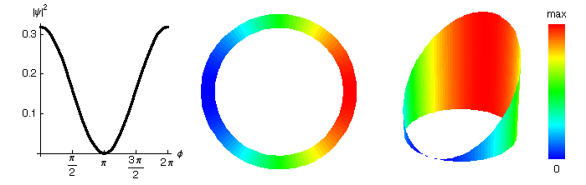
Multiple Representations:
Quantum Ring

Slide 15
Kinesthetic Teaching
Linear charge density
Two state quantum systems

Slide 16

Spin-1/2 Systems
Stand up.
Your left shoulder is the origin.
Rotate your left arm to show the whole complex plane.
Straight out in front of you, represents reals.
Straight up represents the pure imaginaries.
Show
$$\frac{1}{\sqrt{2}}(1−i)$$

Slide 17
Spin 1/2 Systems
Choose a partner.
Together, show the quantum spin ½ state

Slide 18
Spin 1/2 Systems
Show the states that are physically equivalent to this state.

Slide 19

Plane Wave
What’s a Dot Product?
Visualizing a Plane Wave
  Groups with Large White Board (7x7 grid)
  I will draw origin and k vector
  Label each point with $\vec{k}⋅\vec{r}$
  Connect points with equal values of $\vec{k}⋅\vec{r}$

Slide 20
Difference in Feedback
Hearing from a few who understand
  Everyone understands
  Hearing from everyone
    No one inderstands

Slide 21
Classroom Control
With more interaction you need to be able to regain control
Bullying
Exuding Confidence
Looming

Slide 22
“Laboratory” Sessions
Meet once a week outside of normal lecture times
Assignments completed as groups
No new material presented
Challenging problems with coaching
  instructor
  TA’s
  other students

Slide 23
Types of Activities
Drawing conclusions from realistic simulations
  Dan Schroeder’s Stern Gerlach
  PhET Band Structure
  Turley’s EPR Simulation
Numerical projects
  Stationary state wave functions and energies in Woods-Saxon potential
  Time evolution of quantum superposition states
Group conceptual projects

Slide 24
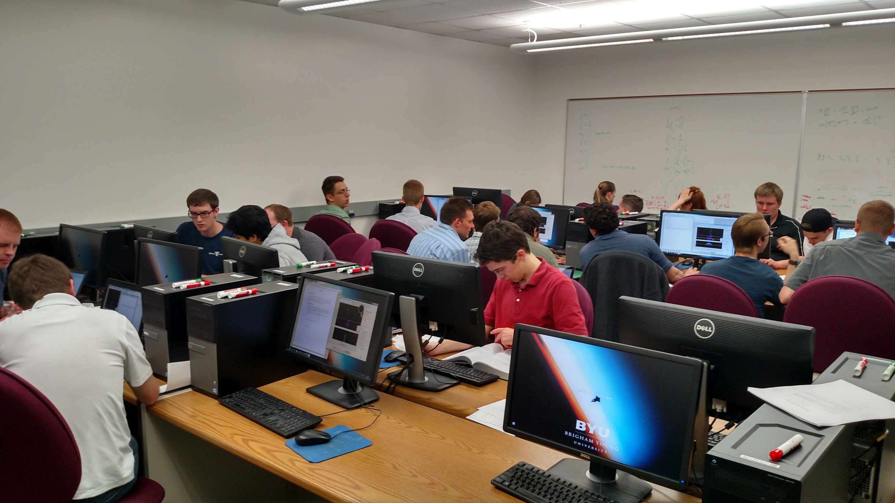
Notes:
Note students clustered around workstations. We don’t have any advanced classroom space like TEAL or SCALE-UP, but this is an effort to use the space we have in a similar way. Introduce PhET at this point for those who may be unfamiliar with it.

Slide 25
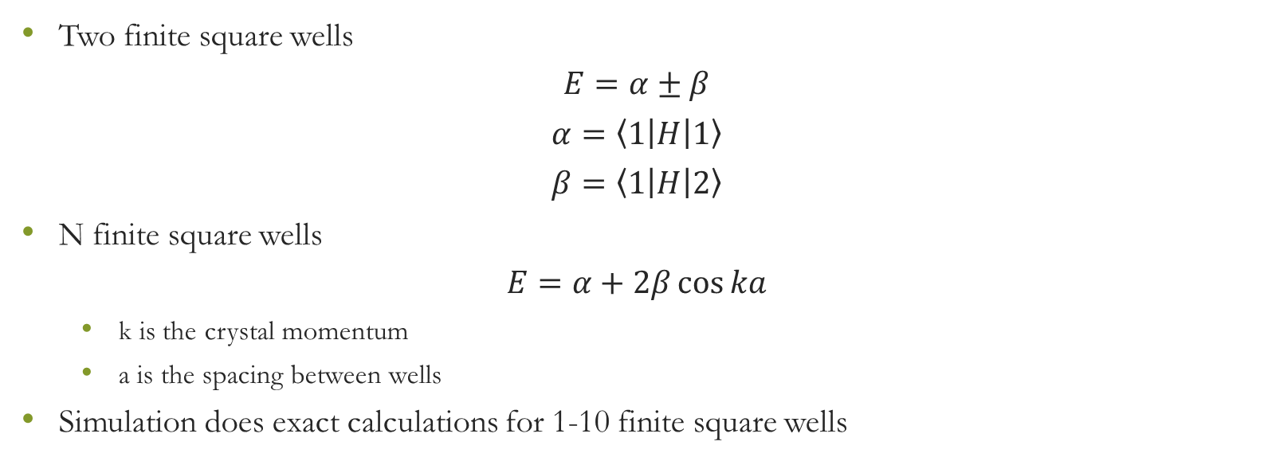
Band Ideas from Class: LCAO
Two finite square wells
$$E=α±β$$
$$α=\left\langle 1\left|H\right|1\right\rangle$$
$$β=\left\langle 1\left|H\right|2\right\rangle$$
N finite square wells
$$E=α+2β\cos{ka}$$
  k is the crystal momentum
  a is the spacing between wells
Simulation does exact calculations for 1-10 finite square wells

Slide 26
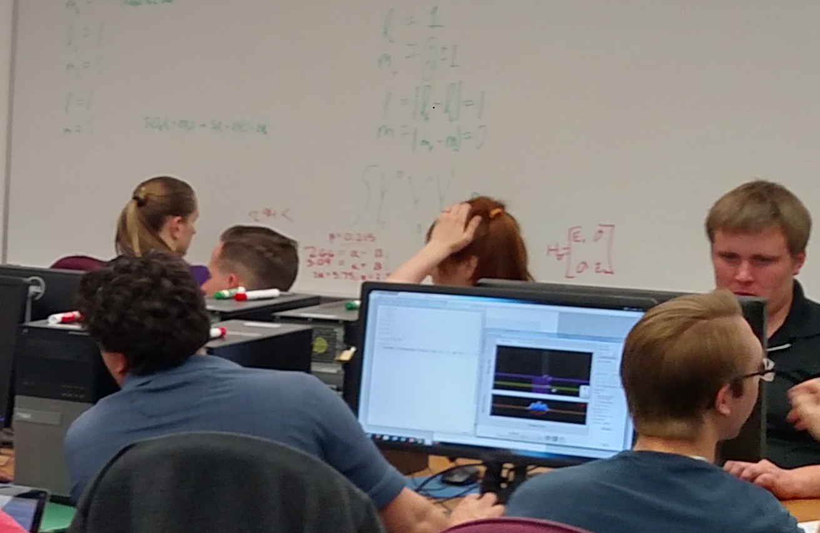
Notes:
The kind of discussion going on at the white board is typical of what students were doing in this exercise. Note the active discussion both within and between groups.

Slide 27
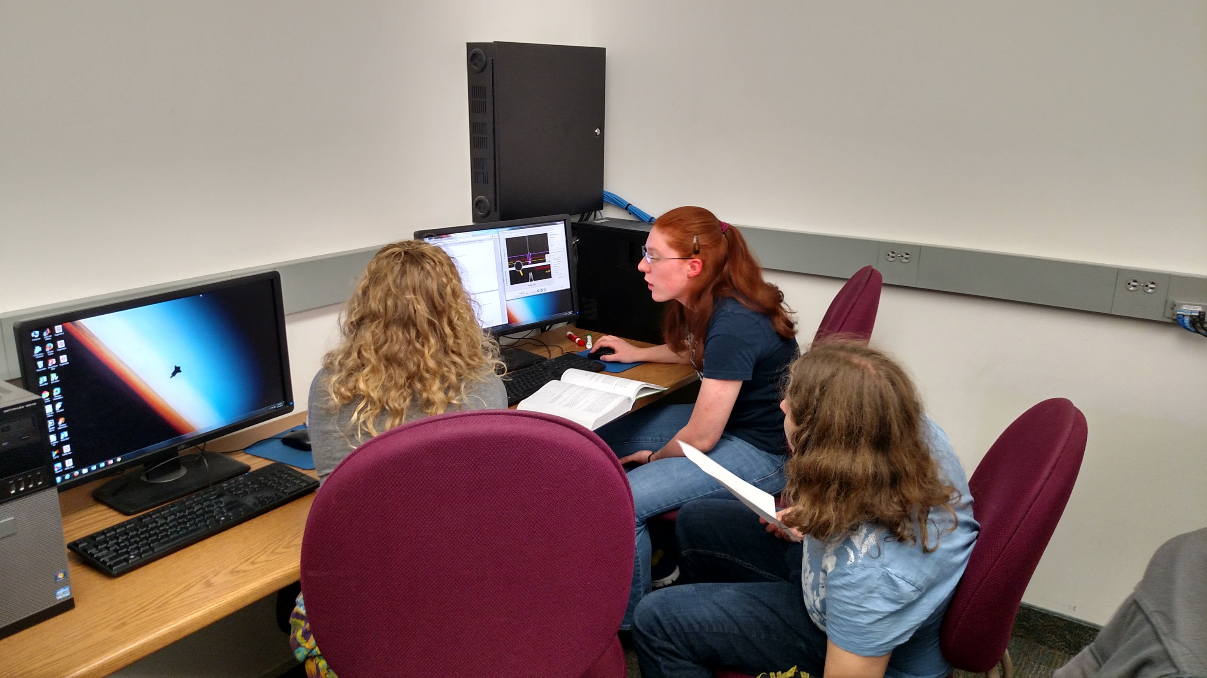
Notes:
Note the integration going on here. They have their textbook open, are looking at the simulation, doing computations using Mathematica, and consulting their notes from class.

Slide 28
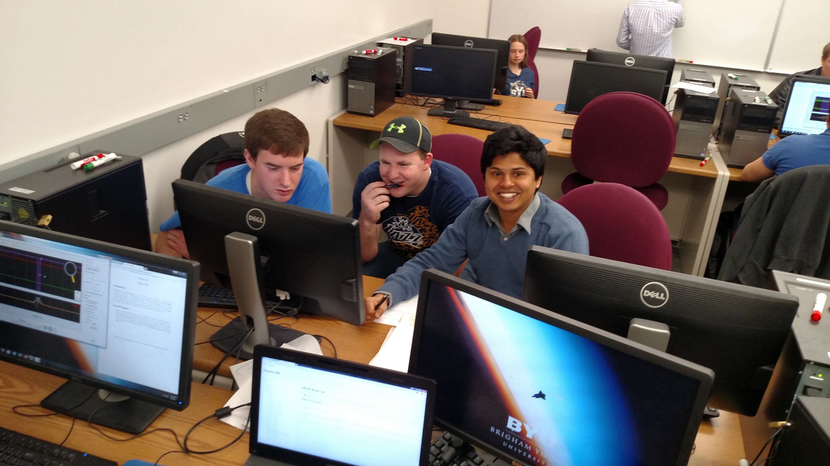
Notes:
They would tend to work together in the same groups each week. They would take these some collaborations to study together and work together on homework assignments. This also carried over into the classroom, where they tended to collaborate with each other in an active learning environment.

Slide 29
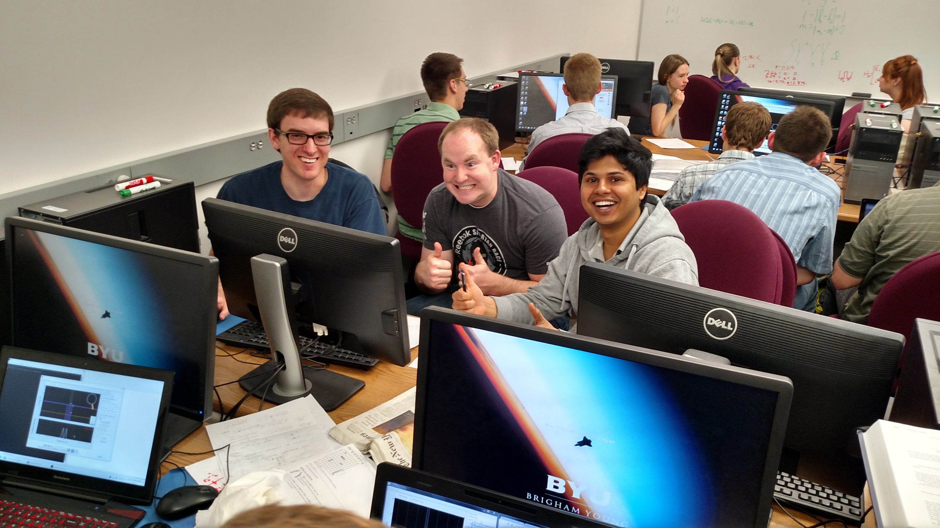
Notes:
The joy of success!

Slide 30
Group Whiteboards in a Computer Lab or Classroom
Set up shared google docs with one for each group
Use google draw documents for symbolic input and graphics
Use google text documents for words
I would switch displays on the screen to discuss the work of each group
Left input up to them
  Drew on screen with mouse
  Pasted formulas from another program like Mathematica
  Drew with their fingers on tablets they brought with them

Slide 31
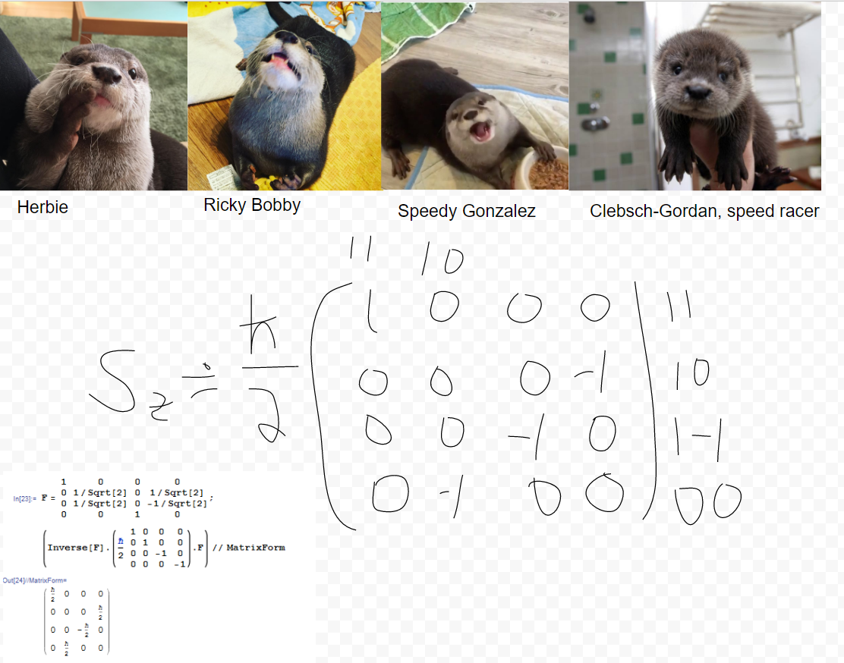

Slide 32
