Slide 1
Lessons from the COVID-19 online teaching and learning experiences
S4.3 Assessing Student Work
M. Shane Hutson, Vanderbilt University
Session Chair: Jim Napolitano, Temple University
Session Co-Chair: Josh Grossman, St. Mary’s College of Maryland
45 minutes to brainstorm, discuss and try to outline some best practices

Slide 2
Email thread subject lines on Midwest Chairs listserv
Privacy and Online Proctoring
Online teaching and exams…
Online exams- how to combat cheating?
exam cheating (a long discussion about Chegg); Chegg and the like
Some concerns that came up in these threads
Quality of student internet access
Sense that online cheating was pretty rampant
Unauthorized use of book, notes, online resources
Students communicating with one another
$@!*ing Chegg and its ilk!
But online proctoring feels like an “invasion of privacy”; a little big-Brotherish; fear that stress of having someone “closely watching” will cause worse exam performance
Some online proctoring tools
Proctorio (with Canvas)
Examity
Respondus
Honorlock
So, how do we balance exam integrity with student privacy and equitable treatment of all students? And how do we do all that while maintaining a reasonable faculty/TA workload?

Slide 3
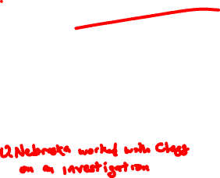
Chegg and its ilk
One of our faculty identified a student who posted to Chegg because the numbers in the posted problem matched the unique numbers in their particular exam. – Seems like there were many similar cases elsewhere.
At the bottom of Chegg’s website under Honor Code
If you have concerns that students may be using our products inappropriately, Chegg is here to work with you and address your concerns. We will cooperate with any official investigation by an academic instruction. To open an official Honor Code investigation in conjunction with an academic investigation, the request must come directly from the office of the dean or the body in charge of handling matters of academic investigation at the university.
Many Chairs would like Universities to jointly go after Chegg, but would likely be a game of whack-a-mole with replacement sites filling their niche

Slide 4
Our approach (almost certainly still some cheating, but as good
as we could do for the sudden change mid-semester):
used Brightspace/D2L - learning management system our students were used to (just a competitor to Blackboard)
multiple choice, true/false and short answer questions that can be (almost) auto-graded
plus upload links for students to post pictures of their written out work for longer problems
made exam available for a 24-hr (or longer) window, but with a time-limit that requires a student to finish within 2 hrs of starting (FYI – online exams seemed to take students about 1.5x longer than a similar in-class exam; some evidence that one student may take exam early to relay info to another student taking it late)
were not comfortable using any sort of invasive monitoring, so we wrote exams
to be taken open-book / open note
to use random number selections for the problems
to be completed within a set time limit (our time limit may have been too long, others have noted that answers could appear on Chegg in ~30 min)
emphasized our honor code, including an explicit exam question on which the students had to attest that they had not given or received unauthorized aid

Slide 5
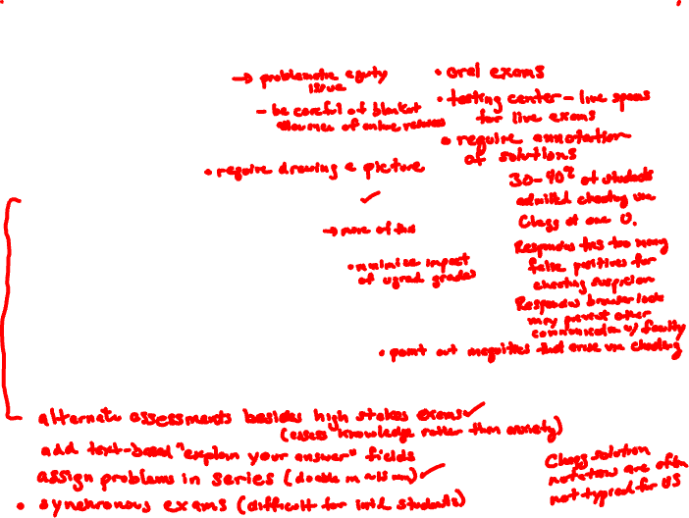
Best Practices? Brainstorm, then Discuss
Webcam-based monitoring
Open-book / open-note design
Randomized and unique numbers for each student
Time limits
Replace exams with more and shorter quizzes
Include some show-your-work questions
Explicit honor code attestation on exam
Monitoring of Chegg et al in real time
Preventive communication
Stories about students caught using Chegg
Telling students about efforts being taken to protect the hard work of overwhelming majority who are being honest

