Slide 1
The AIP career pathways project
Toni Sauncy
Chair, Texas Lutheran University
Former Director of SPS and Sigma Pi Sigma
© 2015 Toni Sauncy - AIP Career Pathways Project

Slide 2
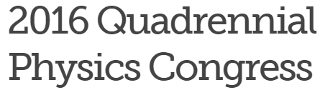

SAVE THE DATE
hosted by
November 3-5, 2016
Silicon Valley
San Francisco Hyatt Regency SFO
largest undergraduate physics meeting
in the world…
© 2015 Toni Sauncy - AIP Career Pathways Project

Slide 3

Acknowledgements Project Personnel
Project Investigators
Thomas Olsen, former Assistant Director – Society of Physics Students
Kendra Redmond, Programs Manager – Society of Physics Students
Roman Czujko, Director – AIP Statistical Research Center
Toni Sauncy, former Director – Society of Physics Students and Sigma Pi Sigma
Student Contributors-SPS Summer Interns
Amanda Palchak, University of Southern Mississippi(2011)
Shouvik Bhattacharya, Minnesota State University (2012)
Jose “Ro” Avila, King College, SPS Summer Intern (2013)
Work supported by the National Science Foundation Project No. 1011829, “Expanding the STEM Workforce by Equipping Physics Bachelors Degree Recipients and their Departments to Address the Full Range of Career Options”

Slide 4
I like physics
BUT…
© 2015 AIP Career Pathways Project

Slide 5
What *can * I do
with a
physics degree?#*!
What will you do with a physics degree?!?
© 2015 AIP Career Pathways Project

Slide 6
Physics Professor
What can I do with a physics degree?
© 2015 AIP Career Pathways Project

Slide 7
ANYTHING!
???????????????
© 2015 AIP Career Pathways Project

Slide 8
??????????
Anything….
Like what?
© 2015 AIP Career Pathways Project

Slide 9
….Be a professor
….Do research
….Anything!!!
hmmmmmmmmmmm
© 2015 AIP Career Pathways Project

Slide 10
:-/
Cool! So…….
How do I get an “anything” job?
© 2015 AIP Career Pathways Project

Slide 11
…um…
...um…
???????????????
© 2015 AIP Career Pathways Project

Slide 12
Career Services Professional
What can I do with a physics degree?
© 2015 AIP Career Pathways Project

Slide 13
Oh, uh,…
-Be a professor
-Do research
-Umm…Yeah, sure!
:/
© 2015 AIP Career Pathways Project

Slide 14
The Perception
of physics career options at the bachelor’s level
Become a professor
Become a professor
Become a professor
Do research
Do research
Do research
Become a professor
Become a professor
Become a professor
Do research
Become a professor
Do research
Become a professor
Do research
Become a professor
Do research
Become a professor
Do research
Do research
Become a professor
Become a professor
Become a professor
Do research
© 2015 AIP Career Pathways Project

Slide 15
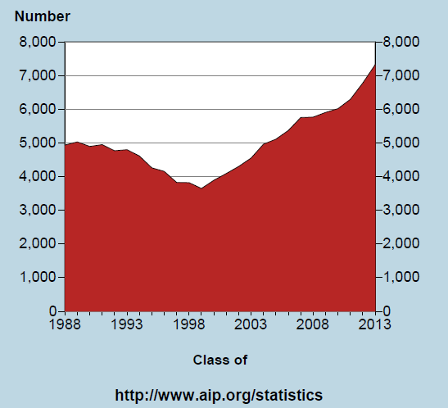
Data. How many?
Good news.
Physics bachelor’s degree production is on the rise.

Slide 16
The “typical” physics major - STATS
Among those who earn physics bachelor’s degrees
~3/4 have research experience.²
~1/3 graduate with a double major, many in math.³
1/10 started at a two-year colleges.⁴

Slide 17
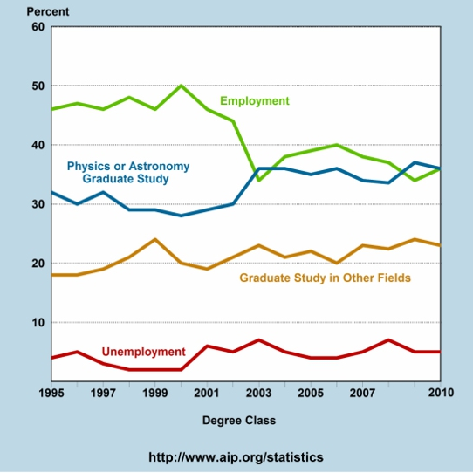
One year later.
Good news!
Notes:
With an average 40\% of all physics baccalaureate degree recipients opting not to enter graduate school, it is a question worth considering for departments aiming to build robust programs that prepare students for a broad range of career paths.
What if a student expresses a desire to enter the workforce upon completion of the bachelor's degree?

Slide 18
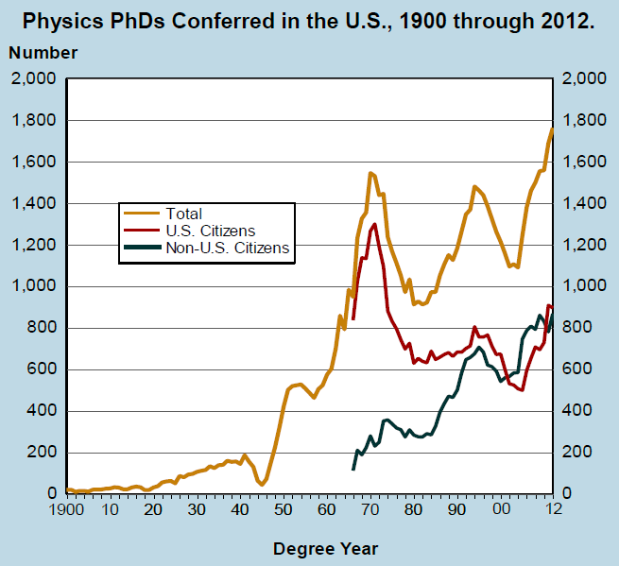
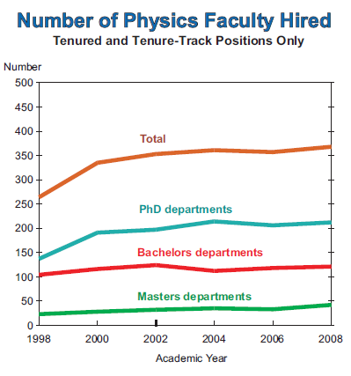
What about PhDs?
October 2009

Slide 19

So, where do all those BS/BA physics graduates go?
Notes:
This introduces the fundamental question that we hoped to answer with the Career Pathways research project. It is often useful to entertain a discussion, and poll the crowd of students to see how many of them plan on attending graduate school in physics. Statistically, most of them are not. The next slide introduces an activity.

Slide 20
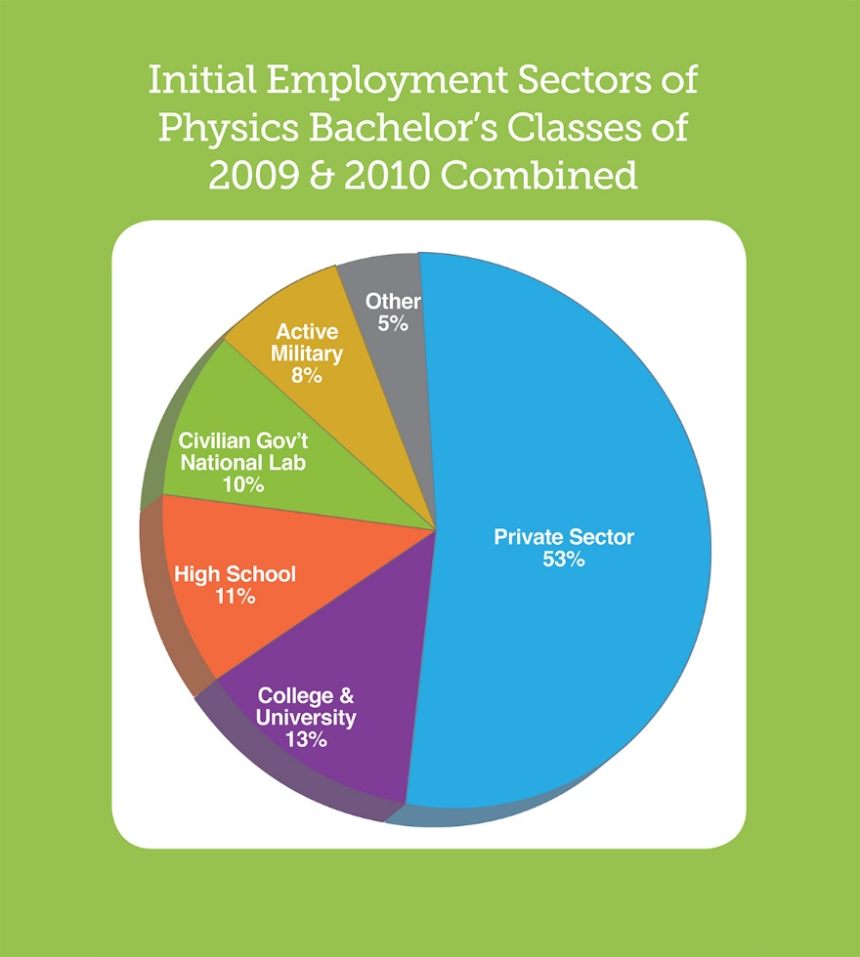
Let’s zoom in

Slide 21
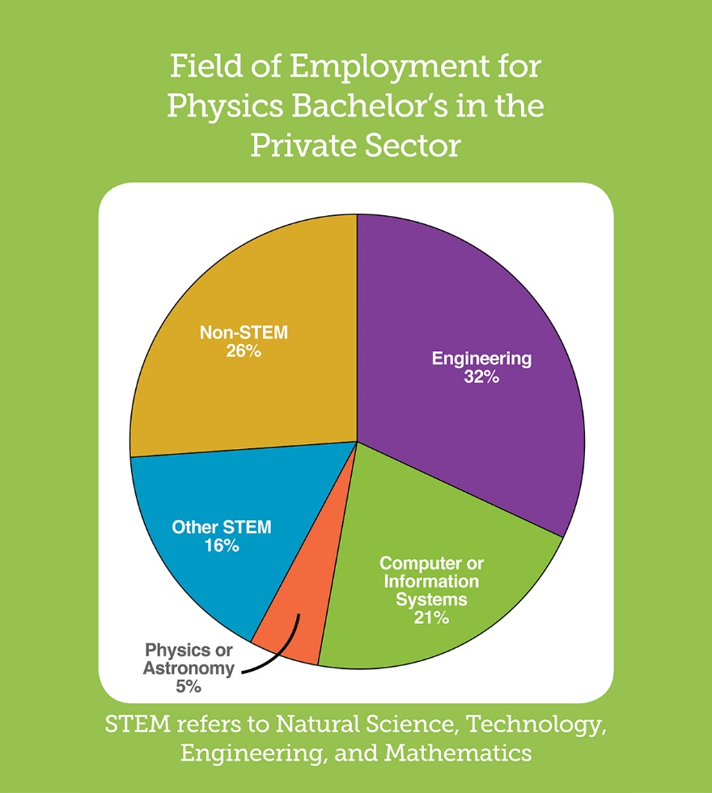

Slide 22
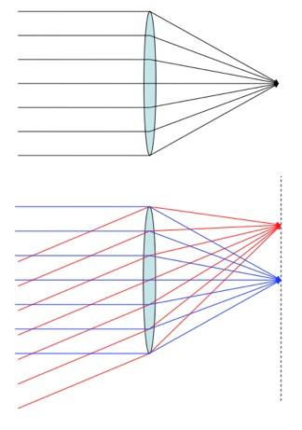
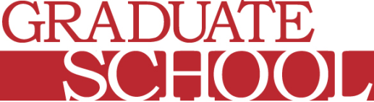
All this good news
…despite…
a cultural default focus in many departments
main goal is preparing students for entry into advanced physics degree programs.
physics is perceived by many as an academic major with no direct pathways to careers outside of academia
evidence clearly indicates the Physics BS/BA is a marketable degree

Slide 23

Anything!
Students should be equipped for the path they choose when they complete their
bachelor’s degree. Any path!
Workforce (STEM, non-STEM)
Grad School
(Physics & other)
Teaching K-12
Departments that provide robust programs addressing a broad range of career trajectories for undergraduate students tend to be most successful.

Slide 24
Discuss
Can you name more than one undergraduate student who graduated from your program who did NOT go to graduate school?
Do you know where they work and what they are doing?
Have you ever bragged about your students that choose not to go to graduate school?

Slide 25
Fact.
STUDENTS HAVE OPTIONS!

Slide 26
What could happen if….
Educators learned how
to effectively convey information about the broad range of career opportunities for current (and potential) undergrads?
and
to better prepare students for that broad range of career opportunities….

Slide 27
Identified Common Features
SPIN-UP
Curricular
Varied and high quality lab courses
Research opportunities for undergraduates
Curricular flexibility
Communication skills as part of the physics curriculum
Extra-curricular
Faculty and staff commitment to student success
Strong community of students
Connections with alumni
Relationship with the Career Services Office
Mentoring/advising in accordance with interests and goals

Slide 28

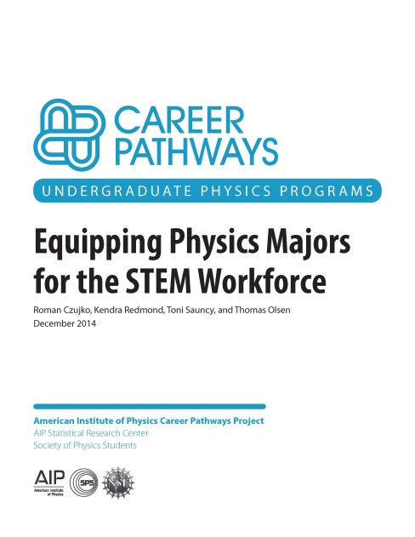
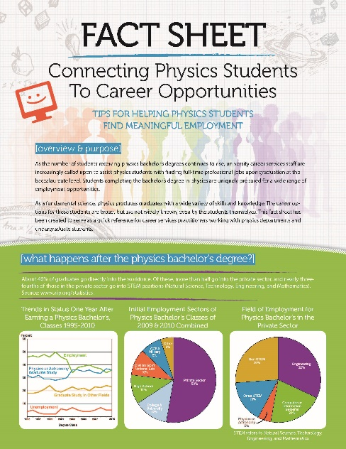
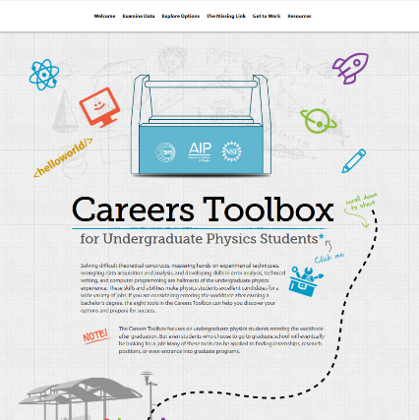
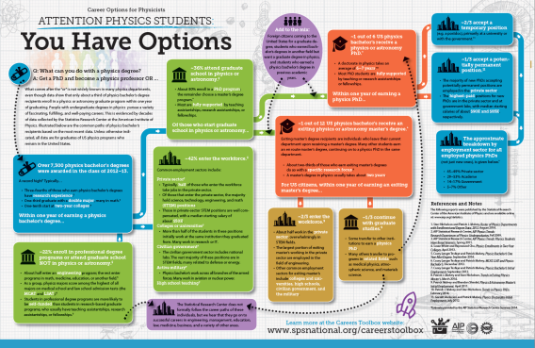


The Career Pathways Project
www.spsnational.org/career-resources/career-pathways
NSF Award 1011829

Slide 29
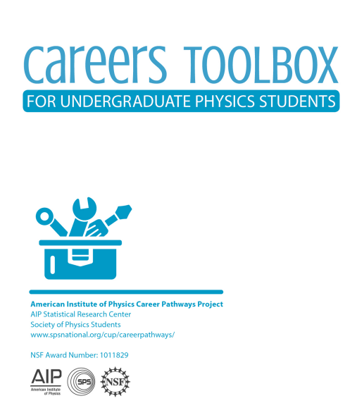
The Careers Toolbox for undergraduate physics students
Developed using common features, statistical research data, and the tremendous work of SPS Summer Interns over three summers

Slide 30

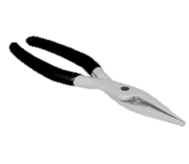

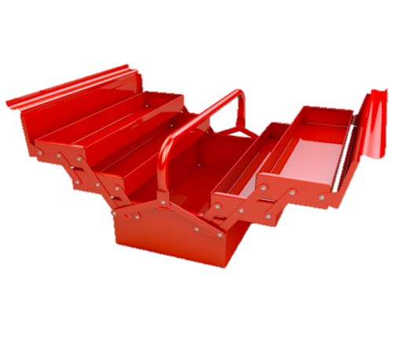
Student Resource: The “Toolbox”
Eight professional development tools with lessons, built in exercises, and activities
1.Common Job Titles | 5.The Job Search
2.Informational Interviews | 6.Knowledge & Skills-Based Resume
3.Networking | 7.Effective Cover Letter
4.Knowledge and Skills Assessment | 8.Interviewing With Confidence

Slide 31
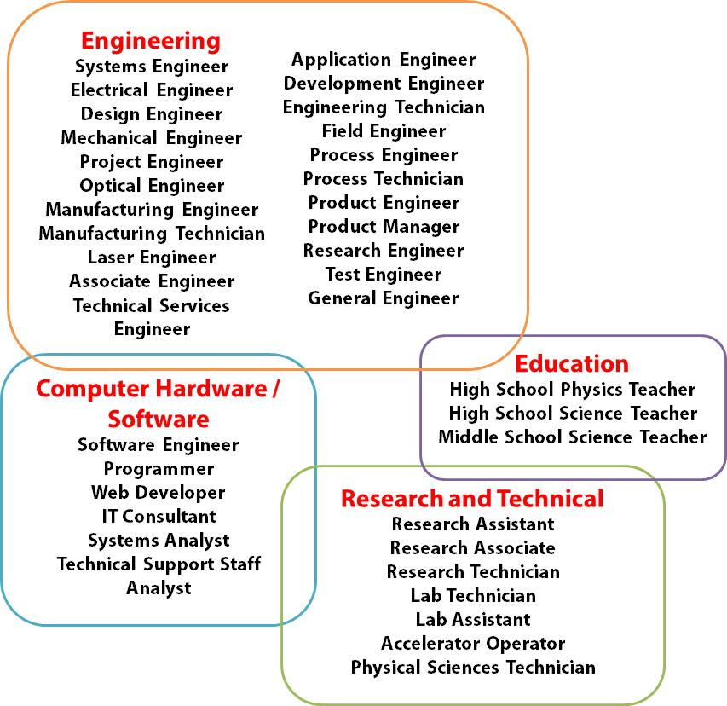


Tool #1
List of
Common
Job Titles
© 2015 Toni Sauncy - AIP Career Pathways Project

Slide 32

Informational Interview.
Tool #2
What is an “informational interview”?
How do I do this?
Who should I contact?
What do I say?
A new kind of
research project:
what kind of job do I want?

Slide 33

Networking: Not just for business majors.
Tool #3
Where/when/how to network
How to build your list of professional contacts
Putting together PERSONALIZED Elevator Speech(es)
© 2015 Toni Sauncy - AIP Career Pathways Project

Slide 34

The Missing Link articulation of knowledge & skills
Tool #4
The key to success.
Physics students gain a unique set of knowledge and skills from the undergraduate physics experience.
Articulating
Translation of what students know into language that describes desirable and marketable SKILLS
© 2015 Toni Sauncy - AIP Career Pathways Project

Slide 35
The Missing Link articulation of knowledge & skills
Tool #4
Step one – assess you.
Self reflection
Serious consideration of life experience
Not just a list of classes!
Nothing off limits
Curricular, extracurricular, social – all of it counts!
Should take time, serious thought, and be revisited OFTEN
After every semester
© 2015 Toni Sauncy - AIP Career Pathways Project

Slide 36
Physics – Common skills
Tool #4
Working with laboratory instruments | Computer hardware and software
Conducting research | Analysis and quantitative thinking
Communicating complex ideas | Working with others
Problem solving and critical thinking | Others??

Slide 37

Effective Job Searching.
Tool #5
How to effectively use powerful online resources
How to critically read and analyze employment ads
Who’s Hiring Physics Bachelor’s
What if they don’t ask for a degree in Physics?
Efficient use of time to match SKILLS with a THE JOB (that YOU WANT)

Slide 38

The effective resume.
Tool #6
What is the goal of the resume?
How to write a resume that achieves the goal of
getting an interview
What to include (and what not to include)
Customize resume to employer needs priorities

Slide 39

The cover letter.
Tool #7
Putting it together
A formal introduction of YOU…on paper
Format, content, how to make sure you stand out as a candidate for the position you want and are qualified to have!

Slide 40

Interviewing with confidence.
Tool #8
Making the interview count!
Face-to-face or on the phone
Another opportunity
to demonstrate knowledge and skills

Slide 41
The following slides are used to facilitate a workshop for students focused on tool #4
Using the resources in the AIP Careers Toolbox for Undergraduate Physics Students

Slide 42

Practice time.
Getting started
on your path -
focus on Tool #4: Knowledge & Skills Assessment

Slide 43
Tool#4 –Knowledge and skills assessment
SHAPING YOUR OWN KEY.

Slide 44
WHO ARE YOU?
Self reflection
Serious consideration of life experience
Nothing off limits
Should take time, serious thought, and be revisited OFTEN

Slide 45
BRAINSTORMING
My classes / training | My leadership experiences / group activities / professional associations
My jobs / research experiences / internships | My hobbies / others
Consider this exercise to be
a comprehensive brainstorm
of your cumulative life experience!
Put it all down on paper!

Slide 46
BRAINSTORMING (example)
My classes / training | My leadership experiences / group activities / professional associations
My jobs / research experiences / internships | My hobbies / others
Math double major-through advance calc
LaTEX training class
CPR certified
Learning assistant (1yr)
Machine Shop safety training
Drum major – marching band (2 yrs)
Certified Camp counselor
Cryogenics handling safety training
Tutor for freshman physics (2yrs)
Intro Physics (made B’s)
Helped organize campus research symposium
Advanced Physics classes (thermal, EM, Quantum, Mechanics) C’s & B’s
SPS member-outreach presenter
AFM, SEM training
Tutor in language lab (spanish)
Labview Tutorial
International Student Union-member
Advanced Lab – Experimental techniques/Error analysis training
Worked in research lab as a sophmore (mostly data reduction)
Accomplished knitter
Sing in community choir
Part time cashier at Lowe’s
Attended comicon
Paid tutor at the YMCA after school program
Summer research assistant in professor’s lab (responsible for interfacing spectrometer)
Workshop on gravitational wave astronomy

Slide 47
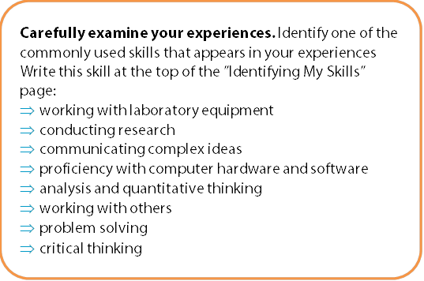
Now, carefully examine the collection of experiences that describe YOU.
1

Slide 48
Physics – Common skills
Working with laboratory instruments | Computer hardware and software
Conducting research | Analysis and quantitative thinking
Communicating complex ideas | Working with others
Problem solving and critical thinking | Others??

Slide 49
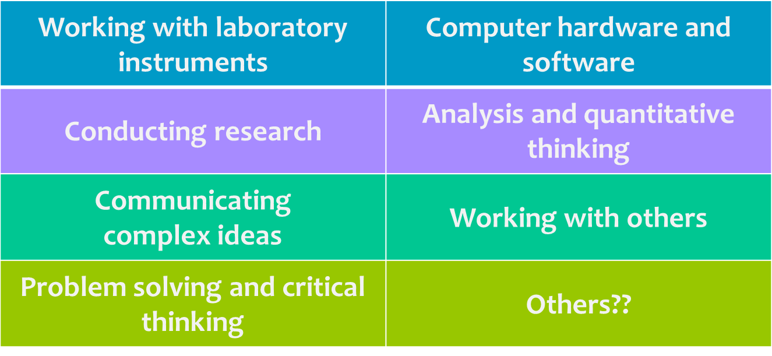
BRAINSTORMING (example)
My classes / training | My leadership experiences / group activities / professional associations
My jobs / research experiences / internships | My hobbies / others
Math double major-through advance calc
LaTEX training class
CPR certified
Learning assistant (1yr)
Machine Shop safety training
Drum major – marching band (2 yrs)
Certified Camp counselor
Cryogenics handling safety training
Tutor for freshman physics (2yrs)
Intro Physics (made B’s)
Helped organize campus research symposium
Advanced Physics classes (thermal, EM, Quantum, Mechanics) C’s & B’s
SPS member-outreach presenter
AFM, SEM training
Tutor in language lab (spanish)
Labview Tutorial
International Student Union-member
Advanced Lab – Experimental techniques/Error analysis training
Worked in research lab as a sophmore (mostly data reduction)
Accomplished knitter
Sing in community choir
Part time cashier at Lowe’s
Attended comicon
Paid tutor at the YMCA after school program
Summer research assistant in professor’s lab (responsible for interfacing spectrometer)
Workshop on gravitational wave astronomy

Slide 50
BRAINSTORMING (example)
My classes / training | My leadership experiences / group activities / professional associations
My jobs / research experiences / internships | My hobbies / others
Math double major-through advance calc
LaTEX training class
CPR certified
Learning assistant (1yr)
Machine Shop safety training
Drum major – marching band (2 yrs)
Certified Camp counselor
Cryogenics handling safety training
Tutor for freshman physics (2yrs)
Intro Physics (made B’s)
Helped organize campus research symposium
Advanced Physics classes (thermal, EM, Quantum, Mechanics) C’s & B’s
SPS member-outreach presenter
AFM, SEM training
Tutor in language lab (spanish)
Labview Tutorial
International Student Union-member
Advanced Lab – Experimental techniques/Error analysis training
Worked in research lab as a sophmore (mostly data reduction)
Accomplished knitter
Sing in community choir
Part time cashier at Lowe’s
Attended comicon
Paid tutor at the YMCA after school program
Summer research assistant in professor’s lab – part of group - (responsible for interfacing spectrometer)
Workshop on gravitational wave astronomy

Slide 51

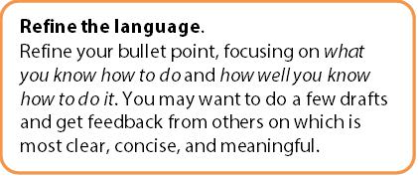
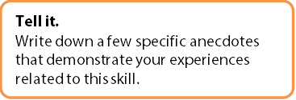

Get to the point.
3

Slide 52
Skills Assessment Sheet
Assessing My Skills
Skill category: ________________________
Skill category:
Brainstorming: My experiences related to this skill category
Tell it: Draft a bullet point related to this skill
Refine the language: Refine your bullet point, focusing on what you know how to do and how well you know how to do it
Show it: Write down a few anecdotes that demonstrate your experiences related to this skill

Slide 53

Skills Assessment Sheet: Example
Assessing My Skills
Skill category: ________________________
Skill category:
Brainstorming: My experiences related to this skill category
Tell it: Draft a bullet point related to this skill
Refine the language: Refine your bullet point, focusing on what you know how to do and how well you know how to do it
Show it: Write down a few anecdotes that demonstrate your experiences related to this skill
Camp counselor, tutor(in spanish and in freshman physics, and for math at YMCA), learning assistant, working with lab group (research), sing in choir and helped organize a resaerch conference for my peers
Good at working in teams and cooperating in group situations

Slide 54
Skills Assessment Sheet: Example
Assessing My Skills
Skill category: ________________________
Refine the language: Refine your bullet point, focusing on what you know how to do and how well you know how to do it
Show it: Write down a few anecdotes that demonstrate your experiences related to this skill
Good at working in teams and cooperating in group situations
Good at working in teams and cooperating in group situations
Team work and group skills – really good at it.
Team work and group skills – really good at it.
Strong teamwork skills; demonstrated comfort in a variety of group dynamics.

Slide 55
Your set of strengths. YOUR skills
My Skills Summary
List your “Tell it” bullet points below
Aim for about 5-10 skill sheets
Should be revised regularly as your experiences grow and change
Practice on-going self assessment to continuously update skills/knowledge list
List your “Tell it” bullet points below
List your “Show it” stories below
Hard work DONE.

Slide 56
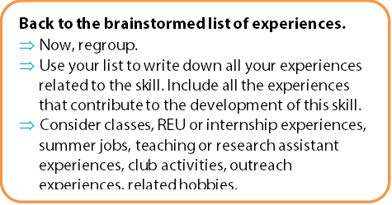
Use your brainstorm
2
Find a skill that appears in several of your experiences

Slide 57
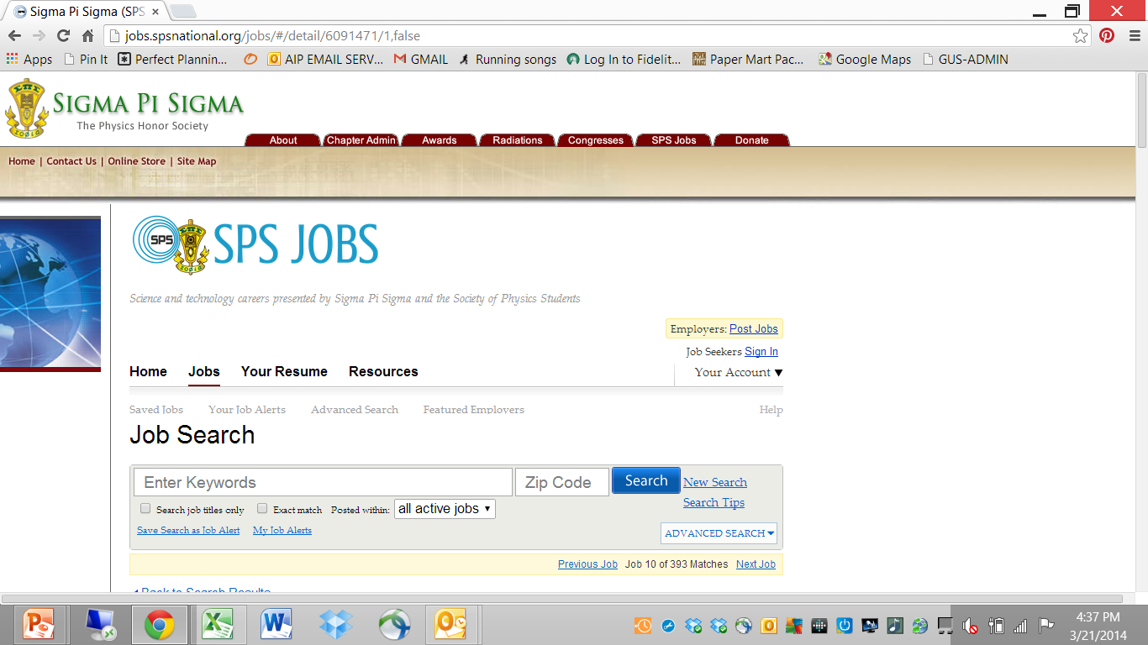
Practice

Slide 58
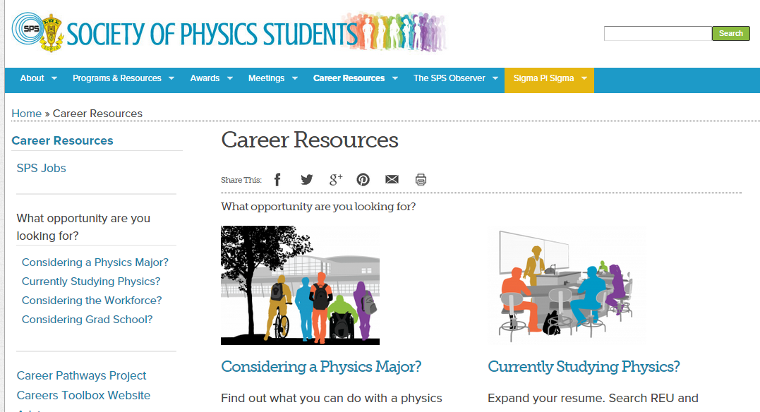
Resources are FREE.
https://www.spsnational.org/career-resources/career-pathways
Toni Sauncy - tsauncy@tlu.edu

Slide 59
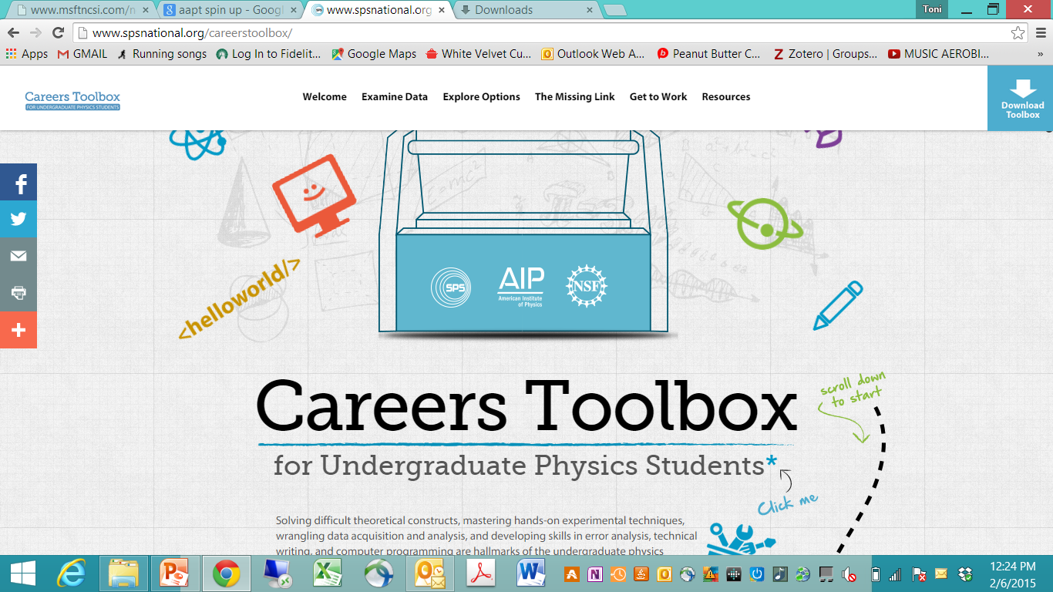
Interactive Toolbox Website

Slide 60
Summary
You have options. But, You have homework.
DO YOUR HOMEWORK
Use the toolbox!–
This homework impacts t he rest of your life!
Revisit your knowledge & skills
assess at the end of each semester
Start (or continue) networking
Consider scheduling some informational interviews
Begin investigating job ads

Slide 61
I can’t wait to hear where *your* Career pathway takes you!
Physics Professor

Slide 62

www.spsnational.org
Toni Sauncy
tsauncy@tlu.edu

Slide 63
The following slides are used to facilitate a workshop for students focused on tool #3
Using the resources in the AIP Careers Toolbox for Undergraduate Physics Students

Slide 64

Practice time.
Getting started
on your path -
focus on Tool #3: Building a professional network

Slide 65

General Networking Tips
Prepare an “elevator” speech
Network everywhere
Help others
Attend physics meetings
Get involved!
Ask questions!
Network online
Project a positive attitude

Slide 66
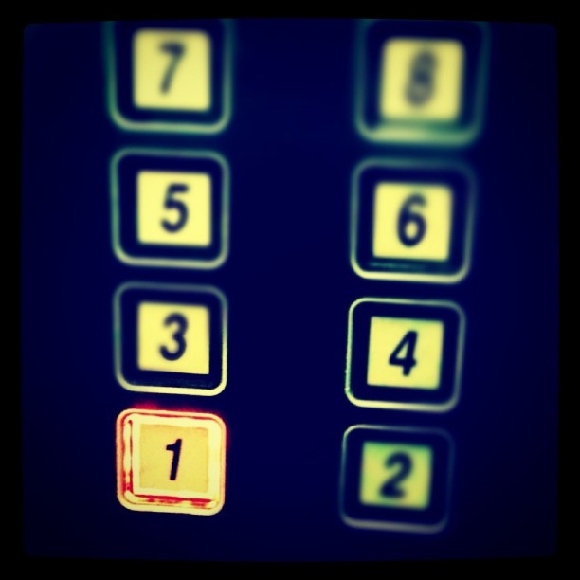
The elevator speech
Stick to the basics.
Informational facts about you
Who am I?
Be sure to include your name and where you go to school!
What are one or two relevant, interesting things that I have done recently?
What do I want to do?

Slide 67
Practice time. Toolbox, page 37
exercise#3: Informational facts about you
Who am I? (Be sure to include your name and where you go to school!)
What are one or two relevant, interesting things that I have done recently?
What do I want to do?
Stick to the basics.
Be sure to include your name and where you go to school ( or work)!
Highlight successes, fun/interesting (career related) anecdotes.
Have clear, easy to understand goals

Slide 68
The following slides are used to facilitate a workshop for students focused on tool #6
Using the resources in the AIP Careers Toolbox for Undergraduate Physics Students

Slide 69
Practice time.
Getting started
on your path -
focus on Tool #6: Your Resume

Slide 70
Some guidelines Toolbox Page 69
Most important focus for physics students
detailed list of the knowledge and skills relevant to the specific job for which you are applying
This is more important than a list of work experience
This is more important than a list of your degrees or educational background.
You should expect to write a separate resume for every single job application!

Slide 71

Main questions your resume should answer….
What is my story?
Who am I, and what are my important experiences that make me the best candidate for this job?
focus on including content that is relevant, accurate, and presented well.

Slide 72
Suggested resume sections
for physics students
Knowledge and skills
list the skills that appear to be most important to the employer first-directly tied to the information in the job advertisement.
Work experiences
Include any work-related experiences - order most relevant to the specific job ahead of those that are not.
Include Brief statement highlighting specific accomplishments or tasks - align with the description of the position you are applying for.
Explicitly highlight transferable skills
Educational background
HS diploma optional
Bachelor’s degree (or your expected graduation date)
Technical and online training courses (certifications in software, safety, or other relevant areas.)

Slide 73
Other Tips
Use a reverse chronological order
In most cases it is not necessary to include your GPA.
…but ….if your GPA is above 3.0, you should consider including it because it demonstrates your academic ability.
If the employer asks for GPA in the job posting, include it.
"Relevant Coursework" section may or may not make sense to include.
you may choose to put your educational background information at the end of your resume.

Slide 74
References
AIP Statistical Research Center, AIP Physics Trends: Research Experiences of Physics Undergraduates, Fall 2009.
AIP Statistical Research Center, AIP Physics Trends: Physics Students Have Broad Interests, Spring 2011.
Susan White and Raymound Chu, Physics Enrollments in Two-Year Colleges, April 2013.

