Slide 1
TOWARD PROGRESS FOR ALL: STATISTICS ON THE PHYSICS COMMUNITY
Rachel Ivie
Statistical Research Center

Slide 2
Physics Bachelors
Degrees
Initial employment

Slide 3
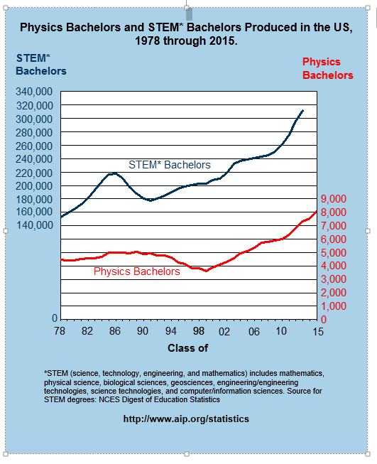
8122
3646
Notes:
Nat sci includes: Biological and biomedical sciences, Computer and information sciences, Engineering, Engineering technologies, Mathematics and statistics, Physical sciences and science technologies
Doubled since low in 1999 of 3646. Current 7526

Slide 4
Physics Bachelors One year after Degree
Classes of 2013 & 2014 Combined
Notes:
Recipients of bachelor’s degrees in physics typically either enter the work force or enroll in graduate school. For the classes of 2013 and 2014 combined. Just over half (54%) of physics bachelors entered graduate school, with the majority pursuing advanced degrees in physics or astronomy. Just under half of physics bachelors entered the workforce. Overall unemployment rate in the US in 2015 was about 5%.
About 80% of Physics BS earners will not get a PhD in physics
One third enters into graduate school in physics and astronomy - with 80% in a PhD program
Remainder enters graduate school in other fields… lets further explore graduate school

Slide 5
STATUS OF PHYSICS BACHELORS ONE YEAR AFTER DEGREE
Notes:
The initial outcomes of physics bachelors has undergone a change over the last few years, with a greater proportion accepting employment immediately following graduation. This has coincided with a drop in the proportion entering graduate school in the fields of physics or astronomy. The percent who began graduate studies in other fields has remained stable, as has the proportion who were unable to obtain employment.

Slide 6
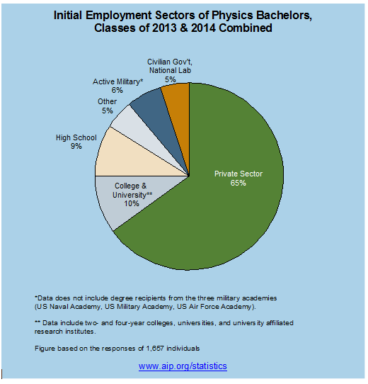

Slide 7
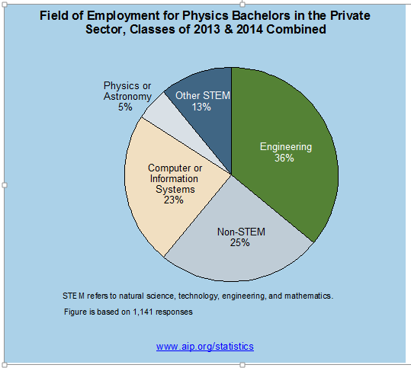

Slide 8

https://www.spsnational.org/careerstoolbox

Slide 9
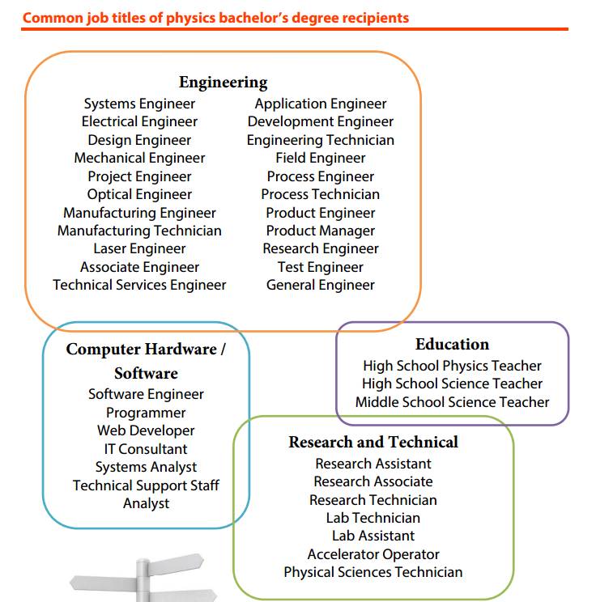

Slide 10
Physics PhDs
Degrees
Initial Employment
PhD+10
Academic Employment

Slide 11
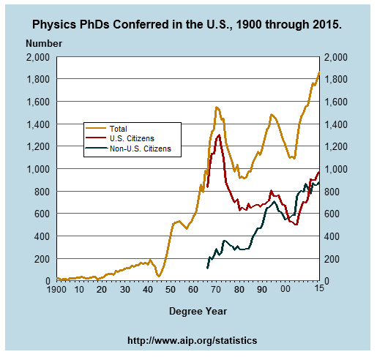
Notes:
Highest number ever, 1803 in 2014

Slide 12
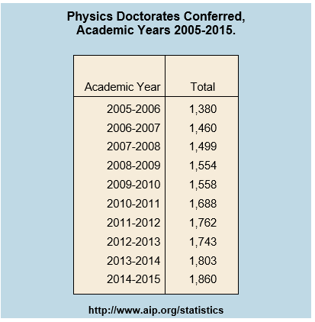
Notes:
From Physics Graduate Degrees July 2011

Slide 13
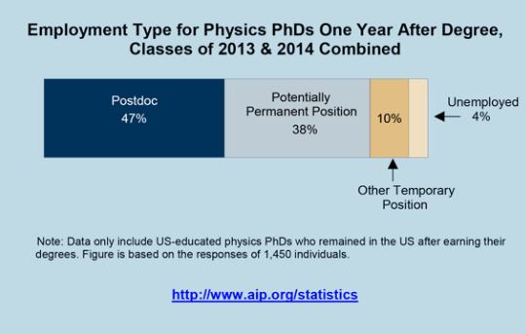

Slide 14
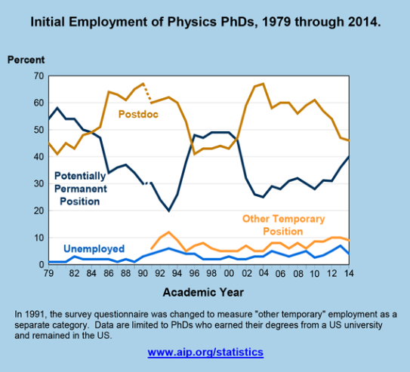

Slide 15


Slide 16
Primary Types of Careers in Private Sector
Top eight primary types of careers that mid‐career physicists chose to pursue in the private sector:
  self‐employed
  finance
  government contractors,
  primarily engaged in engineering
  primarily engaged in computer science
  primarily engaged in physics
  primarily engaged in other STEM fields
  not working in a STEM field.
Notes:
It should be noted that these categories are neither monolithic nor mutually exclusive.
Overlaps between categories do occur, and it is easy to imagine physicists whose employment
could be classified into two of the above.
There were a small but non‐trivial number of respondents who worked for other types of
private sector employers, i. e. for‐profit health and medical organizations that were not
included in this analysis.

Slide 17
Salaries

Slide 18
Salary Regression
Ran a regression model using
  Employment sector
  Time since degree
  Whether respondent had stayed with same employer
  Whether or not respondent had take a postdoc
  Highest degree the department offers (academic only)
  Respondent’s sex

Slide 19
Regression Results
Men make more than women
  ~6% more (p = 0.025)
Academic respondents in PhD-granting departments make more than others
  ~20% more in physics/astronomy (p = 0.000)
  ~34% more in other disciplines (p = 0.000)
Academic respondents outside physics / astronomy departments make more
  ~6% more (p = 0.000)

Slide 20
Impact of First Job

Slide 21
Notes:
There are fewer PhD departments now.

Slide 22
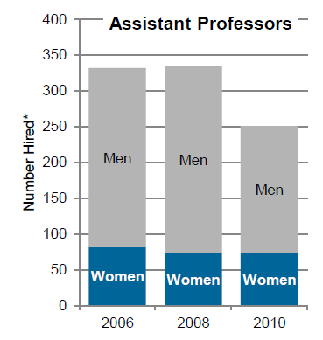
Men and Women among Newly-Hired Physics Assistant Professors
Notes:
Even though the total number of faculty members hired has dropped, the number of women has remained relatively constant since 2006.

Slide 23
Positions Held by New Hires
Bachelor’s Departments

Slide 24
Positions Held by New Hires
PhD Departments

Slide 25
Women

Slide 26
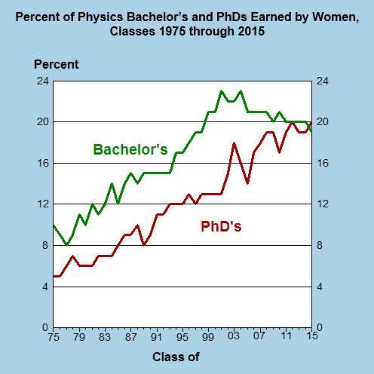
365
153
Notes:
The number of women earning physics PhDs has increased from 153 in the class of 2001 to 354 in the class of 2012, a 138% increase.
About 60% increase overall.

Slide 27
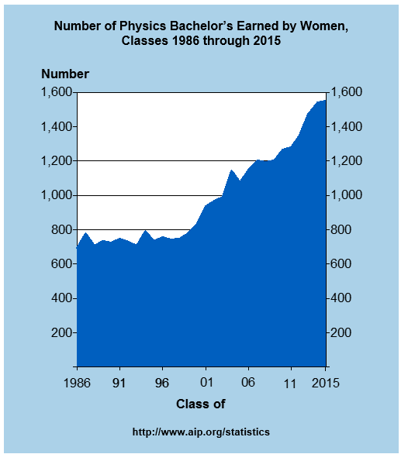

Slide 28
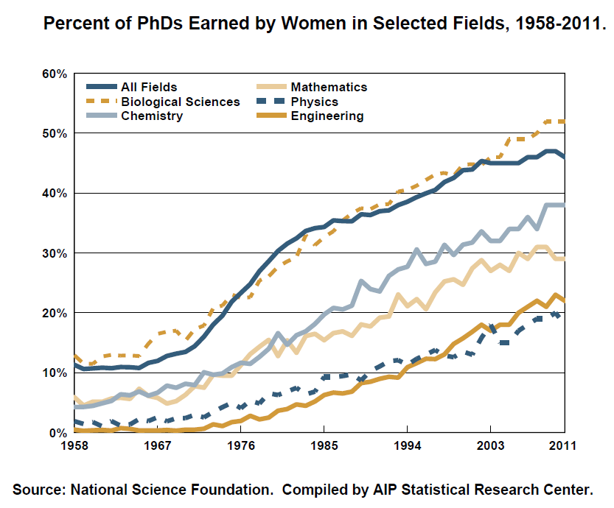

Slide 29
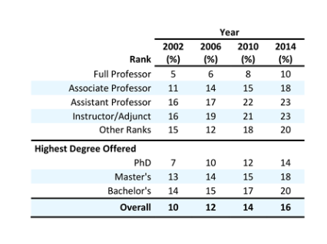
WOMEN AMONG PHYSICS FACULTY MEMBERS

Slide 30
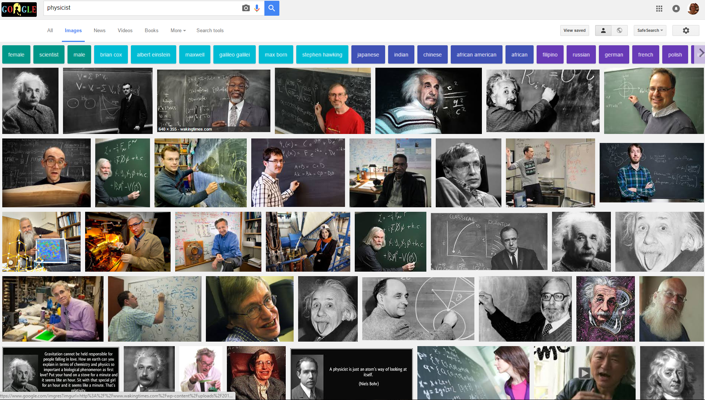

Slide 31
Under-represented Minorities

Slide 32
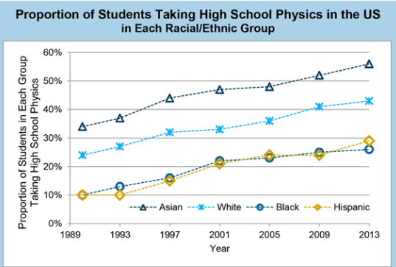
A closer examination of the data reveals that these differences are likely driven more by socioeconomic factors than by race.

Slide 33
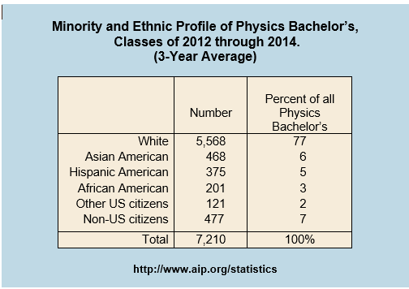
Notes:
From Sept 2012 physics bachelor’s degrees report

Slide 34
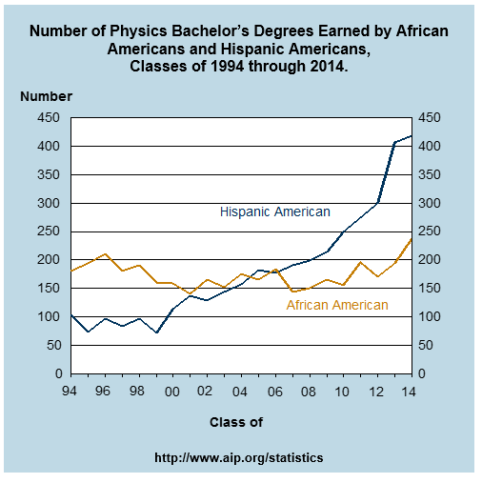

Slide 35
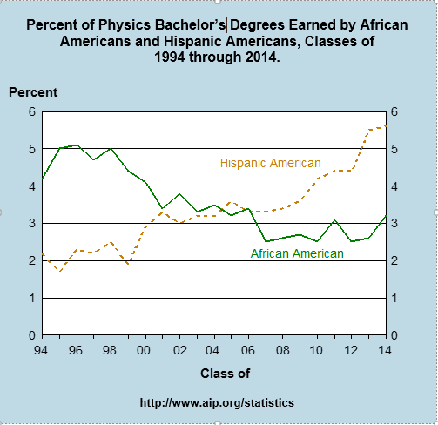

Slide 36
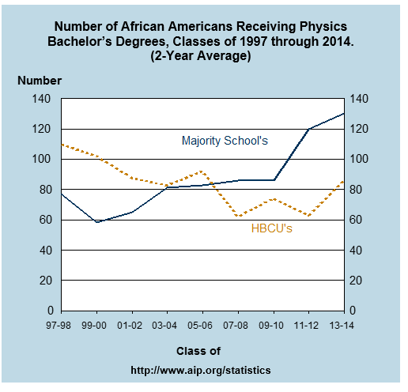

Slide 37
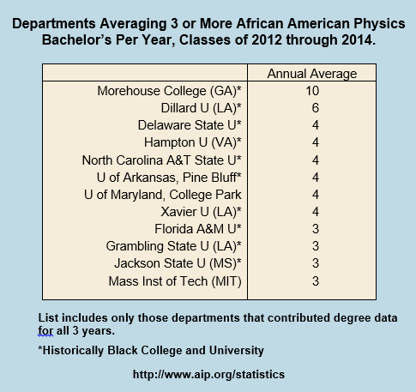

Slide 38
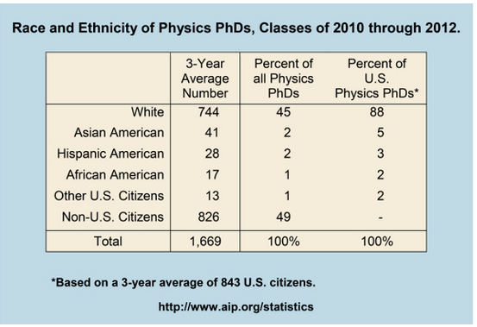

Slide 39
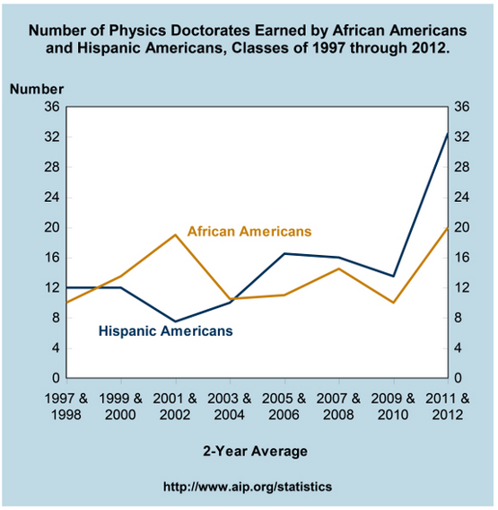

Slide 41
190
288
Notes:
In 2012, there were 288 Hispanic and 190 African-American faculty members in physics departments.
About half (89 of 190) of African-American physics faculty members are employed by physics departments at HBCUs, which account for only 4% (30 of 746) of all physics departments. Half of all African-American physics faculty members work at just 23 departments, meaning that most physics students will never see a black faculty member.

Slide 42
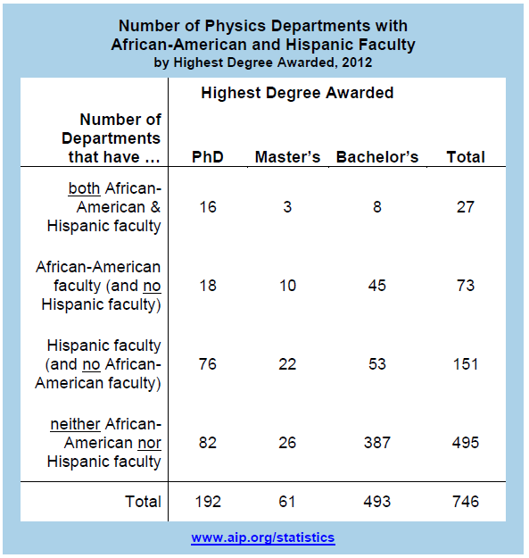
Notes:
Two-thirds have no Hispanic or black faculty.

Slide 44
Will increasing representation fix everything?
Data should be collected on other important areas
  Salary
  Workplace environment
Even with equal representation, some groups could have limited access to resources and opportunities

Slide 45


Global Survey of Physicists
Opportunities and resources
Employment sector
Economic
development
Age
Sex

Slide 46
Thanks to my colleagues
Susan White, Laura Merner, and Patrick Mulvey

