Slide 1
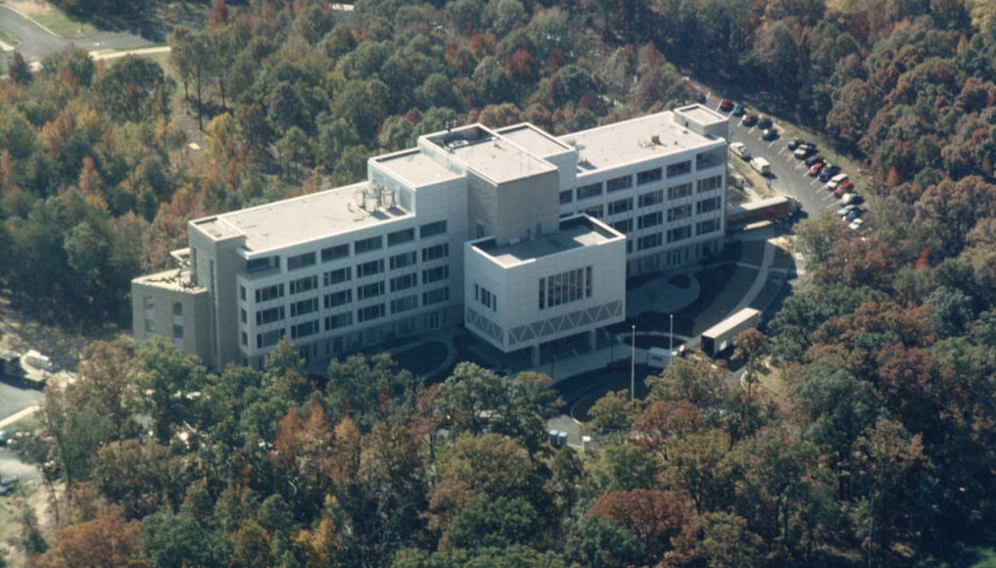
Pathways to
Leadership at AAPT
AAPT Webinar
May 10, 2017
David Sokoloff
University of Oregon
AAPT Way-Way Past President (2011)

Slide 2

AAPT has identified four critical issues that will guide future activities:
Increase AAPT's outreach to and impact on physics teachers
Increase the diversity and numbers of physics teachers and students
Improve the pedagogical skills and physics knowledge of teachers at all levels
Increase our understanding of physics learning and of ways to improve teaching effectiveness
How can you get more involved in AAPT and contribute to these goals?

Slide 3

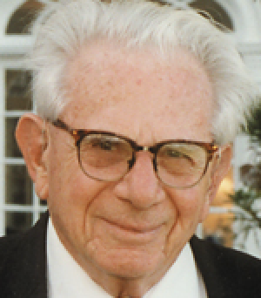
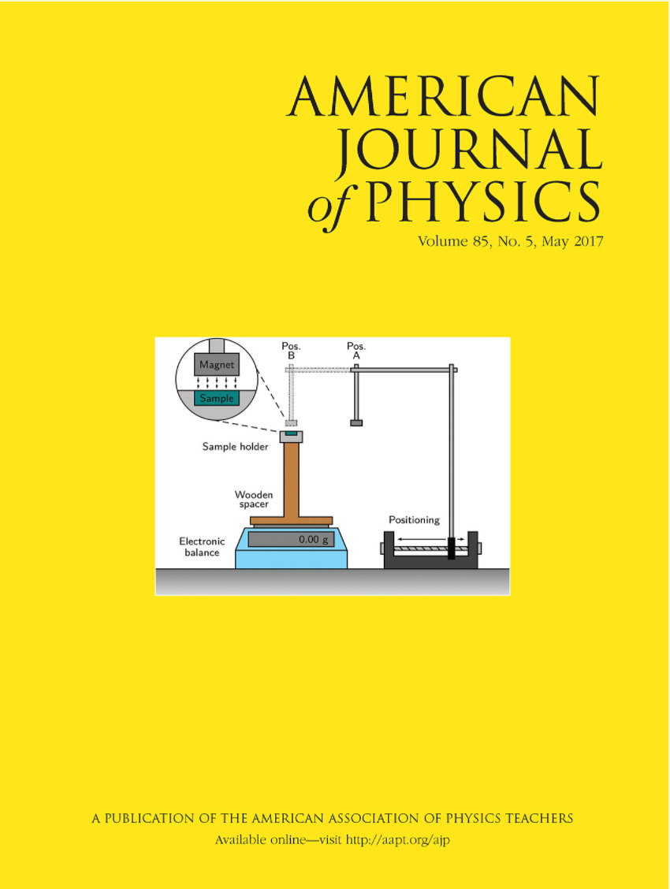
An Example: My AAPT Leadership Path
Arnold Arons during Q & A: “this is just another example of the ridiculous trend to dumb down physics courses, which then serve no useful purpose.” (paraphrase)
1977-78: First papers published in American Journal of Physics and The Physics Teacher, about MEL.
1978-87: Attended meetings sporadically.

Slide 4

1987: Presented my first computer-based labs workshop at an AAPT meeting, WM1987 in San Francisco, while on sabbatical leave at Cal Poly, SLO.
1987-present: have attended most meetings (but not WM2006 in Anchorage or SM2008 in Edmonton). Presented workshops at most of these meetings.
1995: presented first Working Tutorial on Interactive Lecture Demonstrations at SM1995, Spokane. Presented tutorial pretty much every meeting since.
1992-95: appointed to Research in Physics Education Committee, became co-chair.
An aside in 1997: Arnold Arons gave colloquium at University of Oregon. He apologized for not contacting me about working on an advisory committee on which we were both serving. (I don’t think he remembered my talk in Anaheim!)
1997: Honored by AAPT with a Distinguished Service Citation.

Slide 5
I became a very disgruntled member, finding a number of changes in workshop procedures and other policies inefficient, misdirected and annoying!
2007: I was awarded the Millikan Award by AAPT.
Fall, 2008: A colleague asked permission to nominate me for the Vice Presidential election, I said yes, and the rest is history . . .
I made a lot of friends and learned a lot during 2009-2012 as VP, President Elect, President and then Past President.
I presided over the transition to a new Executive Officer, supported the growing PER community, and helped to fix and stabilize AAPT’s budget.
Fortunately, the current leadership and staff were not around back then!!

Slide 6

And now as way-way past President of AAPT, here I am . . .
Are you interested in taking a leadership role in AAPT?
Could this be your path?
Well, probably not exactly like mine, but one thing is for sure:
AAPT is an organization that is run by its members. The more you contribute, the stronger AAPT is!
We invite you to do more.
In the remainder of this webinar, I’ll give you some details on many of the things you can do:
Attend a national meeting | Nominate a member for an award
Present a workshop, talk or poster | Submit a paper to an AAPT publication
Serve on or chair an Area Committee | Serve on the Executive Board
Join a Topical or Associated Group | Check out other opportunities

Slide 7
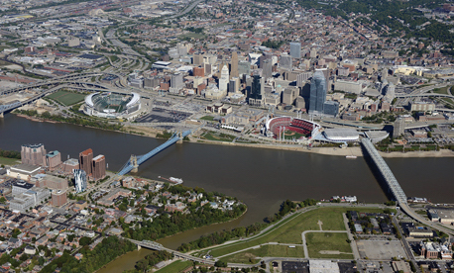
Attend SM2017 in Cincinnati or WM 2018 in San Diego
Attend a national meeting
Cincinnati Marriott
at RiverCenter
Be there
July 22-26!

Slide 8
Early Bird registration for SM2017 with substantial savings ends May 31!
40 workshops/tutorials on Saturday and Sunday
Plenaries:
John C. Brown: “Black Holes and White Rabbits”
Frances Slakey, Georgetown University, author of best-seller, To the Last Breath
Julianne M. Pollard-Larkin: MD Anderson Cancer Center, University of Texas
100’s of parallel invited and contributed talks and posters
Exhibit area with apparatus and books to explore (and free refreshments and drawings for prizes)
Awards plenary sessions and lots more—as always!
Physics Education Research Conference (PERC) follows!

Slide 9
Present a workshop, talk or poster
Tomorrow, May 11 is the last day to submit an abstract for SM2017!
To submit, you need to be a member or be sponsored by a member.
Can respond to a call for papers: http://aapt.org/conferences/call4papers.cfm, or submit on any topic related to physics education. Papers are sorted into sessions by volunteers at biannual paper sorts. (You can help with this too!!)
Poster or oral presentation abstract requirements are on the AAPT website: http://www.aapt.org/conferences/aapt_abstractrequirements.cfm
To propose a session or workshop, you must contact the Chair of the appropriate Area Committee: http://aapt.org/aboutaapt/organization/chairs.cfm
There are 19 Area Committees, each focused on a specific interest of AAPT, and each charged with proposing workshops and sessions for meetings.

Slide 10
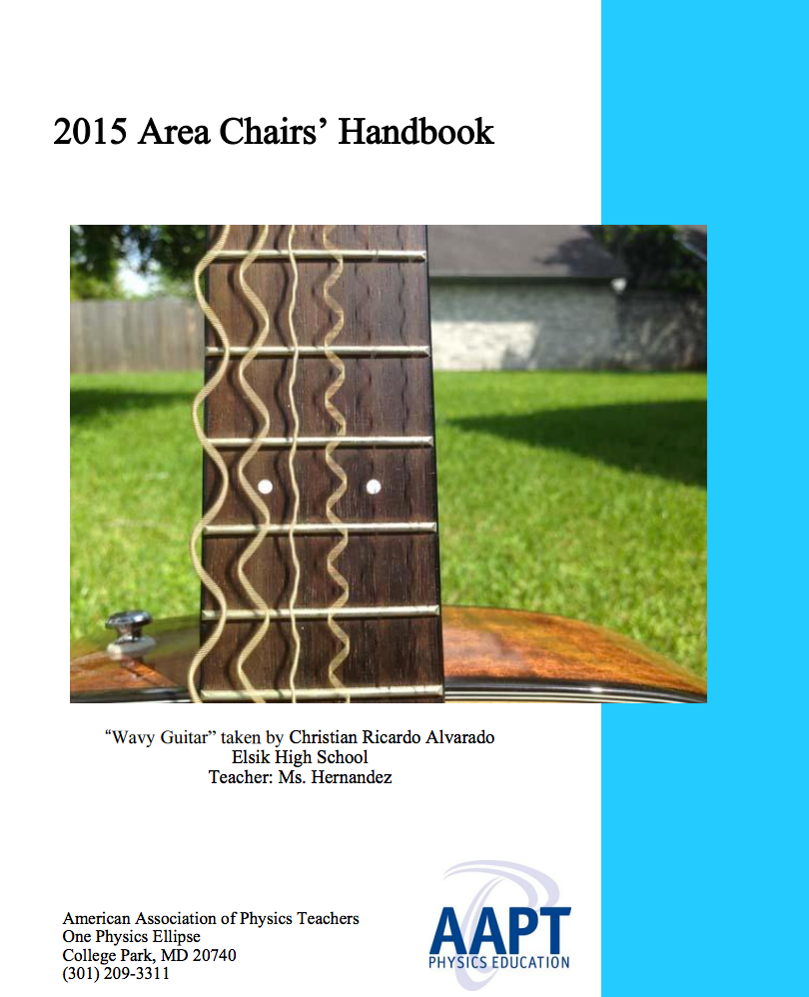
AAPT Area Committees
Committee on Apparatus
Committee on Diversity in Physics
Committee on Educational Technologies
Committee on Graduate Education in Physics
Committee on the History and Philosophy of Physics
Committee on the Interests of Senior Physicists
Committee on International Education
Committee on Laboratories
Committee on Physics in High Schools
Committee on Physics in Pre-High School Education | Committee on Modern Physics
Committee on Physics in Two-Year Colleges
Committee on Physics in Undergraduate Education
Committee on Professional Concerns
Committee on Research in Physics Education
Committee on Space Science and Astronomy
Committee on Teacher Preparation
Committee on Women in Physics
Committee on Science Education for the Public

Slide 11
Serve on or chair an Area Committee
Besides proposing sessions and workshops, Area Committees
Advise the Executive Board, the Executive Office, and the Association at-large on issues relating to their areas of focus.
Are encouraged to take leadership roles in their areas of interest.
Are looked upon to identify related issues and practices of significance and to carry out projects and initiatives to advance the mission of AAPT.
Serve AAPT as think tanks and working groups in their areas of interest.
If you are interested, you should
Attend the Area Committee meetings of your choice (no need to be a member) and eventually let the chair know that you want to be a member.
Of the nine members on an AC, six are appointed by the Nominating Committee and three by the President-Elect.
Members must be willing to attend at least four of the six national winter and summer meetings during their three-year term.

Slide 12
Join a Topical or Associated Group
Physics Education Research Topical Group (PERTG)
Topical Group within AAPT, formed for those with a special interest in research on the teaching and learning of physics.
The Physics Education Research Leadership and Organizing Council (PERLOC) is elected by PERTG to serve as the representative body for community decision-making.
To become part of the PERTG, AAPT members may self-identify and pay an annual fee of $40 ($15 for students). These funds are used for:
Costs related to the annual Physics Education Research Conference (PERC)
Financial support for PER-Central, the online clearinghouse to PER-based materials, research results and publications
General support for PER activities within AAPT

Slide 13

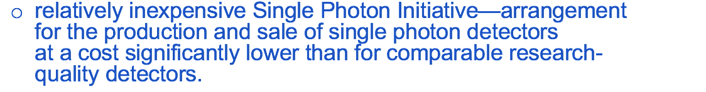
Advanced Laboratory Physics
Association (ALPhA)
Association of college and university faculty and staff dedicated to advanced experimental physics instruction.
Independent and separate from the American Association of Physics Teachers (AAPT), but works with AAPT to advance instruction.
$30 dues
ALPhA's main projects for 2017 include
organizing the third Conference on Laboratory Instruction Beyond the First Year (BFYIII)
continuing the ALPhA Laboratory Immersions Program—providing participants with two to three days of intensive hands-on work with a single advanced laboratory experiment.

Slide 14
Nominate a member for an award
Hans Christian Oersted Medal
John David Jackson Award for Excellence in Graduate Physics Education | Homer L. Dodge Citation for Distinguished Service to AAPT
David Halliday and Robert Resnick Award for Excellence in Undergraduate Physics Teaching | Paul W. Zitzewitz Award for Excellence in K-12 Physics Teaching
Robert A Millikan Medal | Richtmyer Memorial Lecture Award
Klopsteg Memorial Lecture Award | AAPT-ALPhA Award
Melba Newell Phillips Medal | AAPT Fellowship
Complete the nominations form and submit nominations by email to the AAPT Awards Committee.
http://aapt.org/Programs/awards/upload/AwardsNominationFormonlinev3.pdf
AAPT also has recognition programs for excellent high school students, and college/university learning assistants and teaching assistants.

Slide 15
Submit a paper to an AAPT publication
Share your teaching ideas and PER
with other members of the Physics
Education community in one of AAPT’s
peer-reviewed journals.
The Physics Teacher focuses on teaching introductory physics at all levels.
The American Journal of Physics is geared to a more advanced audience, primarily at the college level.
Physical Review Special Topics - Physics Education Research is an electronic-only journal with the same high scholarly and technical standards of all the Physical Review journals. It is a publication for the full range of experimental and theoretical research on the teaching and/or learning of physics.
Details about submission of papers can be found at: https://www.aapt.org/Publications/

Slide 16
Serve on the Executive Board
A nomination for any Executive Board position may be submitted at any time during the year. AAPT members simply submit the Nomination Form to any member of the Nominating Committee.
Elections for vacant positions are held annually September - November for terms beginning at the conclusion of the next winter meeting.
The positions are:
Vice President. Serves four years as Vice President, President-Elect, President, and Past President.
Secretary. Serves two years with a maximum of three consecutive terms.
Treasurer. Serves two years with a maximum of three consecutive terms.
Member-at-Large. Serves three years with no consecutive terms. Election rotates annually among High School Representative, Two-Year College Representative, and Four-Year College and University Representative.

Slide 17
Check out other opportunities
Found or become faculty adviser to an SPS (Society of Physics Students) chapter on your campus. Check out AIP’s SPS webpage: https://www.spsnational.org/
Become active in your state or regional AAPT Section. See: http://aapt.org/Sections/
Become involved in physics teacher preparation through PhysTec: http://www.phystec.org/
Nominate a student for a Barbara Lotze Scholarship for Future Teachers: https://www.aapt.org/programs/grants/lotze.cfm
Coach and/or sponsor members of the U.S. Physics Team to compete at the International Physics Olympiad Competition. https://www.aapt.org/physicsteam/2017/
Sponsor and/or proctor the AAPT Physics Bowl exam at your school: https://www.aapt.org/Programs/PhysicsBowl/index.cfm
Encourage your colleagues and students to join AAPT!

Slide 18
Become an AAPT Leader
It will make your membership more fulfilling, and you will be better serving the cause of physics (and STEM) education nationally and internationally!

Slide 19
Questions?

