Slide 1
Building Better (and More) Physics Educators
Beth A. Cunningham
Executive Officer
American Association of Physics Teachers
Notes:
General outline:
Overview of the problem – the need for highly qualified physics teachers
Current status of high school physics courses and teachers – building the case for more being produced in pre-service and better support of in-service
Producing more pre-service physics teachers through PhysTEC
Supporting new teachers (induction) via eMentoring
Supporting new and experienced teachers through PTRA
Providing resources for students and teachers

Slide 2
Why should we be concerned about who is teaching high school physics?
A physics degree is not required for being an effective physics teacher but the most consistent and powerful predictor of student achievement in science and math is a teacher who is fully certified and has at least a bachelor's degree in the content area. (from Rising Above the Gathering Storm)
The number of students taking high school physics is increasing nation wide.
Physics is needed more and more for developing future technically proficient workforce and an educated populace.
We need to be equitable and provide equal access to all students independent of socioeconomic background!
Notes:
While having a physics degree is not required for being an effective physics teacher, the National Academies' report Rising Above the Gathering Storm stated that the most consistent and powerful predictor of student achievement in science and mathematics is a teacher who is fully certified and has at least a bachelor's degree in the content area.

Slide 3
Need for High School Teachers

Slide 4
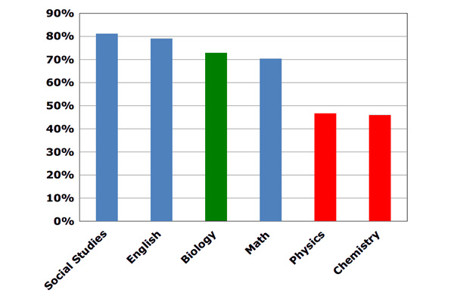
High School Classes Taught By Teacher with Degree in the Field
Source: Schools and Staffing Survey

Slide 5
HS Physics Teacher Education Background
http://www.aip.org/statistics

Slide 6
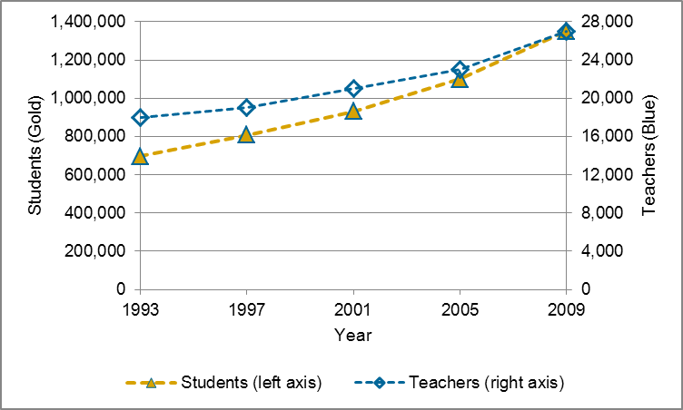
Number of Students and Teachers in High School Physics All U.S. High Schools
http://www.aip.org/statistics

Slide 7
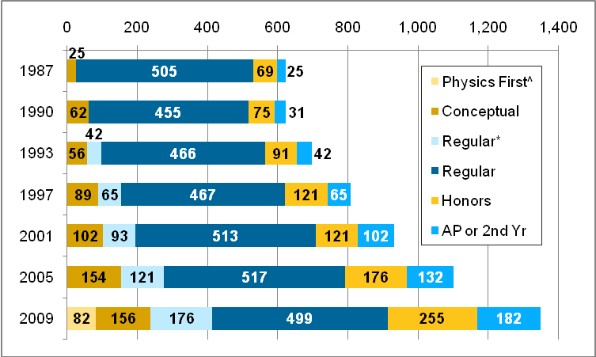
Physics Enrollment in U.S. High Schools by Type of Course, 1987 – 2009 (numbers in 1,000s)
^ Physics First was explicitly included in the list of courses for the first time on the 2008-09 survey.
*Regular course taught using conceptual text.
http://www.aip.org/statistics

Slide 8
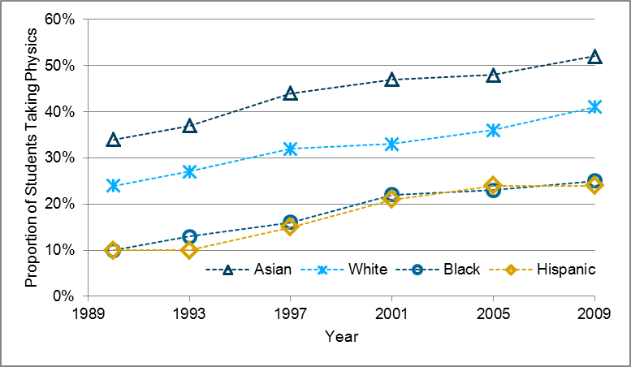
Proportion of Students in Each Racial or Ethnic Group Taking Physics* All U.S. High Schools
*A closer examination of the data reveals that these differences are likely driven more by socioeconomic factors than by race.
http://www.aip.org/statistics

Slide 9
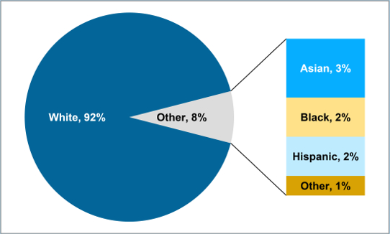
Proportion of HS Physics Teachers in Each Racial or Ethnic Group, 2008-09 All US High Schools
http://www.aip.org/statistics

Slide 10
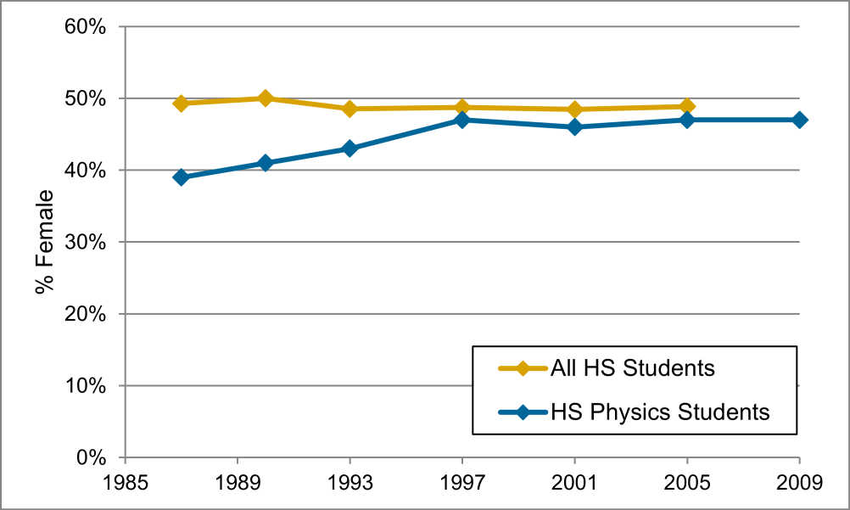
Proportion of Females among US High School Students All US High Schools
Data for all high school students from US Department of Education, National Center for Education Statistics
http://www.aip.org/statistics

Slide 11
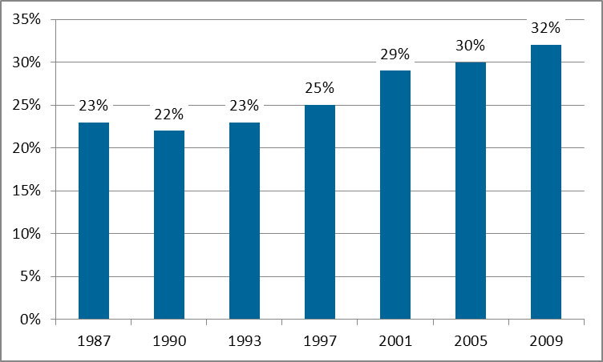
Women among High School Physics Teachers
http://www.aip.org/statistics

Slide 12
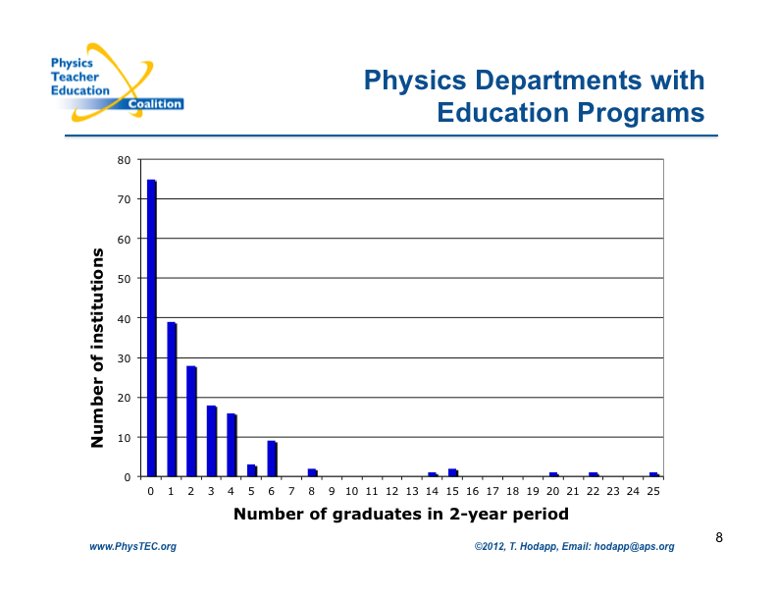

Slide 13
Location of PhysTEC teachers
Teach within X miles of their institution
62% 50 miles
22% 50-200 miles
16% >200 miles
PhysTEC Teachers: 67 respondents

Slide 14


PhysTEC Project Goals
Transform physics departments to engage in preparing physics teachers
Demonstrate successful models for increasing the number of highly-qualified physics teachers
Spread best-practice ideas throughout the physics teacher preparation community

Slide 15


PhysTEC Project
National Coalition
National conference
Community leaders
Topical workshops
Sharing innovative ideas
Broad dissemination
290 member institutions
Demonstration Projects
Comprehensive (< $300k)
All key elements
Teacher in Residence
Targeted sites (< $75k)
Innovative ideas, smaller sites
National models
Institutional support
Now 31 supported sites

Slide 16
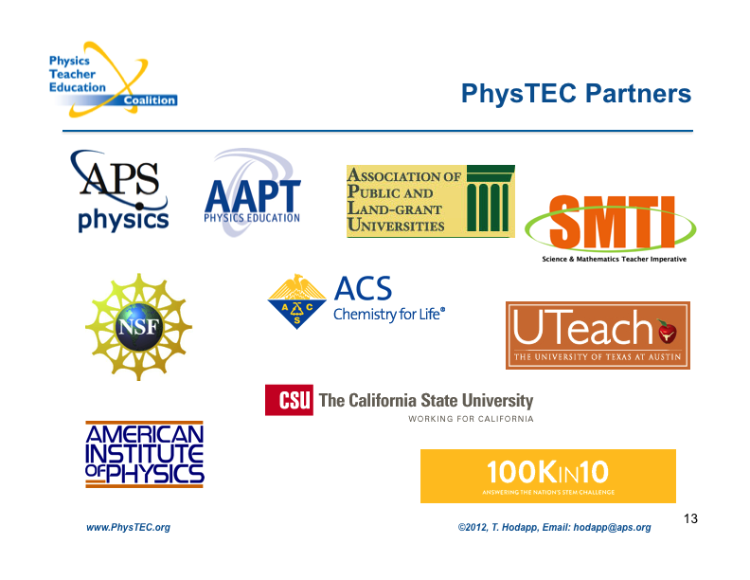

Slide 17
PhysTEC Components
Recruitment
Teacher-in-Residence
Course Reform
Learning Assistants (exposure to teaching)
Collaboration
Teacher Advisory Groups
Induction / Mentoring
Sustainability

Slide 18
Key Element: Champion
Promote/lead program from within Physics Dept.
Contact with administration to build long-term support
Faculty advocate
Student advocate
Obtain funding
Bridge between Physics/Education/K-12 schools
Knowledge of issues/literature
Recruiting lead

Slide 19
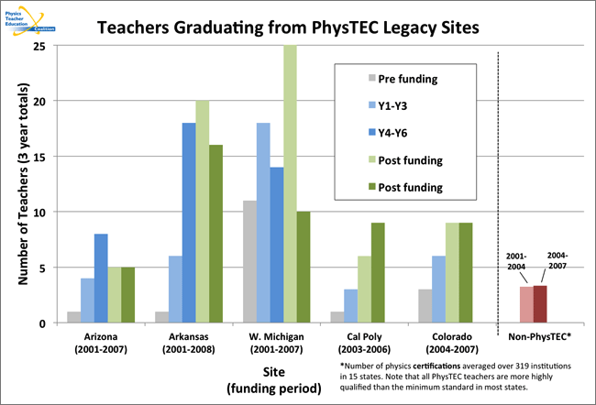
PhysTEC Project Outcomes

Slide 20
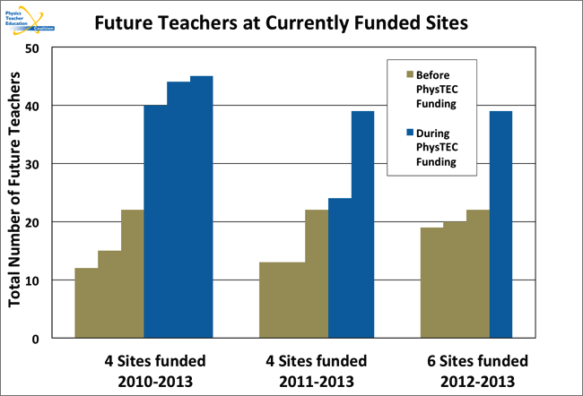

Slide 21
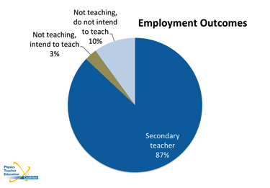
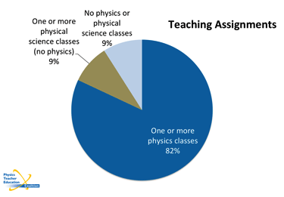
PhysTEC Graduates Go On To Teach Physics
Three year retention rate (PhysTEC): 76%
Three year retention rate (All K-12): 74%
(Source: DoEd)

Slide 22
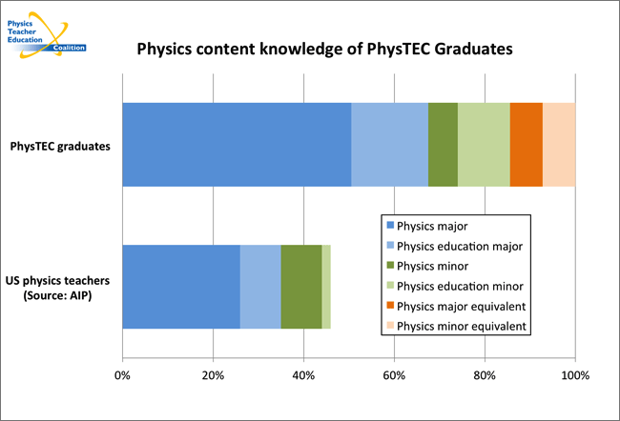
PhysTEC Graduates Have Strong Content Knowledge

Slide 23
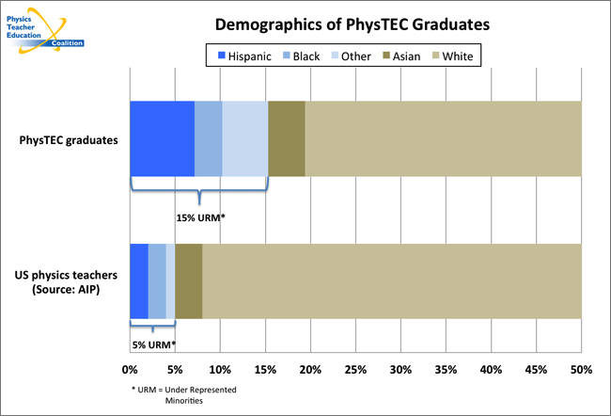
PhysTEC Sites Increase Diversity of Physics Teacher Workforce

Slide 24
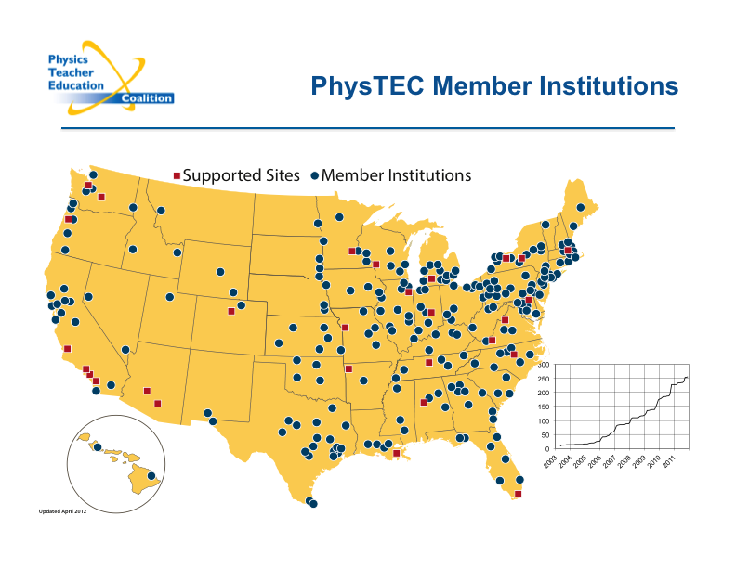

Slide 25
New Solicitation
3 comprehensive, 3 (?) sites focused on recruiting majors
Initial proposals Spring 2014 (RFP available on 3/31/14 and pre-proposals due 5/12/14, must be PhysTEC member)
Final proposals Fall 2014 (deadline for those invited is 9/8/14)
Sites begin Fall 2015
Extended timeline for more planning
Opportunity to experiment

Slide 26
What About Teachers Already in the Field Teaching Physics or Assigned to Teach Physics?
We can’t rely only on graduating more physics teachers in the near future to meet the need
Most teachers of physics don’t have degrees in physics or physics education (“cross over” teachers)
The first few years can be very challenging
Many teachers leave the field after 3 – 5 years
Most schools require continuous professional development
Teachers learn best from peers
Notes:
THE NEED CAN’T BE MET SOON BY PRODUCING MORE TEACHERS THROUGH PRE-SERVICE PROGRAMS!!

Slide 27

Designed to connect high school physics educators teaching physics for the first time and who desire additional guidance with experienced high school physics educators
Is the “match.com” for new high school physics teachers to gain insight from master teachers and have a long term (1 year or more) relationship

Slide 28
Outcomes of eMentoring
An evaluation of the first few years indicates that
over 90% of the Mentees who participated believe that having an eMentor has increased the likelihood that they will continue teaching
75% predicted that they would remain in teaching for four or more years. (50% predicted more than 10 years!)
Planning to expand to “instant mentor” to assist new teachers with questions (“I need to know for tomorrow’s class”)

Slide 29


AAPT Physics Teaching Resource Agents (PTRA)
Peer led profession development for in-service teachers of physics and physical science: workshops with teachers teaching teachers
PD on physics content, teaching techniques based on research in physics education, technology
Workshops are hands-on giving participants the opportunity to experience activities as their students would.
Activities at a variety of levels from low tech to high tech.
Institutes to develop teacher leaders (as PTRA’s) to offer PD
Teachers develop teacher resources
(Funded by NSF between 1986 and 2010 and with support from APS)

Slide 30
Impact on Content: Did they learn anything?
N pre = 664
N post = 645
Notes:
consistent low pre scores and always increase in post, even though magnetism was not always addressed
The questions were not easy questions as is seen by the pre and post scores.

Slide 31
Gender Data
2010 Final NSF Report by EAT, Inc.
Notes:
Slide showing that the participants (students) had a greater percent change in content understanding than non-participant AND the females had a larger gain than the males. So basically you went from 35% to over 90% for the participant females

Slide 32
Average Percent Change
Notes:
Summary of all 2006 and 2007 students. I would need to go back and find N….can’t believe it was not on slide….yikes

Slide 33
What Worked
Partnerships between AAPT, university/college professors and PTRAs (workshops led by PTRAs)
Offering multiple opportunities to attend training (rotate years, sites and topics)
Predetermined and consistent curriculum (quality control)
PTRAs trained in curriculum, pedagogy, and adult learning methods
Assessments correlated to workshop objectives
ABC: Activity Before Concept; Active learning
Peer led professional development by AAPT certified master teachers
2010 Final NSF Report by EAT, Inc.

Slide 34
What Doesn’t Work
Spray and Pray (Smorgasboard Curriculum)
Inconsistency in hours of training
Inconsistency in curriculum/topics taught
Lack of storyline; discontinuity of Professional Development
Isolated lecture
Demonstrations/activities without applicable content
Free equipment without content context or training
Training teachers in equipment they don’t have
2010 Final NSF Report by EAT, Inc.

Slide 35

ComPADRE.org
Is a network of free online resource collections supporting faculty, students, and teachers in Physics and Astronomy Education
Physics Front includes lesson plans for appropriate grade levels and type of physic class (e.g. Physics First, conceptual, etc)
Physics To Go has fun physics photos and articles
Physical Sciences Resource Center provides education resources and simulations by subject (classical mechanics, E&M, optics, etc)

Slide 36





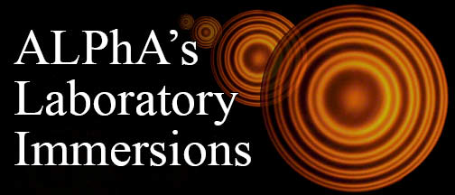



AAPT has much to offer!
American Journal of Physics
The Physics Teacher
Competitions for HS students
Meetings (Summer in Minneapolis)
Sections
And more

Slide 37
Questions?
For information about eMentoring and PTRA:
www.aapt.org
For information about ComPADRE:
www.compadre.org
For information about PhysTEC:
www.phystec.org

