Slide 1
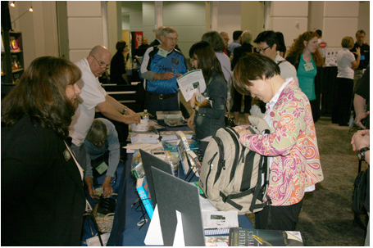
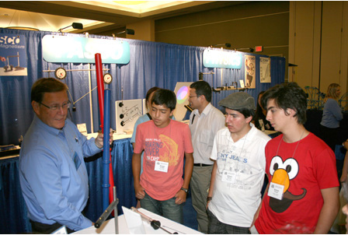
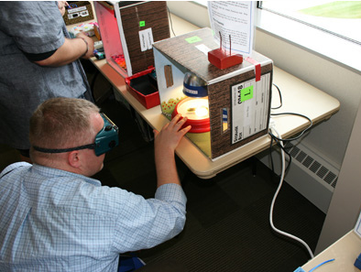
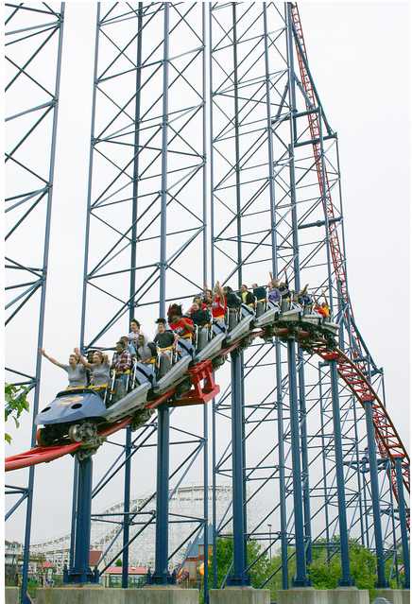

AAPT & Your Section!
Support and Resources
You CAN Use.
AAPT Membership
2013 Winter Meeting
Section Officers Exchange

Slide 2
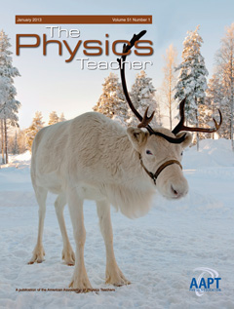
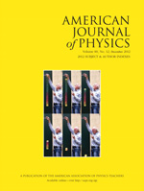

Leading in Knowledge
Professional Journals
  The Physics Teacher: 50 years of online articles to browse, save, and share with 3 free articles per issue. http://tpt.aapt.org/
  The American Journal of Physics: 80 volumes online. http://ajp.aapt.org/
  Physics Review Special Topics http://prst-per.aps.org/
The Physics Educator is an online blog for AAPT members
Free Resource pages for Pre-College (aapt.org/Resources/pre-college.cfm) and College/University (aapt.org/Resources/colluniv.cfm)faculty
ComPADRE (compadre.org/)
Physics Education Research Topical Group
Notes:
Physics education content is abundantly available on aapt.org and our journal websites. Share press releases, information from the eNNOUNCER, and AAPT’s social media site links.

Slide 3
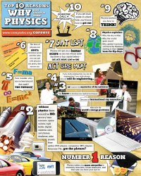

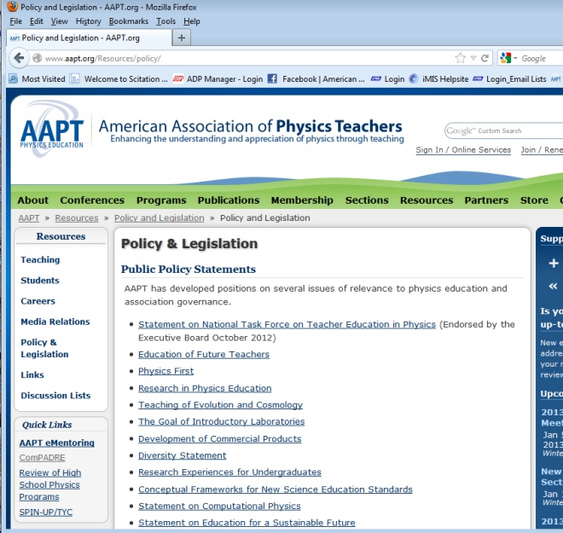
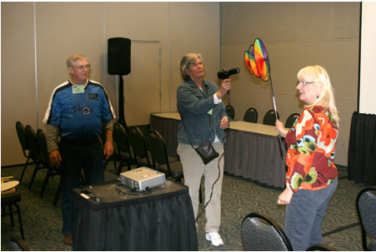
Winning with Resources
eMentoring
Physics Advocacy
Email Discussion Lists
Career Center
Continuing Education Units
Nationally recognized programs
  PTRA
  PhysTEC
Notes:
Many of AAPT’s resources are available at or near cost. Mentoring from an experienced physics educator is available through the eMentoring Program. Advocacy for Physics Education on a national scale includes participation in the Next Generation Science Standards with a group of members meeting to review the next draft of the standards being released on Tuesday, January 8.

Slide 4
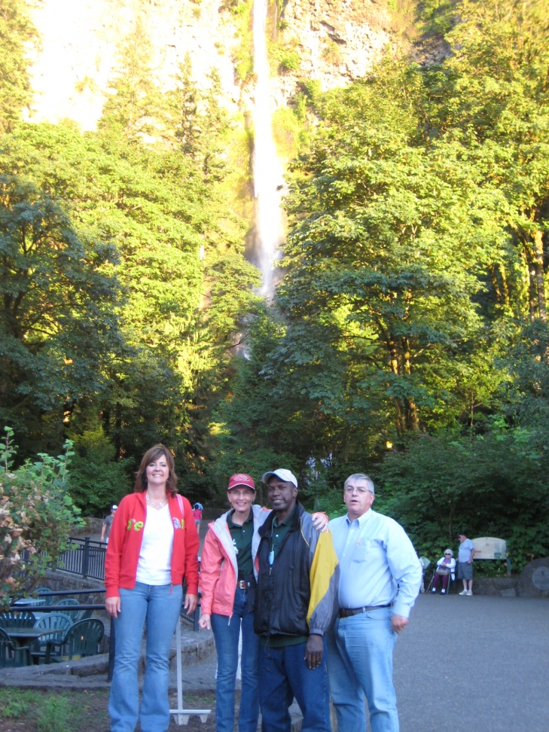
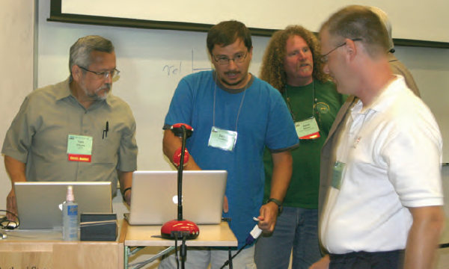
Success in Leadership
Local Committees/Advisory Boards
Sharing ideas with AAPT Section News
Local Meeting Promotion/Calendar of Events
Section Officers , Events, and contact information displayed on AAPT website
Funding for Section Representatives to attend Council Meeting
National AAPT member email list for sections
Notes:
Leadership opportunities help high school physics teachers seeking to attain a Proficient or Distinguished level of performance as defined in Enhancing Professional Practice: A Framework for Teaching, 2nd ed. by Charlotte Danielson (Alexandria, Va: ASCD, 2007). College and University physics faculty will enrich their pathway to tenure through membership and presentation at local meetings.

Slide 5
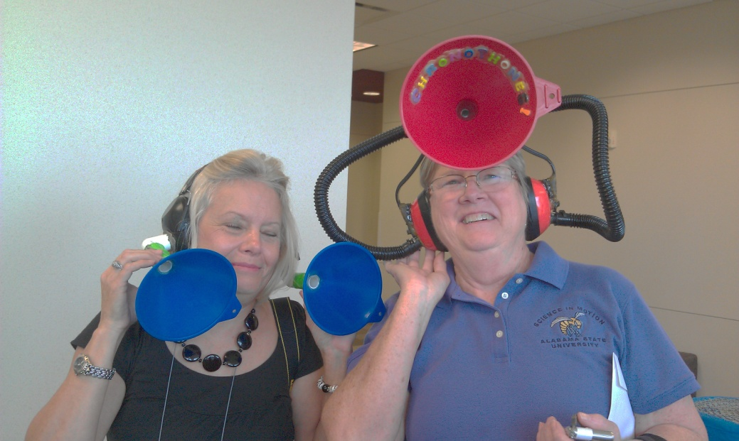
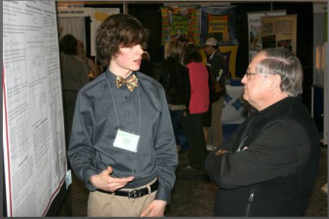
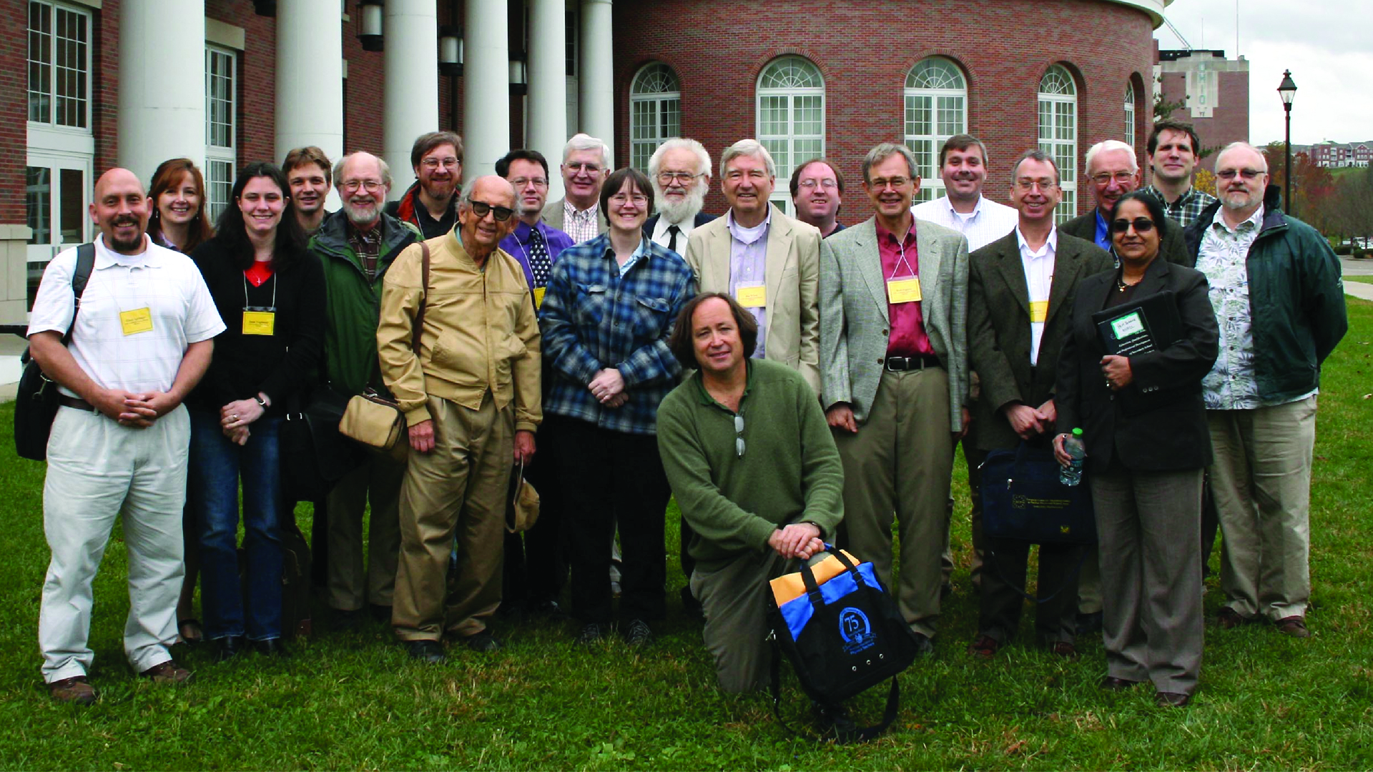
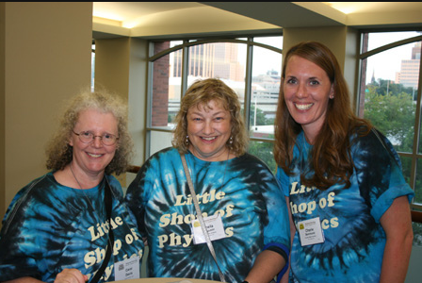
Unbeatable Personalities
Local Section Meetings
State AAPT Meetings
Physics Day at NSTA
Notes:
Members tell us that meeting other physics educators is what they like best about AAPT. We bet exciting and fun section meetings are a favorite draw for local educators as well! Read AAPT Section News to discover what other successful sections are doing.

Slide 6
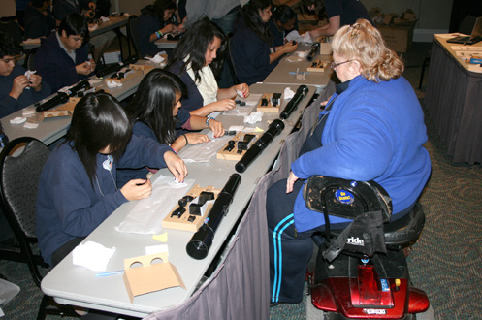
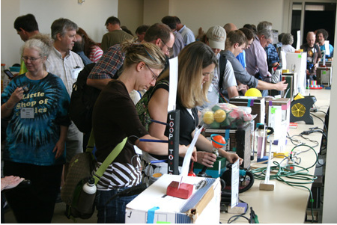
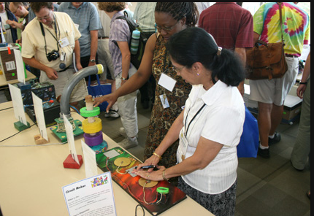
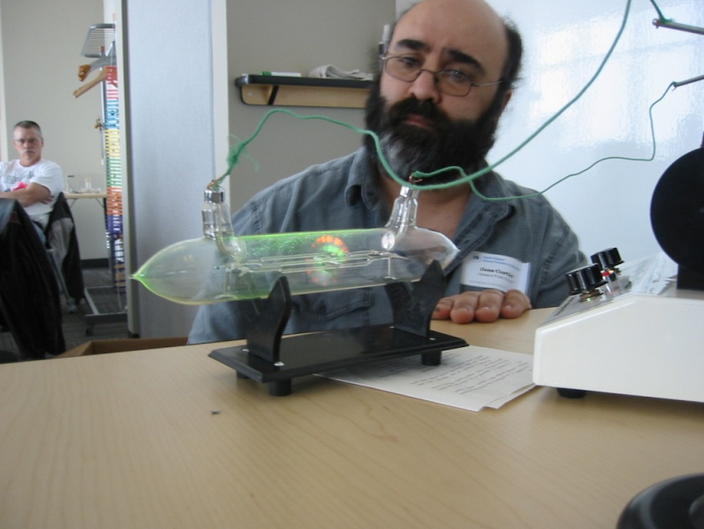
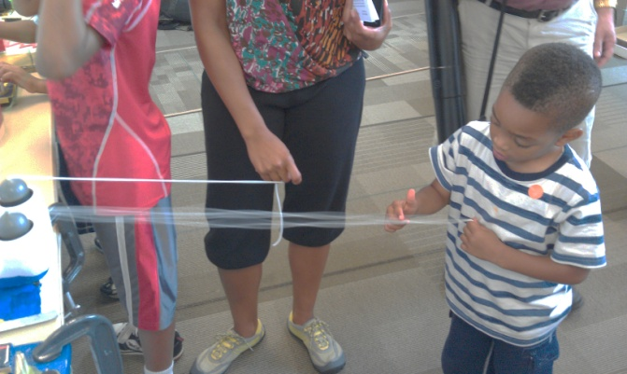
AAPT and You
Champions for Physics Education
aapt.org/sections
Notes:
For a complete list of the opportunities and support available to sections from AAPT visit aapt.org/sections.

