Slide 1
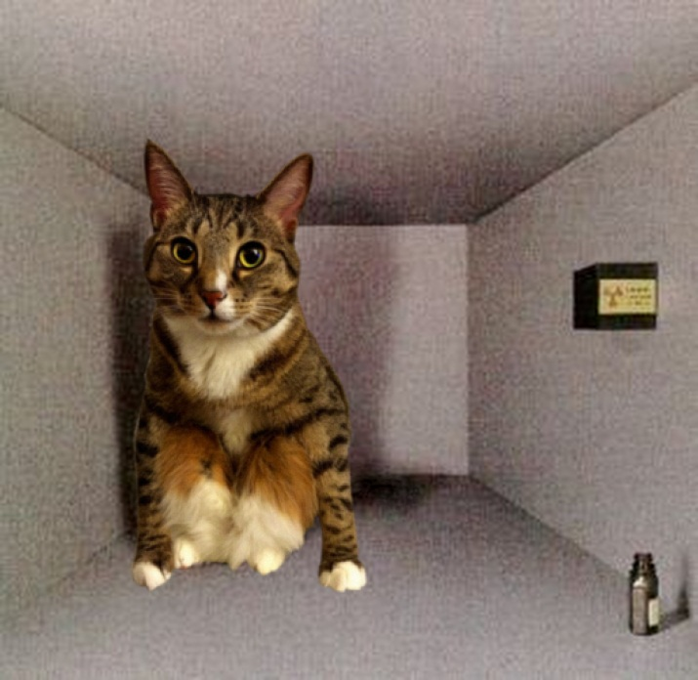
Teaching Quantum Mechanics and Quantum Statistical Mechanics to Sophomores
Deepthi Amarasuriya
Assistant Professor of Physics
Northwest College, Powell, WY

Slide 2
GREATER MATHEMATICAL SOPHISTICATION AT THE SOPHOMORE LEVEL
COMPUTATIONAL
* Material draws heavily upon recently acquired calculus techniques
e.g. integrating exponential functions by parts, separating variables,
AND
introduces lot of new techniques
e.g. basic PDEs, boundary value problems
* Introduces non - closed form solutions to differential equations ;
some require numerical techniques
CONCEPTUAL
More conceptually sophisticated math
mathematical spaces, operators as mathematical entities, statistical /
non - deterministic approaches

Slide 3
INCORPORATING CHALLENGING MATH CONTENT INTO A PHYSICS COURSE
How do you incorporate all this into a course
that introduces abstract Physics concepts?
Foundation for my approach (based on many years as a tutor/ T.A.)
First two semesters -
Material is obviously at an introductory level
Modern Physics -
Instructors may forget that students are encountering “advanced” topics at the
introductory level.

Slide 4
TYPICAL ACADEMIC BACKGROUND
PRIOR
Physics I : Newtonian Mechanics, mechanical waves, (brief) introduction to thermodynamics
Physics II : Electromagnetism , electromagnetic waves, Introduction to physical and geometrical optics, (brief) introduction to modern physics
Calc I, Calc II, Calc III surface and volume integrals, integration by substitution, introduction to vectors, simple variable separable equations
CONCURRENT
Differential Equations I : ODEs, variable separable differential equations
Possibly - Linear Algebra : Eigenvalues and eigenfunctions taught at the tail end of the course

Slide 5
ADDITIONAL MATH REQUIRED FOR QM, QSM (USUALLY TAUGHT AT THE JUNIOR LEVEL)
Vector spaces
Operator spaces
Expansion in basis functions
Eigenvalues and eigenfunctions
Orthogonality and orthonormality of functions
(Postulates of QM)
Partial differential equations (Schrödinger equation for the H atom)
Special functions (H atom angular wavefunctions, Riemann zeta function)
Discrete probability distributions (MB, BE, FD distributions)
Probability density functions (Blackbody radiation – in terms of λ, ν, etc.)

Slide 6
OVERVIEW INCORPORATING MATH PRINCIPLES
* Give printed notes with worked examples and math appendices.
* Use Power Point slides to show supplementary images and graphics.
* Use the “spiral approach’’ when teaching the math background.
Revisit at increasing levels of sophistication e.g. blackbody radiation
* Keep pointing out each time a specific math technique or principle is used.
(Most students may not be recognize a newly introduced usage in a different
context.)
* Include “conceptual math” questions in quizzes and exams. (Identification
only; no computations)

Slide 7
PRINTED CLASS NOTES - ADVANTAGES
Helps with the logistical challenge of presenting the material within a very limited time allocation.
* Allows for better student preparation
* More class time to do complete exercises by drastically cutting short on
transcribing time
* Students have the correct material (easy to make mistakes in copying down
complicated equations, detailed diagrams e.g. H wave functions in units of aB)
* Can present important proofs, and worked examples (use time saved from
writing down all the steps to point out the key steps/ details)

Slide 8
PRINTED CLASS NOTES – ADVANTAGES (CTD.)
Students have more time to focus on the concepts.
Students are too stressed out about completing HW on time, to really think about the underlying Physics and Math . (They are looking for a “quick fix”.)
Giving worked examples similar to HW problems gets students started on assignments.
Helps students who may feel too overwhelmed with the new materials / approaches to get started on their own initiative.

Slide 9
PRINTED CLASS NOTES - FORMAT
Beginning of each chapter and section
Overview of the general theme of the chapter /section.
Summary of the foundational principles to serve as motivation for the new material.
[Inspiration for writing style – Encyclopedias, reputable scientific blogs and articles for a non-specialist audience.]
In the body of the notes
Mathematically simple proofs, and those that explicitly show the usage of the assumptions
Fully worked out examples – Do at least the infinite square well before presenting postulates of QM.

Slide 10
PRINTED CLASS NOTES – FORMAT CTD.
In the body of the notes (ctd.)
Point out Math used; try to keep to the notation used by the text. (If deviating a lot, include list of your notation in printed notes.)
Math instructors may use different symbols especially with spherical and cylindrical coordinates.
If not using SI units, provide the transition clearly, and with several worked examples.
End of each section
Interpretation, significance of results, comparison with Classical Mechanics
More challenging proofs in appendices

Slide 11
PRINTED CLASS NOTES - APPENDICES
Math background in appendices – each section may include a few additional proofs showing how the math is applied:
(i) Mathematical spaces
(ii) Mathematical operators
(iii) Partial differential equations
(iv) Special functions
(v) Waves and vibrations
(vi) Statistical concepts
(vii) Standard integrals, advanced derivations
(viii)List of constants and formulae for quizzes and exams.

Slide 12
DEALING WITH POSSIBLE DISADVANTAGES OF PRINTED CLASS NOTES
Student inattention / absence –
* Do additional problems (including those similar to HW and exam
problems) in class.
* Give short in-class exercises (open notes/ books) worth a small
percentage of the grade.

Slide 13
Power Point slides
Supplementary graphics
* 3D images e.g. atomic orbitals
* Spectral line shifts
* Images of experimental techniques / apparatus
* Images of 20th c. Physicists with brief biographical sketches

Slide 14
HOMEWORK, QUIZZES and EXAMS
HW –
* Longer problems involving hand calculations
* Numerical solutions using graphing calculators and/ or math software
Quizzes – Simpler, shorter versions of exams
* Test basic concepts (many students may not be sufficiently ready for an exam)
* Break down question into several steps – guide students through steps
* Write the equation to be solved (do not solve)
* Conceptual questions (identifications of formulae and expression; know their
significance)
Exams –
* Numerical questions in story problem format
* Conceptual questions (identifications of formulae and expression; know their
significance)

Slide 15
IDENTIFICATION QUESTIONS - QM
Conceptual understanding of the underlying math
Identify each of the following equations:
Time independent Schrödinger equation for a spherical potential
(ii) Differential equation satisfied by the H atom radial wave function

Slide 16
IDENTIFICATION QUESTIONS - QSM
Identify each of the following equations in the case of a large assemblage of
identical particles:
Probability of an electron having energy E
Probability of a photon having energy E

Slide 17
IDENTIFICATION QUESTIONS - QSM
Definitions of technical terms
Match each phrase in column A with the most appropriate phrase in column B.
For the case of a large assemblage of identical particles:
A Number of particles with energy Ei
B Occupancy number n(Ei)
A Number of different states with the same energy Ei
[Alternate : Number of distinct ways particles could be rearranged to give the same energy Ei ]
B Degeneracy function g(Ei )

Slide 18
FORMAT - QUIZZES and EXAMS
* Quizzes – 1 hr; Exams – 2 hrs
* No index cards, notes or books allowed
* Calculators used only for numerical computations
* All required Physics/ Math formulae, physical constants and table of
simplest H wave functions provided
* Quiz solution key provided to students immediately after they hand in
completed quiz

Slide 19
Effectiveness of Modern Physics course (mainly QM and Special Relativity)
All students except one who has taken the course (introduced in 2007) have passed; almost everyone with A s and B s.
Number of students taking PHYS 2320 at my small (< 2000) community college has increased from 2-3 per semester to 6. The largest community college in WY (~ 4000 students) has an enrollment of around 8 per semester.
A student who took PHYS 2320 at my college recently graduated as a Physics major from the state college (UW) – the only community college student to have done so within the past 10 years. His senior thesis was a topic in quantum mechanics. Another was selected as one of 6 students from a competitive nationwide pool for an NSF funded Astronomy research project at UW. Recent alumni have requested my current version of the notes to help with their upper level classes.

Slide 20
Acknowledgements and References
Gautreau, R. Schaum's Outline of Modern Physics
Taylor, J., Zafiratos, C., Dubson, M., Modern Physics for Scientists and Engineers, Addison-Wesley
Image on title slide – Scott Danzig
http://sneakyghost.com/
Informal exchanges at Articulation meetings with Physics instructors from other community colleges in WY, and from UW .

