Slide 1
The Multipole Expansion of the Electric Potential and Non-Spherical Nuclei
John Karkheck
Marquette University
Summer Meeting
American Association of Physics Teachers
University of Minnesota
July 30, 2014

Slide 2

Electrostatic Potential

Slide 3


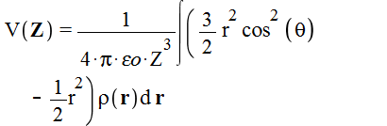
Multipole Expansion
Monopole term
Dipole term
Quadrupole term

Slide 4
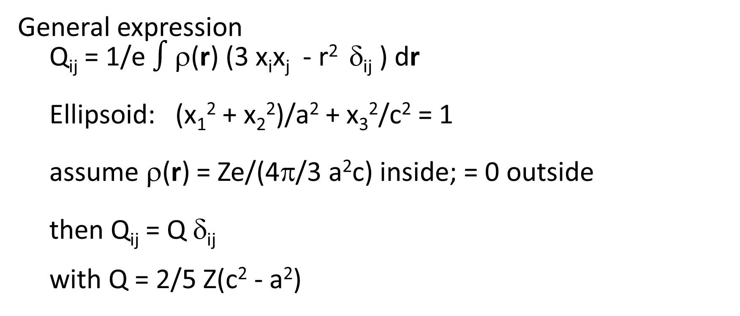
Electrostatic Quadrupole Moment
General expression
  Q_{ij} = 1/e $∫$ρ(r) (3 x_{i}x_{j} - r² δ_{ij} ) dr
  Ellipsoid: (x₁² + x₂²)/a² + x₃²/c² = 1
  assume ρ(r) = Ze/(4π/3 a²c) inside; = 0 outside
  then Q_{ij} = Q δ_{ij}
  with Q = 2/5 Z(c² - a²)

Slide 5
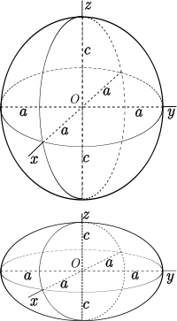
Ellipsoids
Prolate: Q > 0
Oblate: Q < 0

Slide 6
Measured Quadrupole Moment
Q_{m} = I (2I - 1) /((I + 1)(2I + 3)) Q
  I = nuclear spin

Slide 7
Closure
Arithmetic model
Nuclear radius
  R = R₀ A^{1/3}
  = (c - a)/R
  R = (a + c)/2
  Q = 4/5 Z R² δ
Geometric model
Nuclear density
4π/3 a²c = 4π/3 R³
c³ – 2.5 (I + 1)(2I + 3)/(I(2I-1)) (Q_{m}/Z) c - A R₀³ = 0

Slide 8
Table 1. Semimajor and semiminor axes obtained via arithmetic and geometric approaches to closure.
Arithmetic Geometric
Nucl. Spin Q_{m} (fm²) c a δ a²c/R³ c a
¹⁴N 1 2.02 3.516 2.269 0.431 0.748 3.707 2.555
⁴⁰K 4 -7.49 3.986 4.222 -0.058 1.028 3.947 4.185
¹⁵¹Eu 5/2 90.3 6.783 5.998 0.123 0.935 6.912 6.144
¹⁵³Eu 5/2 241 7.461 5.375 0.325 0.815 7.792 5.825
¹⁶⁷Er 7/2 357 7.672 5.544 0.322 0.817 8.010 6.002

Slide 9
Quadrupole Moment Influence
atomic and molecular spectra
nuclear quadrupole resonance
nuclear magnetic resonance
electron paramagnetic resonance
nuclear rotational spectra

