Slide 1
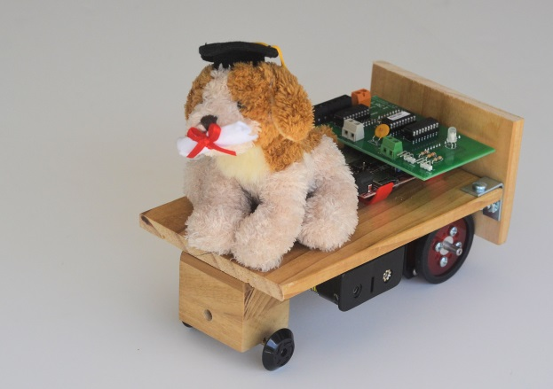
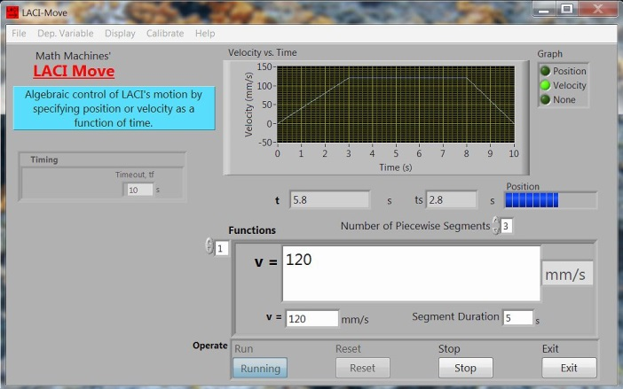
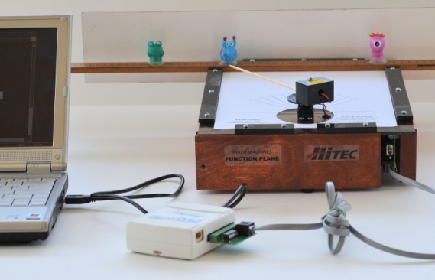
Using Kinematic Equations to Design and Control Linear Motions Session CG08 -- AAPT 2015 Summer Meeting
Fred Thomas & Robert Chaney
Sinclair Community College &
Learning with Math Machines

Slide 2
A True STEM Collaboration
A pair of Sinclair Community College professors from physics and math who have worked together for 25 years and tried to listen seriously to our colleagues in engineering and technical programs.
Fred is “retired” from college teaching, but still obsessed with finding better ways to incorporate rigorous math as a solid framework for all STEM careers
Bob Chaney is the 2013 US Professor of the Year for Community Colleges
Originated at Sinclair under a series of grants from the National Science Foundation and other sources. Outreach and many other activities were “spun off” to create an independent non-profit, 501(c)(3), organization Learning with Math Machines, Inc.
Our work has been supported by the National Science Foundation, Honda Manufacturing, Duke Energy, Vernier Software, National Instruments and more
Anxious to give away software and lots of other stuff, along with support for teachers in learning to use it.

Slide 3
Pedagogical Assumptions:
Kinematics is a critical bridging topic between math and physics classes. It SHOULD be an opportunity to help students:
think about equations as dynamic, functional relationships, and
better understand the central role of acceleration in physics.
Applications should be incorporated early in the learning process especially for students preparing for engineering, technical or medical careers. Physics and mathematicians analyze motion; engineers and technicians control motion.
Learning takes time and effort. Students are more likely to persist if they receive immediate, authentic, physical feedback about their work without being told explicitly that it is right or wrong.
Learning activities should be cost-effective in terms of time, space and resources. Capstone projects such as designing and building bridges, roller coasters or robots can be very valuable, but there is also a place for short, engineering-style tasks in which students design and test processes rather than building things from scratch.

Slide 4
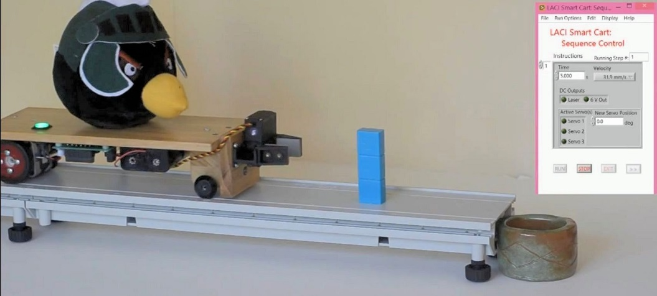
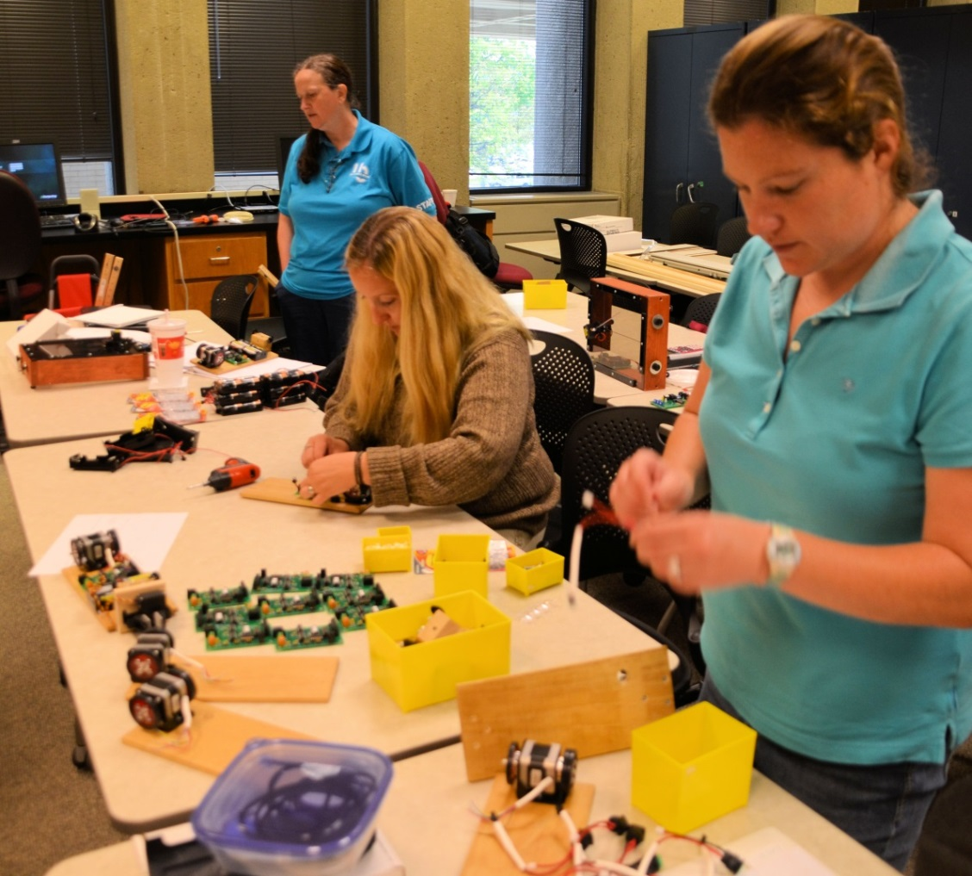
LACI Smart Cart (2014 version)
Printed circuit board
or
Breadboard (instructions at www.mathmachines.net)
Vernier SensorDAQ
or
National Instruments myDAQ
or
TI-84 calculator with CBL2
Free LabVIEW executable software
and TI Basic programs at
www.mathmachines.net

Slide 5
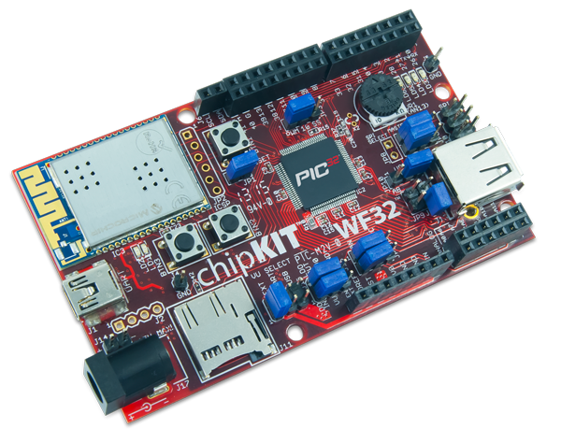
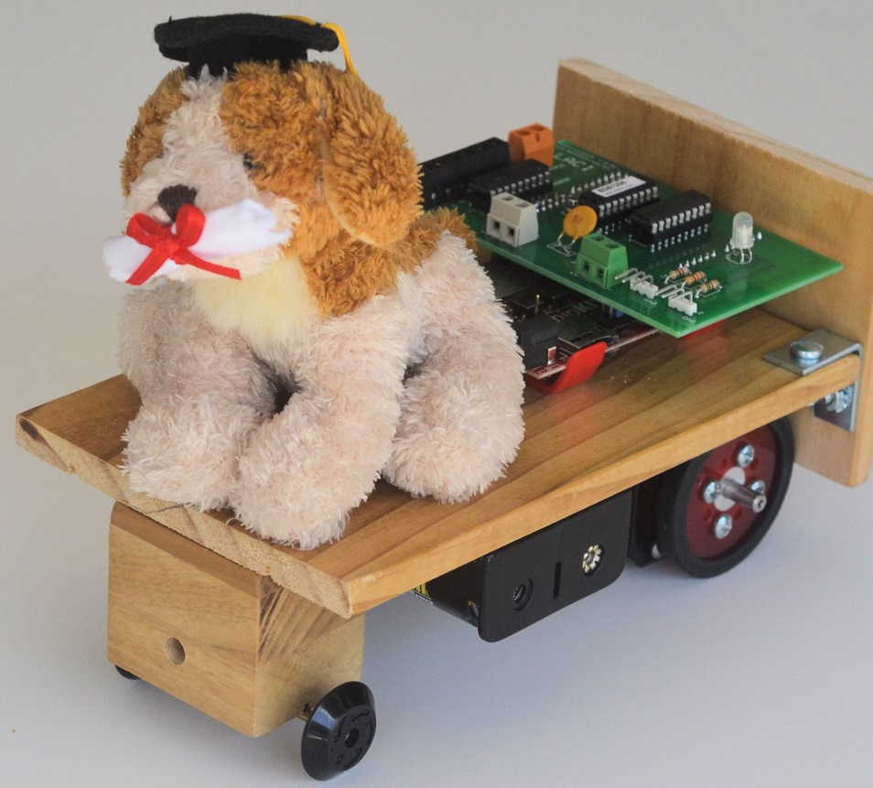
The Next Generation LACI Smart Cart
Based on the Arduino-related
Digilent chipKIT WF32
We intend to release source code at
www.mathmachines.net
and
www.labviewmakerhub.com
Looking for collaborators

Slide 6
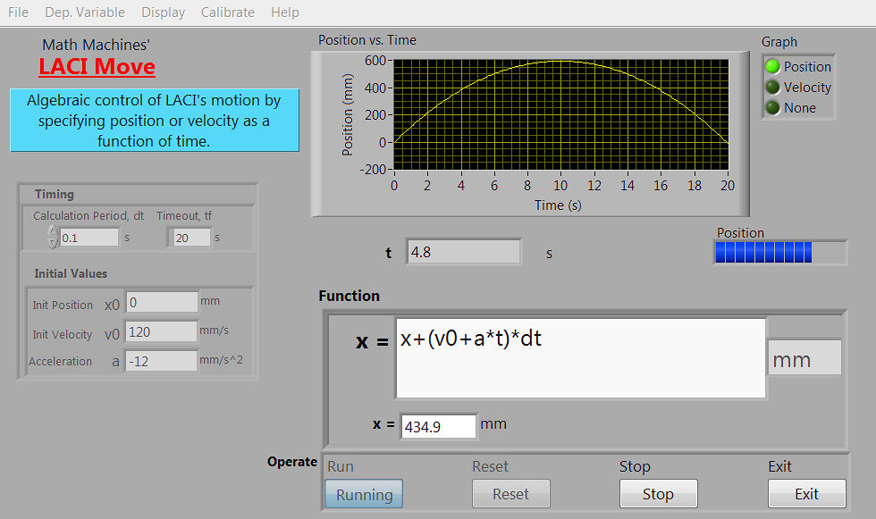
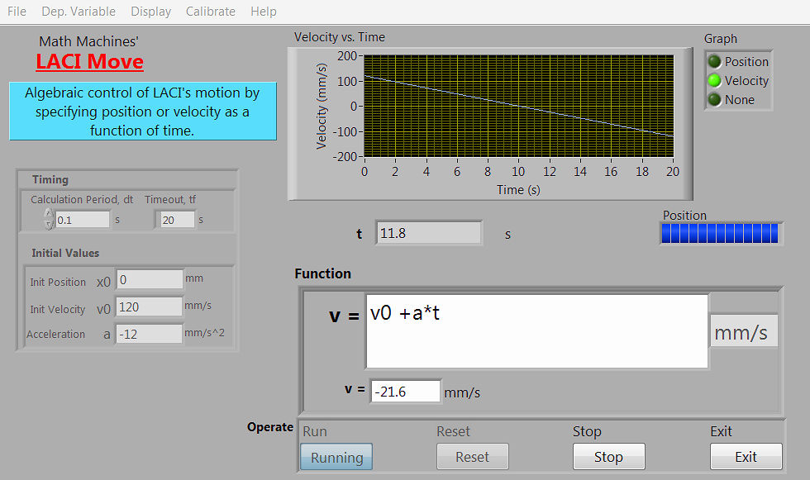
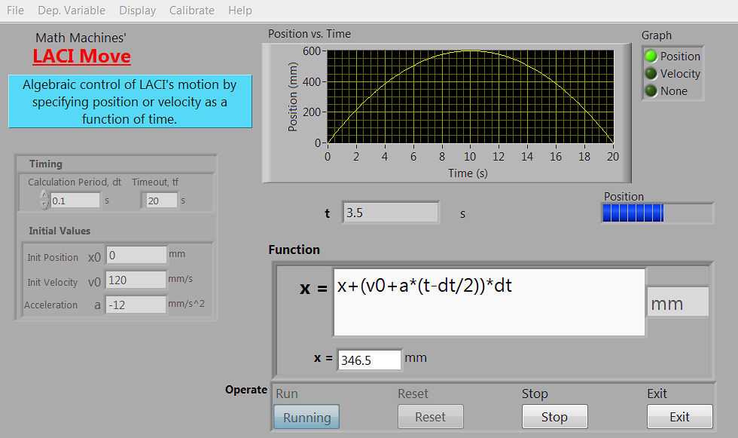
Current Software

Slide 7
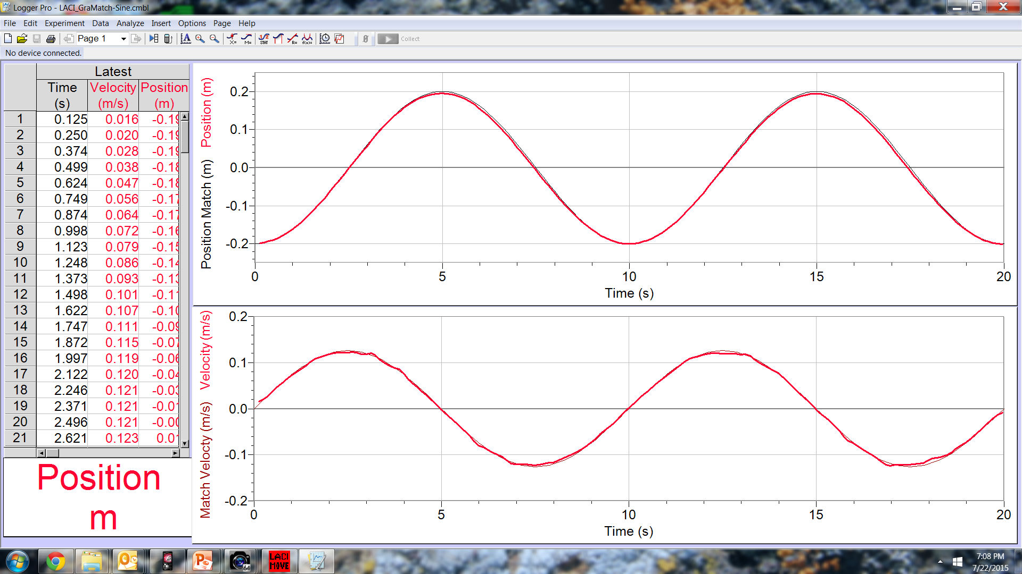
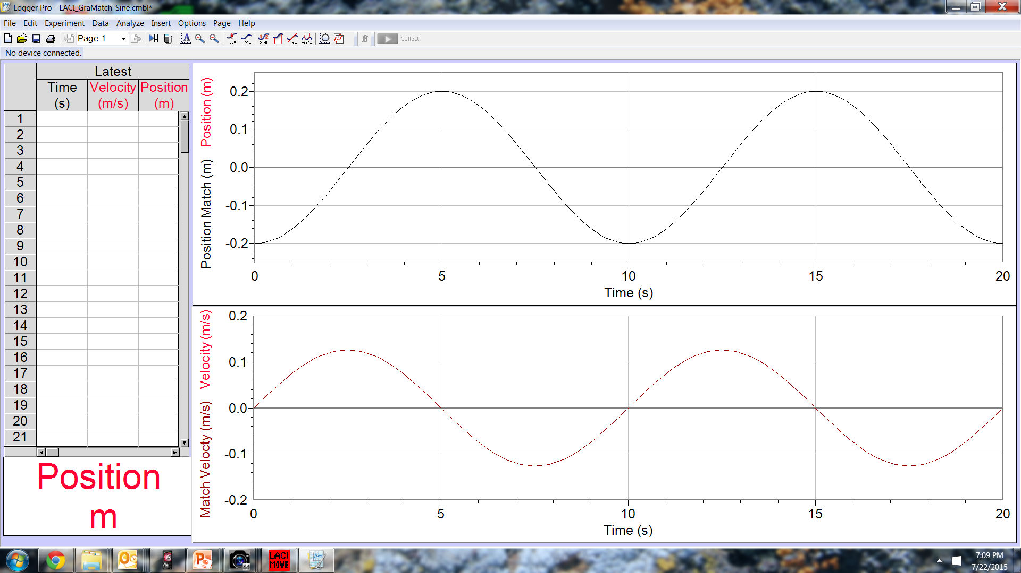
Sample Task: Algebraic Graph Match

Slide 8
Sample Task: Why Acceleration Matters
Move the battery 200 mm in 4 seconds

Slide 9
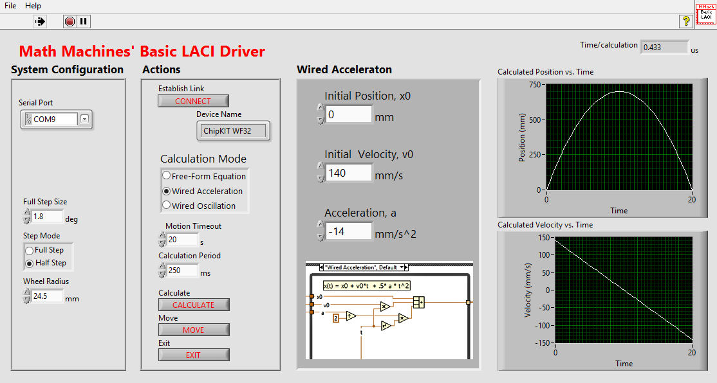
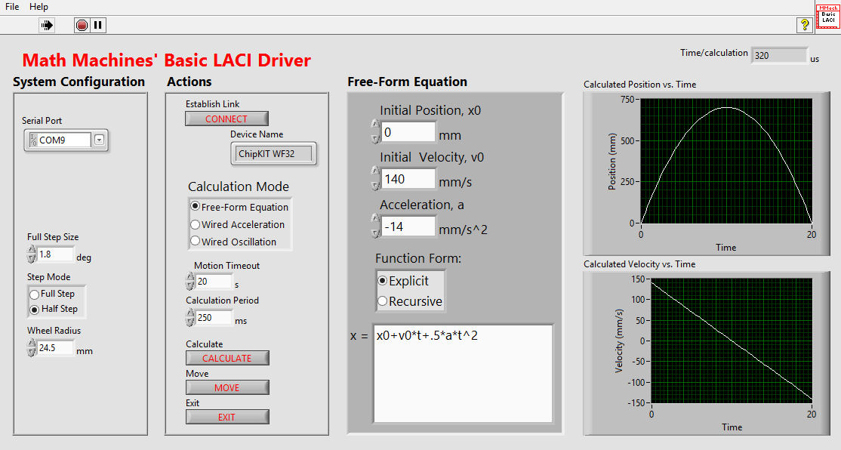
Optional Alternative Software for Next Generation LACI

Slide 10
Why Math Machines?
Students think algebraically, designing and testing dynamic functions instead of solving word puzzles.
Students are motivated by the actions as well by a realization that kinematics and the concept of acceleration are widely used by engineers and technicians to control motion.
Students receive immediate, authentic feedback, encouraging persistence and self-reliance.
Math Machines are quick and inexpensive compared with grand projects such as building roller coasters or battlebots, and there is no need to learn a specific programming language.

Slide 11
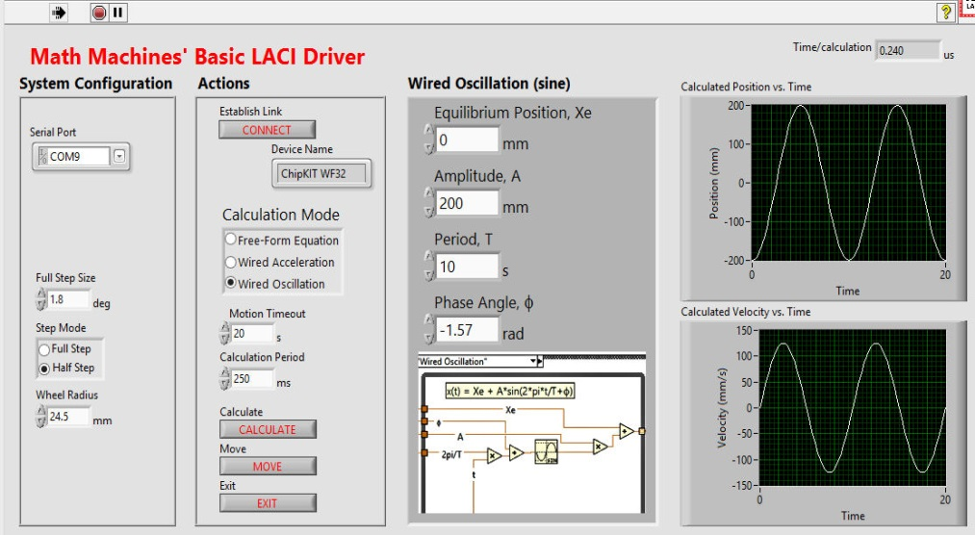
www.mathmachines.net
fred.thomas@mathmachines.net
www.labviewmakerhub.com/forums/
Labs/Apparatus Poster PST1D09, 8:30 - 9:15 PM
Sinclair Community College &
Learning with Math Machines

