Slide 1


Characterization of the relationship between identity and context dependent performance in physics
Keron Subero
ksubero@linfield.edu
Sophia Inzunza-Cisneros
Sophia.Cisneros@umb.edu
Notes:
1

Slide 2
Outline
‘Brief’ History
Taking in further: preliminary results
Suggestions / Comments
2
Notes:
2

Slide 3
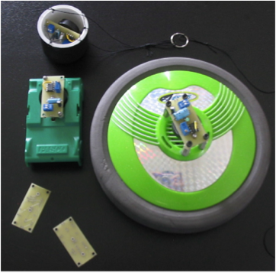
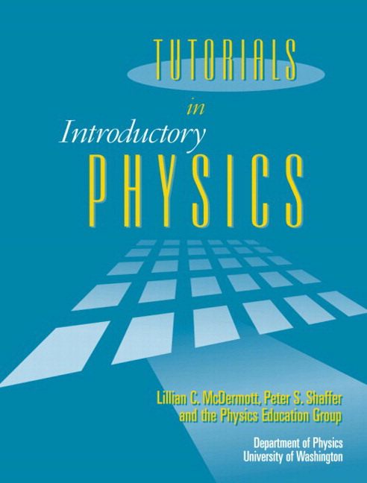
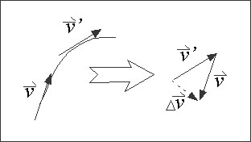
How did we get here?
Promoting Vector Use in Introductory Mechanics Laboratories
(Steve Kanim, NMSU).
(2004-2010)
F. Reif, Cog. Instr. 9(1) 1-44 (1992).
3
Notes:
How did we get here? Trying to apply Fred Reif’s 5 steps to conceptual understanding of acceleration. Put flashing lights on everything so students would have something concrete with which to associate these ‘arrow-vectors’. “Introductory labs on the vector nature of force and acceleration ,” Am. J. Phys. 78, 461 (2010).
3

Slide 4
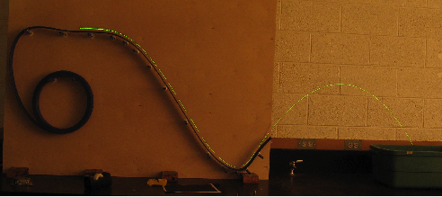
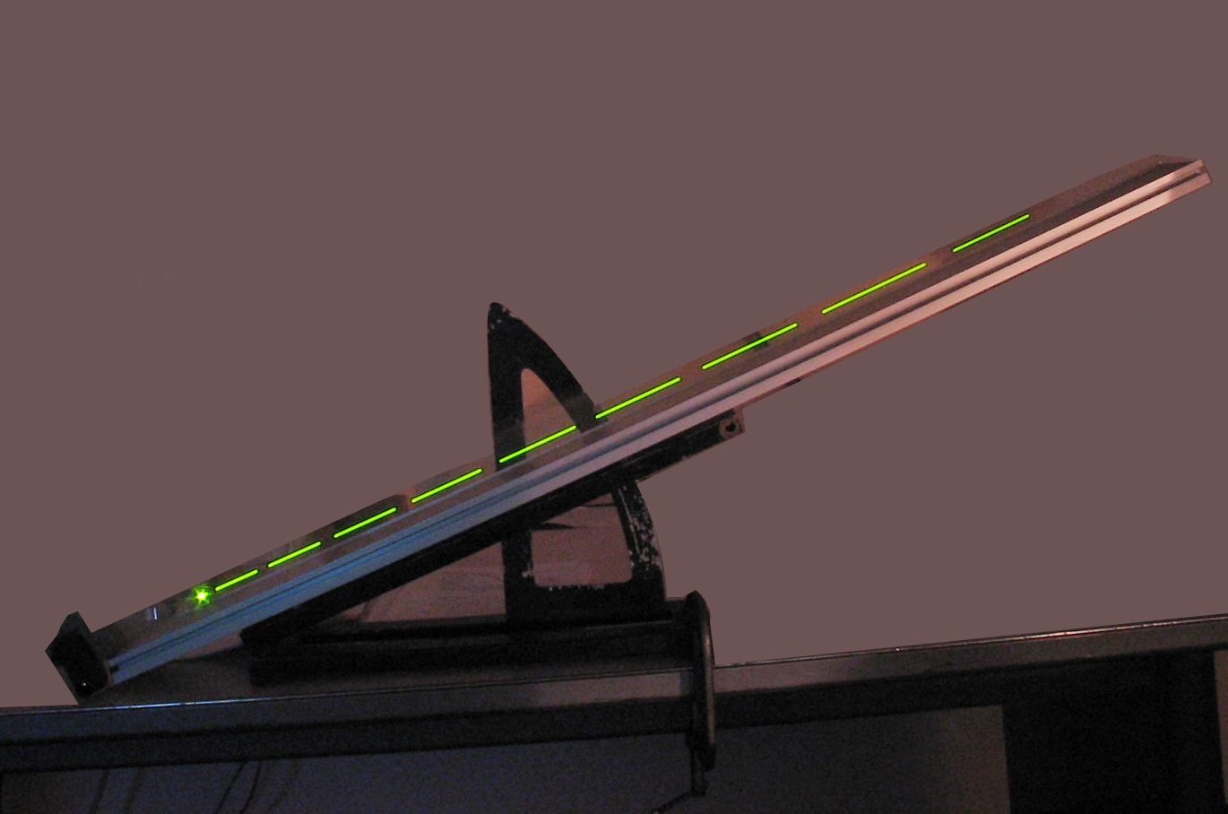
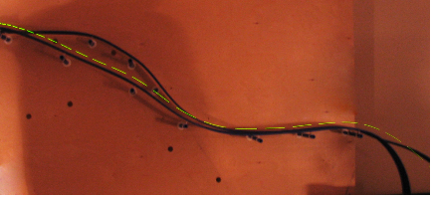
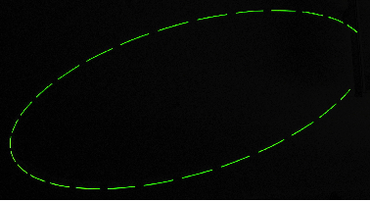
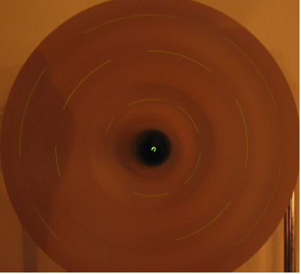
‘Blinkies’ on Everything
As well as others…
4
Notes:
What’s the acceleration when …it’s going down the hill? In the air? Slowing down going down a hill, moving in a circle? Oval?
4

Slide 5
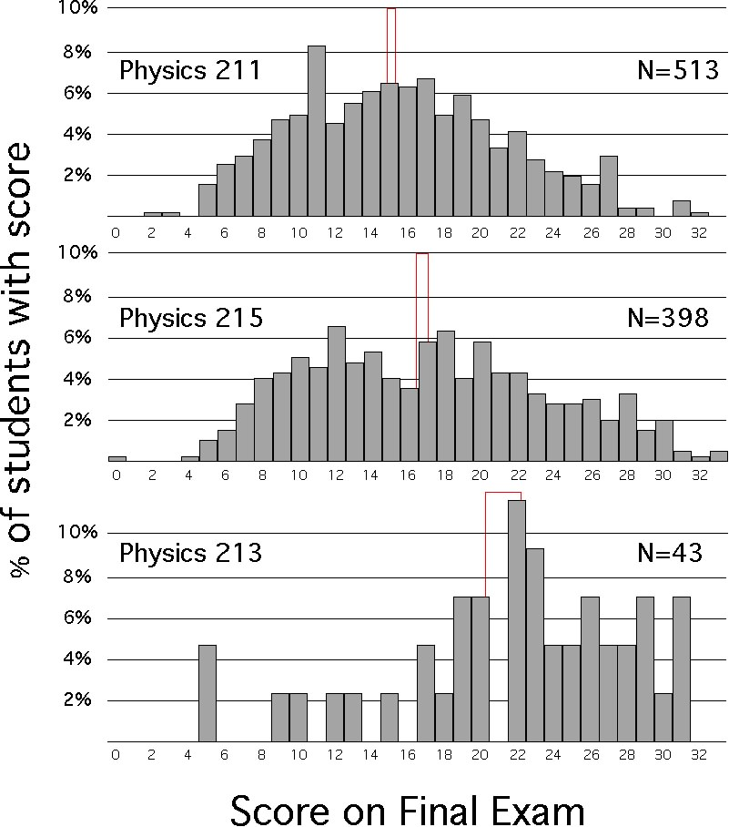
Distribution of Final exam scores
Notes:
Results all over the place. Describe that top were life sciences students, middle engineers…majors OK. What did we need to ‘get other students ready?

Slide 6
Correlation between G and pretest measures
Coletta & Phillips pretested students using Lawson Test of Scientific Reasoning.*
They found r=0.67 for upper quartile of students in a college class and HS.
But only r=0.27 for lower quartile students.
*“Interpreting FCI scores: Normalized gain, pre-instruction scores, and scientific reasoning ability,” Am. J. Phys. 73, 1172 (2005)
Notes:
Take home – “You need these ‘basic skills’ (Piagetian abilities)…to be able to get much from physics course”
6

Slide 7
Challenges to Interpretation
(Hammer, Elby et al.)
Ability tests are highly context dependent – results more a reflection of student comfort with context. (Different contexts activate different ‘resources’).
Other affective measures come into play: how much they care about context, idea of taking a pretest etc.
7
Notes:
7

Slide 8
Original (Lawson) pretest
The cylinders at right have equally spaced marks on them. Water is poured into the wide cylinder up to the 4th mark (see A). This water rises to the 6th mark when poured into the narrow cylinder (see B).
If water were poured up to the 6th mark in the wide cylinder, how high will it reach in the narrow cylinder?
8
Notes:
8
We used the ‘proportional reasoning’ questions from Lawson Test of Scientific Reasoning plus one more ratio reasoning question (in total 5 question multiple choice test).

Slide 9
Modified pretest
The cold medicine you bought came with an adult (wide) and a child (narrow) cylinder. When you pour medicine from the 4th mark in the adult cylinder into the children's cylinder, it rises to the 6th mark.
By mistake you pour your child’s medicine up to the 6th mark in the ADULT dosage cylinder. How high will it reach if you pour it into the child’s container?
9
Notes:
Modified version of test to include ‘everyday situations’ allowing students to better draw on relevant resources.

Slide 10
Cohen's d is defined as the difference between two means divided by a standard deviation for the data, i.e.
For Cohen's d an effect size of 0.2 to 0.3 might be a "small" effect, around 0.5 a "medium" effect and 0.8 to infinity, a "large" effect.
https://en.wikipedia.org/wiki/Effect_size
Notes:
When comparing two sets of distributions, t & d are useful & related statistics that I’ll use throughout. SD/sqrt(N) = S.E. and t is defined as B0-B1/SE.

Slide 11
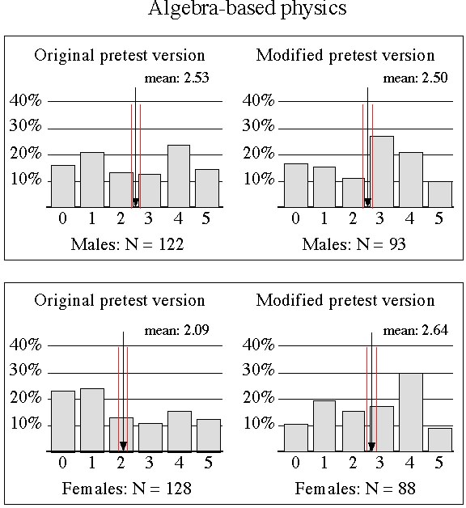
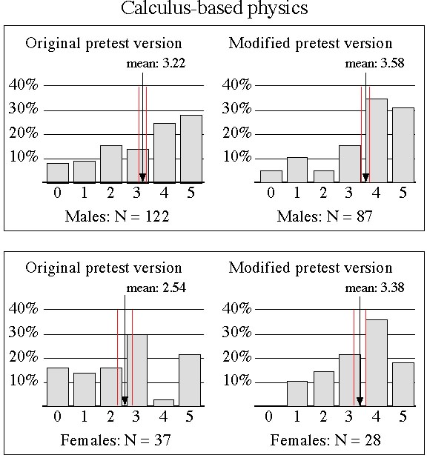
Gender difference in performance
“The Role of Context and Gender in Predicting Success in a Modified Laboratory Course,” Dissertation, Keron Subero
Notes:
Males no difference in performance, but for females definitely significant improvement in performance.

Slide 12
Physics 211 (algebra-based)
Version performance difference
Gender | Pretest Version | N | Mean Score | Std Dev. | T-value | Pr>|t|
Male | Original | 122 | 2.53 | 1.73
 | Modified | 93 | 2.50 | 1.58
 |  |  | -0.03 | 1.67 | 0.13 | 0.90
Gender | Pretest Version | N | Mean Score | Std Dev. | T-value | Pr>|t|
Female | Original | 128 | 2.09 | 1.75
 | Modified | 88 | 2.64 | 1.55
 |  |  | 0.55 | 0.23 | 2.38 | 0.02*
12
Notes:
P-value <0.05 for females.
12

Slide 13
Physics 211 (algebra-based) gender difference
Pretest Version | Gender | N | Mean Score | Std Dev. | T-value | Pr>|t|
Original | Male | 122 | 2.53 | 1.73
 | Female | 128 | 2.09 | 1.75
 |  |  | 0.44 | 1.74 | 2.00 | 0.05*
Gender | Pretest Version | N | Mean Score | Std Dev. | T-value | Pr>|t|
Modified | Male | 93 | 2.50 | 1.59
 | Female | 88 | 2.64 | 1.55
 |  |  | -0.14 | 1.57 | 0.61 | 0.55
13
Notes:
Gender gap on Original versions; but no Gender gap on Modified version
13

Slide 14
Physics 215 (calculus-based) gender difference
Pretest Version | Gender | N | Mean Score | Std Dev. | T-value | Pr>|t|
Original | Male | 121 | 3.22 | 1.62
 | Female | 37 | 2.54 | 1.71
 |  |  | 0.68 | 1.64 | 2.22 | 0.03*
Gender | Pretest Version | N | Mean Score | Std Dev. | T-value | Pr>|t|
Modified | Male | 87 | 3.58 | 1.47
 | Female | 28 | 3.36 | 1.25
 |  |  | 0.22 | 1.42 | 0.71 | 0.48
14
Notes:
Same for gender gap in calculus course.
14

Slide 15
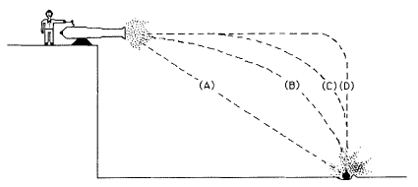
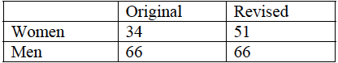
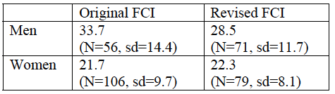
Laura McCullough (RFCI)
L. McCullough “Gender Context & Physics Assessment; J. of Int. Women’s Studies; Vol 5 #4 May 2004.
Notes:
McCullough reported reduction in gender gap – I should calculate t & P from her numbers.

Slide 16
Take-home message: Gender gap goes away when we use familiar contexts!?!?
…..(Hypothesis).

Slide 17
What did we get done this past semester?
Spring 2015
More data to test (bolster?) previous hypothesis.
What kinds of familiar contexts can you use in Astronomy? E&M? Would we get similar results?
Why would an unfamiliar context ‘cause’ someone to perform poorly? (Would stereotype threat be correlated with this phenomenon)?
Notes:
17
Tried to answer these questions.

Slide 18
Recommendations to reduce gender bias
Trimmer^{a)} suggests: Contextualized problems, involve human presence, explain, evaluate.
Avoid: locate, information-dense problems, very short answer.
Rennie & Parker^{b)}: Use concrete problems, careful portrayal of gender roles in problems.
18
Notes:
K. Trimmer, “Performance of girls in the TEE: An analysis of the effect of change in the Western Australia Physics syllabus on performance of girls in the TEE,”
J. Kahle, L. Parker et al. “Gender differences in sciences education: building a model” Educ. Psychol. 28(4), 379-404 (1993).
18

Slide 19
CSEM Q1
While making a cool new Christmas tree ornament, Jamie finds a hollow metal sphere that is electrically neutral (no excess charge). She then suddenly places a small amount of negative charge at one point P on this hollow metal ornament and looks away for a few seconds as her cat knocks over a glass bowl. When she checks back on the excess negative charge she will find:
vs
A hollow metal sphere is electrically neutral (no excess charge). A small amount of negative charge is suddenly placed at one point P on this metal sphere. If we check on this excess negative charge a few seconds later we will find one of the following possibilities:
Notes:
Involving human presence.

Slide 20
CSEM (Original)
Notes:
6 females vs 8 males…numbers very low. Graphs show average score on pretest by gender. The displayed error bars are St Deviation while they should be Standard error.

Slide 21
You are listening to Hot 97 radio station in NYC, and you know that it is broadcast at a frequency of 97.1 MHz.(97.1E6 Hz). What is the length of the wave?
vs
A pulsating radio star (pulsar) is found to emit radio waves at 403 MHz. (403E6 Hz). What is the wavelength of these waves?
Notes:
Will not show these results as there was additional factor, but promising results also.

Slide 22
We need more data!!
What other question features induce this gender effect?
(How) Does identity play into this? (got a start on) .

Slide 23
Memorable quotes:
“Using good contexts makes problems / class more interesting which will be good for your evaluations.” (Sophia Cisneros)
“What’s the point of introducing words like ‘simotrichus’ on national spelling bee?” (Terry Gross’ linguist, June 11, 2015).
“The redesigned SAT prioritizes content that reflects the kind of reading and math students would encounter in college and their work lives [as opposed to the obscure vocabulary words for which the SAT was infamous]. (College Board President, David Coleman – New York Times, 03-09-2014).
“All these extra words make this (‘female-friendly’) version way more confusing. I wouldn’t prefer this version.” ((male) Dept. Chair)

Slide 24
Suggestions / Comments??
(Thanks for coming!)
24
Notes:
24

