Slide 1
Gender Differences in Belonging, Cost, and Satisfaction in Physics Graduate Students
Amber Byrum*¹, Sara Mueller¹, Dr. C.D. Porter¹, Dr. Alison C. Koenka²,
Hanna Lafranconi¹, Mike Lopez¹, and Dr. Andrew Heckler¹
Department of Physics¹, Department of Educational Studies²
The Ohio State University
Notes:
Good afternoon, my name is Amber Byrum – I am grad student in the Physics Education Research group at The Ohio State University. Today I will be reporting some preliminary findings from a new retention study – namely, gender differences in belonging, cost, and satisfaction among physics graduate students.

Slide 2
Background
Goal:
Improve diversity, retention, and student experience in graduate physics
Longitudinally examine:
Cognitive and motivational factors
How academic achievement, gender, and ethnicity relate to student success, retention, and student experience
Notes:
The overall goal of this study is to improve diversity, retention, and student experience in graduate physics. We are soon wrapping up our first year of the study, but eventually we will longitudinally examine cognitive and motivational factors (which will be listed shortly), and look at how academic achievement, gender, and ethnicity relate to student success, retention, and experience.

Slide 3
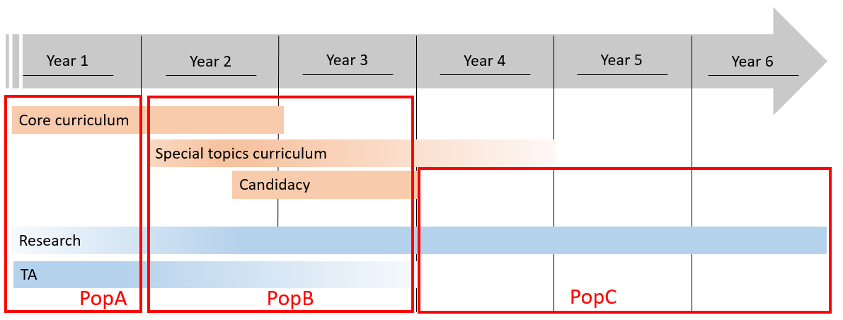
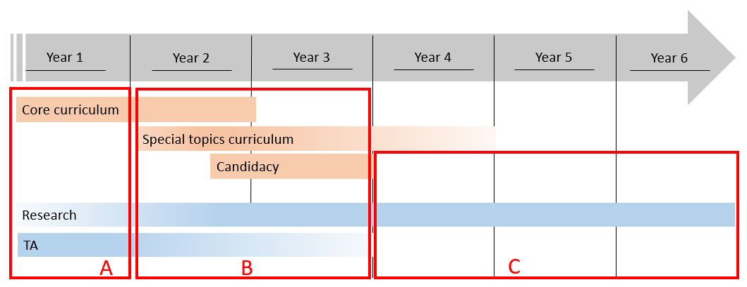
Physics Graduate Populations
First Year
Core coursework
Teaching
At most, loose affiliation with research group
Notes:
For this study, we’ve broken up the graduate student population into three separate populations based on where they are in the program:
What we refer to as “PopA” students are first year students whose primary job is to complete core coursework for which there is an average grade requirement. Many of these students are also teaching at this time, and due to these large time commitments, these students are at most loosely affiliated with a research group.

Slide 4
Physics Graduate Populations
First Year
Core coursework
Teaching
At most, loose affiliation with research group
Pre-candidacy
Less coursework
Affiliated with research group
Likely still teaching
Notes:
“PopB” students are beyond their first year but have not yet gone through the candidacy process (for those unfamiliar, candidacy is a written and oral exam administered by a committee of faculty– most students complete this around the end of their second year – beginning of their third year). These students are taking advanced topics courses that are generally much lower stress courses that do not require as much time or work, are likely still teaching, and have taken a more active role in a research group.

Slide 5
Physics Graduate Populations
First Year
Core coursework
Teaching
At most, loose affiliation with research group
Pre-candidacy
Less coursework
Affiliated with research group
Likely still teaching
Post-candidacy
Primary function as research assistant
Notes:
“PopC” students are PhD candidates whose primary role is as a research assistant.

Slide 6
Design
Design:
Survey all graduate students every year
~200 total graduate students, divided into three populations
Students complete population-dependent version of survey
Likert scales used
Incentives
PopA (first year): first year course requirement, twice per year
PopB (pre-candidacy): voluntary twice per year (part of annual review in future)
PopC (post-candidacy): part of annual review, once per year
Notes:
All graduate students receive a survey every year – this is about 200 total graduate students, divided into the three populations described on the previous slide. Each population receives a survey relevant to them, and a variety of Likert-scale items are used for measurement.
For the PopA students, completing the survey is a requirement for a first year seminar course all students take (and it is taken in both the fall and spring semesters)
This year, the PopB survey was voluntary and administered twice, but next year it will be a part of annual review (and thus will go out to students once a year)
For PopC, the survey is a part of annual review (so is administered once a year).

Slide 7
Measurement
Dimensions Measured
Scales Used
Validated | In Development
Value | Student Experience
Belonging | Teaching
Identity Development
Mindset
Goal Orientation
Anxiety/Stress
Satisfaction
Milestones
Cost
Notes:
The items on the left are all validated scales – Many of these factors have been shown to affect retention at the undergraduate level, but as far as our group is aware, there hasn’t historically been much work studying these factors in a graduate setting (if you are aware of other studies, please let me know!). These items were all measured in the last year, and today I’ll be reporting on how PopB data revealed gender differences in belonging, satisfaction, and cost .

Slide 8
Measurement
Example Questions
Belonging (22)
“I have found other graduate students in this graduate physics program with whom I relate.”
Satisfaction (15)
“In most ways my graduate experience in physics is close to my ideal.”
Cost (19)
“I have to sacrifice too much to be in this physics graduate program.”
Notes:
Students respond by selecting to what extent they agree with the statements listed (answers ranging on a 7 point scale from “Strongly disagree” to “Strongly agree”)
22 belonging questions were asked, and an average score was assessed for each student’s overall sense of belonging
One example, “I have found other graduate students in this graduate physics program with whom I relate– the extent to which the student feels they fit in
“In most ways my graduate experience in physics is close to my ideal” is one of the satisfaction questions
And “I have to sacrifice too much to be in this physics graduate program” is an example of a cost question – to what extent they feel they have to give things up for this program

Slide 9
Satisfaction, PopB
Low satisfaction
 | Male (N=14) | Female (N=7)
Mean $±$ SE | 0.82 $±0.27$ | -0.36 $±0.31$
Mann-Whitney p-value | 0.02
High satisfaction
Notes:
The horizontal scale is indicative of the responses -> so a -3 is “strongly disagree”, a 0 is “neither agree nor disagree”, and a 3 is “strongly agree”
For overall average satisfaction, men score at 0.82, which is on the higher satisfaction end of the spectrum
Women average a -0.36, which is a little under neutral on the satisfaction scale
And
This p-value of 0.02 tells us that the distributions are different – Males report higher levels of satisfaction
(U = 18.5)

Slide 10
Cost, PopB
Low cost
 | Male (N=14) | Female (N=7)
Mean $±$ SE | -0.31$±$ 0.33 | 0.93 $±$0.51
Mann-Whitney p-value | 0.04
High cost
Notes:
For overall average cost, men score at -0.31, which is between “somewhat disagree” and “neither agree nor disagree”
Whereas women average a 0.93, which is a “somewhat agree”
And
This p-value of 0.04 tells us that the distributions of the two groups are in fact different – females report higher cost than men
(U = 23)

Slide 11
Belonging, PopB
Low sense of belonging
 | Male (N=14) | Female (N=7)
Mean $±$ SE | 1.38 $± 0.18$ | 0.54 $± 0.3$2
Mann-Whitney p-value | 0.05
High sense of belonging
Notes:
Here, the response trends for males and females are opposite – most female responses are at 0 and then decrease, whereas male responses start at 0 and increase to a peak response of around 2.
It was promising to note that no one in PopB had an overall belonging average of less than 0!
On average cost, men score at 1.38, which indicates a decently high overall sense of belonging, Whereas women average a 0.54 (much closer to neutral)
And
This p-value of 0.05 tells us that the distributions of the two groups are marginally different – males report a higher sense of belonging
(U = 17.5)

Slide 12
Summary
Summary:
In initial stages of longitudinal study
We have found in preliminary data some problematic differences in men and women’s physics experiences
On average, males report higher satisfaction than females
Women report higher cost than men
Most men report a high average belonging, whereas most women average a neutral belonging
Notes:
In summary, we are in the very early stages of a longitudinal retention study
And there is preliminary evidence of some gender differences in satisfaction, cost, and belonging:
Males overall are more satisfied
Women report higher cost
Men report higher average belonging

Slide 13
Future Work
Plans for future:
More years, more N
Examine underrepresented minority data
Track changes in individual student responses
Compare response patterns between populations
Analyze how population response patterns change over time
Notes:
As we continue this study, we will (thankfully) have more numbers to look at – with larger N, we will be able to draw more confident conclusions and see specific patterns more clearly.
Since N is so small currently, we can not yet draw any conclusions about what the data tell us from underrespresented minority responses – with more N, we will be able to gain insight.
As students take the survey several times, we will be able to track how individuals respond over time.
We will be able to compare how response patterns differ between populations (i.e. How do PopA and PopB compare?) and how particular populations’ response patterns change over time (e.g. Are there patterns that emerge that are unique to a certain population, despite the students in that population changing out?)

Slide 14
Bibliography
[1] Perez, Cromley, & Kaplan. (2014). Journal of Educational Psychology, 106: 315–329. doi:10.1037/a0034027
[2] https://www.nsf.gov/statistics/srvydoctorates/
[3] Hyater-Adams, Hinko, & Finkelstein. 2015 PERC Proceedings, edited by
Churukian, Jones, and Ding; Peer-reviewed, doi:10.1119/perc.2015.pr.033
[4] Dabney & Tai. (2013) Phys. Rev. ST Phys. Educ. Res. 9, 010115, doi:10.1103/PhysRevSTPER.9.010115
[5]Gonsalves, Danielsson,& Pettersson. (2016) Phys. Rev. Phys. Educ. Res.
12, 020120. doi:10.1103/PhysRevPhysEducRes.12.020120
[6] Goodenow, C. (1993), Psychol. Schs., 30 : 79–90. doi:10.1002/1520-6807(199301)30:1<79::AID-PITS2310300113>3.0.CO;2-X
[7] Kaplan, A., & Midgley, C. (1997). Contemporary Educational Psychology, 22: 415-435. doi:10.1006/ceps.1997.0943
[8]Blackwell, L. S., Trzesniewski, K. H. and Dweck, C. S. (2007). Child Development, 78 : 246–263. doi:10.1111/j.1467-8624.2007.00995.x
[9]Midgley, Kaplan, Middleton, Urdan, Maehr, Hicks, Anderman, & Roeser. (1998). Contemporary Educational Psychology, 23: 113–131. doi:10.1006/ceps.1998.0965
[10] Battle & Wigfield. (2003). Journal of Vocational Behavior, 62: 56-75 doi:10.1016/S0001-8791(02)00037-4
[11] Vaez, PhD, M., & Laflamme, L. (2008). Social Behavior and Personality: An international journal, 36: 183-196. doi: 10.2224/sbp.2008.36.2.183
[12] Eccles & Wigfield. (2000). Contemporary Educational Psychology, 25: 68–81 doi:10.1006/ceps.1999.1015
[13]Larsen, RJ, Diener, E and Emmons, RA. (1985). Social Indicators Research, 17:1–18.doi: 0303-8300/85.10
[14]Lock, R., Hazari, Z., & Potvin, G. (2012). 2012 PERC Proceedings, Philadelphia, PA. doi:10.1063/1.4789702

Slide 15
Acknowledgements
Funding for this research was provided by the Center for Emergent Materials: an NSF MRSEC under award number DMR-1420451
Want to hear more about physics retention?
PERC Contributed posters: Byrum A11, Mueller A45, Lafranconi B32

