Slide 1
The Learning Assistant Model and DFW Rates in Introductory Physics Courses
Jessica L. Alzen, Laurie Langdon, and Valerie Otero
University of Colorado Boulder
American Association of Physics Teachers
Cincinnati, OH
25 July 2017

Slide 2
Motivation
Large introductory courses are efficient and cost effective at the expense of interpersonal interactions among students and instructors (Talbot, Hartley, Marzetta, & Wee, 2015)
Failure in such courses leads many to switch majors or drop out of college (Webb, Stade, & Grover, 2014; Crisp, Nora, & Taggart, 2009)
Notes:
“Can be” little interaction

Slide 3
Motivation
Learner-centered instruction lowers course failure rates (Webb, Stade, & Grover, 2014)
LAs facilitate research-based, learner-centered activities (Otero, 2015)
Prior research indicates a positive relationship between exposure to LAs and learning gains on course assessments (Pollock, 2009)

Slide 4
Research Question
How do failure rates compare for students who do and do not receive LA support in Physics I and Physics II at CU Boulder?

Slide 5
Learning Assistant Model Goals
Curriculum
and Course Transformation
LA
Discipline-Based
Educational Research
Institutional Change
Teacher Recruitment
& Preparation

Slide 6
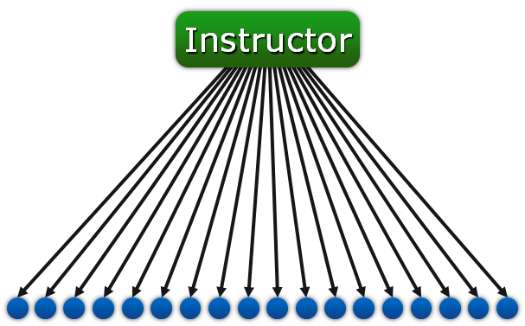
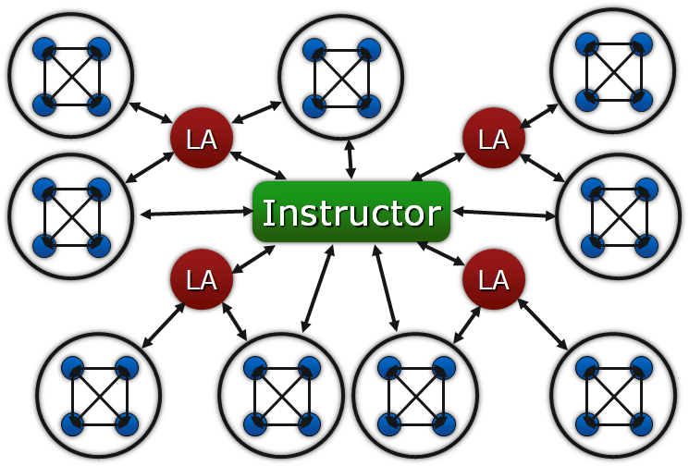
Traditional
Transformed with LAs
Students
Learning Teams
Notes:
Some differences between the LA Model and other peer instruction models such as Peer-Led Team Learning (PLTL) and Supplemental Instruction (SI):
PLTL is more specific (usually) in terms of how peers interact with students (80-minute “workshops” involving one PLTL leader and 8-10 students). LA model is more flexible in terms of how peers are used to transform courses. LAs might work with students during class, in recitation / tutorial settings, in lab, and in other roles. Typically, one LA might work closely with 60 students during the week.
LAs meet weekly with faculty teaching the course as well as participate in a weekly math and science teaching seminar (see next slide)
Teacher recruitment and preparation is an explicit goal of the LA Model

Slide 7
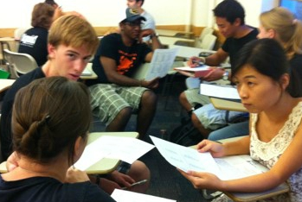
LAs and LA-Supported Courses
Learning Assistants (LAs) are undergraduate students who, through the guidance of course instructors and a special pedagogy course, facilitate discussions among groups of students in a variety of classroom settings that encourage student engagement and responsibility for learning.
LA-Supported courses involve opportunities for students to work in groups toward a learning goal, for students to articulate and defend their ideas, and for instructors to make instructional decisions based on what students say and do in class.

Slide 8
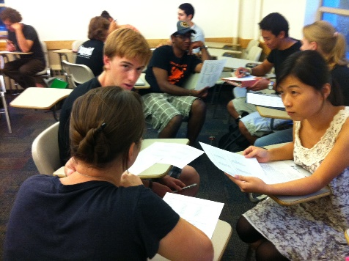
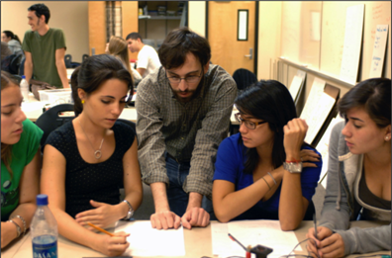
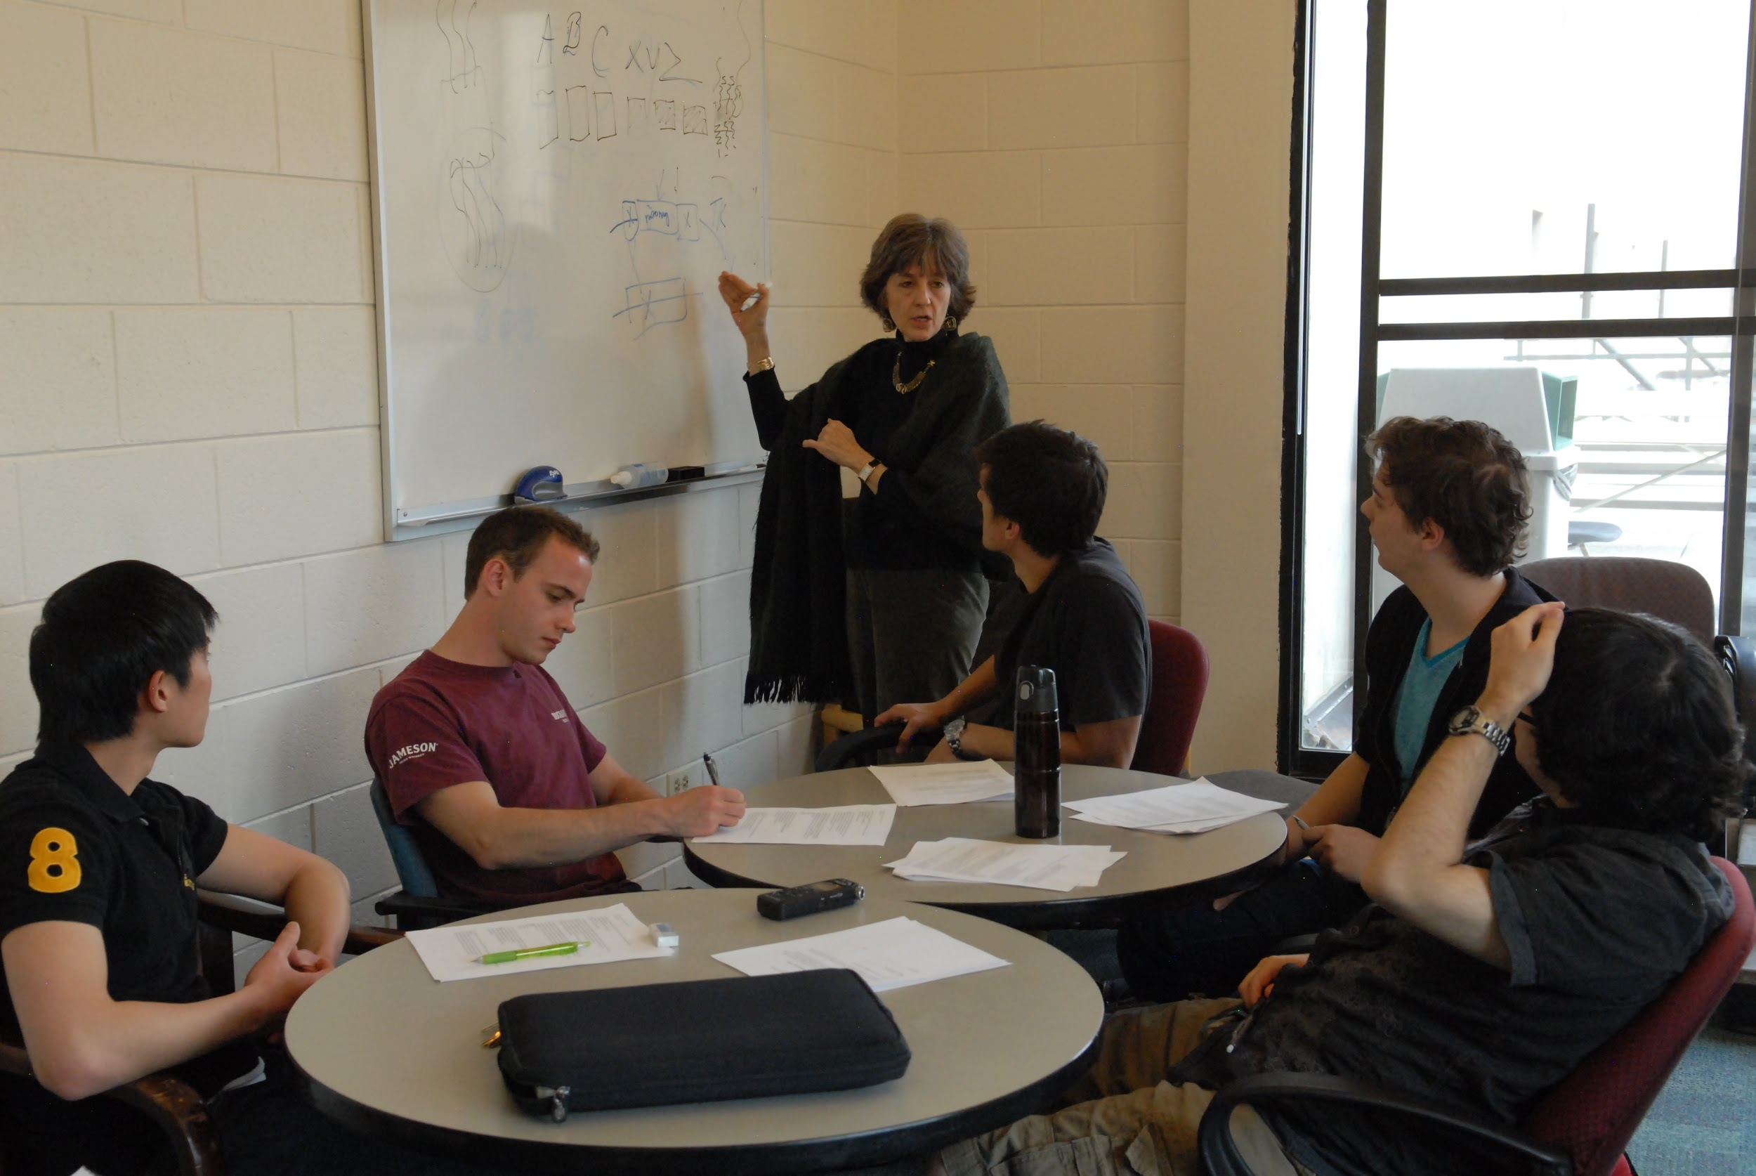
Learning Assistant Experience
Practice: LAs lead Learning Teams focusing
mainly on eliciting student thinking and helping each group member participate in developing a shared understanding.
Content Prep Meeting:
LAs and their lead instructor meet as a team at least once per week to prepare for future classes and exchange information about how students are interacting with the course.
Pedagogy Course introduces LAs to research and strategies that support conceptual development by (1) eliciting student ideas,
(2) listening and questioning; (3) building relationships; and (4) integrating learning theories with practice.
Notes:
All LAs engage in these three key experiences.
Work with small groups of students on challenging activities.
Meet weekly with instructors to prepare for next week.
New LAs take pedagogy course.

Slide 9
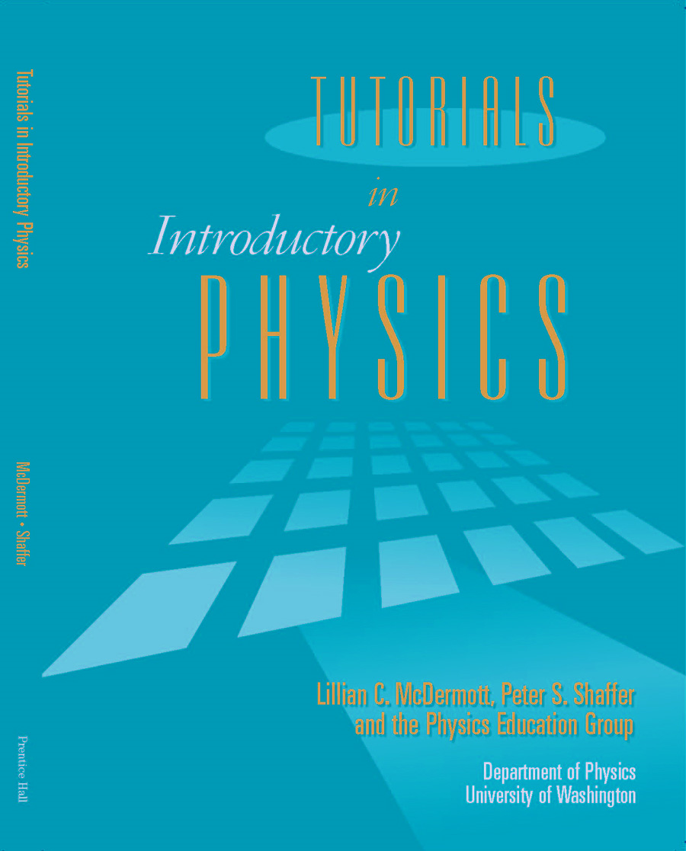
Physics Tutorials with LA support
Notes:
Context: Use of LAs in physics at CU is in conjunction with University of Washington tutorials
The tutorials provide the content
LAs provide the instructional strategies for active student engagement
Results presented here are representative of the use of LAs in conjunction with the tutorials, and we cannot separate the two
However, we’ve done similar analysis in another department without tutorials and see similar results

Slide 10
Data
First-time freshman who enrolled at the university in fall 2001-2010 (10 cohorts)
4,941 students enrolled in Physics I and/or Physics II from 2001-2014
5 instructors who taught both LA and non-LA supported courses with at least 100 students in the sample
Notes:
Take Physics from 2001-2014
Limited to these cohorts because of timing of LA-supported courses

Slide 11
Data
 | LA support | No LA support | p-value
 | % | %
Female | 25 | 21 | <0.01*
Nonwhite | 23 | 23 | 0.83
First Gen | 16 | 15 | 0.66
Financial aid | 52 | 50 | 0.23
 | Mean (SD) | Mean (SD)
Credits at entry | 9 (12) | 7 (10) | <0.01*
HS GPA | 3.67 (0.33) | 3.60 (0.35) | <0.01*
Test Score | 27.5 (3.4) | 27.2 (3.2) | <0.01*
N | 3696 | 1289
*indicates statistically significant difference
Notes:
SLOW
Emphasize this is data we have
Lots of other differences, but this is what we can control for

Slide 12
Data
 | LA support | No LA support | p-value
 | % | %
Female | 25 | 21 | <0.01*
Nonwhite | 23 | 23 | 0.83
First Gen | 16 | 15 | 0.66
Financial aid | 52 | 50 | 0.23
 | Mean (SD) | Mean (SD)
Credits at entry | 9 (12) | 7 (10) | <0.01*
HS GPA | 3.67 (0.33) | 3.60 (0.35) | <0.01*
Test Score | 27.5 (3.4) | 27.2 (3.2) | <0.01*
N | 3696 | 1289
*indicates statistically significant difference

Slide 13
Raw failure rates
 | # enrolled | # fail | % fail
LA Support | 4419 | 372 | 8
No LA Support | 1422 | 210 | 15
Difference |  |  | -7
A complication:
Physics I without LAs only from Fall 2001 – Spring 2003 and Fall 2004 – Fall 2005
Physics II without LAs only from Fall 2001 – Spring 2004
Notes:
Note that this includes Physics I & II so students are double-counted if they took both courses. That’s why enrollment doesn’t look the same as on the previous slide.

Slide 14
What we know at this point
We see lower failure rates for students exposed to LAs
We know that students exposed to LAs are different from those who are not exposed
A logical following question:
Are the lower failure rates due to being exposed to LAs or something else?
Differences in the groups of students
Historical changes over time; other interventions

Slide 15
Methods
Ideal conditions for causal claims:
Identical and contemporaneous Treatment and Control groups except exposure to LAs
Necessary conditions for causal claims:
Sufficient control variables to feel treatment and control groups are close to identical except exposure to LAs
Realistic conditions leaving us with a descriptive or correlational study:
No contemporaneous control groups
Limited control variables

Slide 16
Methods
This study is an improvement over raw counts of failure rates because it disentangles some variables that might affect course failure
We can identify that a relationship exists between exposure to LAs and course failure and how it might differ for particular groups of students

Slide 17
Methods
Regression Analysis
Identify the relationship between dependent and independent variables
Provides information on how DFW rates change when exposure to LAs changes while the other independent variables are held constant
Two general types of regression analysis
Linear Regression—continuous outcome
Logistic Regression—binary outcome

Slide 18
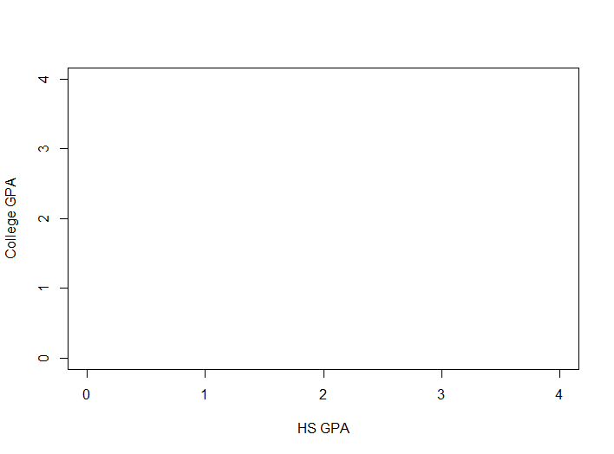
Methods: Linear Regression

Slide 19
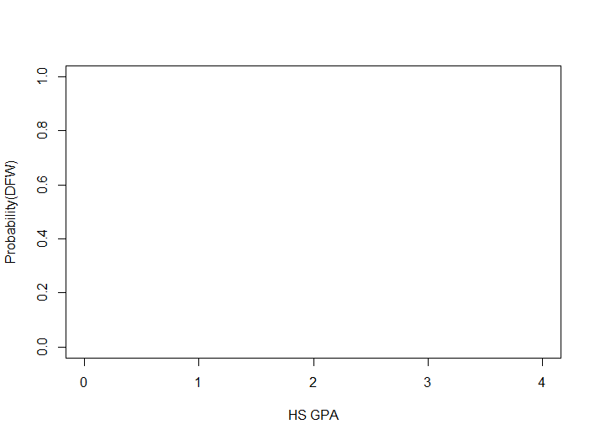
Methods: Logistic Regression
Without LA support
Difference in probability of failure
With LA support

Slide 20
Methods
Logistic Regression
$$logit \left(π\right)=α+βX$$
$π$ = probability of failing the course
Failing = receiving either a D or an F as a final course grade or withdrawal from the course
X = matrix of student demographic and instructor effect variables

Slide 21
Control Variables
Exposure to LAs
Gender
Race/ethnicity
First-generation status
Financial aid status
Number of credits at entry
High School GPA
Admissions test scores
Instructor

Slide 22
Results: Adjusted failure rates
Key contrast | % Difference with LA support
White males | -4 to -6
White females | -7 to -11
Nonwhite males | -4 to -6
Nonwhite females | -7 to -11
First-generation males | -6 to -9
First-generation females | -10 to -14
Male, white, non-first generation college students who do not receive financial aid, have mean credits at entry, HS GPA, and admissions test scores are 4-6% less likely to fail introductory physics if they receive LA support.
Notes:
Ranges because of variability due to instructor

Slide 23
Results: Adjusted failure rates
Key contrast | % Difference with LA support
White males | -4 to -6
White females | -7 to -11
Nonwhite males | -4 to -6
Nonwhite females | -7 to -11
First-generation males | -6 to -9
First-generation females | -10 to -14
Students who are the same except female are 7-11% less likely to fail with LA support.
Notes:
Ranges because of variability due to instructor

Slide 24
Results: Adjusted failure rates
Key contrast | % Difference with LA support
White males | -4 to -6
White females | -7 to -11
Nonwhite males | -4 to -6
Nonwhite females | -7 to -11
First-generation males | -6 to -9
First-generation females | -10 to -14
Similar results for non-white students
Notes:
Ranges because of variability due to instructor

Slide 25
Results: Adjusted failure rates
Strongest relationship between LA exposure and lower failure rates for first-generation students, regardless of gender
Key contrast | % Difference with LA support
White males | -4 to -6
White females | -7 to -11
Nonwhite males | -4 to -6
Nonwhite females | -7 to -11
First-generation males | -6 to -9
First-generation females | -10 to -14
Notes:
Ranges because of variability due to instructor
Magnitude = 2-4% stronger for -1 SD HS GPA
Magnitude = 2-3% weaker for +1 SD HS GPA
NW FG Males: 6-9%
NW FG Females: 10-14%
5% multi racial; 11% hisp; 2% AA; 5% Asian

Slide 26
Summary of Results
Raw data analysis: 7% lower failure rates when exposed to LAs in Physics I & II
Regression analysis: 4-14% lower failure rates when exposed to LAs in Physics I & II
Regression analysis provides more nuanced information
Stronger relationship between exposure to LAs and lower course failure for traditionally under represented groups

Slide 27
Preliminary Qualitative Findings
LAs facilitate conversation and activities that allow students to uncover their own misunderstandings
Undergraduates are more comfortable revealing their current thinking to LAs than graduate TAs and instructors
LAs help students navigate the sea of information in these introductory courses

Slide 28
Graduation Rate Teaser
LA program associated with either an increase OR decrease in the probability of graduating
Mechanism for assignment to LA support likely influences results
Presentation EB05 this afternoon at 3:10
PERC Poster Session for First-Time Attendees
Contact Info: jessica.alzen@colorado.edu

