Slide 1
Relationship between Learning Assistants and Persistence to Graduation
Jessica L. Alzen, Laurie Langdon, and Valerie Otero
University of Colorado Boulder
American Association of Physics Teachers
Cincinnati, OH
25 July 2017

Slide 2
Motivation
Large introductory courses are efficient and cost effective at the expense of interpersonal interactions among students and instructors (Talbot, Hartley, Marzetta, & Wee, 2015)
Failure in such courses leads many to switch majors or drop out of college (Webb, Stade, & Grover, 2014; Crisp, Nora, & Taggart, 2009)

Slide 3
Research Question
How do graduation rates compare for students who do and do not take LA-supported introductory science courses?

Slide 4
Data
First-time freshman who enrolled in fall 2004-2010 (7 cohorts)
15,089 students enrolled in gateway courses in physics, math, applied math, & chemistry

Slide 5
Data
 | LA Support | No LA Support | p-value
 | % | %
Female | 36 | 50 | <0.01*
Nonwhite | 24 | 24 | 0.72
First Gen | 17 | 19 | <0.01*
Financial aid | 52 | 50 | 0.049*
 | Mean (SD) | Mean (SD)
Credits at entry | 8 (12) | 5 (10) | <0.01*
HS GPA | 3.66 (0.33) | 3.55 (0.36) | <0.01*
Test Score | 27 (4) | 25 (3) | <0.01*
N | 10127 | 4962
*indicates statistically significant difference

Slide 6
Raw Graduation Rates
 | # enrolled | # graduate | % grad
LA Support | 10127 | 7562 | 74
No LA Support | 4962 | 3140 | 63
Difference |  |  | 11
Are the higher graduation rates due to being exposed to LAs or something else?
Lots of factors we can’t control for
Some factors can be controlled for

Slide 7
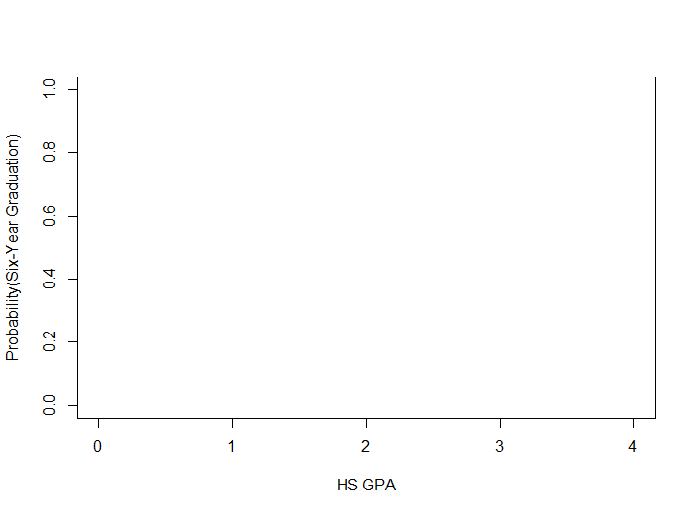
Methods: Logistic Regression
With LA support
Difference in probability of graduating
Without LA support

Slide 8
Results
Group | Change in probability of graduating in 6 years or less when exposed to LAs
All Departments | 7 to 12% higher
Chemistry only | 6 to 15% higher
Applied math only | 5 to 7% lower
Students who receive LA support in at least one STEM gateway course are 7-12% more likely to graduate in six years or less than those students who take at least one STEM gateway course and receive no LA support in any of those courses.
Notes:
Pooling departments together masks differences in results between departments

Slide 9
Results
Group | Change in probability of graduating in 6 years or less when exposed to LAs
All Departments | 7 to 12% higher
Chemistry only | 6 to 14% higher
Applied math only | 5 to 7% lower
Notes:
Applied math results on the cusp of statistical significance. Likely sensitive to model specification.

Slide 10
Results
Group | Change in probability of graduating in 6 years or less when exposed to LAs
All Departments | 7 to 12% higher
Chemistry only | 6 to 14% higher
Applied math only | 5 to 7% lower
Notes:
Applied math results on the cusp of statistical significance. Likely sensitive to model specification.

Slide 11
Assignment to LAs Likely Matters
Applied Math
Chemistry
Students who sign up to receive LA support are strongly encouraged based on
Self-confidence in math
Self-confidence in college generally
All students who receive LA support take the “On-Semester” Chemistry sequence
No LAs in the “Off-semester”. Taking this sequence often happens
When students fail CHEM I in the fall
When students don’t feel confident in their chemistry abilities

Slide 12
Summary of Results
Relationship between exposure to LAs and graduation varies by context
Likely over and underestimation issues due to uncontrolled factors
More work is needed to gain a better understanding of these relationships

Slide 13
DFW Rate Teaser
Students exposed to LAs have from 4 -14% lower failure rates in introductory physics
The relationship between exposure to LAs and lower failure rates in introductory physics is strongest for traditionally under represented groups
PERC Posters @4pm tomorrow
Contact Info: jessica.alzen@colorado.edu

Slide 15
Methods
Ideal conditions for causal claims:
Identical and contemporaneous Treatment and Control groups except exposure to LAs
Necessary conditions for causal claims:
Sufficient control variables to feel treatment and control groups are close to identical except exposure to LAs
Realistic conditions leaving us with a descriptive or correlational study:
Limited control variables

Slide 16
Methods
This study is an improvement over raw counts of graduation rates because it disentangles some variables that might affect propensity to graduate
We can identify that a relationship exists between exposure to LAs and graduation and how it might differ for particular groups of students

Slide 17
Methods
Regression Analysis
Identify the relationship between dependent and independent variables
Provides information on how a typical dependent variable (i.e. DFW) changes when any one independent variable varies (i.e. LA exposure) while the other independent variables are held constant
Two general types of regression analysis
Linear Regression—continuous outcome
Logistic Regression—binary outcome

Slide 18
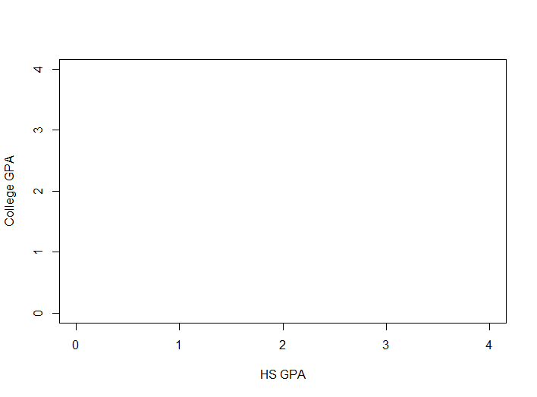
Methods: Linear Regression

Slide 19
Methods
Logistic Regression
$$logit \left(π\right)=α+βX$$
$π$ = probability of graduating in 6 years or less
X = matrix of demographic variables and cohort dummy variables

Slide 20
APPM: Calculus 1 and 2
All students enroll in lecture.
No LAs.
CHEM: Gen Chem 1 and 2
All students enroll in lecture. LAs work with students during “clicker questions.”
Some students enroll in 100-minute workgroup. Each workgroup facilitated by 1 TA and 2 LAs.
All students also participate in 50-minute recitation facilitated by 1 TA and 1 LA.
Notes:
Differences among the two groups in APPM and CHEM that we aren’t able to control for
--self-confidence in APPM might under-estimate AAPM results
--reasons for being in “off-semester” CHEM courses might over-estimate CHEM results. Reasons include fail 1st semester, not confident enough to jump in, or course overload.

