Slide 1


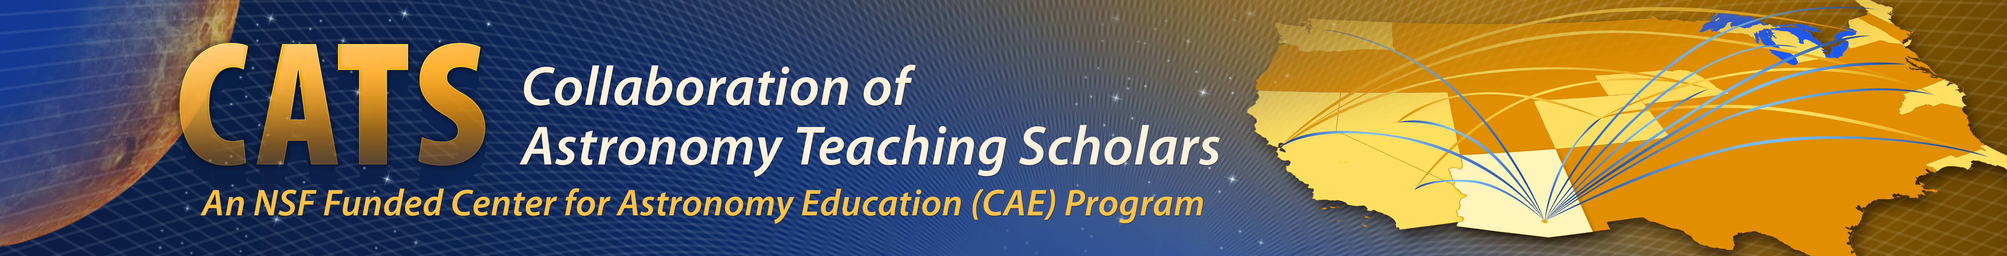
Unpacking General Relativity - Choosing Representations for Teaching Novice Learners
Tim Chambers
University of Michigan
In collaboration w/ the Center for Astronomy Education (CAE)
University of Arizona

Slide 2
Thanks and Support
JPL’s NASA Exoplanet Exploration Public Engagement Program
NSF - “Collaboration of Astronomy Teaching Scholars (CATS)”

Slide 3
Collaboration of Astronomy Teaching Scholars (CATS)
Leilani Arthurs, UNL
Duncan Brown, Syracuse Univ.
Sanlyn Buxner, Univ. of Arizona
David Consiglio, Bryn Mawr College
Steve Desch, Guilford Tech. CC
Doug Duncan, CU Boulder
Jeffrey Eckenrode, Pacific Science CTR
Tom English, Guilford Tech. CC
John Feldmeier, Youngstown State Univ.
Amy Forestell, SUNY New Paltz
Rica French, MiraCosta College
Adrienne Gauthier, Dartmouth
Pamela Gay, SIU-Edwardsville
Dennis Hands, High Point Univ.
Kevin Hardegree-Ullman, University of Toledo
Melissa Hayes-Gehrke, Univ. of Maryland
Seth Horstein, CU Boulder
David Hudgins, Rockhurst Univ.
Chris Impey, Univ. of Arizona
Jessica Kapp, Univ. of Arizona
John Keller, Cal Poly SLO
Julia Kregenow, Penn State
Kevin Lee, UNL & NSF
Patrick Len, Cuesta College
Chris Lintott, Univ. of Oxford
Michael LoPresto, Henry Ford CC
Daniel Loranz, Truckee Meadows CC
Julie Lutz, Univ. of Washington
Danny Martino, Santiago Canyon College
Benjamin Mendelsohn, West Valley College
Ed Montiel, Louisiana State University
Peter Newbury, Univ. of British Columbia
Lee Powell, UN Kearney
Ed Prather, Univ. of Arizona
Matthew Price, Ithaca College
Jordan Raddick, Johns Hopkins Univ.
Alex Rudolph, Cal Poly - Pomona
Travis Rector, Univ. of Alaska
Paul Robinson, Westchester CC
Wayne Schlingman, Ohio State
Sébastien Cormier, San Diego College
Colin Wallace, UNC Chapel Hill
Kathryn Williamson, NRAO
Michelle Wooten, Univ of Alabama
James Wysong Jr., Hillsborough CC
Todd Young, Wayne St. College

Slide 4
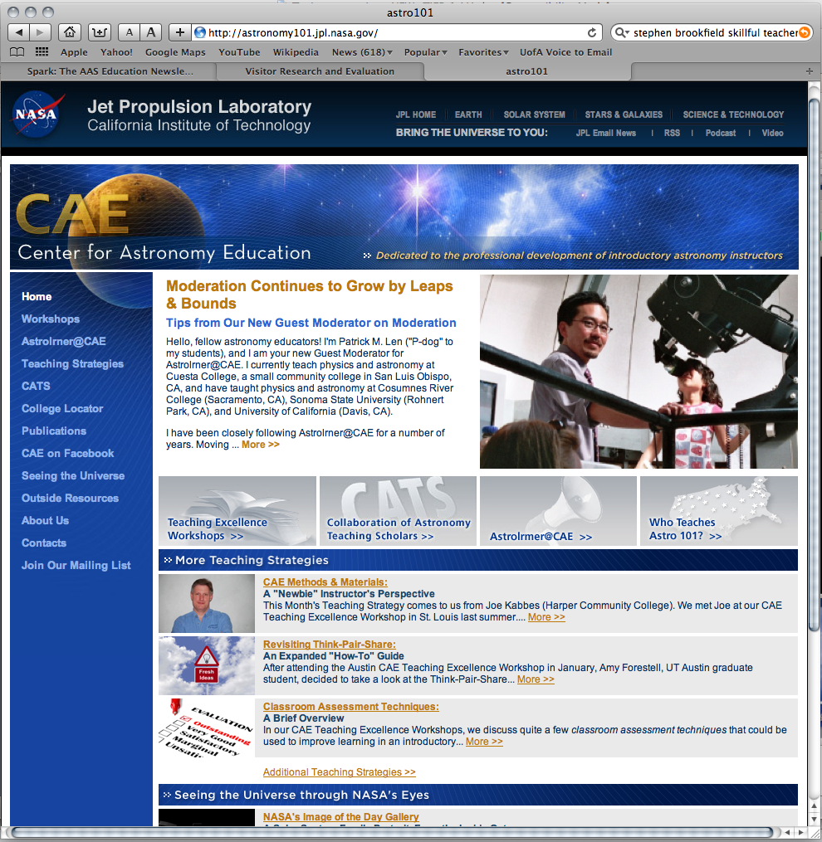
Astronomy101.jpl.nasa.gov

Slide 5
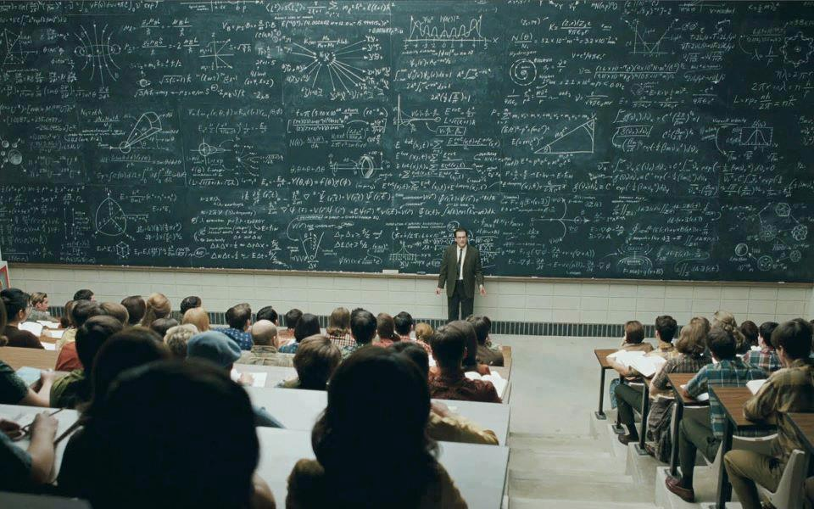
Notes:
This model of teaching is insufficient for getting our students to where we want them to go.
We want them to be able to X, Y Z – we want them to become fluent.

Slide 6
Verbal, graphical, pictorial, mathematical, physical, kinesthetic…
For teaching a specific topic to a specific population
Pedagogical Discipline Representations (PDR) allow learners to meaningfully engage with and develop fluency in discipline-specific content.
Intentionally provide discipline ideas in a way that facilitates unpacking
Building and applying mental models of physical phenomena
To coherently exchange discipline ideas with others
Affordances are intrinsic to the representation
Generating, interpreting, and mapping between representations
Accessibility of affordances is population dependent
In our work “affordances” of a representation are defined as the elements of disciplinary content that students are able to access and reason about using the representation (Linder, 2013, Fredlund et al., 2014)
Notes:
Let me unpack a framework for understanding these ideas of learning and fluency. For the teachers in the room, (practice, helping students etc). For the researchers in the room (curriculum development, assessment, analyzing cognition, etc).

Slide 7
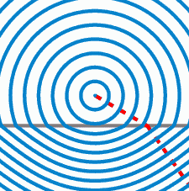
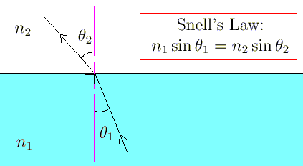
An Example: Developing Fluency in Snell’s Law Using PDRs

Slide 8
No Topic Too Scary
We teach general relativity in Astro 101!
…using representations whose affordances our students can access and reason with.
Notes:
And that’s our research.

Slide 9
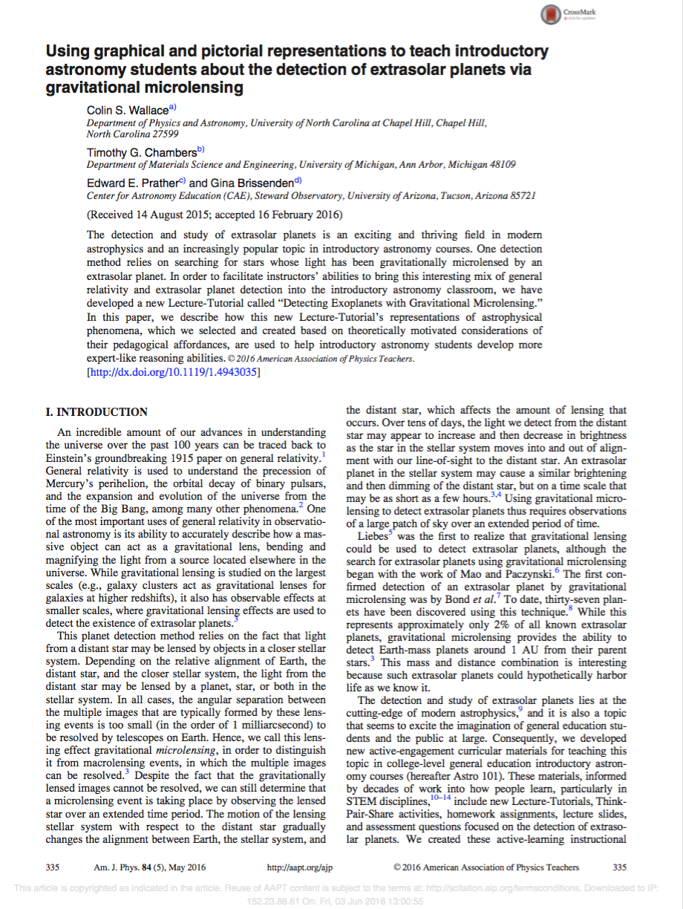

Slide 10
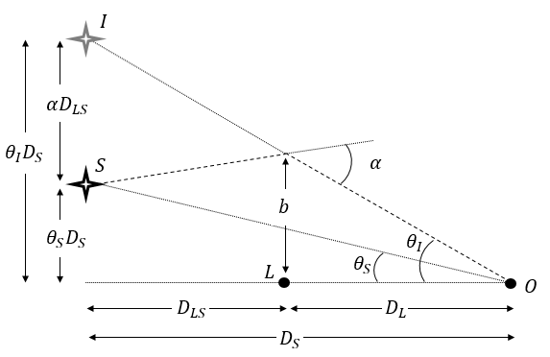
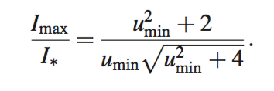
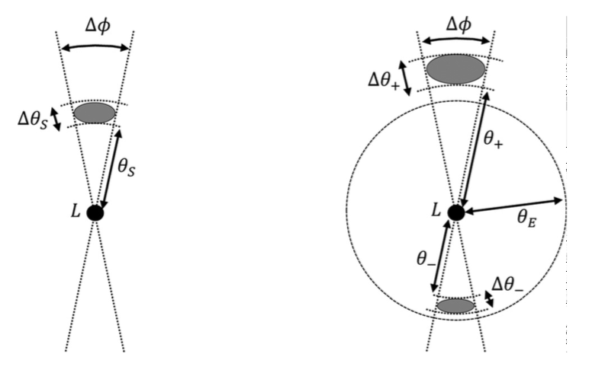
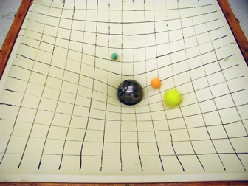

Common PDRs for MGR
Notes:
Our Astro 101 students can make many of the same physical predictions about phenomena using our PDRs that you might expect upper division majors to make using the mathematical representations. And all that mathematical machinery is underlying the representations we make, see the paper for more.

Slide 11
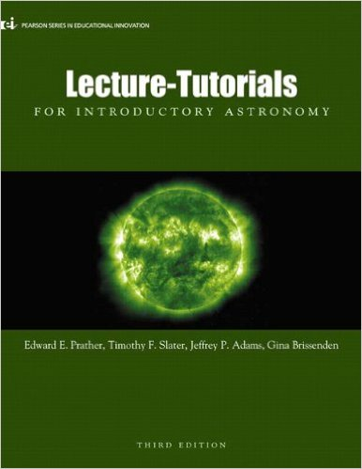
Why Gravitational Microlensing (GML) ?
Wanted to do another topic in GR
Builds on prior course content
Bring contemporary Astrophysics into the classroom
Appropriately challenging for the population
Can be done within the logistical constraints
Is rich for development of PDRs that lead to discipline fluency

Slide 12
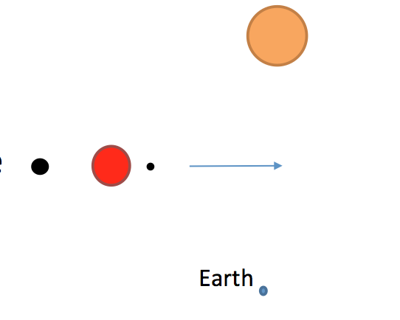
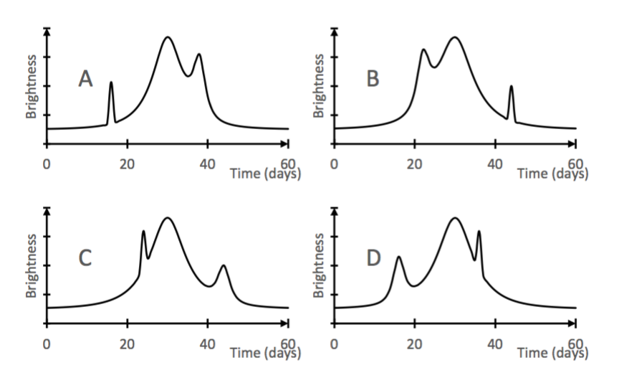
Work with your partner…
Draw a light curve for a distant source, being lensed by a small star with a massive planet orbiting far away, and a low mass planet orbiting close. The lensing system is moving from left to right across our field of view.
Notes:
This is fluency in our class. We want students to be able to do x given y. And if you were wondering how intellectually rigorous this can be… you have 30 seconds, go.
And that’s how we can do meaningful assessment as both teachers and researchers.

Slide 13
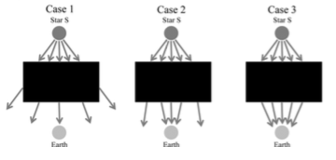
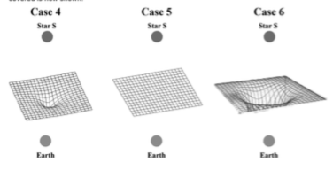
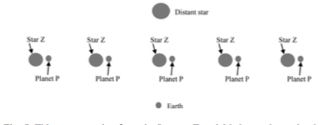
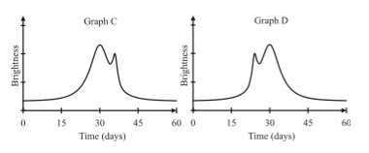
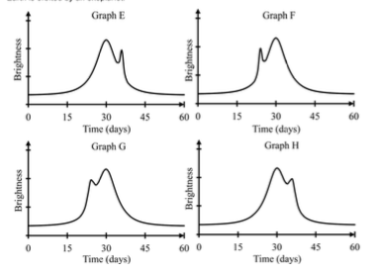
PDRs in the new Lecture Tutorial on teaching MGR
Start here
then here
?
then here
Notes:
MENTAL MODELS

Slide 14
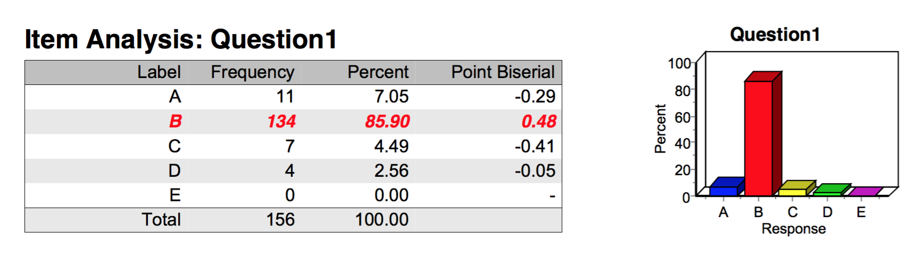
Then here…

Slide 15
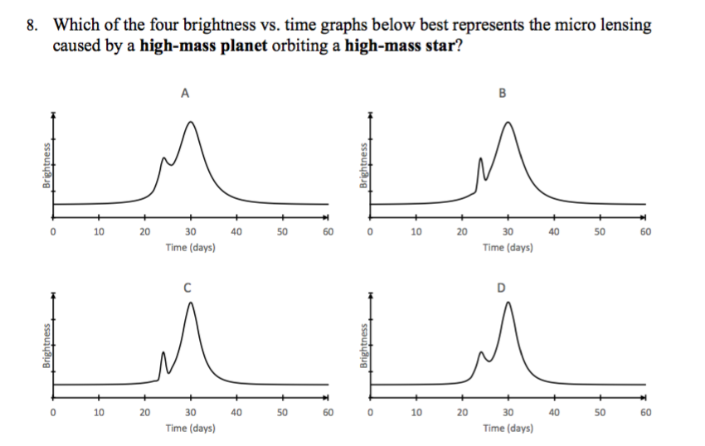
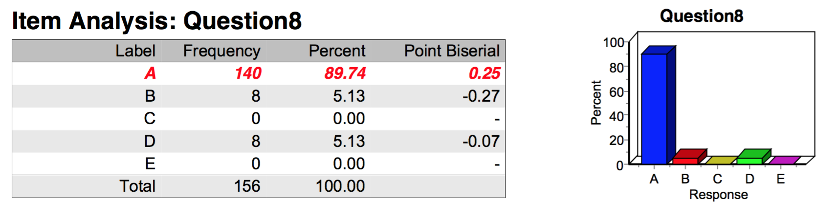
Then here…

Slide 16
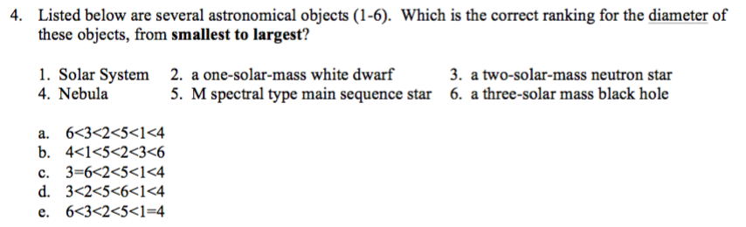
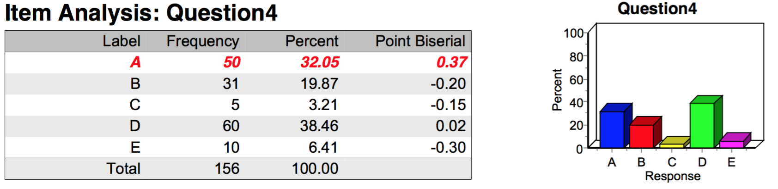
Not all is well…

Slide 17
The How
Choose a really gnarly task that you want your students to succeed at
Unpack the reasoning and discipline content your students need
Use, create, modify, plunder PDRs whose affordances match this content
Teach your students to model and reason about the physical phenomena using and mapping between these representations

Slide 18
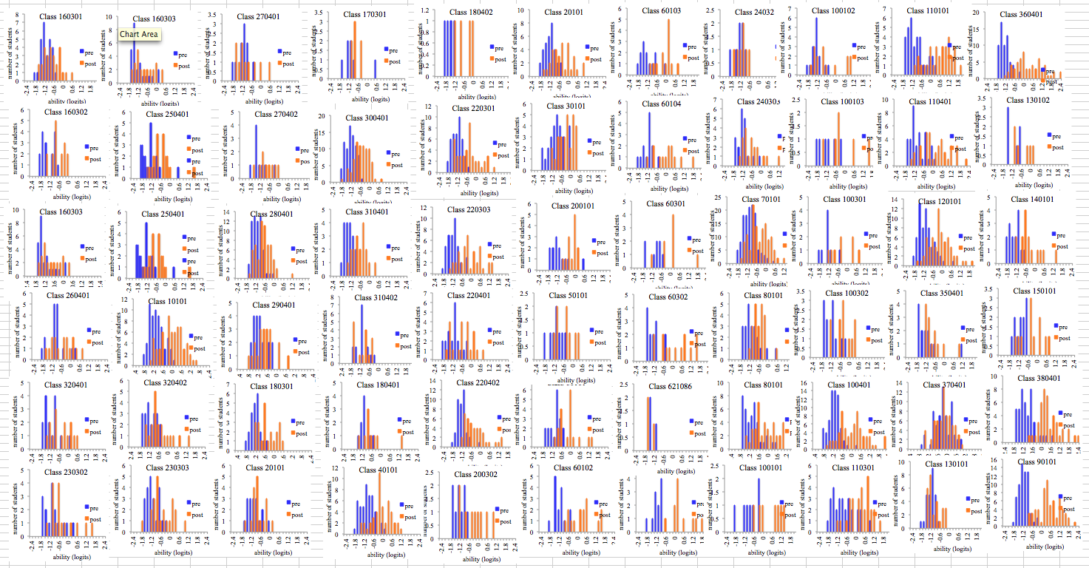
Modeling the pre and post instruction abilities of students
Notes:
More than 30 institutions, Appoximately 70 classrooms, Over 4000 students

Slide 19
A
B
C
D

