Slide 1
The Impact of Kahoot! on Students’ Participation in Introductory Physics
Dr. Randa Asa’d and Dr. Cindy Gunn
American University of Sharjah

Slide 2
Happy to be back in Cincinnati ☺

Slide 3
students
Engineering and Science Freshman students
Physics 101
American university of Sharjah.
United Arab Emirates ( The most famous city there is Dubai ☺)

Slide 4
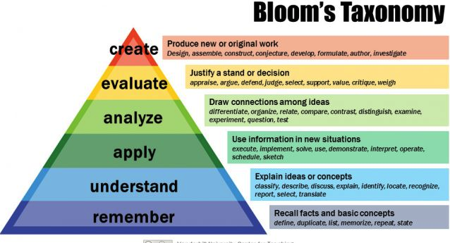

Slide 5
Motivation
Physics is like swimming; one cannot master it by watching, it requires practice.
The challenge is how to motivate students to practice physics.

Slide 6
The problem
Physics’ instructors all over the world have observed many first year students know how to redo problems done on the board, but find it challenging to identify and apply the appropriate physics concepts on a new problem.

Slide 7
The problem
Many students don’t perform well in the exams, even if there is a question very similar to Homework questions.
Many students admit that when studying, they simply look at the solution and think they will be able to reproduce it if needed.

Slide 8
The problem
Many students don’t perform well in the exams, even if there is a question very similar to Homework questions.
Many students admit that when studying, they simply look at the solution and think they will be able to reproduce it if needed.

Slide 9
The problem
Our role as educators is not only to ask students to practice and solve problems, but also motivate them to do so.
The challenge remain: How to do so?

Slide 10
Our Approach
Our approach was to introduce Kahoot! in the classroom. . Students have to solve problems on their own and use their cellphones to answer the problems in class.

Slide 11
How is it Done
Introduce the new physics concept and solving only a couple of examples on the board.

Slide 12
How is it Done
Provide the students with a problem set with a number of problems on the topic covered and ask students to solve them.
Those problem sets start with straightforward questions that slowly get more challenging.

Slide 13
How is it Done
3. We use Khaoot! to play a “game” with the exercises of the problem set.
4. Students participated using their smart phones.

Slide 14
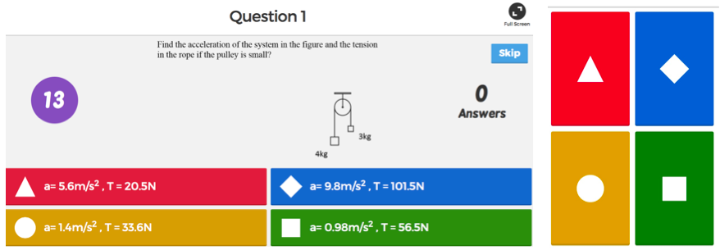
How is it Done

Slide 15
How is it Done
5. The names of the fastest five students to get the correct answer are automatically displayed on the screen in the class, creating a competitive motivating atmosphere.
.

Slide 16
How is it Done
Using Kahoot! gives immediate feedback about the level of the students. We use the class time effectively to solve more challenging exercises.
When there is a common misconception, we spend more time explaining it

Slide 17
How is it Done
Participation in the game counted for attendance, so it saves the time of calling the names of the students in the classic way. This way the time of the game does not waste any of the time of the class.

Slide 18
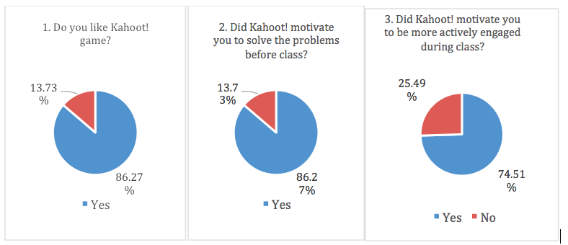
Results

Slide 19
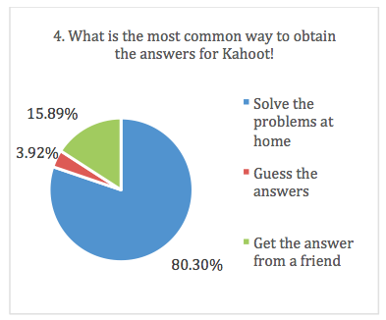
Results

Slide 20
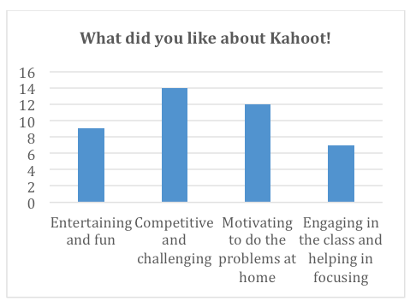
Results

Slide 21
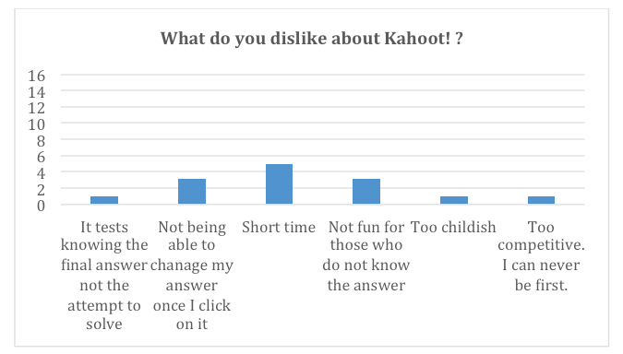
Results

Slide 22
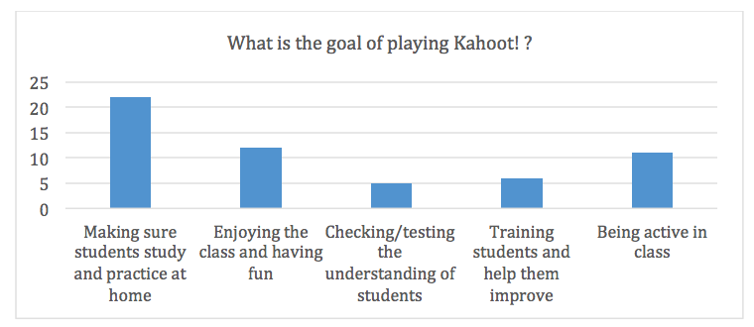
Results

Slide 23
Results

Slide 24
Note:
Although the grades of the students were better than students in previous semesters, we purposely avoided using the grades as ways of showing the significance of using Kahoot! because the students’ performance varies due to the lack of standardized testing in physics 101.

Slide 25
Conclusion
The results of this study show positive responses. More than 85% of the students like Kahoot! and it motivated them to solve the problems at home before coming to class, which is the ultimate goal of using this tool in the classroom.

Slide 26
Conclusion
Using Kahoot! in the classroom motivated students to be practice problems on their own, and not keep the passive role of just watching the instructor do the problems on the board. We plan to continue using this tool in the classroom.
.

