Slide 1
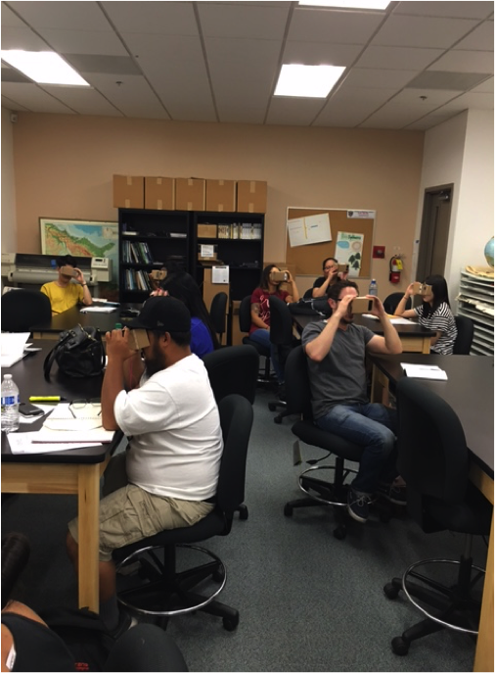
Using Two Simulation Tools to Teach Concepts in Introductory Astronomy
Pamela A. Maher ¹ Janelle M. Bailey²
University of Nevada, Las Vegas¹ Temple University²
maherp@unlv.nevada.edu janelle.bailey@temple.edu
Abstract
This design-based study uses phenomenography to determine the variety of experiences N = 65 astronomy students at a two-year college have manipulating a lunar flyby. Students used a motion sensor device in the planetarium and used a virtual reality headset to manipulate a lunar flyby. Changes in the flyby speed were informed by student feedback to determine the optimum flyby speed.
Method and Data
The sample size of this design-based mixed methods phenomenography was N = 65 students enrolled in Introductory Astronomy Laboratory. Participants were drawn from four classes (see photo at right) over two semesters at a two-year college. Each participant engaged in a treatment manipulating a lunar flyby using a motion sensor device in the college planetarium and while wearing a virtual reality headset (Weigel & Moraitis, 2017) to answer the research questions: 1. What optimum lunar flyby speed is comfortable to manipulate a motion sensor device? 2. What variety of experiences do college students have manipulating a lunar flyby using fulldome planetarium software and a virtual reality headset? Data collected in post-treatment questionnaires using Likert-type scales was used to determine the optimum flyby speed. In the figure below immersion is the amount of engagement experienced (Sinatra, Heddy,& Lombardi, 2015).
Results
The figure to the left measures the amount of simulator sickness experienced and the amount of engagement when participants used each tool. Optimum flyby speed to answer the first research question is a factor of two multimedia design principles: immersion and simulator sickness. Responses were answered quantitatively to determine that the optimum flyby speed for the Moon was .04 x the radius of the Earth (3,959 miles) or 158.36 miles per second.
In the table above codes and their examples are identified to answer the second research question on the phenomenography, or variety of experiences college students have manipulating a lunar flyby using fulldome planetarium software and a virtual reality headset. Students registered a variety of experiences, both positive and negative to help instructors determine best use.
Introduction
Multimedia tools afford students and instructors the opportunity to enhance and extend comprehension of astronomy. Planetaria are traditional simulations used teach astronomy. Virtual reality headsets are relatively new. In this study both tools are used to identify different experiences students have manipulating a lunar flyby using design-based research to alter the flyby speed informed by student feedback.
References
Sinatra, G. M., Heddy, B. C., & Lombardi, D. (2015). The challenges of defining and measuring student Weigel, A. D. & Moraitis, C. D. (2017, January). Virtual Reality Astronomy Education Using AAS WorldWide
engagement in science. Educational Psychologist. 50(1), 1-13. http://dx.doi.org/10.1080/00461520.2014.1002924 Telescope and Oculus Rift. In American Astronomical Society Meeting Abstracts, (Vol. 299).

