Slide 1
Diversifying Diversity
Lee L. Zia
National Science Foundation
www.nsf.gov
January 6, 2015
AAPT Symposium, San Diego

Slide 2
Outline
What? (definitions)
Who? (audiences)
Why? (motivations)
How? (incentives)

Slide 3
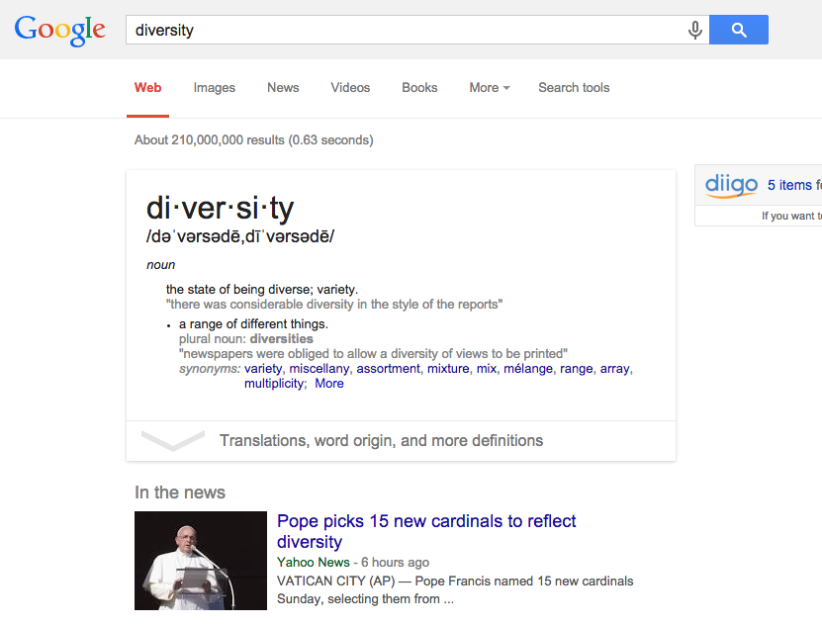

Slide 6
Dimensions of Diversity
??

Slide 7
Audiences
Students
Faculty
Departments
Institutions
Federal agencies (states, also)
Professional societies

Slide 8
Dual (Diverse) Roles
Creators ←→ Users
Learners ←→ Teachers
Theoreticians ←→ Practitioners

Slide 9
Federal Context
Administration’s college completion agenda - opportunity, access, and retention
STEM workforce – #s and quality
Fact Sheet - http://1.usa.gov/1oJOtgL
Increasing College Opportunity for Low-Income Students - http://1.usa.gov/1dagqsh
AAPT represented at 12/04/2014 WH event!

Slide 10
NSF Strategic Goals
Transform the Frontiers of Science and Engineering (T)
Stimulate Innovation and Address Societal Needs through Research and Education (S)
Excel as a Federal Agency (E)
http://www.nsf.gov/pubs/2014/nsf14043/nsf14043.pdf

Slide 11
Key Strategic Objectives
T-2: Integrate education and research to support development of a diverse STEM workforce with cutting-edge capabilities.
S-2: Build the capacity of the Nation to address societal challenges using a suite of formal, informal, and broadly available STEM educational mechanisms.

Slide 12
Key Strategic Objectives
E-1: Build an increasingly diverse, engaged, and high-performing workforce by fostering excellence in recruitment, training, leadership, and management of human capital.

Slide 13
Excerpts from Strategic Plan
http://www.nsf.gov/od/broadeningparticipationbp.jsp

Slide 14
N S F
Incentives

Slide 15
N $ F

Slide 16
N $ F


Slide 17
Not Sufficient Funds

Slide 18
N $ F

Slide 19
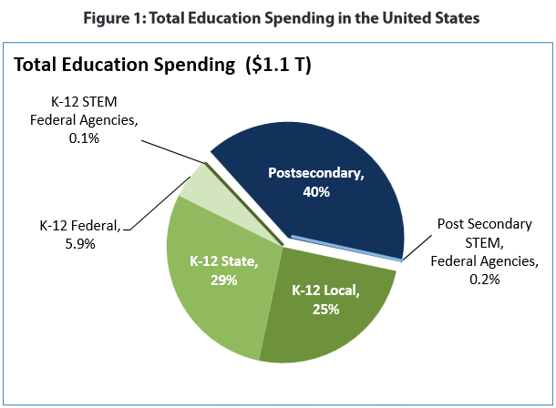
US Department of Education
Digest of Educational Statistics, 2009
via CoSTEM Report (2011)

Slide 20
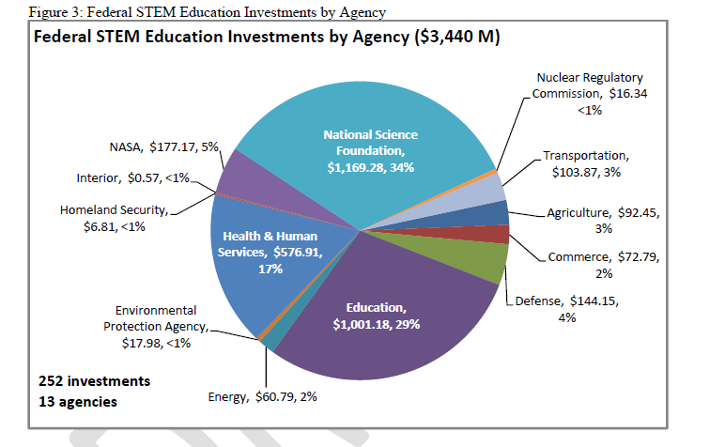
Federal Investment in STEM Education
Source: CoSTEM Report (2011)

Slide 21
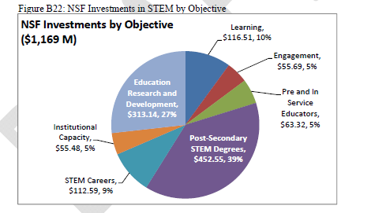

Slide 22
NSF Directorate for Education and Human Resources (EHR): Goals
Prepare the next generation of STEM professionals and attract/retain more Americans to STEM careers
Develop a robust research community that can conduct rigorous research and evaluation to support excellence in STEM education
Increase the technological, scientific and quantitative literacy of all Americans
Broaden participation and close achievement gaps in all STEM fields.

Slide 23
EHR Thematic Framework
Learning and Learning Environments
Develop understanding of the foundations of STEM learning; emerging contexts and tools; building new environments for learning in a technological society
Broadening Participation in STEM
Increase the scientific workforce by engaging and building capacity in all people in STEM learning and professional training
STEM Professional Workforce Development
Improve the education and preparation of a STEM professional workforce
NSF FY 2014 budget request for EHR: http://www.nsf.gov/about/budget/fy2014/pdf/25_fy2014.pdf

Slide 24
Directorate for Education and Human Resources (EHR): Divisional Framework
Division of Undergraduate
Education
(DUE)
Division of Human Resource Development
(HRD)
Division of Research on Learning in Formal and Informal Settings (DRL)
Division of Graduate Education
(DGE)

Slide 25
Strategic Re-envisioning for EHR*
View Broadening Participation as a Solution, not as a Problem to be Solved
View Broadening Participation as Central to Cultivating a Culture of Science
* EHR Advisory Committee Report:
http://www.nsf.gov/ehr/Pubs/AC_ReEnvisioning_Report_Sept_2014_01.pdf

Slide 26
Funding Opportunities
Numerous EHR programs, not all in HRD
Towards a science of broadening participation
Models (for intervention)

Slide 27
Inputs and Outputs

Slide 28
Inputs and Outputs

Slide 29
Inputs and Outputs

Slide 30
Inputs and Outputs

Slide 31
Models for Intervention
Execution inside the circle is key!
Ideas and people as both input/output
Diversity: inputs and execution
Understanding that execution
Temporal aspect: short- vs. long-term

Slide 32
Challenges
Funding discovery versus funding change
NSF is not a social agency
NSF is not a policy-making body
How best to act catalytically?

Slide 33
Professional Societies
Community leadership and mobilization
Physics (and mathematics) are central to further STEM study
Partnering, e.g. joint efforts with other disciplinary societies? Long-term commitments with business/industry?

Slide 34
Advantages
Agility
Advocacy
Accountability:
Shout out to the physics community – DATA!

Slide 35
Summary
STEM Education Enterprise as an ecosystem
Ecological diversity
Species diversity versus simply richness …Diversity index?
Health, resilience of the enterprise

Slide 36
EHR Investments
A wide-ranging portfolio
Evidence-based
Evidence-generating
Notes:
Experiential and informal learning settings
Assessment/metrics of learning and practice
Scholarships
Foundational education research (including undergraduate disciplinary-based education research)
Professional development
Curriculum design, development, implementation, and testing
Institutional change

Slide 37
NSF Scholarships in Science, Technology, Engineering, and Mathematics (S-STEM)
Goal: Provide scholarships to academically talented, and financially needy, students pursuing associate, baccalaureate, or graduate degrees in a STEM field.
http://www.nsf.gov/pubs/2012/nsf12529/nsf12529.pdf
New solicitation under development

Slide 38
S-STEM
MAJOR FEATURES
Eligible disciplines include almost all NSF supported areas (see solicitation for guidance)
Maximum scholarship amount is $10,000 (but still based on financial need)
Total award increased to $600,000: Based on the scholarship funds subtotal, 5% allowed for administration and 10% for student support
Maximum of $225,000 in any one year, but can ramp up
One proposal per constituent school or college that awards degrees (also schools within institutions)
About $50 million was available in FY 2013, similar for FY 2014 (source of funds is fees paid by H-1(B) visa applicants)

Slide 39
S-STEM
Additional Program Features
PI must be a faculty member in a STEM discipline.
Involves cohorts of students.
Can fund student support structures.
Includes optional enhancements such as research opportunities, tutoring, internships, etc.
Enrolls students full time.
Connections with local businesses and industry considered essential.

Slide 40
IUSE: EHR
Track | October 2014 | January 2015
Engaged Student Learning | Exploration up to $250K Deadline: 10/22/14 | Design and Development Level I - up to $600K Level II - $600K - $2M Deadline: 1/13/15
Institutional and Community Transformation | Exploration up to $250K Deadline: 10/22/14 | Design and Development up to $3M Deadline: 1/13/15
http://www.nsf.gov/pubs/2014/nsf14588/nsf14588.pdf

Slide 41
IUSE GOAL
Address immediate challenges and opportunities facing the undergraduate STEM education enterprise

Slide 42
IUSE Envisioned Outcomes
Increase student retention in STEM
Students prepared to participate in STEM for tomorrow
Improved student learning gains
New knowledge about how students learn and about effective practice
Broadened participation in STEM

Slide 43
IUSE R&D
Improving the undergraduate STEM education enterprise through:
Projects that build on fundamental research in undergraduate STEM education and prior R&D
Research on design, development, and widespread implementation of effective learning/teaching knowledge and practice
Foundational research on student learning

Slide 44
IUSE Resources
Webinar Slides
http://ehrweb01.aaas.org/stem-iwbw/iuse-webinars/
(find links to recent slides and audio recordings at the bottom of the page)
Common Guidelines for Education R&D
http://www.nsf.gov/pubs/2013/nsf13126/nsf13126.pdf

Slide 45
EHR Core Research (NSF 15-509)
Make strategic research investments in potentially transformative areas;
Accelerate development and growth of theory and methodology;
Address challenges of practice;
All in STEM Education, Broadening Participation, and Workforce Development!
http://www.nsf.gov/funding/pgm_summ.jsp?pims_id=504924

Slide 46
Division of Human Resource Development (HRD)
Mission: “To grow the innovative and competitive U.S. science, technology, engineering and mathematics (STEM) workforce that is vital for sustaining and advancing the Nation's prosperity by supporting the broader participation and success of individuals currently underrepresented in STEM and the institutions that serve them.”

Slide 47
HRD Programs
Historically Black Colleges and Universities Undergraduate Program (HBCU-UP)
Tribal Colleges and Universities Program (TCUP)
Louis Stokes Alliances for Minority Participation (LSAMP)
Centers of Research Excellence in Science and Technology (CREST)
Alliances for Graduate Education and the Professoriate (AGEP)
Increasing the Participation and Advancement of Women in Academic Science and Engineering Careers (ADVANCE)
Presidential Awards for Excellence in Science, Mathematics, and Engineering Mentoring (PAESMEM)

Slide 48
Goals of HRD Programs
HBCU-UP: To enhance the quality of undergraduate STEM education and research at HBCUs
TCUP: To promote high quality STEM education, research, and outreach programs at Tribal Colleges, Alaska Native-serving, and Native Hawaiian-serving institutions
LSAMP: To significantly increase the numbers of students (historically under-represented in STEM) who successfully complete high quality degree programs in STEM disciplines

Slide 49
Goals (continued)
CREST: To strengthen the national research competitiveness of Minority-serving institutions
AGEP: To support the development, implementation, study, and dissemination of innovative models and standards of graduate education and postdoctoral training that are designed to improve underrepresented students’ participation, preparation, and success
ADVANCE: To develop systemic approaches to increase the representation and advancement of women in Academic STEM Careers

Slide 50
Broadening Participation in STEM
ADVANCE, AGEP, CREST, HBCU-UP, TCUP (thematic – L/LE)
Building and implementing models on how to broaden participation and institutional capacity
LSAMP
Alliances
Bridge to the Baccalaureate (B2B)
Bridge to the Doctorate (BD)
Broadening Participation in STEM Education Research

Slide 51
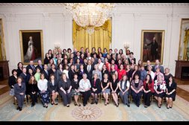
Workforce Development: Presidential Awards
The Presidential Award for Excellence in Science, Mathematics, and Engineering Mentoring (PAESMEM) identifies outstanding mentoring efforts that enhance the participation and retention of underrepresented populations in STEM.
The Presidential Award for Excellence in Mathematics and Science Teaching (PAEMST) recognizes outstanding elementary and secondary teachers of mathematics and science in each state and U.S. jurisdiction.

Slide 52
Links to HRD Programs
HBCU-UP: Historically Black Colleges and Universities, Undergraduate Program
http://www.nsf.gov/pubs/2014/ nsf 14513/nsf14513.htm
TCUP: Tribal Colleges and Universities Program
http://www.nsf.gov/pubs/2014/ nsf 14572/nsf14572.htm
LSAMP: Louis Stokes Alliances for Minority Participation
http://www.nsf.gov/pubs/2012/ nsf 12564/nsf12564.htm
CREST: Centers of Research Excellence in Science and Technology
http://www.nsf.gov/pubs/2014/ nsf 14565/nsf14565.htm
AGEP: Alliances for Graduate Education and the Professoriate
http://www.nsf.gov/pubs/2014/ nsf 14505/nsf14505.htm
ADVANCE: Increasing the Participation and Advancement of Women in Academic Science and Engineering Careers
http://www.nsf.gov/pubs/2014/ nsf 14573/nsf14573.htm

Slide 53
WAYS TO PARTICIPATE
Grant Holder
Principal Investigator
Member of Project Team, or
Coalition, or Advisory Board
Test Site
User of Products
Participant in Workshops and Symposium
Reviewer of Proposals
Notes:
53

