Slide 1

Reimagining Best Practices in Technology-Enhanced Physics Teacher Education
Dr. Marina Milner-Bolotin
The University of British Columbia, Vancouver, Canada
AAPT 2015 Winter Meeting – San Diego, California
Notes:
Abstract: AC04: 11:30 a.m.-12 p.m. Reimagining Best Practices in
Technology-Enhanced Physics Teacher Education
Invited – Marina Milner-Bolotin, The University of British Columbia,
Vancouver, BC V6T 1Z4 Canada; marina.milner-bolotin@ubc.ca
Investigating and promoting best practices in teaching and learning have always occupied a prominent place in science education. From Socratic questioning to modern day technology-enhanced pedagogies, such as Peer Instruction, Interactive Lecture Demonstrations, simulation-enhanced pedagogies, educators have been looking for ways to engage students in meaningful science learning. However, frequently technology becomes a fad imposed on teachers, where, the technological tail wags the pedagogical dog. In this presentation I will invite you to re-examine the technology-enhanced pedagogical practices in physics teacher education. We will first question the applicability of the concept of “best pedagogical practice” itself and examine a number of research-informed “best practices” currently implemented in physics teacher education. We will also consider how prospective physics teachers can be engaged in creating their own “best technology-enhanced practices” that suit their views and goals of physics education and help them become the best physics teachers they can be.

Slide 2
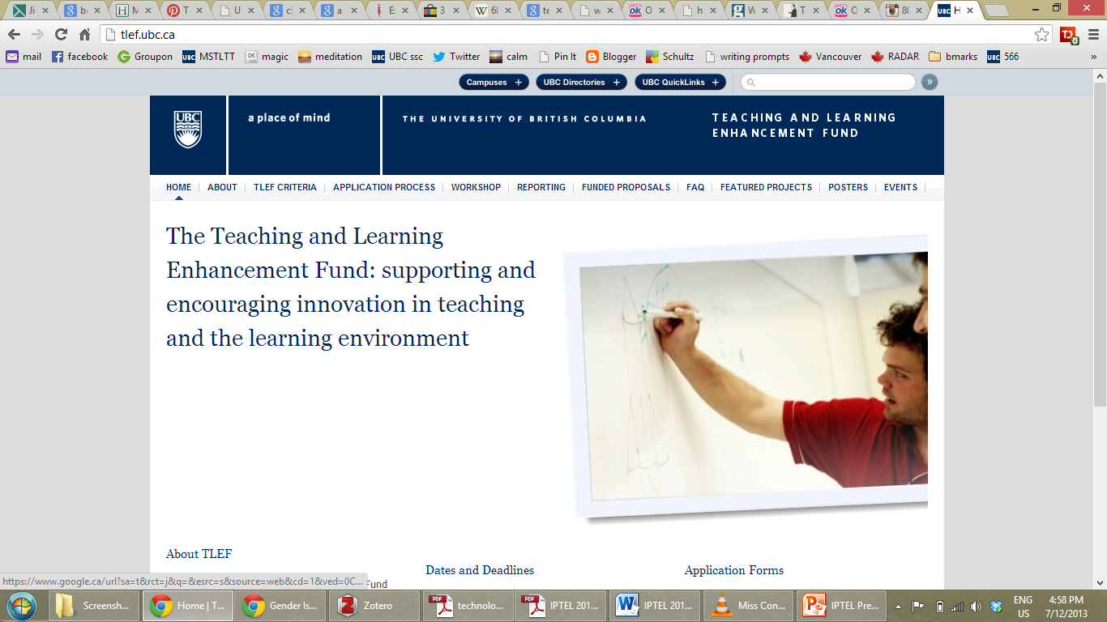
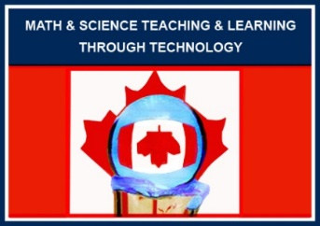
Acknowledgements
  UBC TLEF support 2012-2015

Slide 3
Research Team Members
Davor Egersdorfer (Grad student)
Murugan Vinayagam (Grad student)
Alexandra MacDonald (graduated, MA summer 2014)
Heather Fisher (graduated, MA summer 2014)
Teacher-Candidates, Physics Methods courses
BC Physics and Mathematics teachers

Slide 4
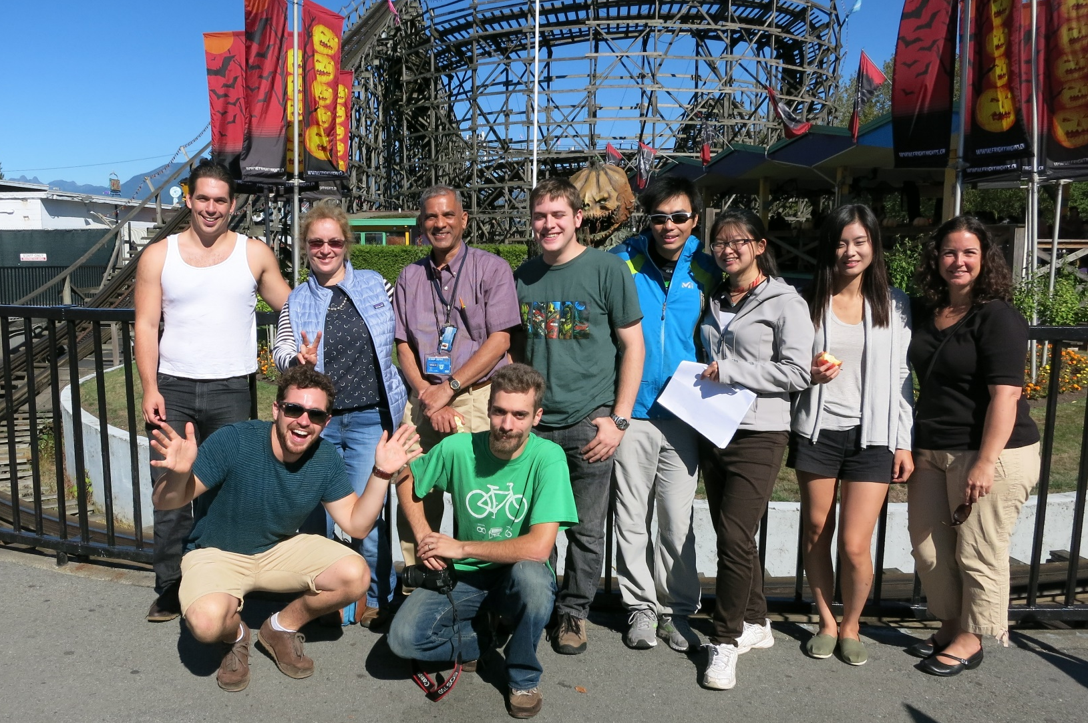
Physics Teacher-Candidates

Slide 5
Best Practice – Wikipedia
A best practice is a method or technique that has consistently shown results superior to those achieved with other means, and that is used as a benchmark. In addition, a "best" practice can evolve to become better as improvements are discovered.
Best practice is considered by some as a business buzzword, used to describe the process of developing and following a standard way of doing things that multiple organizations can use.

Slide 6
Deliberate Pedagogical Thinking
Using Technology to Promote Teacher-Candidates’ capacity and positive attitudes for Deliberate Pedagogical Thinking: Thinking driven by improving student learning and inspiring them in meaningful STEM learning
Notes:
Notice, I focus on learning, not on teaching – teachers are first and foremost learners. If you are not a learner, you cannot be a good teacher.
Never Stop Learning! When you stop learning you stop living. You become a reservoir instead of a river.
Tim Walker quotes

Slide 7
Research Goals: Promoting Deliberate Pedagogical Thinking via technology
Pedagogical Content Knowledge
Positive attitudes about technology in STEM
Capacity for deliberate technology use.
Notes:
In this presentation I will discuss research on the use of educational technologies in mathematics and physics teacher education and on the effects of these technologies on the development of teacher-candidates’ Pedagogical Content Knowledge (Shulman, 1986). I will focus specifically on the role of technologies in three aspects of STEM teacher-education: helping teacher-candidates develop (a) Pedagogical Content Knowledge, (b) positive attitudes about the use of technologies in STEM teaching and learning, and (c) the capacity and willingness to explore novel applications of technologies in their teaching.

Slide 8
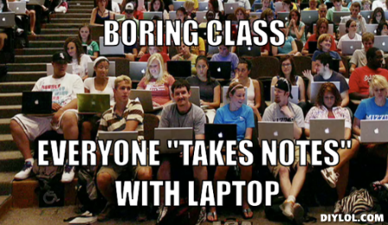
Research and Practice Gap
STEM teachers lack TPCK needed for producing CHANGE. Teacher-Candidates need to begin acquiring this TPCK during their teacher-education years.
Notes:
Start here emphasizing the mismatch between how people learn and how we teach…
Moving away from lecturing is unsafe for the teachers who lack content and pedagogical knowledge…

Slide 9
Context
Secondary Teacher Education Program (~80 STEM teacher-candidates)
Physics methods and inquiry courses
~20 teacher-candidates per course
Action research study

Slide 10
Intervention – Action Research in a Physics Methods Course
Instructor models:
  Deliberate Technology-Enhanced Pedagogical Thinking
  Technology-Enhanced Pedagogies
Teacher-Candidates practice Technology-Enhanced Pedagogies:
  In the methods course
  During Physics Methods courses
Teacher-Candidates reflect on Technology-Enhanced Pedagogies
Notes:
How did we evaluate all of this work/intervention?
CREATE A GRAPHIC:
Methods course
(include short practicum here)
Pre-interviews
Long Practicum
Post-interviews
Focus group
+ background survey

Slide 11
Research Study: 2012-2014
Secondary Physics Methods Course (Deliberate Technology-Enhanced Pedagogical Thinking)
(+ 2-week short practicum)
13 students and 13 weeks
Pre-Practicum Interviews
(8)
Timeline
Extended Practicum
10 weeks
Enhanced Practicum
3 weeks
Post-Practicum Interviews
(7)
Focus Group (1)
Notes:
How did we evaluate all of this work/intervention?
CREATE A GRAPHIC:
Methods course
(include short practicum here)
Pre-interviews
Long Practicum
Post-interviews
Focus group
+ background survey

Slide 12




Four Examples of Deliberate Technology-Enhanced Pedagogical Thinking
Electronic Response Systems (clickers) and PeerWise
Live Data Collection and Analysis (Logger Pro)
Computer Simulations (PhET)
GeoGebra

Slide 13
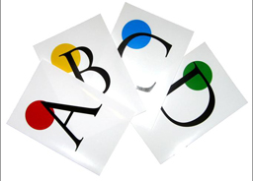
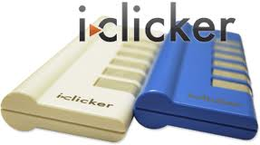
I. Peer Instruction and PeerWise: Active Learning
Electronic response systems (clickers) in K-12 classrooms…

Slide 14
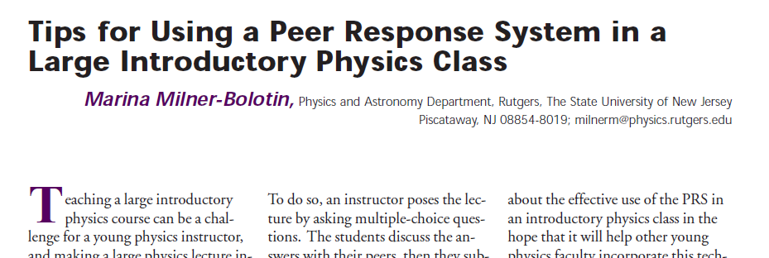
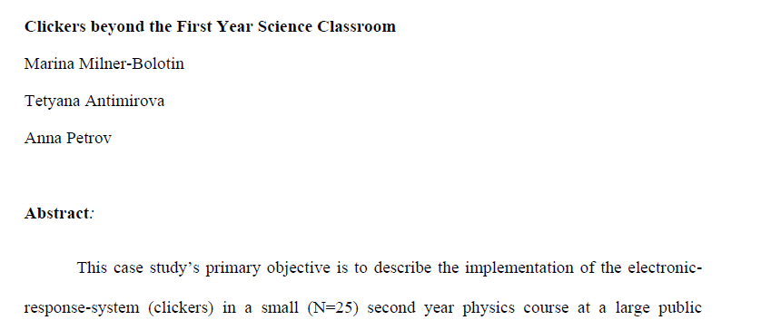
Research-Informed Teacher Education
2004, The Physics Teacher, 42(8), 47-48.
Journal of College Science Teaching, Fall 2009
2010, Journal of College Science Teaching,
40(2), 18-22.
Notes:
From the paper: The Role of Representation in Teaching and Learning Critical Thinking
Definition of representations: A representation is a structure that stands for something else: a word for an object,
a sentence for a state-of-affairs, a diagram for an arrangement of things, a picture
for a scene.
Thus, a good representation system captures exactly the features of a problem (p.58/2)
that are important rather than representing everything. (p.60/4)
Being able to think about why a representation may or may not be good in a particular context is a big part of being a critical thinker. If a student can realise that the problem they are working on is best represented in a particular way, it can help
them identify the most important aspects of a situation and analyse what should be done next. If they know what the ‘accepted’ transformations of a problem type are, then they can begin to think at a higher level about why those are the ones that are
used and why, perhaps, it might be interesting to try a different representation. They can begin to understand why problems are the way they are (p.62/6).
This is not due to a lack of exposure to the representations, but rather an inability to link the different forms of
representation to the underlying common concept of number (Grif. n & Case, 1997). A failure to develop this foundational understanding can lead to serious lags in learning mathematics throughout formal school years (Griffin et al., 1994). Problems
of representational  fluency are apparent in older students as well. University students who can readily translate between and manipulate representations score higher on measures of reasoning ability than those students whose skilled use of representations is more limited (Stenning et al., 1995). Monaghan et al. (1999) found also that higher scores on problem solving tasks were related to ability to use representations more  flexibly. (p.62/6).
However, we want to emphasise that social sciences, arts, languages, natural sciences, and humanities all use various forms of representation, some quite general and some very specialised. Some of these are evidence diagrams, concept maps, v-diagrams, timelines, grammar notations, and dance notations (Novak, 1998; Peterson, 1996). The same costs and benefits for communication and problem-solving apply to all of these as well. (p.63/7).

Slide 15
Peer Instruction

Slide 16
A Key to Question-Driven Pedagogy
Effective use of Peer Instruction is based on using pedagogically effective questions… The technology (clickers) will evolve, yet the ability to come up with pedagogically sound questions will remain with teacher-candidates forever!

Slide 17
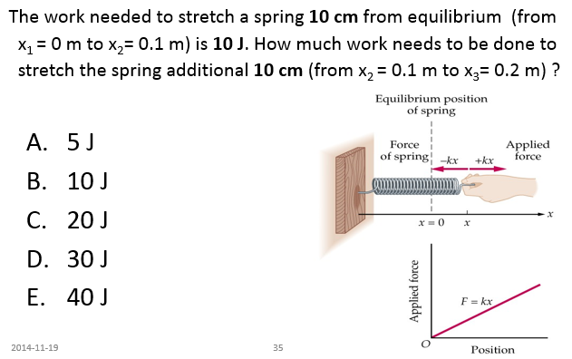
Example of a Conceptual Question

Slide 18
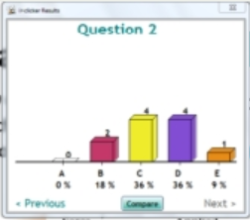
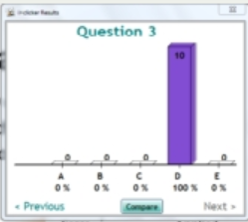
Example of a Conceptual Question
Pre-Discussion Poll
Post-Disc. Poll
10
4
4
2
1
0
Respondents: Physics Teacher-Candidates

Slide 19
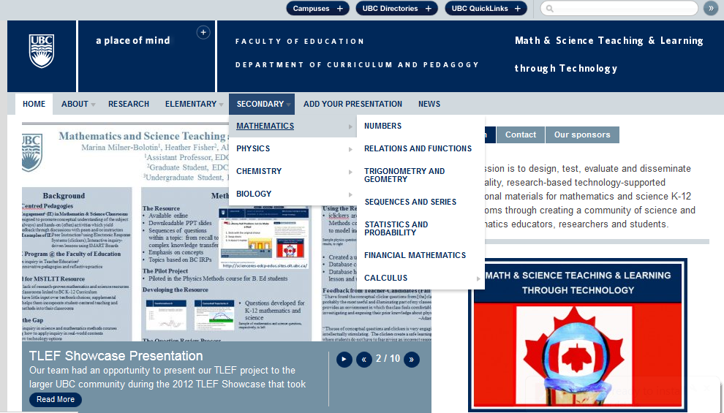
Math & Science Teaching and Learning through Technology

Slide 20
Feedback from UBC Teacher-Candidates
I have found the conceptual clicker questions from your classroom to be probably the most useful and illuminating part of my classes. This format provides an environment in which the class feels comfortable investigating and exposing their prior knowledge about physics. (Adam Quiring).
The use of conceptual questions and clickers is very engaging and intellectually stimulating. The clickers create a safe learning environment where students do not have to fear giving an incorrect response to the teacher. I look forward to using this in my future classroom (Clement Law).

Slide 21
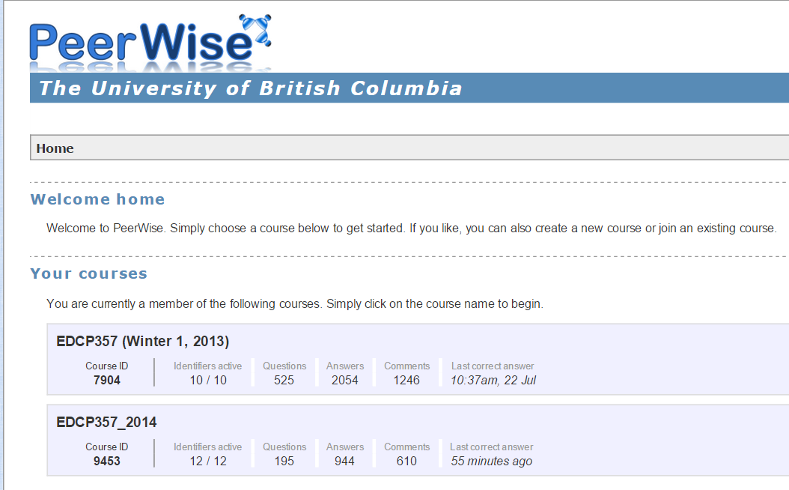
PeerWise: Pedagogically Inspired Online Collaboration

Slide 22
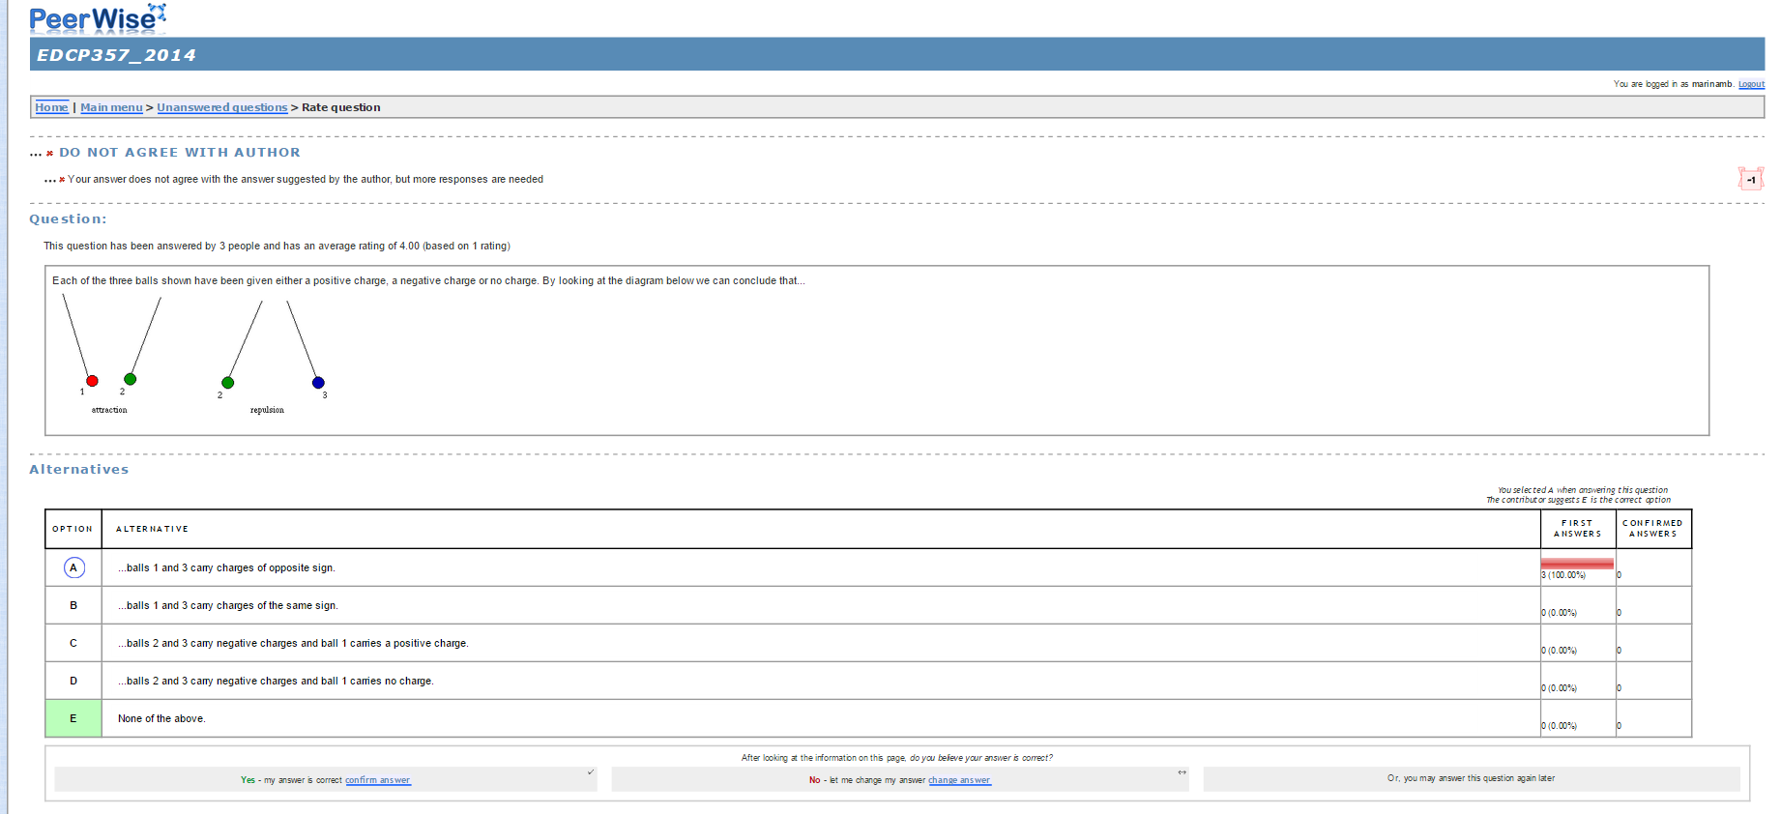
Designing, Answering, Commenting, Reflecting & Improving

Slide 23
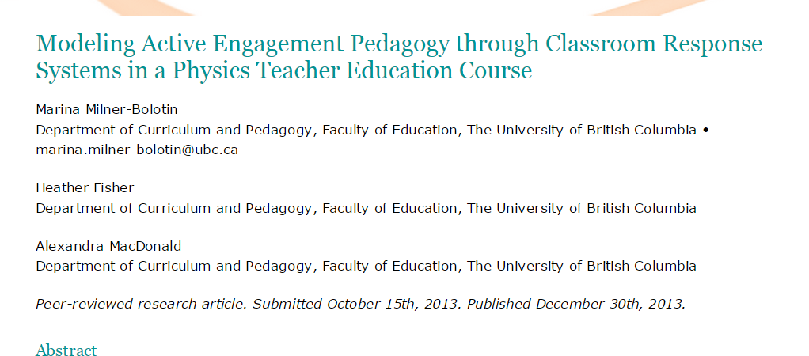
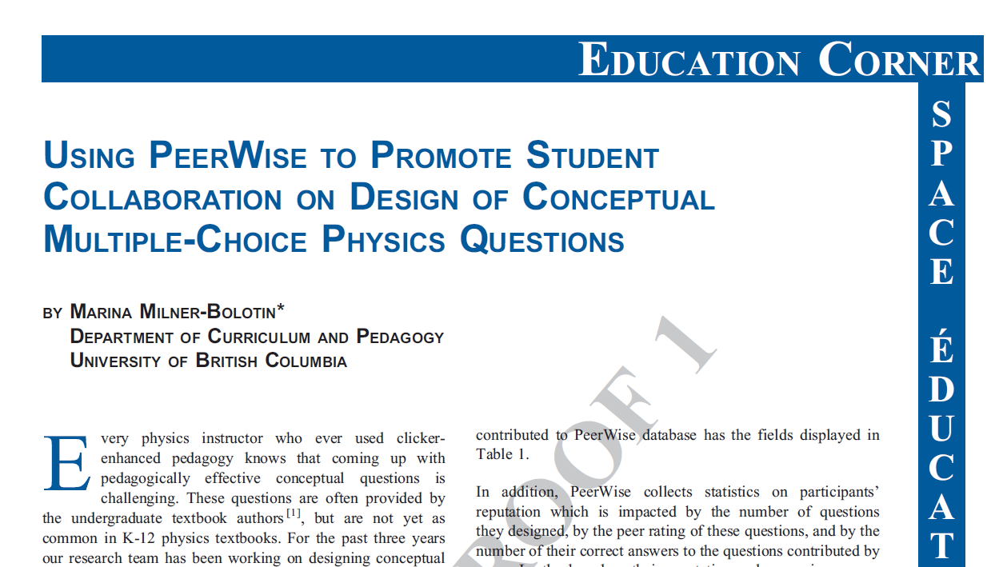
Effect of Peer Instruction on TCs’ Pedagogical Content Knowledge

Slide 24
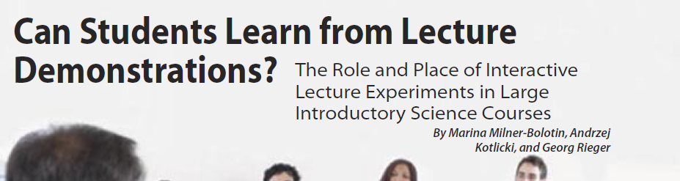
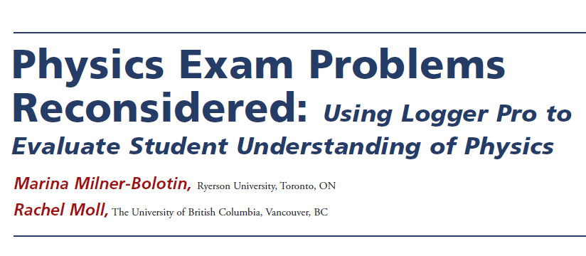

II. Live Data Collection-Analysis
2007, Journal of College Science Teaching, 36(4), 45-49.
2008, The Physics Teacher, 46(8), 494-500.
Notes:
From the paper: The Role of Representation in Teaching and Learning Critical Thinking
Definition of representations: A representation is a structure that stands for something else: a word for an object,
a sentence for a state-of-affairs, a diagram for an arrangement of things, a picture
for a scene.
Thus, a good representation system captures exactly the features of a problem (p.58/2)
that are important rather than representing everything. (p.60/4)
Being able to think about why a representation may or may not be good in a particular context is a big part of being a critical thinker. If a student can realise that the problem they are working on is best represented in a particular way, it can help
them identify the most important aspects of a situation and analyse what should be done next. If they know what the ‘accepted’ transformations of a problem type are, then they can begin to think at a higher level about why those are the ones that are
used and why, perhaps, it might be interesting to try a different representation. They can begin to understand why problems are the way they are (p.62/6).
This is not due to a lack of exposure to the representations, but rather an inability to link the different forms of
representation to the underlying common concept of number (Grif. n & Case, 1997). A failure to develop this foundational understanding can lead to serious lags in learning mathematics throughout formal school years (Griffin et al., 1994). Problems
of representational  fluency are apparent in older students as well. University students who can readily translate between and manipulate representations score higher on measures of reasoning ability than those students whose skilled use of representations is more limited (Stenning et al., 1995). Monaghan et al. (1999) found also that higher scores on problem solving tasks were related to ability to use representations more  flexibly. (p.62/6).
However, we want to emphasise that social sciences, arts, languages, natural sciences, and humanities all use various forms of representation, some quite general and some very specialised. Some of these are evidence diagrams, concept maps, v-diagrams, timelines, grammar notations, and dance notations (Novak, 1998; Peterson, 1996). The same costs and benefits for communication and problem-solving apply to all of these as well. (p.63/7).

Slide 25
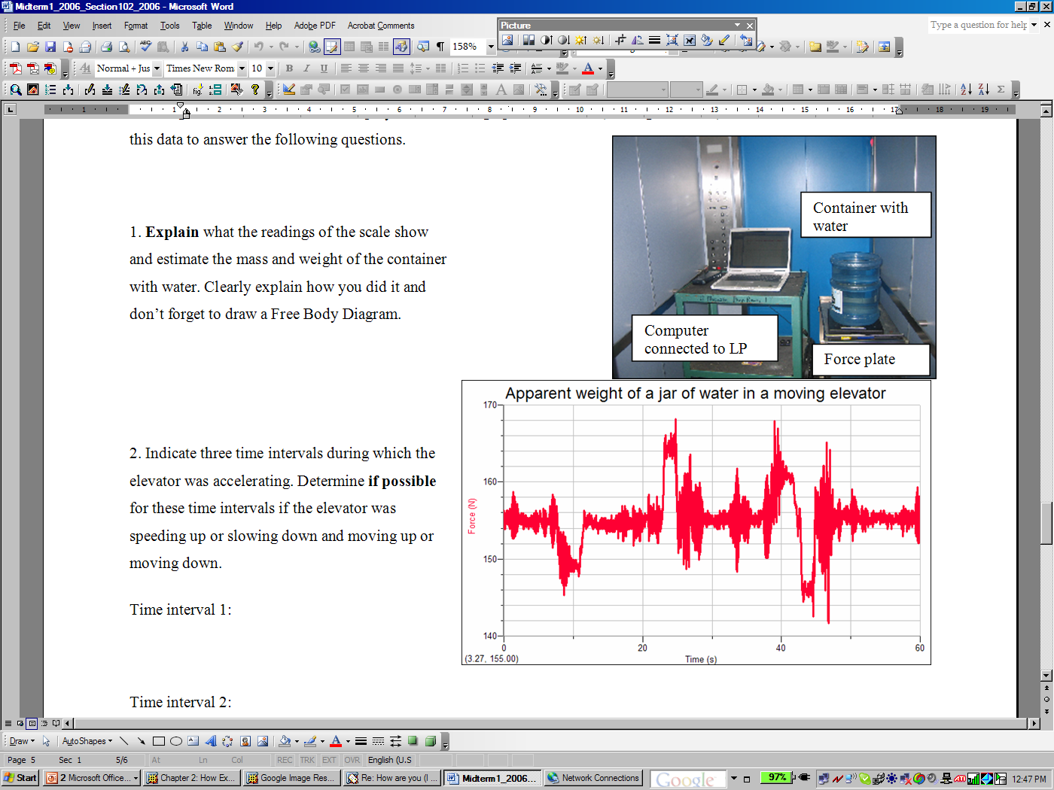
Developing Scientific Thinking
Thinking like a scientist means being able to analyze real life situations using real data.
A water jar was placed on a force plate inside a moving elevator: weight and apparent weight problem

Slide 26
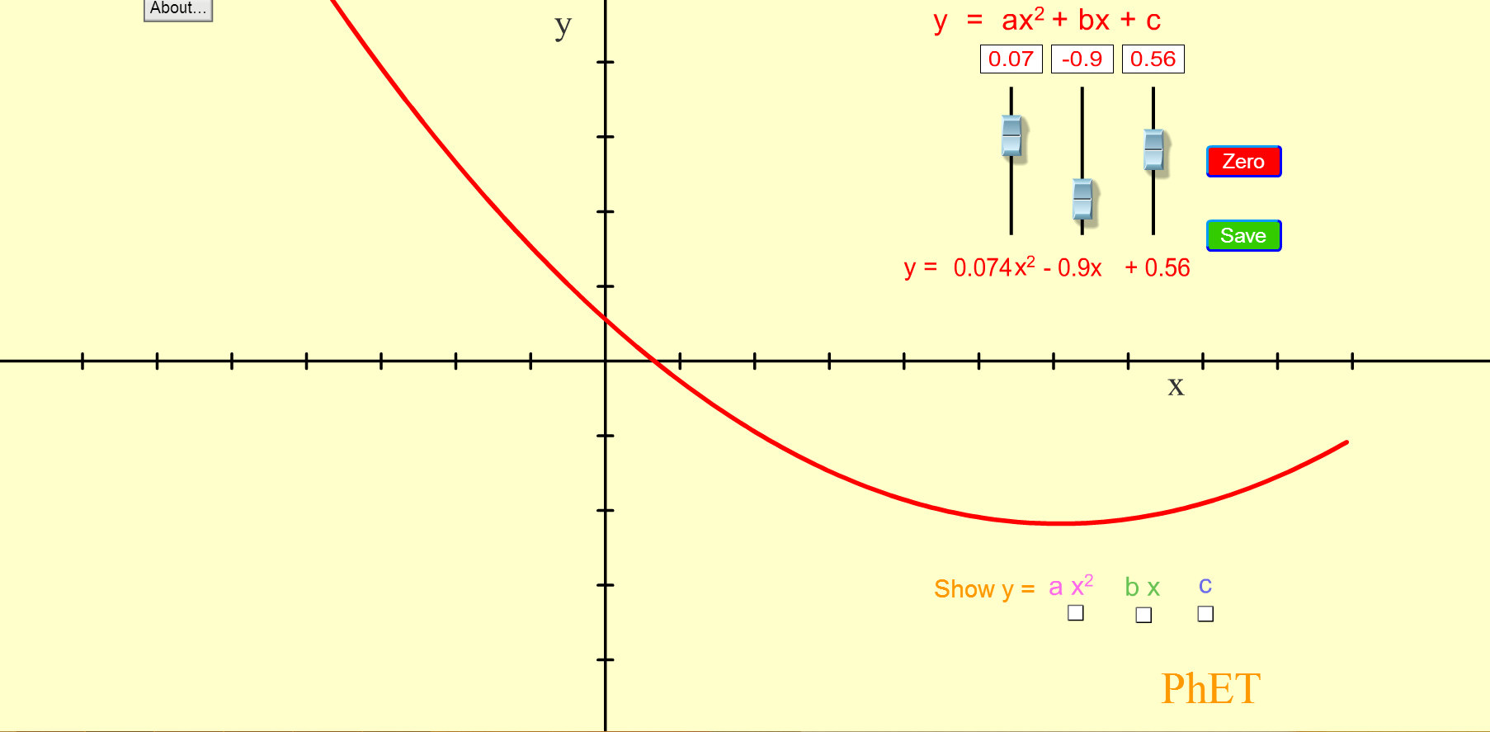
III. Using Computer Simulations
Notes:
From the paper: The Role of Representation in Teaching and Learning Critical Thinking
Definition of representations: A representation is a structure that stands for something else: a word for an object,
a sentence for a state-of-affairs, a diagram for an arrangement of things, a picture
for a scene.
Thus, a good representation system captures exactly the features of a problem (p.58/2)
that are important rather than representing everything. (p.60/4)
Being able to think about why a representation may or may not be good in a particular context is a big part of being a critical thinker. If a student can realise that the problem they are working on is best represented in a particular way, it can help
them identify the most important aspects of a situation and analyse what should be done next. If they know what the ‘accepted’ transformations of a problem type are, then they can begin to think at a higher level about why those are the ones that are
used and why, perhaps, it might be interesting to try a different representation. They can begin to understand why problems are the way they are (p.62/6).
This is not due to a lack of exposure to the representations, but rather an inability to link the different forms of
representation to the underlying common concept of number (Grif. n & Case, 1997). A failure to develop this foundational understanding can lead to serious lags in learning mathematics throughout formal school years (Griffin et al., 1994). Problems
of representational  fluency are apparent in older students as well. University students who can readily translate between and manipulate representations score higher on measures of reasoning ability than those students whose skilled use of representations is more limited (Stenning et al., 1995). Monaghan et al. (1999) found also that higher scores on problem solving tasks were related to ability to use representations more  flexibly. (p.62/6).
However, we want to emphasise that social sciences, arts, languages, natural sciences, and humanities all use various forms of representation, some quite general and some very specialised. Some of these are evidence diagrams, concept maps, v-diagrams, timelines, grammar notations, and dance notations (Novak, 1998; Peterson, 1996). The same costs and benefits for communication and problem-solving apply to all of these as well. (p.63/7).

Slide 27
Developing Intuition & Visualization
Experimentally testing different scenarios: WHAT IF…?
Developing models of invisible phenomena
Teachers must be deliberate in creating meaningful assignments.
Notes:
The way we teach today we do not achieve these goals for the majority of the students. – Traditional lecture demonstrations

Slide 28
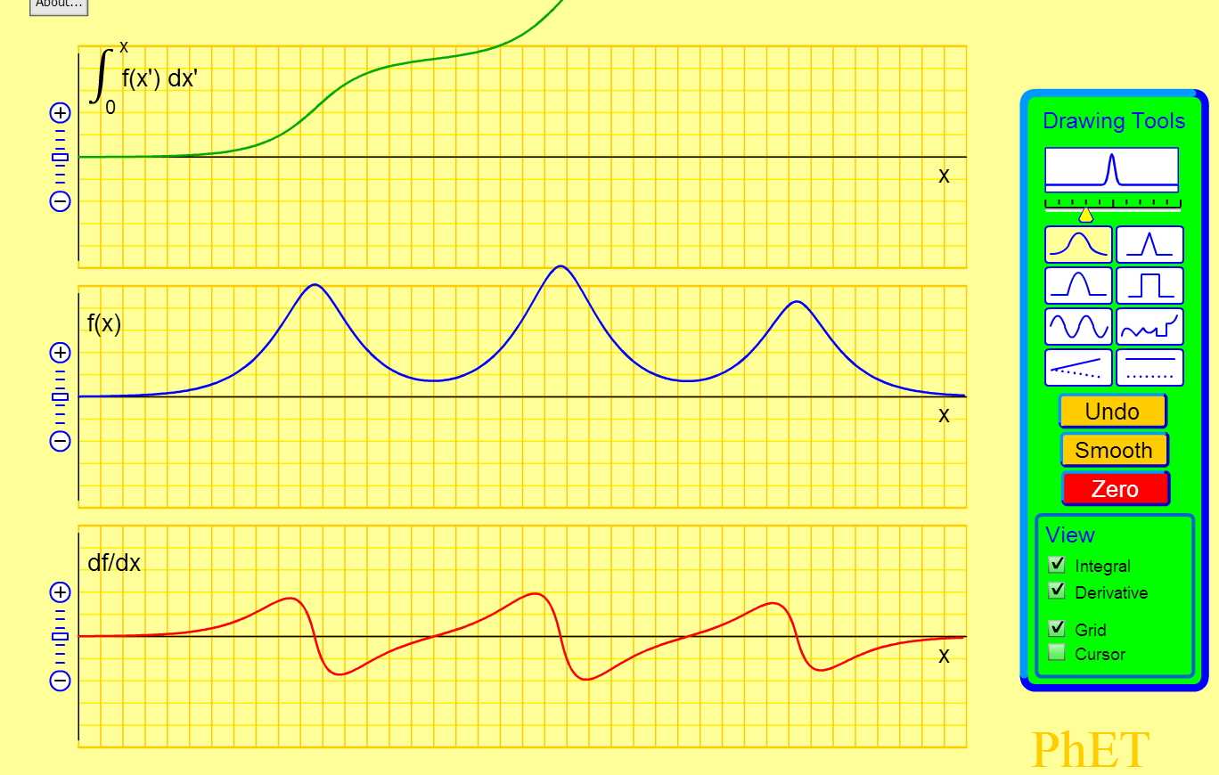
PhET Calculus Grapher
Notes:
http://phet.colorado.edu/sims/calculus-grapher/calculus-grapher_en.html

Slide 29
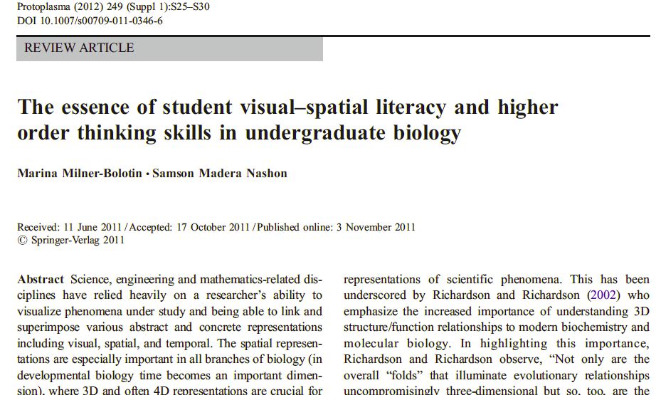
Computer Sims and STEM Literacy
Notes:
From the paper: The Role of Representation in Teaching and Learning Critical Thinking
Definition of representations: A representation is a structure that stands for something else: a word for an object,
a sentence for a state-of-affairs, a diagram for an arrangement of things, a picture
for a scene.
Thus, a good representation system captures exactly the features of a problem (p.58/2)
that are important rather than representing everything. (p.60/4)
Being able to think about why a representation may or may not be good in a particular context is a big part of being a critical thinker. If a student can realise that the problem they are working on is best represented in a particular way, it can help
them identify the most important aspects of a situation and analyse what should be done next. If they know what the ‘accepted’ transformations of a problem type are, then they can begin to think at a higher level about why those are the ones that are
used and why, perhaps, it might be interesting to try a different representation. They can begin to understand why problems are the way they are (p.62/6).
This is not due to a lack of exposure to the representations, but rather an inability to link the different forms of
representation to the underlying common concept of number (Grif. n & Case, 1997). A failure to develop this foundational understanding can lead to serious lags in learning mathematics throughout formal school years (Griffin et al., 1994). Problems
of representational  fluency are apparent in older students as well. University students who can readily translate between and manipulate representations score higher on measures of reasoning ability than those students whose skilled use of representations is more limited (Stenning et al., 1995). Monaghan et al. (1999) found also that higher scores on problem solving tasks were related to ability to use representations more  flexibly. (p.62/6).
However, we want to emphasise that social sciences, arts, languages, natural sciences, and humanities all use various forms of representation, some quite general and some very specialised. Some of these are evidence diagrams, concept maps, v-diagrams, timelines, grammar notations, and dance notations (Novak, 1998; Peterson, 1996). The same costs and benefits for communication and problem-solving apply to all of these as well. (p.63/7).

Slide 30
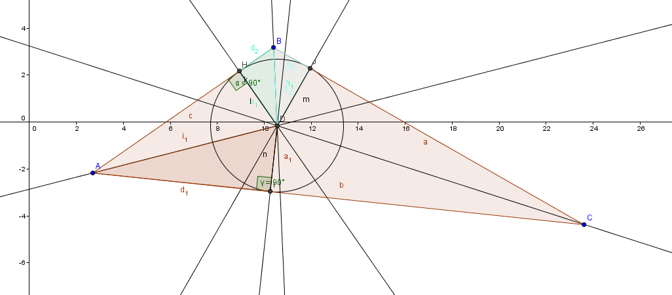
IV. Using GeoGebra
Questioning the obvious: using GeoGebra to stimulate Aha moments

Slide 31
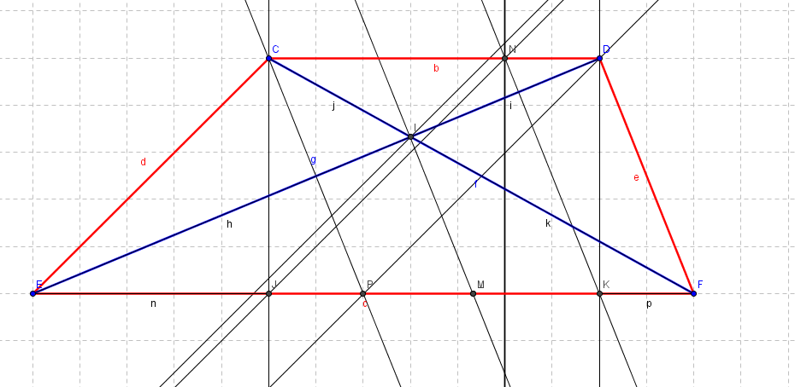
Example of GeoGebra Exploration
An example of a problem in Geometry from the Kenyan math grade 10 final governmental exam.

Slide 32
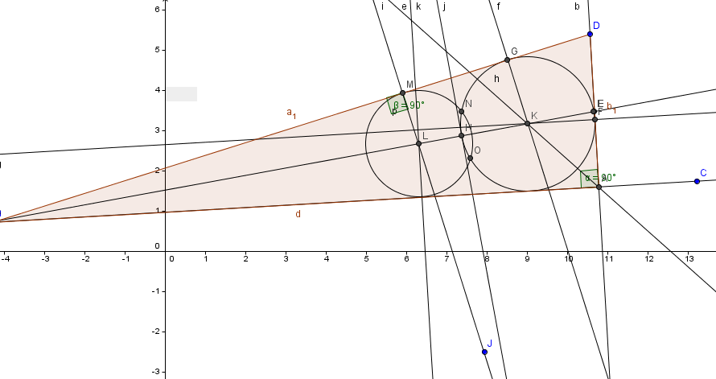
GeoGebra as a Math Laboratory

Slide 33
Research Goals and Findings
Pedagogical Content Knowledge
Positive attitudes about technology in STEM
Capacity for deliberate technology use.
Notes:
In this presentation I will discuss research on the use of educational technologies in mathematics and physics teacher education and on the effects of these technologies on the development of teacher-candidates’ Pedagogical Content Knowledge (Shulman, 1986). I will focus specifically on the role of technologies in three aspects of STEM teacher-education: helping teacher-candidates develop (a) Pedagogical Content Knowledge, (b) positive attitudes about the use of technologies in STEM teaching and learning, and (c) the capacity and willingness to explore novel applications of technologies in their teaching.

Slide 34
Technology as a Vehicle to Promote Content Knowledge
VALUE OF CONCEPTUAL UNDERSTANDING
“…physics is…not about applying formulas, and doing math. It is…about gaining an appreciation of the world around us. And, being able to use your understanding and extrapolate … explain what’s happening around you. [It] has nothing to do with math formulas.”
Post-interview 1
Student understanding as beyond current classroom context
Role of TCs previous conceptual understanding
Notes:
TCs focus on the importance of student understanding for their students’ future educational experiences and the impact of understanding concepts deeply in real-world contexts

Slide 35
Technology as a Vehicle to Promote Scientific Thinking
VALUE OF CONCEPTUAL UNDERSTANDING
“Coming into the program, we were all sort of thought that we were expected to be masters, and if the instructor puts up a clicker question, you think ‘Jeez, I don’t actually know the answer’ – immediately you think well, we’re all supposed to be masters, I’m probably the only one who doesn’t know. But uh when the responses come in, you see other people think like you, it’s definitely reassuring.”
Pre-Interview 2
Questioning what it means TO UNDERSTAND…
Role of TCs previous conceptual understanding
Notes:
TCs focus on the importance of student understanding for their students’ future educational experiences and the impact of understanding concepts deeply in real-world contexts

Slide 36
Technology as a Vehicle to Promote Pedagogical Thinking
VALUE OF PEDAGOGICAL UNDERSTANDING
“It (clickers) really opens the door for … discussions between people … regarding a) … what is the right answer, and b) how would you explain that to … either teacher-candidates or to your potential students.”
Pre-Interview 2
Questioning what it means TO UNDERSTAND in order TO EXPLAIN…
Focusing on the process of UNDERSTANDING
Notes:
TCs focus on the importance of student understanding for their students’ future educational experiences and the impact of understanding concepts deeply in real-world contexts

Slide 37
Technology as a Vehicle for promoting Student Engagement
“So, if you set it up in a dynamic where… different types of people have [different needs], so if you need to talk to someone, you still get that, if you need silence, you get to think on it on your own, and then people aren’t so stressed… And they actually get to argue and talk back and forth and they’ll remember it more. So for them, I think they’ll master it more.”
Post-Interview 2, Participant 20
Notes:
One theme!!
Connections that TC’s make between the importance of good pedagogical practice and content knowledge pre- and post-practicum.
SHULMAN

Slide 38
Technology as a Vehicle for promoting Student Engagement
ROLE OF STUDENT ENGAGEMENT
“… some of the physics 11s who are just doing it to do a science, and are just, ‘Alright, Physics, I’ll try it out.’ Some of them were not as en-engaged, and I think doing the… voting-style questions helped get them more into it and more involved. So I’d say… it’s helpful to get those students who hide at the back in these 30 person classes.”
Post-interview 3
Necessary for conceptual understanding
Classroom realities are single most limiting factor in application of this value
Notes:
TCs focus on the importance of student understanding for their students’ future educational experiences and the impact of understanding concepts deeply in real-world contexts

Slide 39

Promoting Deliberate Pedagogical Thinking with Technology

Slide 40
Technology as a Vehicle for Deliberate Pedagogical Thinking
TECHNOLOGY AS A Vehicle not a Goal
“It wasn’t just the clickers alone. It was also in…. the presentation of the question. It wasn’t a simple plug in the answer-type question. It had to be conceptual, in which you could… , the Bloom’s taxonomy, the higher learning of students. So, in itself, clickers… is only a tool. But it needs to be complemented with good conceptual questions in order to make it work.”
Pre-Interview 5
Technology requires a pedagogical purpose
Conceptual understanding as an important outcome
Alternative mechanisms can achieve similar outcomes
Notes:
TCs focus on the importance of student understanding for their students’ future educational experiences and the impact of understanding concepts deeply in real-world contexts

Slide 41
Technology as a Vehicle for Deliberate Pedagogical Thinking
“I’m there as a teacher, (pause) but I’m also there as a student. Conversely, they’re there as a student, but they’re also there as a teacher. That doesn’t mean they’re teaching necessarily, teaching me. They’re teaching each other... You’re always a student-teacher, regardless of whether or not, what your position says. The-the moment you step out, and you meet someone, you now are both a teacher and a learner.”
Post-Interview 1
TC as TEACHERS AND LEARNERS
Capacity and willingness to explore novel technological applications
Capacity for Deliberate Pedagogical Thinking
Notes:
TCs focus on the importance of student understanding for their students’ future educational experiences and the impact of understanding concepts deeply in real-world contexts

Slide 42
To be Continued: Big questions
HOW DO WE LEARN WITH TECHNOLOGY?
HOW DO WE EMPOWER TEACHERS TO LEARN WITH TECHNOLOGY?
HOW DO WE UNCOVER OPPORTUNITIES WITH TECHNOLOGIES INSTEAD OF DOING THE SAME OLD THING WITH NEW TOOLS?

Slide 43
Selected Resources
Beatty, I., Gerace, W., Leonard, W., & Defresne, R. (2006). Designing Effective Questions for Classroom Response System Teaching. American Journal of Physics, 74(1), 31–39.
CWSEI Clicker Resource Guide: An Instructors Guide to the Effective Use of Personal Response Systems (Clickers) in Teaching. (2009, June 1).
M. Milner-Bolotin, H. Fisher, and A. MacDonald, "Modeling active engagement pedagogy through classroom response systems in a physics teacher education course", LUMAT: Research and Practice in Math, Science and Technology Education, 1, 525-544 (2013).
Milner-Bolotin, Marina. (2004). Tips for Using a Peer Response System in the Large Introductory Physics Classroom. The Physics Teacher, 42(8), 47-48.
Mishra, P., & Koehler, M. J. (2007). Technological pedagogical content knowledge (TPCK): Confronting the wicked problems of teaching with technology. In Society for Information Technology & Teacher Education International Conference (Vol. 2007, pp. 2214–2226). Retrieved from http://www.editlib.org/p/24919/

