Slide 1
Earth literacy across the curriculum:
New materials (and more!) from InTeGrate
Anne E. Egger, Central Washington University
AAPT Winter Meeting
San Diego, CA
January 5, 2015

Slide 2
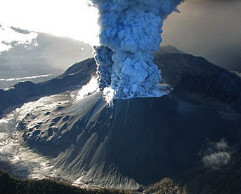
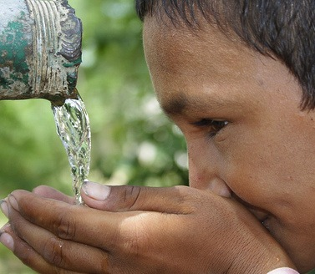
What is InTeGrate?
NSF’s STEP Center in Geoscience
A 5-year community effort to improve Earth literacy and build a workforce prepared to tackle environmental and resource issues
InTeGrate supports integrated interdisciplinary learning
about resource and environmental issues across the undergraduate curriculum to create a sustainable and just civilization.

Slide 3
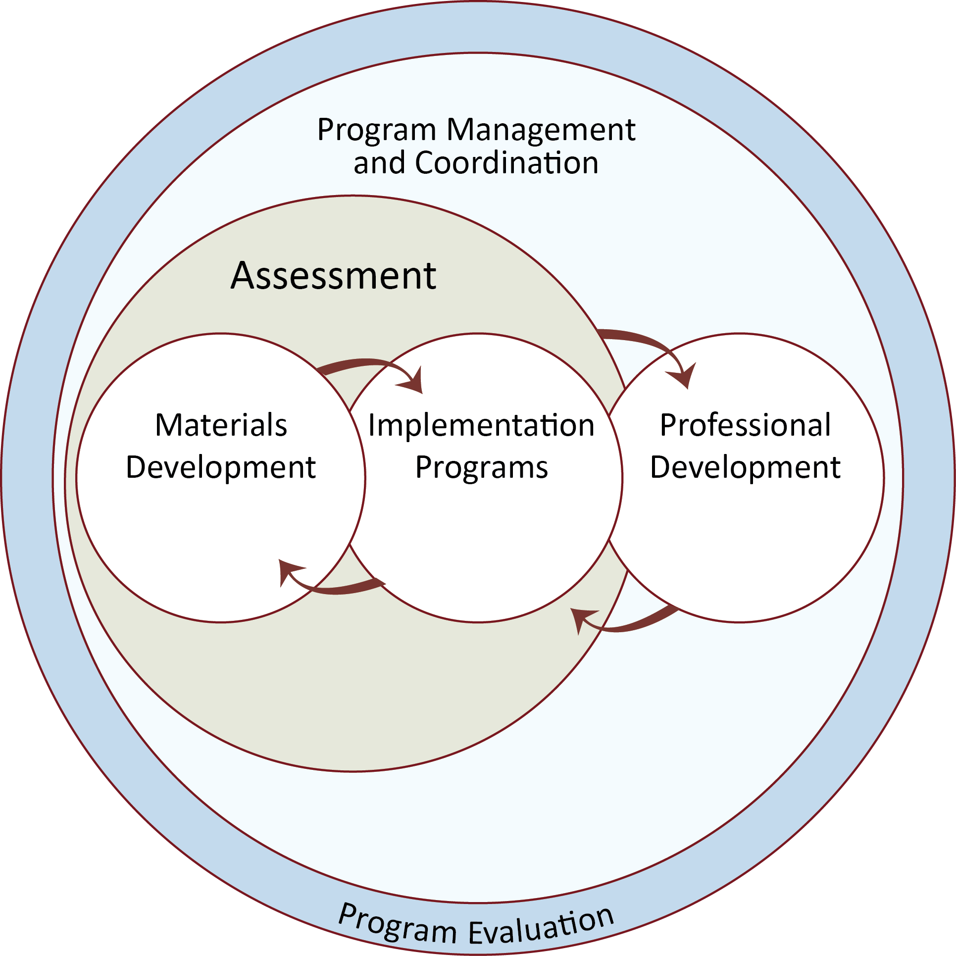
A systems model for transformation of individuals, institutions, and the geoscience community
Courses
Programs/
Institutions
Community/
Network

Slide 4
Preparing students for the future
Curricular materials that …
Engage all students in a variety of settings
Address grand challenges society is facing
Use rigorous science
Use best practices in learning
Are adaptable and adoptable by instructors
How do we ensure that all of these conditions are met in the materials we develop?

Slide 5
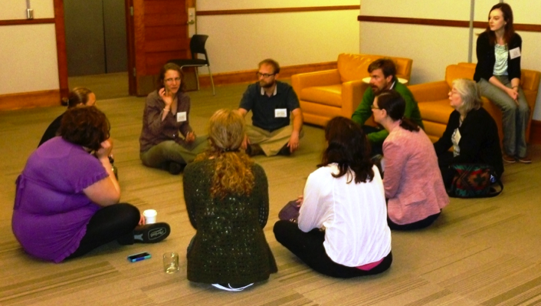
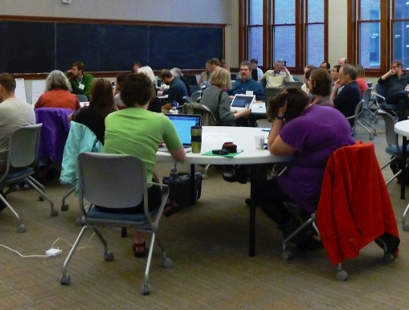
1. Design of development teams
Three instructors from three different institutions (and often from three different disciplines)
Assessment consultant from assessment team
Web consultant from web team
Content area leader from leadership team

Slide 6
2. Goals are encoded in a materials design rubric
Guiding Principles
Learning Objectives and Outcomes
Assessment and Measurement
Resources and Materials
Instructional Strategies
Alignment

Slide 7
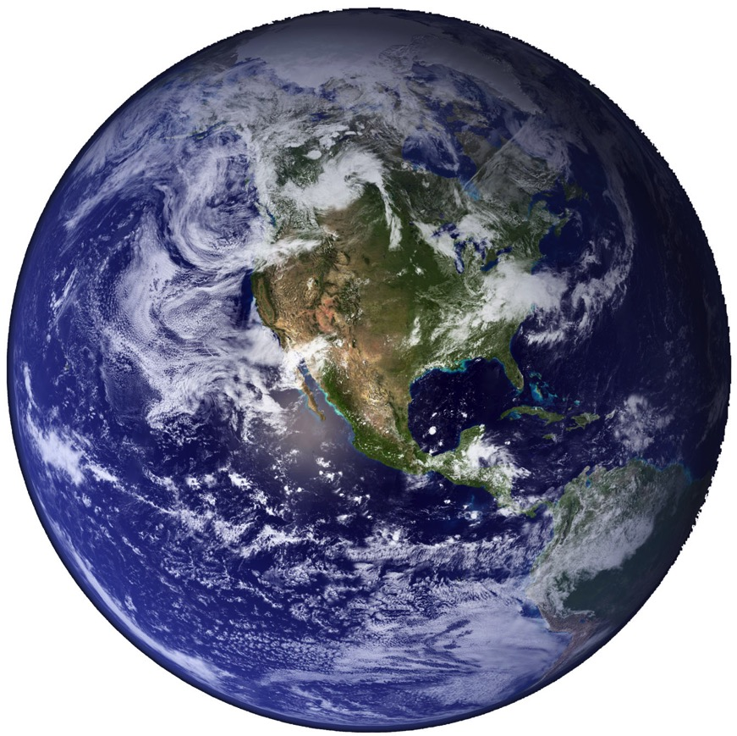
Guiding principles
Address one or more geoscience-related grand challenges facing society
Develop student ability to address interdisciplinary problems
Improve student understanding of the nature and methods of geoscience and developing geoscientific habits of mind
Make use of authentic and credible geoscience data to learn central concepts in the context of geoscience methods of inquiry
Develop student ability and propensity to use systems thinking
→ geoscientific thinking skills

Slide 8
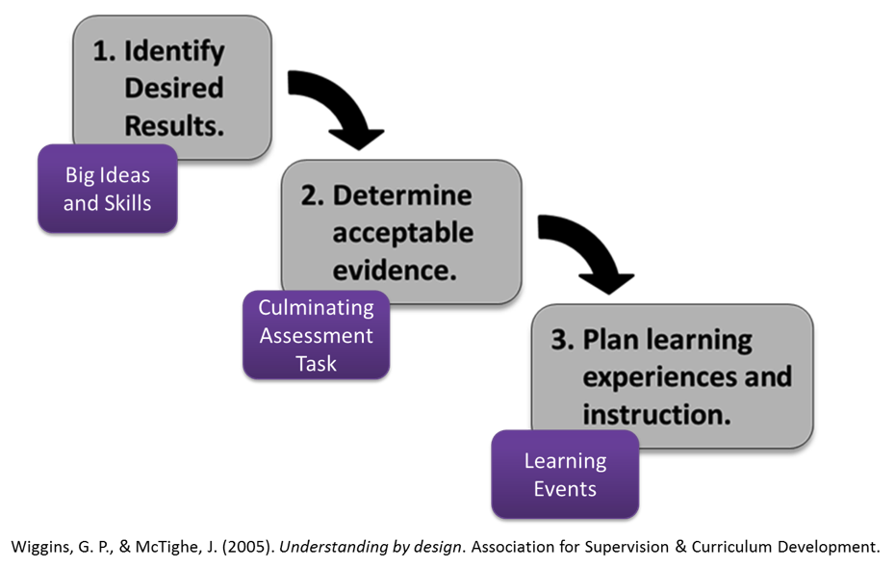
The Rest of the Rubric
Drawn from high-impact practices and research on learning
Based on a backward design model

Slide 9
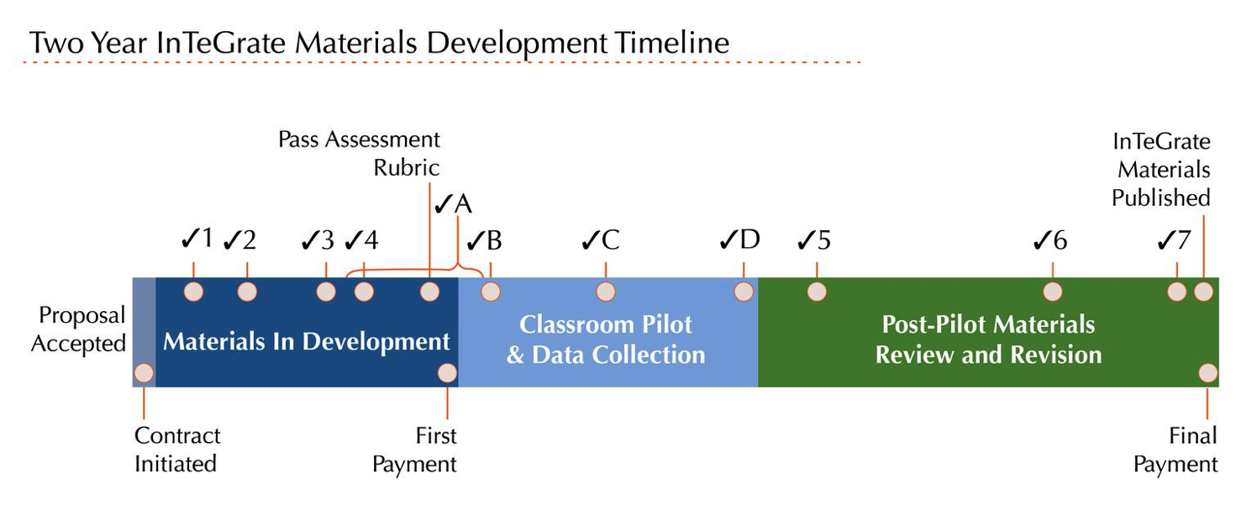

Slide 10
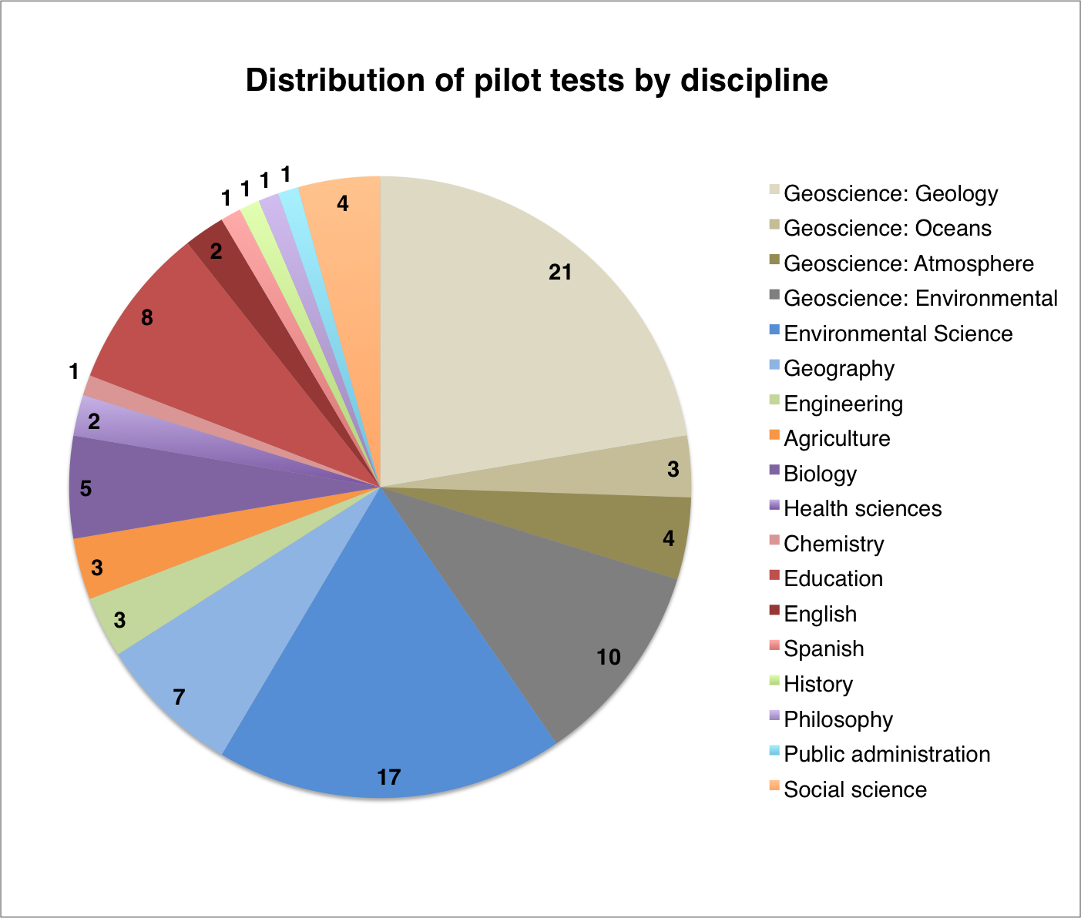
We need you!

Slide 11
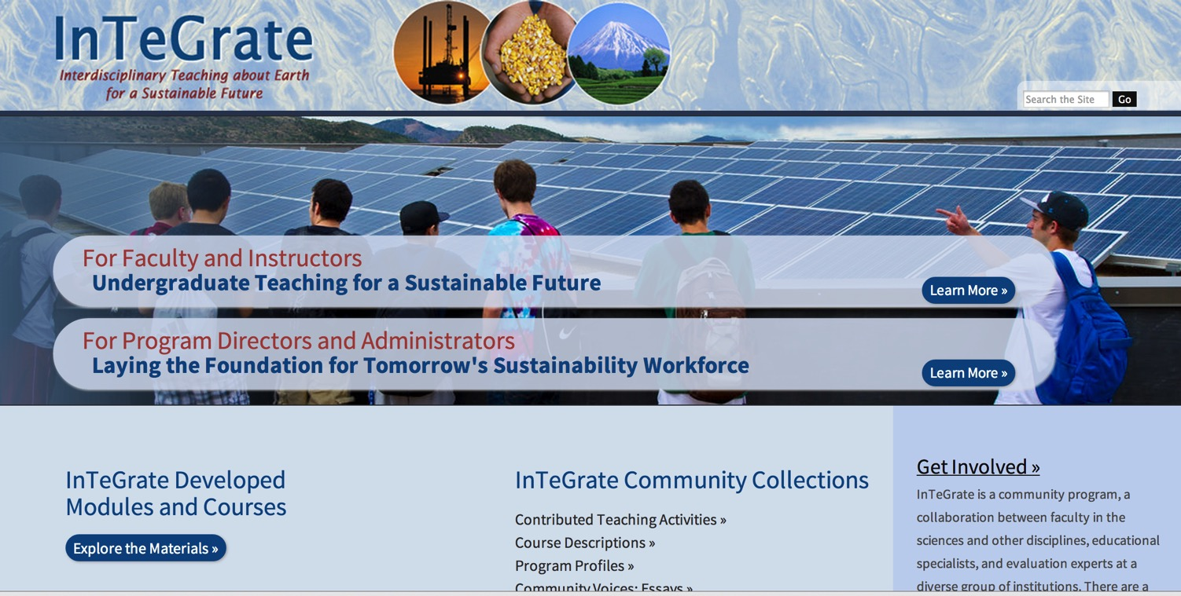
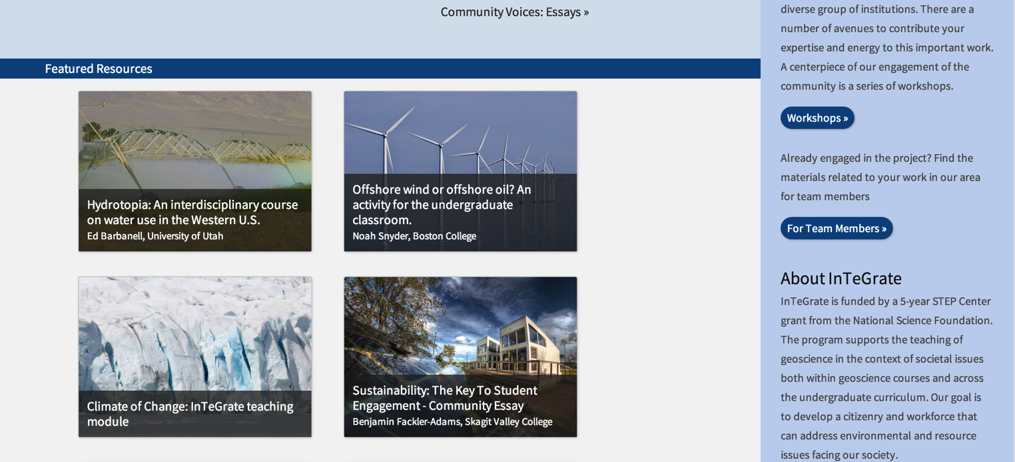
http://serc.carleton.edu/integrate

Slide 12
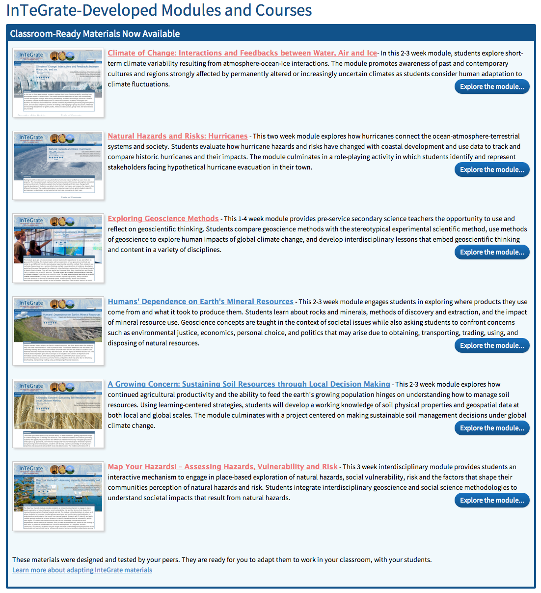
Notes:
Six modules that have gone all the way through this process.

Slide 13
Guiding principles
Address one or more geoscience-related grand challenges facing society
Develop student ability to address interdisciplinary problems
Improve student understanding of the nature and methods of geoscience and developing geoscientific habits of mind
Make use of authentic and credible geoscience data to learn central concepts in the context of geoscience methods of inquiry
Develop student ability and propensity to use systems thinking
→ geoscientific thinking skills

Slide 14
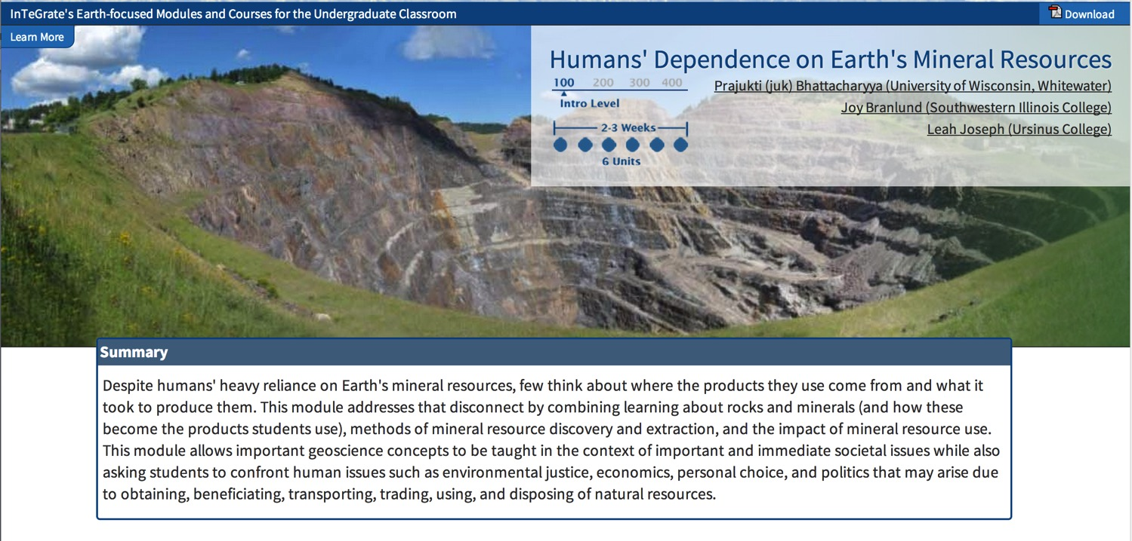

Slide 15
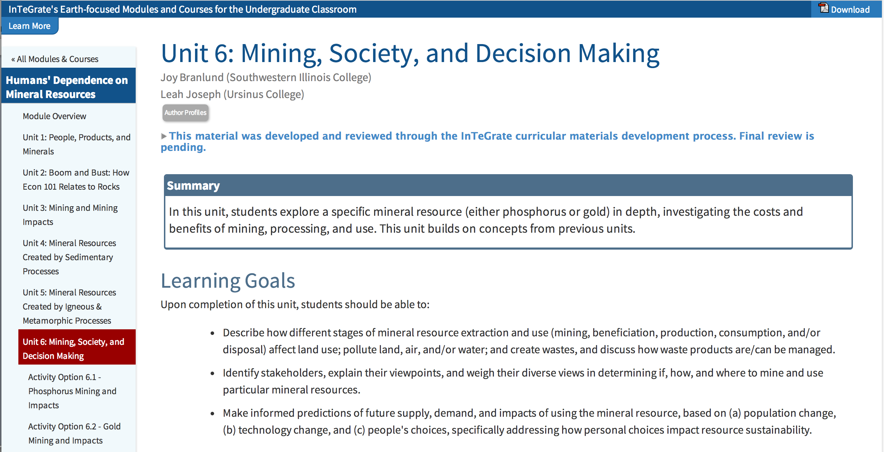

Slide 16
Guiding principles
Address one or more geoscience-related grand challenges facing society
Develop student ability to address interdisciplinary problems
Improve student understanding of the nature and methods of geoscience and developing geoscientific habits of mind
Make use of authentic and credible geoscience data to learn central concepts in the context of geoscience methods of inquiry
Develop student ability and propensity to use systems thinking
→ geoscientific thinking skills

Slide 17
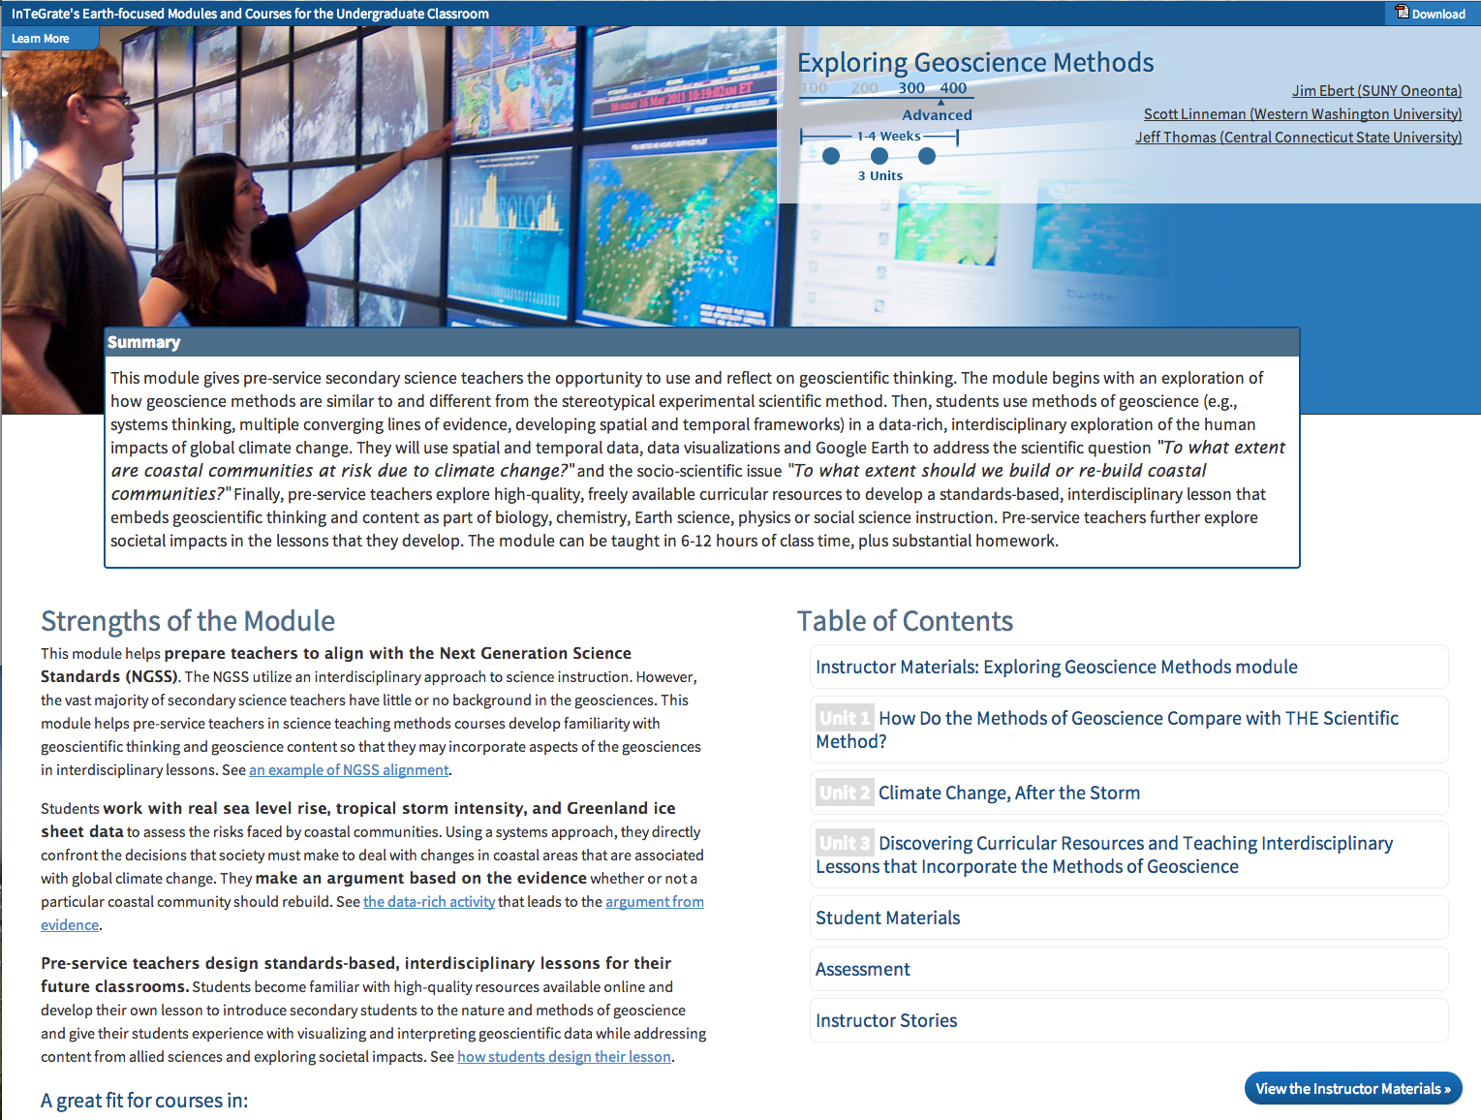

Slide 18
How do we assess if these are working?
Impact on faculty as agents of change;
Impact on students’…
  …Earth literacy;
  …interest in majoring in geosciences and/or in a career that uses geoscience;
  …ability and motivation to contribute to solving grand challenges of resources and environmental sustainability.
Reflections and interviews
Geoscience Literacy Exam (GLE):
pre- and post-
InTeGrate Attitudinal Instrument (IAI):
pre- and post-
Interdisciplinary thinking essay question:
post only

Slide 19
Results thus far
Faculty indicate that they
  Were impressed with the level of engagement and development of the students
  Will continue to use their own module and test other modules
  Have applied what they learned about curriculum development to other courses
Impact on students harder to assess right now: low dosage and small numbers
Stay tuned!

Slide 20
A systems model for transformation of individuals, institutions, and the geoscience community
Courses
Programs/
Institutions
Community/
Network

Slide 21
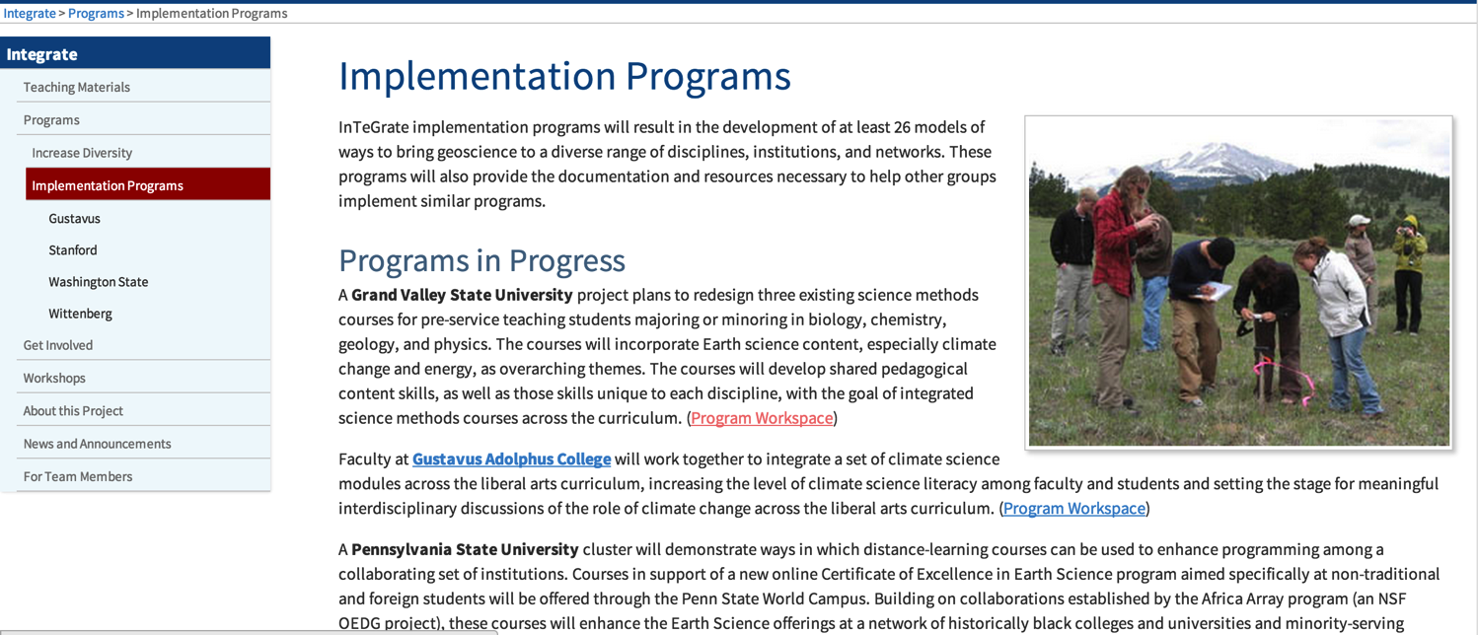
Develop a new vision for developing broad Earth literacy and sustainability studies in higher education
  Within and beyond geoscience departments
  Within and beyond single institutions
  Up to $50K to support design and development

Slide 22
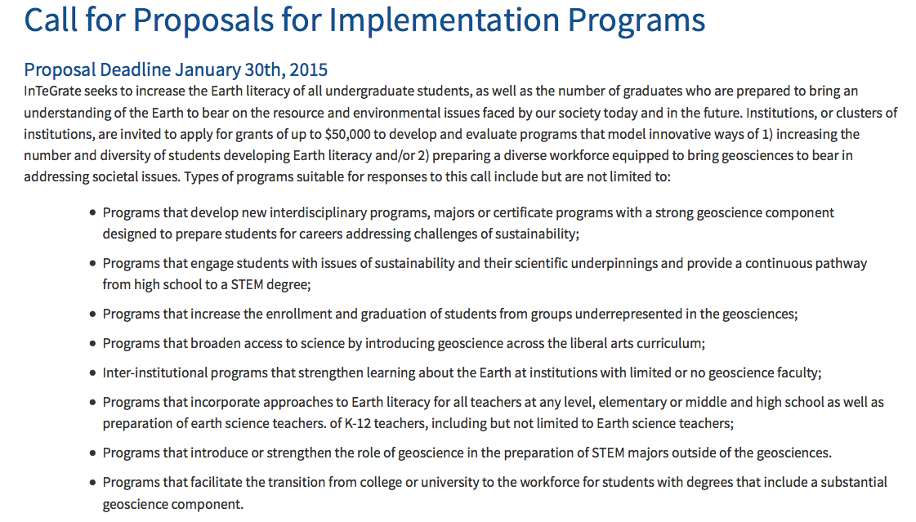
http://serc.carleton.edu/participate/ip_call_f2014.html

Slide 23
A systems model for transformation of individuals, institutions, and the geoscience community
Courses
Programs/
Institutions
Community/
Network

Slide 24
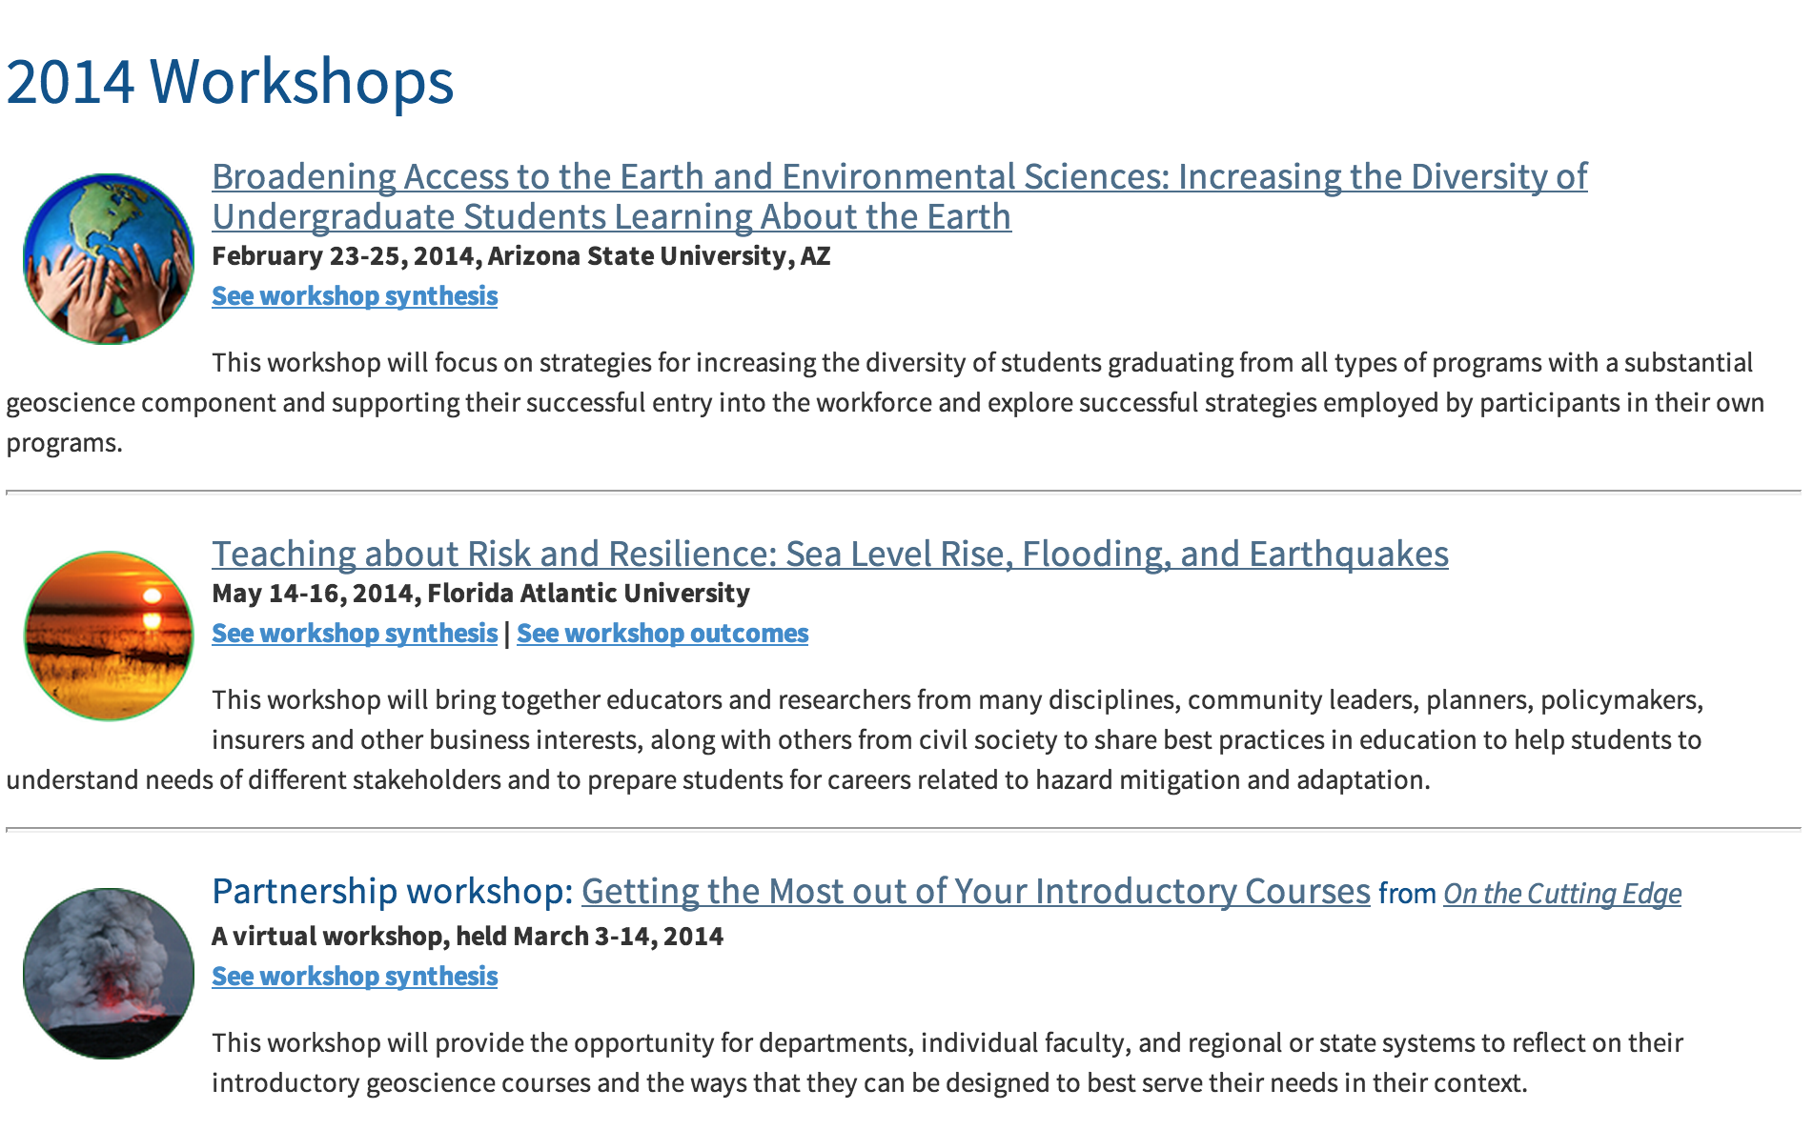
In-gathering…

Slide 25
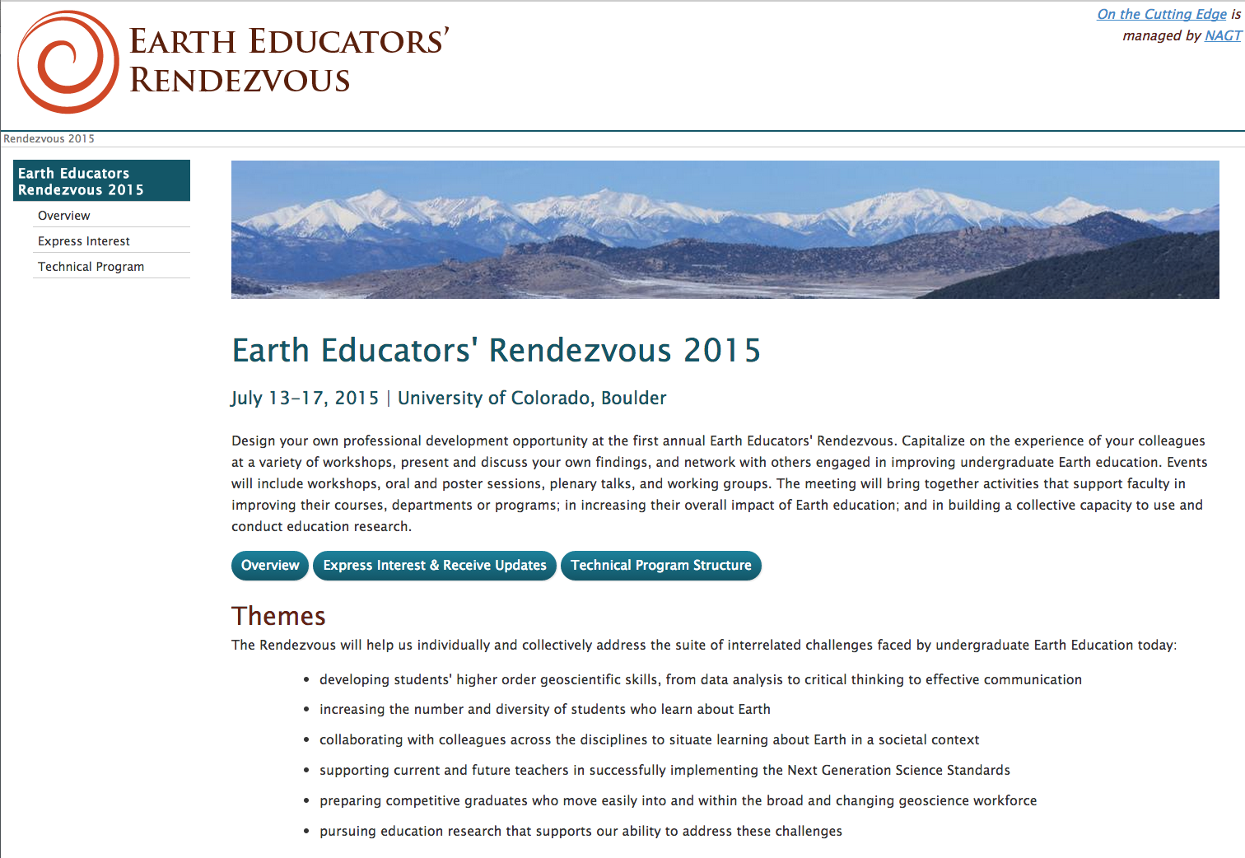
We need you!
Notes:
People come to us.

Slide 26
Summary
All ways to get involved: http://serc.carleton.edu/integrate/participate/index.html
Interested in being a module author?
Email me: annegger@geology.cwu.edu
Interested in an implementation program? http://serc.carleton.edu/participate/ip_call_f2014.html
Interested in talking with others about sustainability across the curriculum? http://serc.carleton.edu/earth_rendezvous/2015/index.html

