Slide 1

Report on the 5th IUPAP International Conference on Women in Physics
(Conference Supported by IUPAP Working Group on Women in Physics)
Beth A. Cunningham, AAPT
Cherrill Spencer, ex-SLAC National Accel. Lab
Anne Cox, Eckerd College

Slide 2
OVERVIEW OF MY TALK
Keynote & 6 plenary talks by distinguished women physicists
My talk and poster on Expanding Girls’ Horizons in Physics and Other Sciences
My STEMStory BLOG
Strategies and policies to encourage women into physics
being pursued by other countries
Panel Discussion on fascinating careers being pursued by women educated as physicists
What does a conference of women physicists from 49 countries having FUN look like ?

Slide 3
KEYNOTE PUBLIC LECTURE
Jill Tarter, Director, SETI Institute, USA
“SETI: Past, Present, and Future: Finding Aliens and Finding Ourselves”
Tarter asked : Are we alone? This question, perhaps more than any other, has endured throughout human history. Is life on earth an astronomical anomaly, or is the universe teeming with life – possibly other intelligent life?
We humans are all STAR STUFF and the universe is extremely old (~ 14 billion years) and extremely large so what’s the chance we are the only things to have evolved into thinking beings?
The Search for Extra Terrestrial Intelligence (SETI) has, for decades, been scanning the sky and listening for messages from other civilizations using radio telescopes. They have 42 radio telescopes working together in northern California, they receive oodles of signals that need analyzing, they have lots of computers working on this, BUT THEY WELCOME YOUR (students’) HELP.
SETI@home is a scientific experiment that uses Internet-connected computers in the Search for Extraterrestrial Intelligence (SETI). You can participate by running a free program that downloads and analyzes radio telescope data. [Dark blue text indicates information that may be useful]
Go to http://setiathome.ssl.berkeley.edu/ to find out how.

Slide 4
SIX PLENARY TALKS presented by distinguished physicists from all continents
Melissa Franklin, Mallinckrodt Professor and Chair of Physics, Harvard University, USA, NORTH AMERICA
Silvia Torres-Peimbert, Professor Emeritus, Institute of Astronomy, Mexico City University and President Elect of the Executive Committee, International Astronomical Union. CENTRAL & SOUTH AMERICA
Claudia Felser, Professor, Johannes Gutenberg University Mainz, Director, Max Planck Institute for Chemical Physics of Solids, Dresden. EUROPE
Sabine Stanley, Associate Professor and Canada Research Chair in Planetary Physics, University of Toronto, Canada. NORTH AMERICA
Patience Mthunzi, Senior Scientist Researcher, National Laser Centre - Biophotonics, Council for Scientific and Industrial Research, South AFRICA
Tsai-Chien Chiang, Science columnist, lecturer at Taiwan University and author of "Madam Wu Chien-Shiung: The First Lady of Physics Research“. ASIA
**********************************************************************************
All fascinating talks on physics topics I mostly knew nothing about, not enough time today to even summarize them, so will mention some things I learnt that I suppose will be of interest to physics educators.

Slide 5
TIDBITS of INTEREST and USEFUL ADVICE for WOMEN in PHYSICS from plenaries
“Constructing A Lab of One's Own“ Melissa Franklin, Physics Dept Chair, Harvard.
Franklin discussed the challenges in navigating the university and international collaborations in experimental particle physics in order to make sustained scientific contributions, and, when she was told her lab was going to be demolished she realized the importance of having “a lab of one’s own” to allow for independent thinking and general well-being.
She got depressed, went to a psychiatrist and observing there was no white board in his office decided taking a shower would do as well.
Once you have your lab , DO NOT HIDE IN IT, use it as a platform to reach out, especially to the other women in your department. Be open to meeting others.
“New developments in the area of topological insulators” Claudia Felser, Professor.
Felser had 4 brothers and her mother did not allow her to go to a German high school, instead she went to a Catholic Girls’ School and did not develop any confidence in her physics ability until she got good marks in the intermediate exams as an undergraduate. She is now the Director of Max Planck Institute of Chemical Physics for Solids, Dresden. All MP Institutes are governed by the Max Planck Society which has institutionalized many of the women-friendly policies which have been proposed for USA institutions, but not always put in place, e.g. The Working Party for the promotion of female scientists; Dual-Career Service: Help and care facilities for dual-career scientist couples; Minerva Program for the Advancement of Outstanding Female Scientists in senior positions.
See this website for details: http://www.mpg.de/equal_opportunities

Slide 6
TIDBITS of INTEREST and USEFUL ADVICE for WOMEN in PHYSICS from plenaries, part 2
“Chemical composition of planetary nebulae. The abundance discrepancy problem.” Silvia Torres-Peimbert, Professor Emeritus, Institute of Astronomy, Mexico City University and President Elect of the Executive Committee, International Astronomical Union.
Torres-Peimbert was raised in a traditional family in Mexico, family wanted her to be a housewife but let her follow her pleasure, so she got mixed messages, but she carried on, got a B.Sc in physics in Mexico AND married a fellow student after the B.Sc. They went to UC Berkeley and got their PhDs in astronomy there, then returned to Mexico and had two children while continuing to do research in planetary nebulae-still doing.
Has experienced some subtle discrimination, not open, but she has limited her career herself repeatedly: suffers from imposter syndrome which she strives to overcome.
Now she has realized she is as capable, or limited, as her fellow workers.
Torres-Peimbert guidelines for life:
In family life - share responsibilities. Give same opportunities to women & men.
In educational institutions - give same opportunities to women & men.
For outreach activities – accept challenge of public presentations. Learn to give a good talk. Make technology work for you.
For leadership in projects – accept those responsibilities; we have to change within ourselves those attitudes that hold us back from accepting challenges.

Slide 7
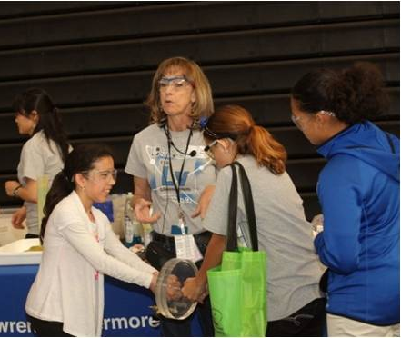
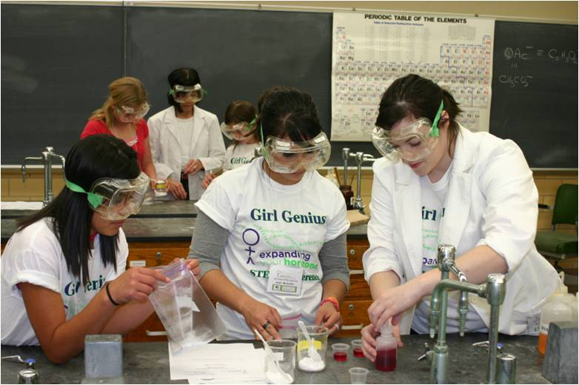
EXPANDING GIRLS’ HORIZONS IN PHYSICS and OTHER SCIENCES- Spencer Talk & Poster
My poster describes an intervention that has been successfully used since 1976 to encourage girls to consider a career in Science, Technology, Engineering or Mathematics (STEM).
Girls must take appropriate pre-requisite-to-college mathematics and science courses when they are 15 to 18 years old in order to start on the path to a career in STEM.
Expanding Your Horizons in Science, Engineering and Mathematics (EYH) conferences are one day conferences for girls aged 12 to 18. They are run by volunteers and happen annually at a local college.
EYH conferences engage schoolgirls in interesting and fun hands-on STEM activities, designed and led by adult women STEM professionals who live in the same community. Over 900,000 girls have been to an EYH since 1976.

Slide 8
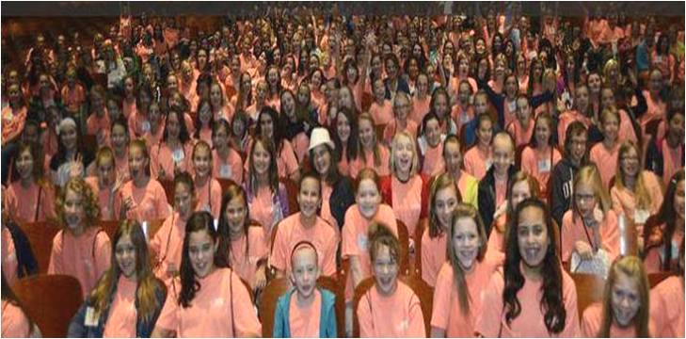
EXPANDING GIRLS’ HORIZONS
IN PHYSICS and OTHER SCIENCES
Evaluations show that attending an EYH conference sparks the girls' interest in and overcomes their prejudices about STEM subjects. The conferences are very popular with girls, their parents and teachers.
Through the adult women role models the girls are informed there are many different STEM careers and that they are enjoyable, pay well and contribute to the well-being of society.
The EYH Network helps new conference sites to get started and provides technical assistance; to find out how to start an EYH conference in your home town visit our website www.expandingyourhorizons.org or contact me at the end of this session.

Slide 9
A BLOG called “My STEM Story” http://mystemstory.wlu.ca/
We invite you to share a story that reflects your life in physics.
Perhaps it’s a memory of the first scientific concept that sparked your curiosity, or a mentor who nourished your sense of wonder.
It may be the story of a research breakthrough – or failure – and how it changed your thinking.
It could be the story of a challenge you faced as a physicist, and how you overcame it.
We welcome any story that conveys an experience or perspective that
has shaped the scientist and person you have become.
Conference attendees submitted their stories before the conference and 24 were chosen to be published; personal stories of women physicists (and one man) from Australia, Canada, China, Democratic Republic of Congo, Egypt, Ghana, India, Indonesia, Ireland, Nepal, Nigeria, Pakistan, Peru, Uganda, United Kingdom, USA and Yemen.
If you have ever felt challenged by your circumstances and unhappy as you carry out your daily tasks I invite you to read the stories in this blog, especially those from the 3rd world, and to thank your lucky stars !

Slide 10
Some excerpts from the stories submitted to My STEM Story
I obtained my M.Sc in Physics in 1989 from Michigan State University. I came back to Yemen looking for a fellowship to proceed with my PhD. Unfortunately, Baghdad’s invasion of Kuwait took place. Due to the political situation, all of the US assistance, including scholarships, was stopped, so, I had to look for other sources to pursue my PhD.
Whenever I heard that girls can’t
do math and physics, the desire ripened inside me to prove this stereotype wrong. When I finally took ‘forbidden’ subjects in my high school, I remember that everyone was angry and upset on learning of my choices…..
Sakina Fakhraddin From Yemen
Shabanar Nisar from Pakistan
During the discussion, as she challenged some of my
statements, it slowly dawned on me that my own daughter knew more about this topic than her father, Professor of Physics & Head of a Physics department. It was both a humbling and touching moment…
Brian Fulton from England

Slide 11
Activities and Strategies in Other Countries
for Assisting Women in STEM/Physics
A very small sample of activities, strategies and policies happening in other countries to encourage girls into physics or to assist and retain women physicists.
INDIA Looking at the overall percentage of women science faculty- 43% one might be pleased, but in the elite universities only 10% of faculty are women.
India has some women-only universities.
Studies of why so many women drop out after their PhD are being carried out, key themes include work-life balance, structure and dynamics of formal spaces in S&T institutions, role of mentors, among others.
NIGERIA Is having conferences for women physicists only, because some husbands from Northern Nigeria won’t allow them to attend mixed-sex meetings.
BRAZIL Has a government project “Science Without Borders”: 100,000 students will study abroad on full scholarships.
CHINA Is focusing on remote areas, working to broaden those populations’ horizons by having speeches by outstanding physicists, including women.
ESTONIA Is improving the “climate” in a science department by changing the artwork on the walls of its new building, to disappear the naked women paintings.
GERMANY See slide #5 of this talk. Women scientists visit schools to talk to the girls about what they do (“Ada Lovelace” program).

Slide 12
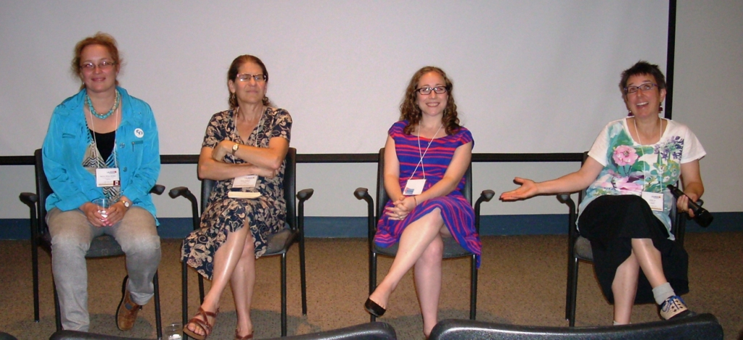
Panel Discussion on Fascinating Careers being
pursued by women educated as physicists
This panel featured four amazing women who obtained university degrees in physics and are now pursuing fascinating careers in science, technology, communication & education. The panelists shared their career paths, experiences
& answered
our questions.
Sandy Eix, PhD in Physics
Sandy Eix has been inventing shows, programs, and exhibits for about 15 years at Science World in BC, Canada. Her job lets her play with all sorts of science and share her discoveries with kids of all ages.
Clara Moskowitz, B.Sc in Physics & Science Writing Course at UC -Santa Cruz
Clara Moskowitz is an associate editor at Scientific American, covering all areas of astronomy, physics and spaceflight. Moskowitz covered the conference for Scientific American and wrote a good blog about it:
http://blogs.scientificamerican.com/voices/2014/09/03/female-physicists-worldwide-fight-sexist-stereotypes/

Slide 13
Panel Discussion on Fascinating Careers being
pursued by women educated as physicists, part 2
Marina Milner-Bolotin, PhD in Physics
Marina Milner-Bolotin is an Assistant Professor in Science Education at the University of British Columbia, Vancouver, Canada. She studies how technology can be used in teacher education in order to promote mathematics and science teaching and learning. Authored this book for undergraduates:
“Physics for Scientists and Engineers. An Interactive Approach”
Eileen Pollack B.Sc in Physics and an MFA
Eileen Pollack is a Professor of English at U. Michigan, and is the author of several novels, collections of short fiction, a children's book, and creative nonfiction. Her article “Why are there still so few women in science” in the NYT has garnered much attention and is the subject of an upcoming book: http://www.nytimes.com/2013/10/06/magazine/why-are-there-still-so-few-women-in-science.html
SOME ADVICE FROM THE PANELISTS
How to make kids love inquiry method: find out what questions they have.
Choose role models who are just a few years ahead of the students, they will be more effective role models.
Very useful website for resources on teaching physics: Compadre.org

Slide 14
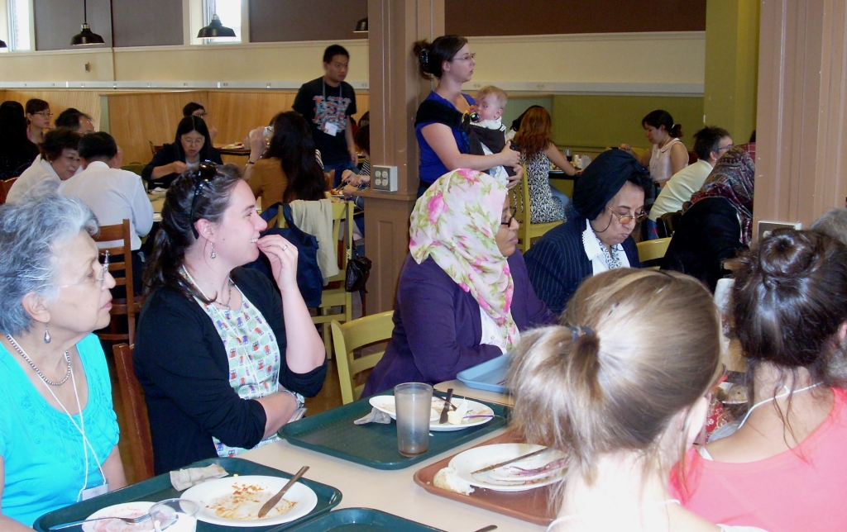
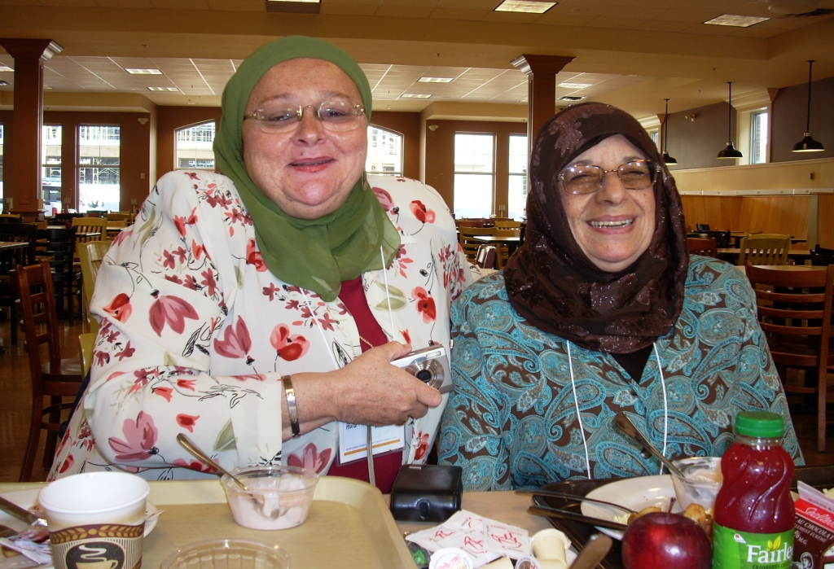
PHOTOS of various events at the 5th ICWIP- 1
Mealtimes were good for meeting delegates from other countries
Egyptian delegates

Slide 15
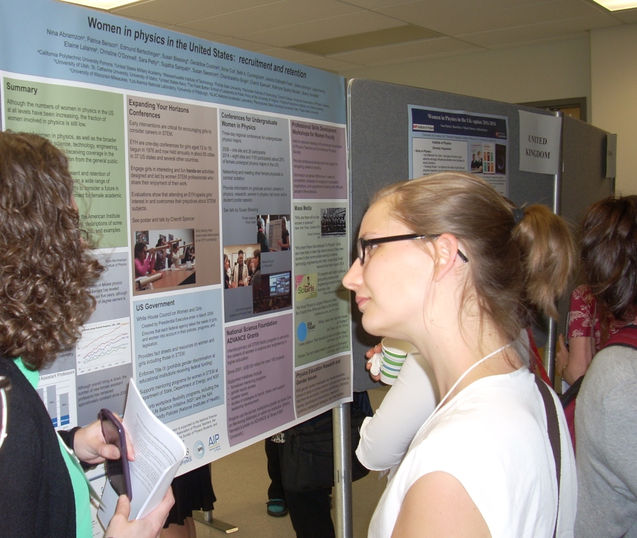
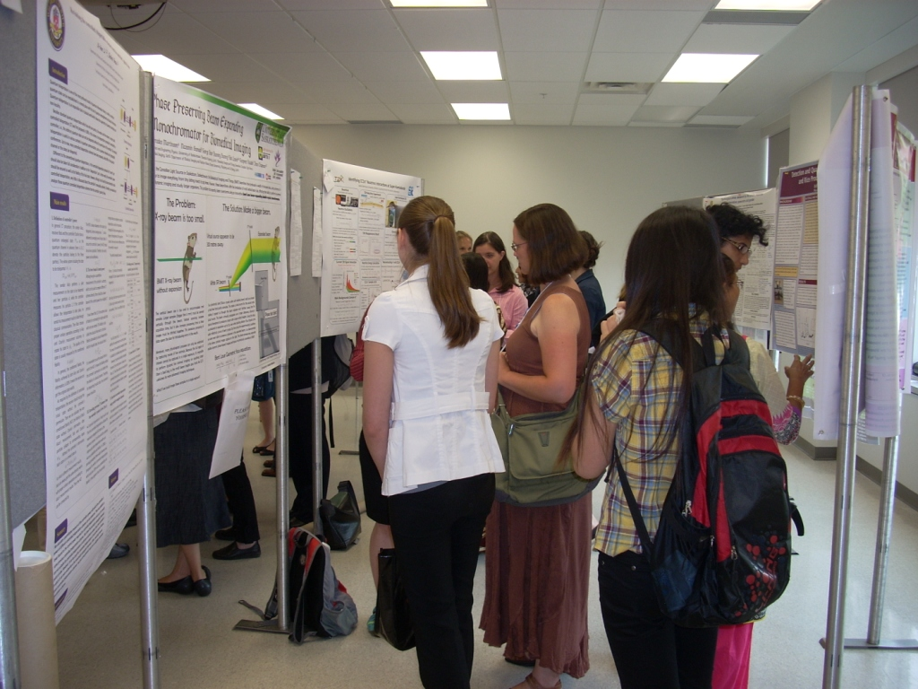
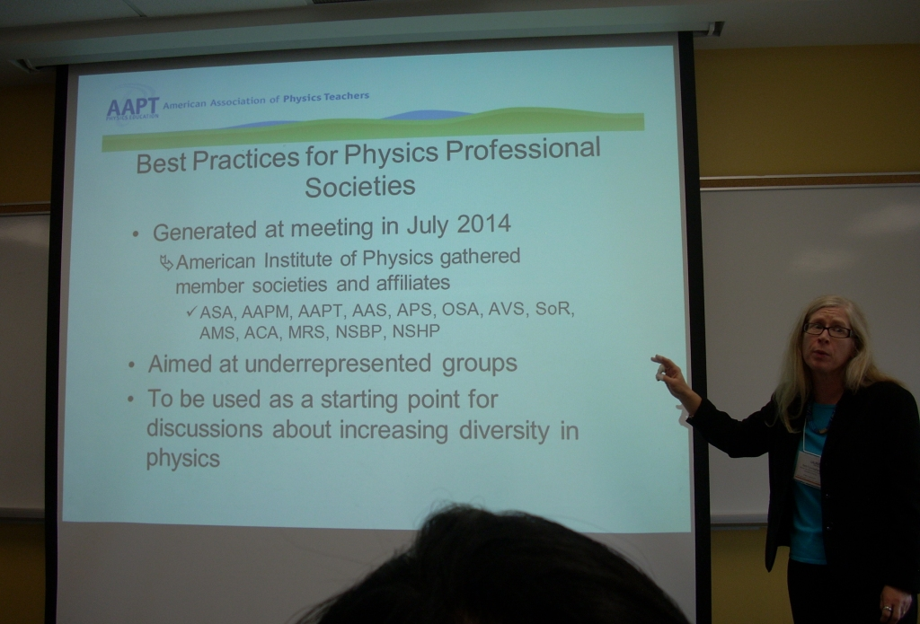
PHOTOS of various events at the 5th ICWIP -2
Poster Sessions and Workshop Talks
ssions and Workshop Talks
US Country Poster
Scientific Posters
Beth Cunningham gives talk in Professional Development & Leadership Workshop

Slide 16
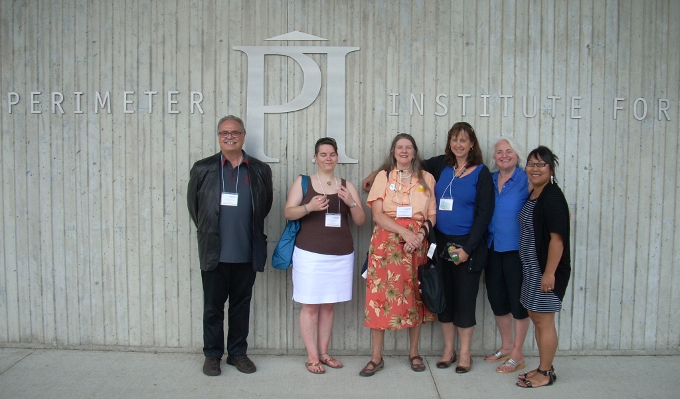
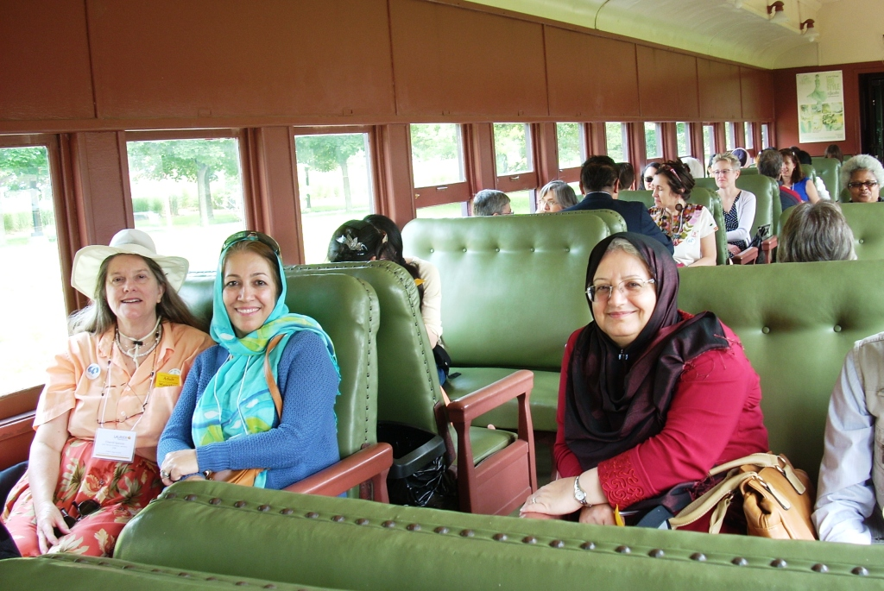
PHOTOS of various events at the 5th ICWIP -3
“Free” afternoon to explore local area
Outside Perimeter Institute for Theoretical Physics
On a local train going to St Jacobs’ Farmers Market, Cherrill sitting with Iranian physicists.

Slide 17
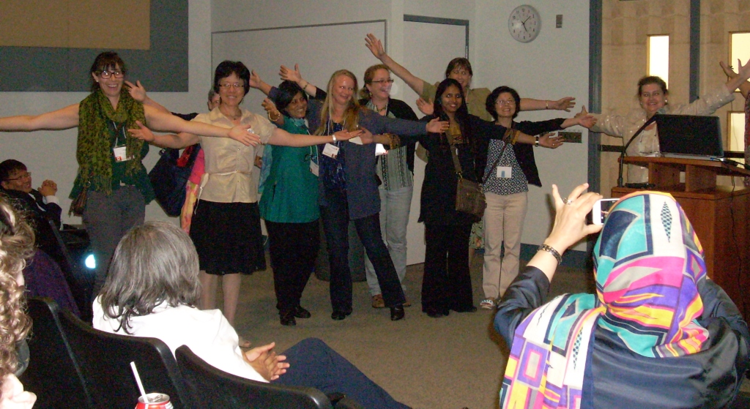
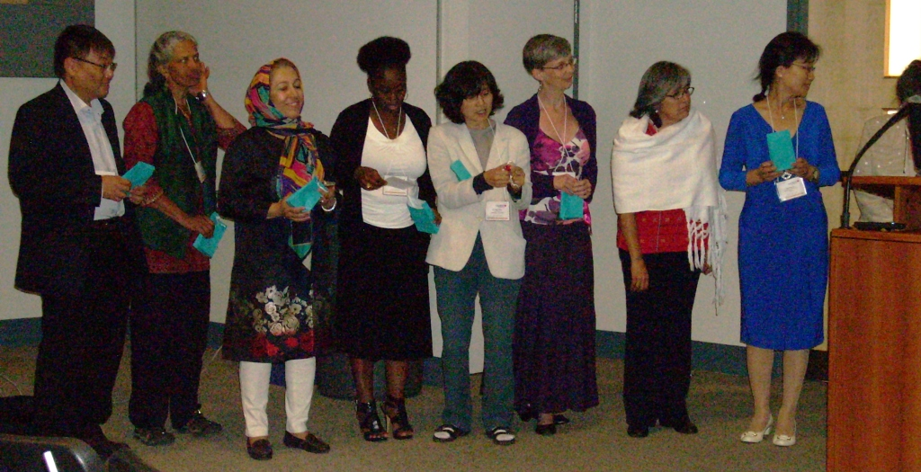
PHOTOS of various events at the 5th ICWIP -4
Local & International Organizing Committees
Local Organizing Committee do the WELCOMING pose suggested by Melissa Franklin
International Organizing Committee receive kudos & their thank-you gifts

Slide 18
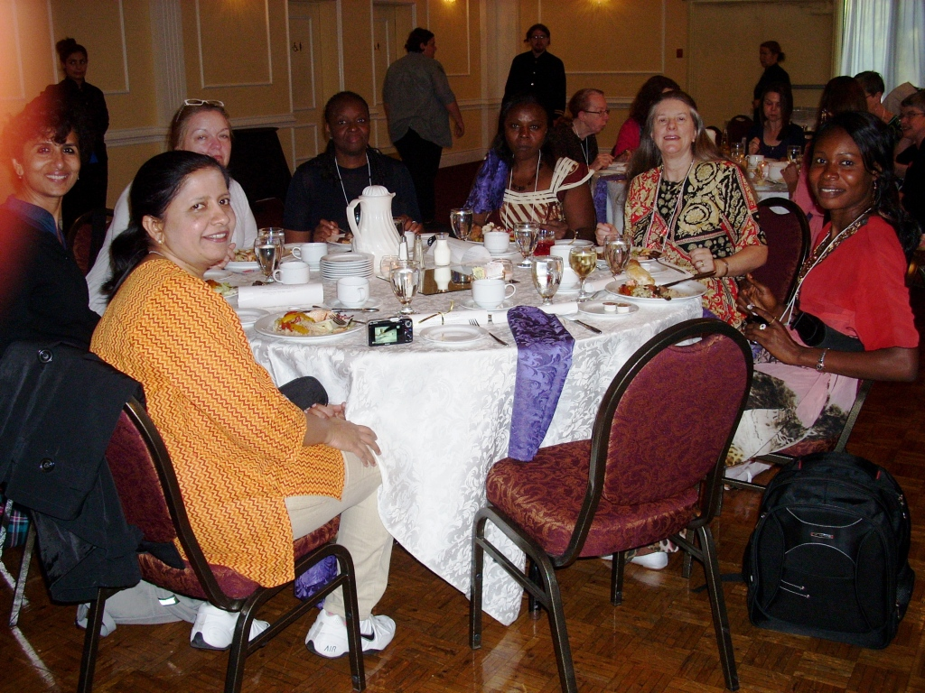
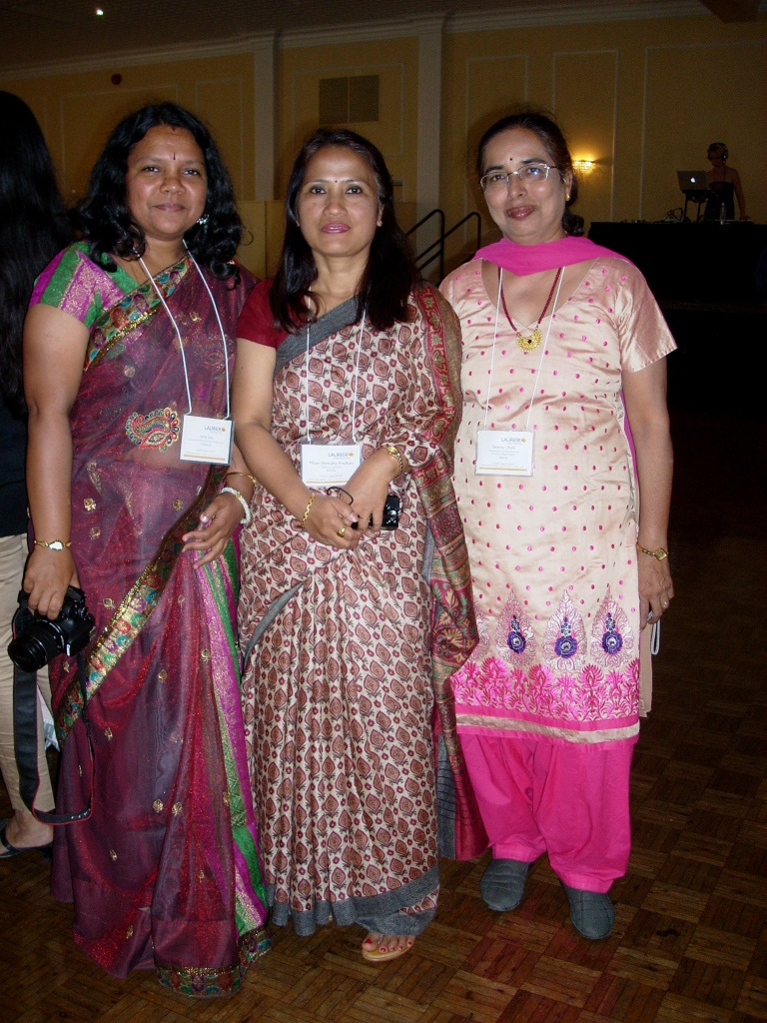
PHOTOS of various events at the 5th ICWIP- 5
Conference Banquet at nearby restaurant
Everyone is in their best clothes
( puts some of us to shame)

Slide 19
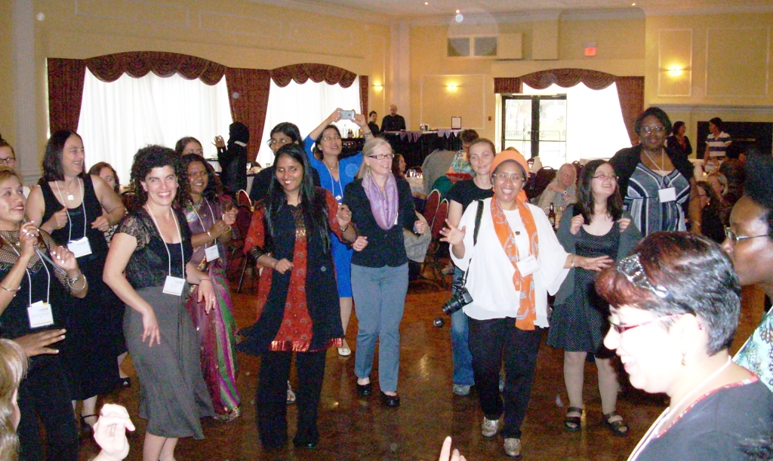
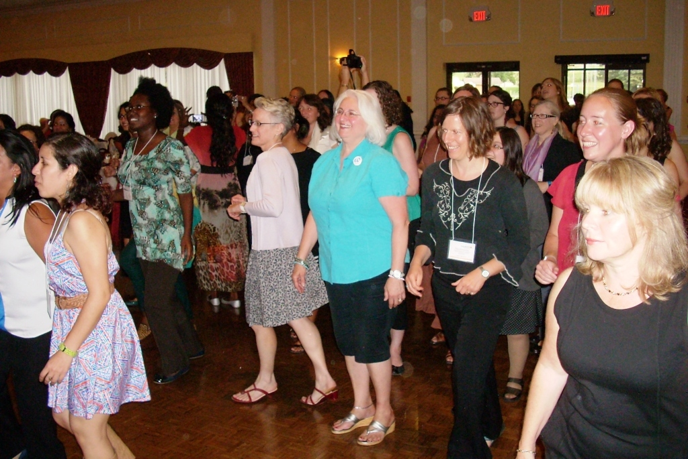
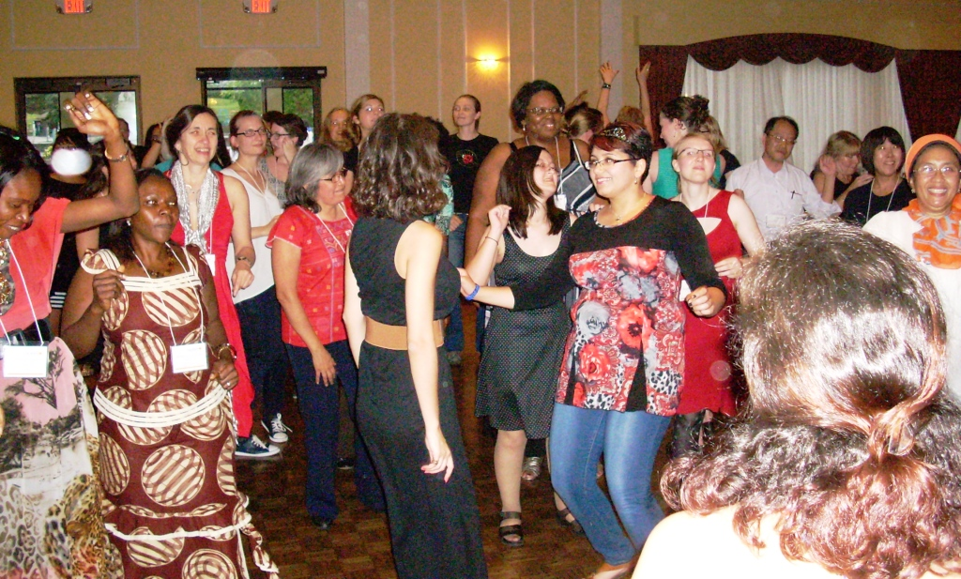
PHOTOS of various events at the 5th ICWIP -6
Dancing after banquet, following instructions of a lively DJ

Slide 20
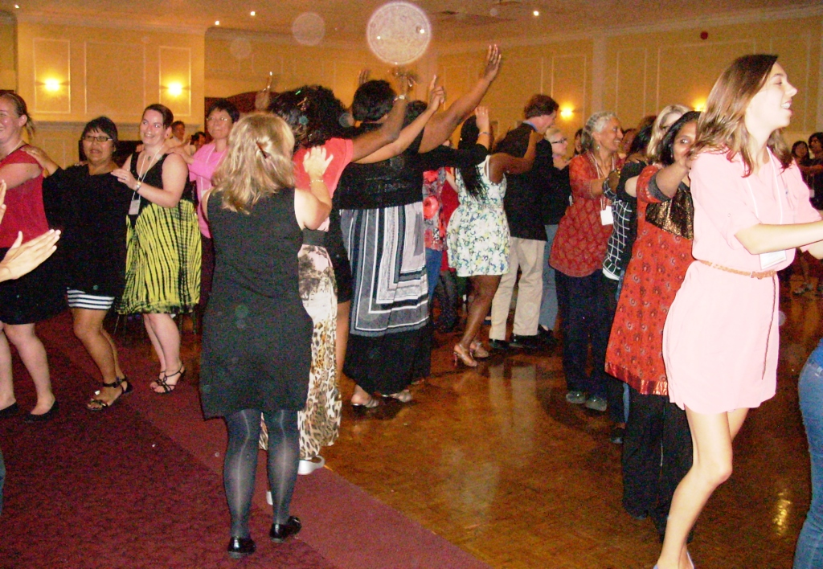
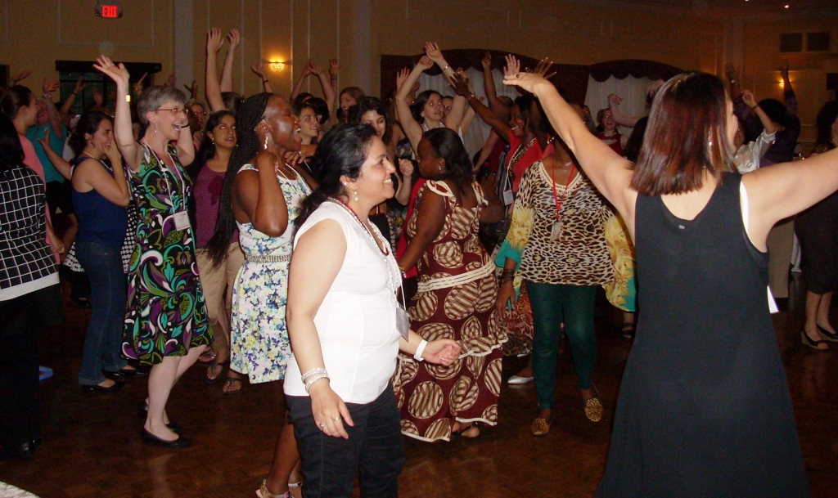
PHOTOS of various events at the 5th ICWIP -7
The FUNNEST conference banquet I’ve ever been to

Slide 21
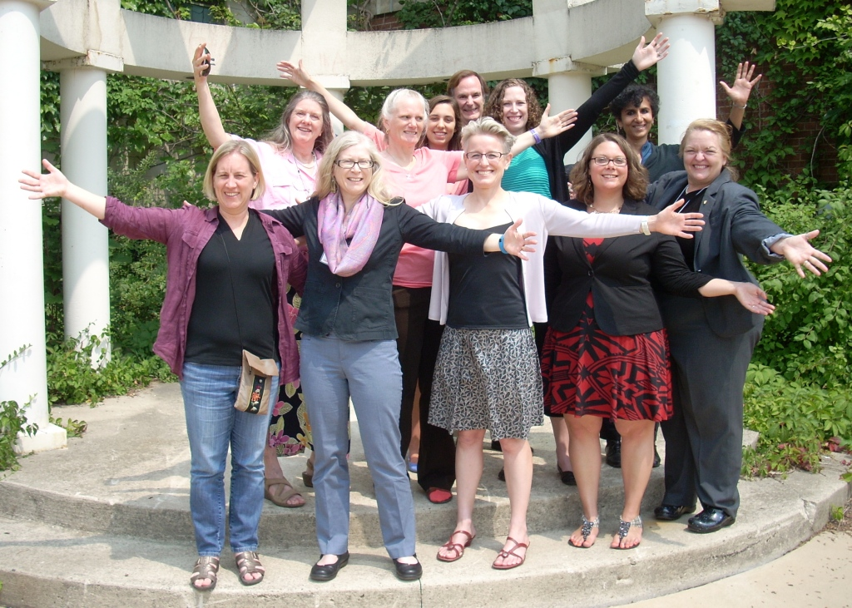
Most of US Delegation in WELCOMING POSE
If you would like a copy of this talk, please send me an email: cherrill@slac.stanford.edu

