Slide 1
Diversity in Physics: Policy and Politics First?
Shirley M. Malcom, Ph.D.

Slide 2
What is Policy Anyway?
Prudence or wisdom in the management of affairs
A definite course or method of action selected from among alternatives and in light of given conditions to guide and determine present and future decisions

Slide 3
Diversity in Physics: A Pre-test
True or false: Policies relevant to addressing issues of diversity in physics are mostly national/federal
True or false: Policies affecting opportunity to learn physics affect the makeup of the talent pool
Which of the following affect(s) school access to physics? (a) graduation requirements; (b) course offerings; (c) teacher assignment; (d) standards; (e) assessment.

Slide 4
Diversity in Physics: A Pre-test (cont’d)
True or false: There is little connection between K-12 physics opportunities and diversity issues in undergraduate physics
True or false: The main reason people don’t pursue study in physics is related to their lack of intellectual capacity to perform in the field
True or false: Socio-economic status has little to do with access to physics

Slide 5
K-12 Education in STEM: Federal and Federalism; National or Nationwide

Slide 6
Federalism and Education (federal interest vs. federal control): Just a handful of elements—statistics; equity; access and quality

Slide 7
From US ED website
“Education is primarily a State and local responsibility in the United States. It is States and communities, as well as public and private organizations of all kinds, that establish schools and colleges, develop curricula, and determine requirements for enrollment and graduation. The structure of education finance in America reflects this predominant State and local role. Of an estimated $1.15 trillion being spent nationwide on education at all levels for school year 2011-2012, a substantial majority will come from State, local, and private sources. This is especially true at the elementary and secondary level, where about 87.7 percent of the funds will come from non-Federal sources.” US investment is approximately 10.7%

Slide 8
NCLB: A blessing and a curse
States decide the cut score: Lowering the floor (-)
Only “mathematics” and language arts (-)
Specific attention to different populations (+)
A narrowing of curriculum (-)
Teaching to the test/teaching for the test (-)

Slide 9
The Coming of the Standards Movement 2
Adoption of standards and assessment as policy
Standards re-visited (What’s different this time?)
The “War within the states”

Slide 10
Are we focusing on the right things?
Recruiting new STEM teachers and renewal of experienced teachers
Projects vs. systemic approaches
Science content and science practices
Engineering w/o engineering qualified teachers
Higher education as key to K-12 reform
Implementation of NGSS—S/Es as critical friends
Specific attention to different population groups
Technology and tools to support learning

Slide 11
Why has it been so hard to address issues related to URGs in STEM? Mainstreaming vs targeting: Receiving less of everything needed to be successful

Slide 12
Why have we had only modest success with women in physics? Learning from our failures and our successes.

Slide 13
Students with disabilities: Seeing the abilities beyond the disabling conditions

Slide 14
Systemic Approaches
Starting from the outside: What STEM education programs beyond the school have been able to tell us (Equity and Excellence)
Moving to the inside
Inside and outside

Slide 15
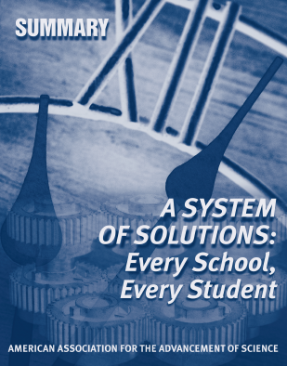
A System of Solutions: Every School, Every Student

Slide 16
Our insights into success for all students
Why, when and under what circumstances are some institutions/programs more successful than others?
What can we learn: Physics First; AP for all (NMSI); physics in non-formal environments (e.g., The Exploratorium)?

Slide 17
What we can do
Individual
Institutional
Organizational
Beyond the system (work in museums, other informal places and programs)
Effecting policy change (Analysis, committee service)
Changing the system
Research/Data

