Slide 1
Topical Discussion: Joint Task Force on Undergraduate Physics Programs (J-TUPP) Undergraduate Curriculum Task Force

Slide 2
Agenda
J-TUPP
Beth A. Cunningham, AAPT
Robert Hilborn, AAPT
Theodore Hodapp, APS
Undergraduate Curriculum Task Force
Andrew Gavrin, IUPUI
Joseph Kozminski, Lewis University
Input from the Audience

Slide 3
J-TUPP and UCTF Background
Concern by departments about the future of physics programs
Pressure from accrediting bodies and senior administrators to know best practices for teaching physics
Need to change curriculum to meet needs of today’s students
Not all go to graduate school
Curriculum the same for 60 years

Slide 4
J-TUPP and UCTF Background
UCTF work started in 2012
APS and AAPT saw value in partnering to address the needs of physics departments
AAPT approved J-TUPP at SM13
APS approved J-TUPP in Fall 2013

Slide 5
J-TUPP Charge
To prepare a report that will engage and inform physicists in answering the question:
“What skills and knowledge should the next generation of undergraduate physics degree holders possess to be well prepared for a diverse set of careers?”

Slide 6
J-TUPP Report
Provide guidance for revising the undergraduate curriculum to improve the education of a diverse student population. Recommendations on:
content
pedagogy
professional skills
student engagement
Describe documentable student outcomes.

Slide 7
J-TUPP Members
Paula Heron, co-chair, University of Washington
Laurie McNeil, co-chair, University of North Carolina, Chapel Hill
Douglas Arion, Carthage College
J.D. Garcia, University of Arizona
S. James Gates, University of Maryland
Elizabeth McCormack, Bryn Mawr College
Duncan Moore, University of Rochester
Helen Quinn, Stanford Linear Accelerator Center
Quinton Williams, Howard University
Lawrence Woolf, General Atomics Aeronautical Systems

Slide 8
Society Liaisons
Beth Cunningham, AAPT
Renee Michelle Goertzen, APS
Bob Hilborn, AAPT
Theodore Hodapp, APS
Liaison to AAPT Undergraduate Curriculum Task Force : Ernie Behringer

Slide 9
Timeline
First face-to-face meeting was mid-November
Input from physics community in 2015
AAPT WM15 and SM15
APS March and April Meetings
Final report anticipated in late 2016

Slide 10
AAPT Undergraduate Curriculum Task Force
Summary of tasks performed so far (Andy)
Undergraduate lab recommendations (Joe)

Slide 11
UCTF Charge
The AAPT Undergraduate Curriculum Task Force (UCTF) is charged with developing specific, multiple recommendations for coherent and relevant undergraduate curricula (including course work, undergraduate research, mentoring, etc..) for different types of physics majors in collaboration with the APS and AIP, and with developing recommendations for the implementation and assessment of such curricula.

Slide 12
UCTF Anti-Charge
NOT to develop a “one-size-fits nobody” curriculum
NOT to develop standardized tests
NOT to become an accrediting body

Slide 13
UCTF Activities
Produce, collect and distribute resources to
Guide curriculum change
Connect with J-TUPP
Major reports so far:
Lab Goals (Joe Kozminski, up next)
Computation *
Undergraduate Research (past)
Spin-Up (original, new)

Slide 14
Computer and Computational Physics Skills and Practices
Draft v3
Evidence in support of including computation and computer skills
Learning outcome recommendations
Technical computer and computational skills
Computational physics thinking practices

Slide 15
Recommendations for the Undergraduate Laboratory Curriculum

Slide 16
Goal of the Subcommittee
Develop a set of curriculum recommendations (objectives, experiences, learning outcomes) for the introductory and advanced (i.e. beyond first year) labs that foster the development of many key 21st century skills and competencies.

Slide 17
These Recommendations DO NOT:
Prescribe a curriculum
Prescribe particular labs the students should do
Provide a list of required equipment
Develop or prescribe particular assessments for your lab courses
Develop a separate set of guidelines for online labs

Slide 18
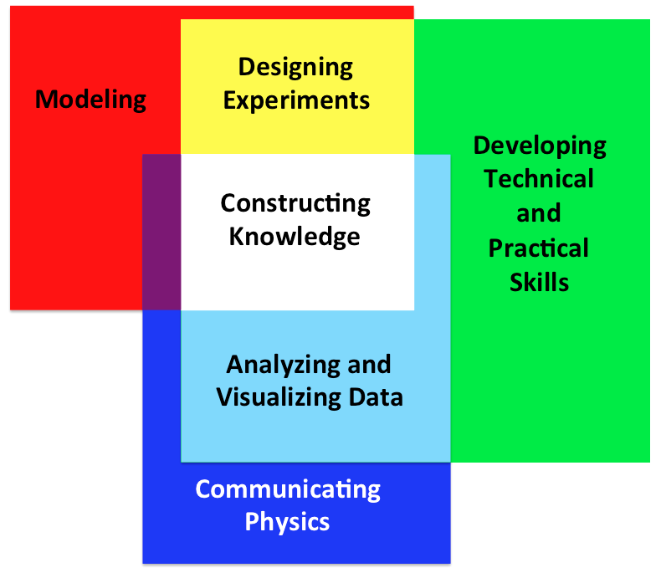
Lab Curriculum Focus Areas

Slide 19
Lab Curriculum Focus Areas
Constructing Knowledge – collect, analyze, and interpret real data from personal observations of the physical world to develop a physical worldview.

Slide 20
Lab Curriculum Focus Areas
Modeling – develop abstract representations of real systems studied in the laboratory, understand their limitations and uncertainties, and make predictions using models.

Slide 21
Lab Curriculum Focus Areas
Designing Experiments – develop, engineer, and troubleshoot experiments to test models and hypotheses within specific constraints such as cost, time, safety, and available equipment.

Slide 22
Lab Curriculum Focus Areas
Developing Technical and Practical Laboratory Skills – become proficient using common test equipment in a range of standard laboratory measurements while being cognizant of device limitations.

Slide 23
Lab Curriculum Focus Areas
Analyzing and Visualizing Data – analyze and display data using statistical methods and critically interpret the validity and limitations of these data and their uncertainties.

Slide 24
Lab Curriculum Focus Areas
Communicating Physics – present results and ideas with reasoned arguments supported by experimental evidence and utilizing appropriate and authentic written and verbal forms.

Slide 25
Status of the Lab Curriculum Recommendations Document
Endorsed by the AAPT Committee on Laboratories on July 29, 2014
Endorsed by the AAPT Executive Board on November 10, 2014
Available on AAPT website:
http://aapt.org/Resources/upload/LabGuidlinesDocument_EBendorsed_nov10.pdf

Slide 26
Future of the Lab Curriculum Recommendations Document
We hope that this document will:
Inform the UCTF and J-TUPP
Be used by departments to evaluate and update their lab curriculum
Be used by external reviewers for departmental reviews
Be used by the PER community for developing laboratory assessments
Have an online presence with user input of implementation examples
http://aapt.org/Resources/upload/LabGuidlinesDocument_EBendorsed_nov10.pdf

Slide 27
What we want from you
What weighs heavily on department minds regarding preparation of undergraduate physics majors?
What can J-TUPP do to help out departments with these concerns?

Slide 28
Presentations By J-TUPP Members
Douglas Arion
Session ED03
Monday, January 5th, 4:30 – 5:00 pm
Updating Physics Curricula: Professional Development and Entrepreneurship Education
Lawrence Woolf
Session GB01
Tuesday, January 6th, 8:30 – 9:00 am
Mentoring Graduate Students for Their Likely Non-Academic Careers

Slide 29
Questions?
J-TUPP website:
http://www.aapt.org/Programs/J-TUPP.cfm
http://www.aps.org/programs/education/undergrad/jtupp.cfm

