Slide 1
Lessons Learned Implementing Online Education at the University of Arkansas
Dr. John Stewart

Slide 2
Abstract
The calculus-based physics sequence at the University of Arkansas-Fayetteville was revised to feature inquiry-based methods as part of the PhysTEC project in 2001. Since this time, the sequence has been a key component to the exceptional growth of the undergraduate physics program and its production of physics teachers. In line with the university system’s strategic goals for online education, online lecture sections were added to the sequence in the Spring 2013 semester. To improve ease of transfer between university campuses, the University of Arkansas-Fayetteville began offering its first-semester, calculus-based physics class online to other campuses of the University of Arkansas during the Fall 2013 semester. This required the production of online laboratories. These laboratories used a mix of simulations and video recording of experiments to replace face-to-face laboratories. Our experiences with taking a very well understood and highly successful course sequence online have been mixed. Some experiences suggest that online options can be an effective replacement of face-to-face options; some experiences suggest that caution is appropriate when considering replacing face-to-face experiences with online options.

Slide 3
No Moocs
This talk is not about MOOCs, but non-MOOC online physics education (where the money is). This talk discusses the addition of online elements to well-understood face-to-face (f2f) physics classes.

Slide 4
Online Education at the University of Arkansas
Providing online opportunities was expressed as a system-wide goal in Fall 2012.
To address this goal and to alleviate serious shortages in large lecture theater seating, online physics options began to be offered in the Fall 2012 semester.

Slide 5
University Physics II
The course studied is the second-semester, calculus-based, introductory physics class at the University of Arkansas.
The class has been presented in the same format by the same lead instructor for over a decade.
The course features interactive laboratories, excellent TA training, and has been a centerpiece of the Arkansas Physics Program and its PhysTEC site.

Slide 6
Course Structure (Before Online)
Lecture was presented during two 50-minutes sessions each week with attendance managed with a lecture quiz.
Two two-hour laboratory sessions were required each week involving hands-on activities, small group work, traditional experiments, and interactive demonstrations.
Students were required to turn in open-response and multiple-choice homework before each lecture.

Slide 7
Course Structure (After Online)
Online and Face-to-Face (f2f) lecture sections were offered both presenting the same 50 minute lecture twice a week.
Online lecture sections used videos of the f2f lecture cut into 5-15 minute segments each accompanied by a lecture quiz question.
The laboratory experience was unchanged.
Students were required to turn in open-response homework after the last lab and multiple-choice homework before each lecture.

Slide 8
A Gradual Introduction
Fall 2012 – Students were given the option mid-semester to watch the lecture on video.
Spring 2013 – Online lecture section opened, but students of both online and f2f sections given option to either attend lecture or watch lecture on video.
Fall 2013 to Spring 2014- Online students required to watch lecture on video.

Slide 9
In Short
The class was virtually (ha ha) unchanged by the introduction of the online option except some students could watch the lecture on video.
This talk will discuss our experiences in transition this f2f course to a blended course.

Slide 10
Experiment I
Students Self-Select Online Options

Slide 11
Starting Online Lecture – Fall 2012
A policy allowing students (N=168) to watch the lecture as a video online was implemented mid-semester in Fall 2012.
Students self-selected the number of lectures watched on video.
All students attended a face-to-face lab and the lab experience was not modified; thus a student could choose to convert a face-to-face course into a blended course.
The replacement of 8 of the 12 lectures remaining in the semester with video was measured using an online quiz taken with the video.

Slide 12
Video Use

Slide 13
Engagement Changes – Change in the Rate Assignments are Submitted
 | Overall (%) |  |  | Non-User (%) |  |  | Low User (%) |  |  | High User (%)
 | BV | AV | Δ | BV | AV | Δ | BV | AV | Δ | BV | AV | Δ
Lecture Quiz | 91.9 | 82.7 | -9.3^{b} | 95.1 | 85.5 | -9.6^{b} | 93.8 | 83.5 | -10.3^{b} | 84.4 | 76.8 | -9.6ª
Laboratory | 97.7 | 96.6 | -1.1ª | 98.6 | 97.4 | -1.2ª | 98.5 | 96.8 | -1.6ª | 95.3 | 94.8 | -0.5
Multiple-Choice Homework | 93.4 | 90.1 | -3.3^{b} | 94.3 | 90.8 | -3.5^{b} | 94.3 | 91.7 | -2.6 | 90.8 | 87.1 | -3.7
Open-Response Homework | 90.8 | 88.9 | -1.9 | 93.0 | 90.0 | -3.0 | 92.5 | 92.0 | -0.4 | 85.0 | 83.7 | -1.3
Optional Assignments | 30.4 | 26.2 | -4.2 | 33.3 | 23.1 | -10.3 | 39.1 | 30.4 | -8.7 | 15.9 | 27.3 | 11.4
The superscript “a” indicates significance at the 5% level; “b” significance at the 1% level. BV=Before Video AV=After Video

Slide 14
Engagement Results
Paired t-tests indicate that some of the changes before video (BV) to after video (AV) were statistically significant.
Analysis of variance showed that the level of video use was not a significant treatment effect on the change in submission rates of any assignment type; watching more video did not indicate a greater decrease in submission rate.
Students electing the video option at high levels had lower submission rates before the availability of the video policy; this difference continued after the policy was introduced.

Slide 15
Achievement Changes
 | Overall |  |  | Non-User |  |  | Low User |  |  | High User
 | BV | AV | Δ | BV | AV | Δ | BV | AV | Δ | BV | AV | Δ
Tests | 73.7 | 74.8 | 1.1 | 76.4 | 77.0 | 0.6 | 73.1 | 74.3 | 1.3 | 69.6 | 71.4 | 1.8
Open-Response Homework | 68.7 | 70.3 | 1.6 | 72.3 | 74.1 | 1.8 | 71.2 | 70.5 | -0.7 | 59.5 | 63.1 | 3.5
Multiple-Choice Homework | 58.5 | 58.4 | -0.1 | 60.8 | 61.4 | 0.6 | 59.7 | 60.7 | 1.0 | 53.0 | 50.5 | -2.6
BV=Before Video AV=After Video

Slide 16
Achievement Results
A paired t-test showed that differences for all assignment types were not significant.
Analysis of variance showed that the level of video use was not a significant treatment effect for the change in achievement for any assignment type.
Students electing high use of the video option were lower achieving before and after the video option; weaker performing students preferentially elected the video option.

Slide 17
Note Taking Behavior
Students were surveyed about the way they took lecture notes after the first and third exams.

Slide 18
Question: Circle the ONE of the following that best describes how you obtain lecture notes | Overall Percent |  | Non-User Percent |  | Low User Percent |  | High User Percent
 | BV | AV | BV | AV | BV | AV | BV | AV
I take my own lecture notes. | 67.72 | 59.63 | 78.67 | 73.97 | 65.12 | 59.09 | 50.00 | 36.36
I print or read the lecture notes at the website after lecture. | 8.23 | 13.04 | 4.00 | 10.96 | 13.95 | 4.55 | 10.00 | 25.00
I print the lecture notes from the website before lecture and follow along during lecture. | 3.16 | 10.56 | 1.33 | 5.48 | 0.00 | 15.91 | 10.00 | 13.64
I print the lecture notes from the website before lecture, follow along during lecture, and add my own notes. | 18.99 | 14.91 | 14.67 | 9.59 | 18.60 | 20.45 | 27.50 | 18.18
I do not take lecture notes nor do I read the lecture notes at the website. | 1.90 | 1.86 | 1.33 | 0.00 | 2.33 | 0.00 | 2.50 | 6.82

Slide 19
Note Taking Results
Students electing a high level of video use used less engaged note taking behavior before the video option was introduced.
Students electing a high level of video use changed their note taking behavior to even more less engaged note taking methods after the introduction of the video option.

Slide 20
Results of Experiment I
Students electing a high level of video use were less engaged and lower achieving both before and after the video option was made available.
The level of video use was not a significant treatment effect for the change in engagement or achievement for any assignment type.
The level of video use ceased to be a significant treatment effect for exam scores after the video option was introduced; high video users caught up a bit.

Slide 21
Results of Experiment I
Weaker students self-select online options.
Generally it doesn’t hurt them.
There is the slightest evidence that it helps somewhat.

Slide 22
Experiment II
Required Online Lecture Sections

Slide 23
Online Lecture Sections
Starting in Spring 2013, students could elect online sections of the lecture and were required to attend no f2f lectures.
The lab requirements were unchanged.

Slide 24
Mostly things were fine
Experiment I demonstrated that online lecture was educationally equivalent and the lab experience meant the online lecture students still attended four hours of f2f lab each week.

Slide 25
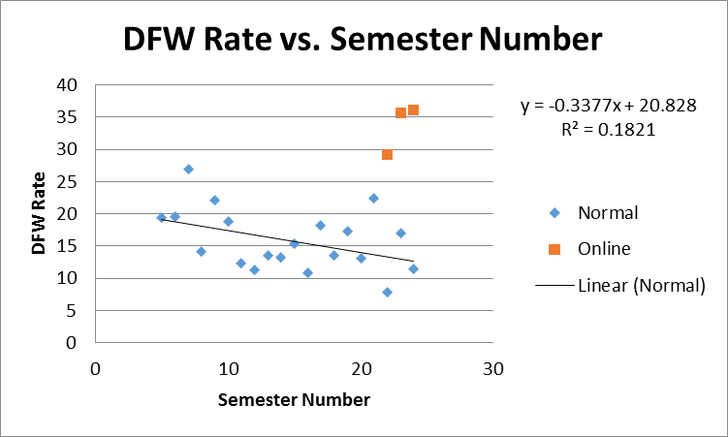
But.. Online Students Fail at Higher Rates

Slide 26
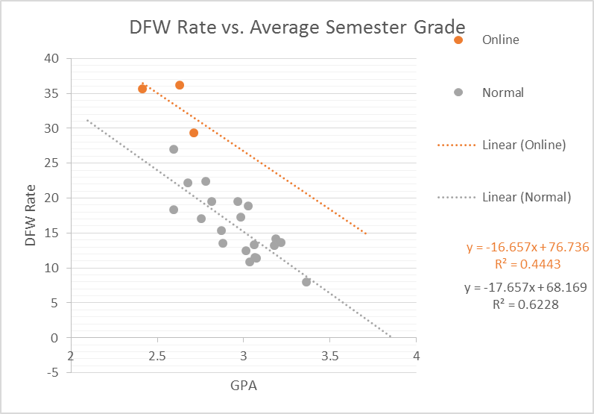
DFW Rate vs Class Average

Slide 27
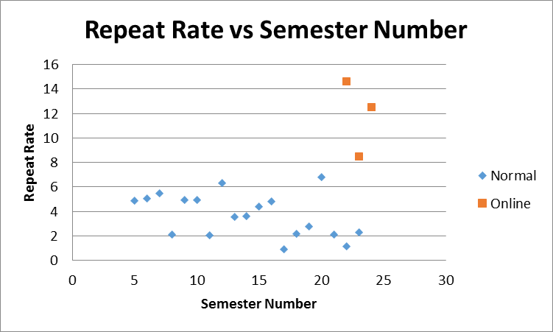
More Online Students are Repeating the class

Slide 28
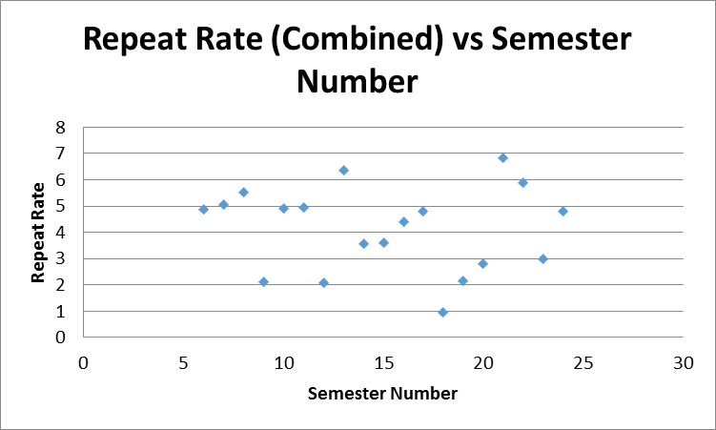
Repeating Students electing online sections

Slide 29
And not Succeeding

Slide 30
Students Successfully repeating the class
Fall 11-Spring 12 |  | Total | Non-Online | Online
 | Total Enrollment | 463
 | Students Repeating | 11 | 11
 | Repeat Rate | 2.38
 | Successful Repeats | 8 | 8
 | Success Rate | 72.73 | 72.73
Fall 13-Spring 14
 | Total Enrollment | 595 | 464 | 131
 | Students Repeating | 21 | 7 | 14
 | Repeat Rate | 3.53 | 1.51 | 10.69
 | Successful Repeats | 7 | 5 | 2
 | Success Rate | 33.33 | 71.43 | 14.29

Slide 31
Success Rate of Repeating Students
 | Students Receiving A, B, C
Fall 11-Spring 12 |  | Total | Non-Online | Online
 | Total Enrollment | 463
 | Students Repeating | 11 | 11
 | Repeat Rate (%) | 2.38
 | Successful Repeats | 8 | 8
 | Success Rate (%) | 72.73 | 72.73
Fall 13-Spring 14
 | Total Enrollment | 595 | 464 | 131
 | Students Repeating | 21 | 7 | 14
 | Repeat Rate (%) | 3.53 | 1.51 | 10.69
 | Successful Repeats | 7 | 5 | 2
 | Success Rate (%) | 33.33 | 71.43 | 14.29

Slide 32
Not the whole problem
DFW Rate Correcting for Repeat Students |  | Total | Online
 | Total Enrollment | 595 | 131
 | Original DFW Count | 105 | 47
 | DFW Rate | 17.65 | 35.88
 | Corrected DFW | 98 | 40
 | Corrected Rate | 16.47 | 30.53

Slide 33
Results of Experiment II
While educationally equivalent, the introduction of online lecture sections produced unforeseen negative impacts on the course studied.

Slide 34
Experiment III
Online Laboratories

Slide 35
Online Laboratories for Physics I
As part of an effort to improve the success of transfer students, the College of Engineering at the University of Arkansas asked that the University Physics I class be offered in a blended model to all students in the Arkansas system.

Slide 36
Creating the Blended Class
One laboratory session each week was identified that could be converted to an online experience.
Students still attend one face-to-face laboratory session each week.

Slide 37
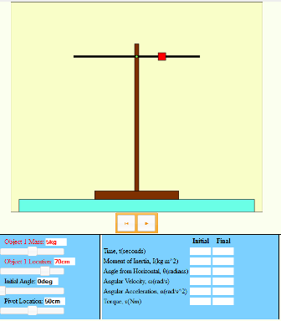
Home-grown Simulations
Javascript+HTML5+SVG

Slide 38
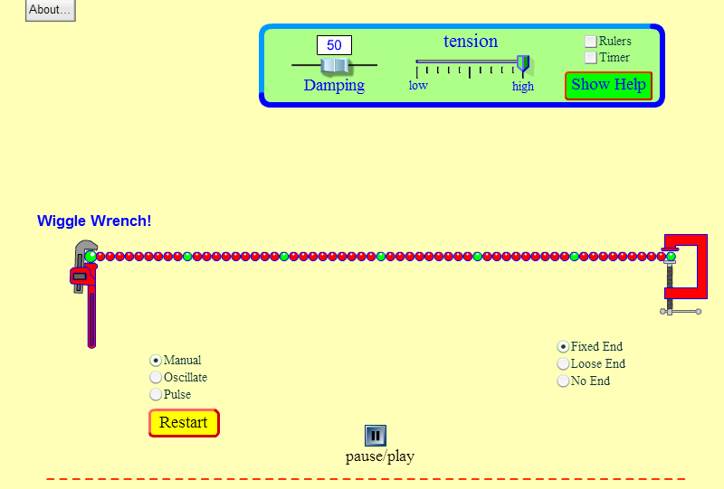
PhET Simulations

Slide 39
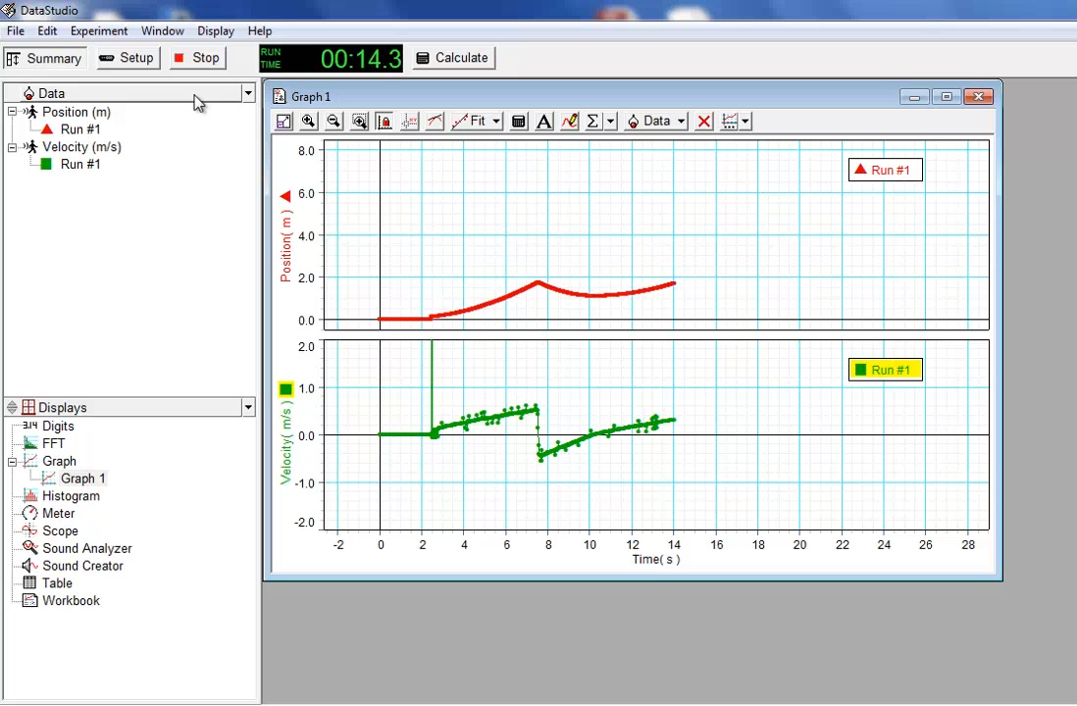
Video Recorded Laboratories

Slide 40
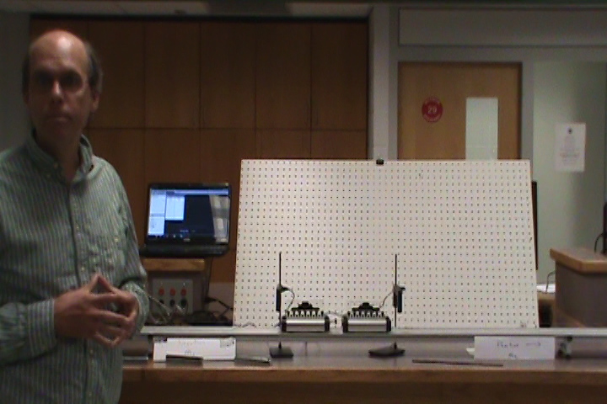
Video Recorded Interactive Demonstrations

Slide 41
Learning Outcomes Unchanged
Students performed equivalently on in-semester examinations and the Force Concept Inventory.

Slide 42
Students find the face-to-face laboratory experience more valuable.

Slide 43
Students preferred simulated labs to video labs

Slide 44
What are online labs missing?
Feature | Importance
Being able to use real equipment | 6.9
Being able to see a demonstration in person | 7.5
Being able to discuss lab with lab partners | 7.9
Being able to get help from a TA when I’m stuck | 9.0
Being able to listen to the TA’s introduction of the lab in person | 7.8
Being able to ask the TA general physics questions like questions about homework | 8.6
Having to come to a lab at a specific time so I don’t put it off | 7.2
Students were asked to rate the importance of various features missing from online labs on a 10 point scale with 10 as most important.

Slide 45
What features would you find most valuable if added to online labs?
Feature | Importance
Online discussion board for each part of the activity | 3.9
Video help for each part of the activity | 5.1
Frequently Asked Questions for the activity | 5.1
Online chat rooms with other students on the activity | 3.7
Online chat room moderated by a TA on the activity | 4.6
TA dedicated to answer questions by email during day | 5.0
Small labs done with simple equipment at home | 3.4
Video conference office hours with a TA | 3.7
Help text tied to the parts of the activity | 4.8
More Test Your Understanding Questions | 3.8
Importance on seven point scale.

Slide 46
Results of Experiment IV
The primary feature the students miss in the face-to-face laboratory was having a TA present to provide immediate help.
The primary features the students would like added to the online lab are traditional asynchronous methods of providing online help.

Slide 47
Experiment IV
What do students think?

Slide 48
Online/Face-to-Face Decision
Students were surveyed about their choice of online or face-to-face lecture in the Spring 2014 semester.

Slide 49
Why did you take the online section?
 | Percent
The face-to-face lecture section was full and this was the only way I could get into the class. | 38.6
There was another class I wanted to take at the same time as the lecture. | 36.4
I had personal or work commitments that conflicted with the face-to-face lecture. | 4.5
I like the flexibility of an online class. | 15.9
I think I learn better using online lectures than face-to-face lectures. | 2.3
Other. (One other response-class was full) | 2.3

Slide 50
How would you compare the educational value of the online lecture to a similar lecture attended in a face-to-face setting (Online Students)?
 | Percent
The online lectures are much more valuable than similar face-to-face lectures. | 4.7
The online lectures are somewhat more valuable than similar face-to-face lectures. | 23.3
The online lectures are equally valuable to similar face-to-face lectures. | 11.6
Face-to-face lectures are somewhat more valuable than similar online lectures. | 51.2
Face-to-face lectures are much more valuable than similar online lectures. | 9.3
The online lectures are much more valuable than similar face-to-face lectures. | 4.7

Slide 51
If you could, would you switch from online to face-to-face?
If you could, would you switch sections? | Online Percent | Face-to-Face Percent
Yes | 61.4 | 16.5
No | 38.6 | 83.5

Slide 52
Cautionary Tale I
The online laboratories were profoundly more expensive than the university was will to support. They also needed additional support (curation) that the university had no plans to fund.

Slide 53
Cautionary Tale II
Even the most passive change (online lecture) to an exceptionally stable and well-understood class had unexpected negative consequences for some populations of students.

Slide 54
Conclusion
Online physics education appears not to harm most students, but much more research is needed before it can be presented with confidence.

