Slide 1

Teach
Best Physics Teaching Practices to Future High School Physics Teachers, I Will!
David J. Sitar
Appalachian State University
Department of
Physics and Astronomy
1-12-2016

Slide 2
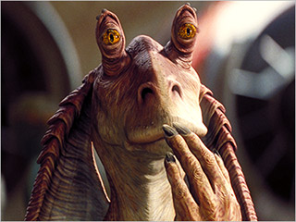
Hmmm….or…maybe…
Teach
Best Physics Teaching Practices
to Future High School Physics Teachers…
…I Did!!!!!
I think??????

Slide 3


In the Beginning….
Took on the Physics Secondary Education Advisor position spring 2015 – good idea…… Vice President of NCS-AAPT ☺
Recruited a few students
Asked to teach PHY3400 – I said yes!!!
Already teaching a new PHY1101 course, new prep… about two weeks prep time
Empty canvas – course had not been taught in nearly a decade
Searched for resources….
History of science
NC teaching standards
Content
Pedagogy
Assessment
Rubrics
Demos
Guest lectures
Field trips
OHHHH MY!!!!
I was going crazy…

Slide 4
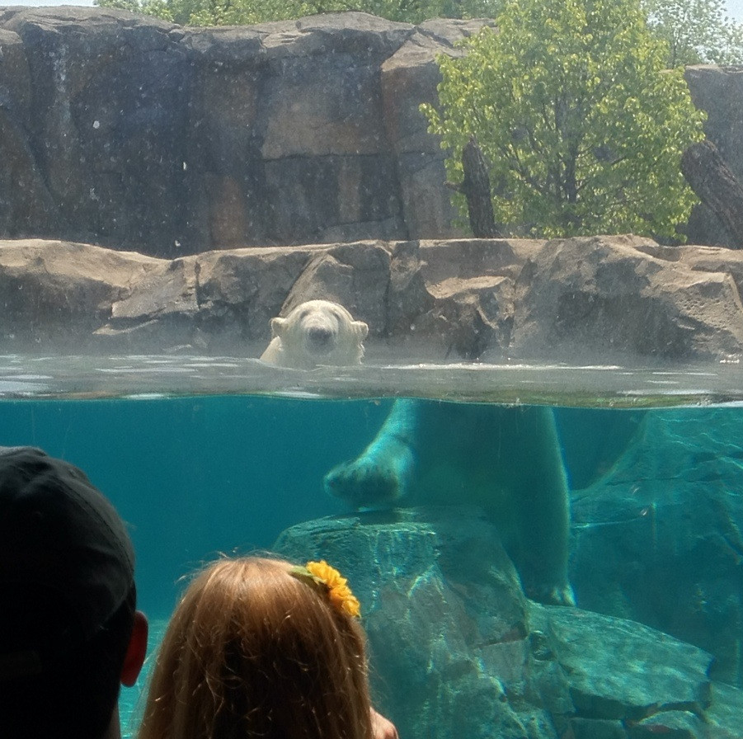
The Day Before the Semester

Slide 5

The Semester Starts
Three undergraduates and one graduate
Articles: Why teach physics?, Who’s teaching what in physics?, Getting involved, AAPT and PER
Never taught a discussion based course
First two weeks (four classes) were awful
Never had less than 24 students
So, what to?
Go back to thee ol’ drawing board!
Third week got better…
…..(details to follow in a moment)

Slide 6

Brainstormed
Decided on four sub categories and implemented:
1. Continue with articles and discussions
2. History
3. Content
4. Curriculum/Assessment
Start doing demos
Take field trips
Have guest lectures
Design projects and presentations
Regular visits to the physics demo room
Plan a tour of the machine shop
FBD in Round Robin – use of chalkboard
Reach out to those who could help; Dana Greene, Thomas Hefner and Scott Thomas

Slide 7
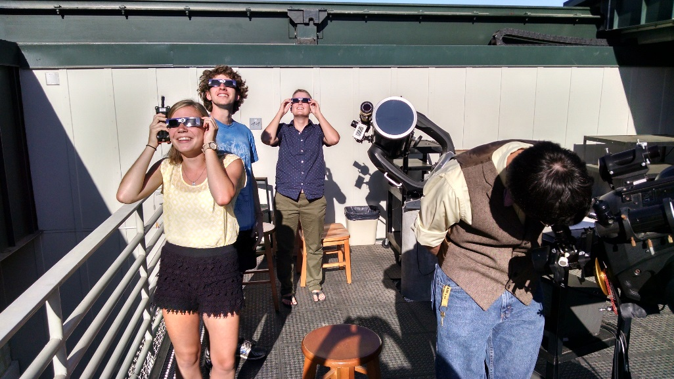
A Brief Look at the Rest of the Semester
Mid-semester – presentations, history and more hands-on, FBD in Round Robin, demos and pedagogy
Things were now going much better
WHEW!!!!!!!!!
For the remainder of the semester – content, SLO’s, curriculum design and assessment

Slide 8
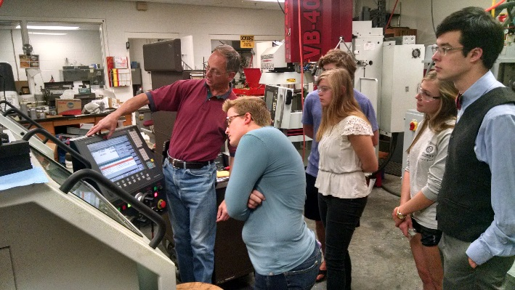
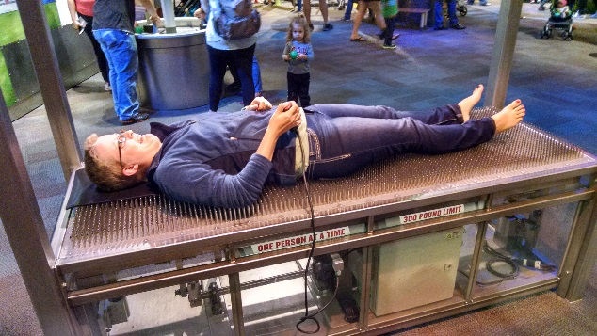
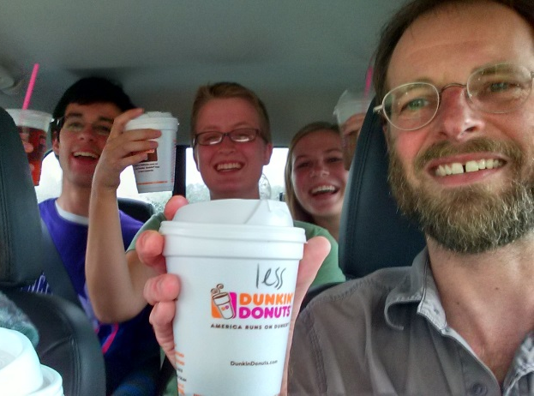
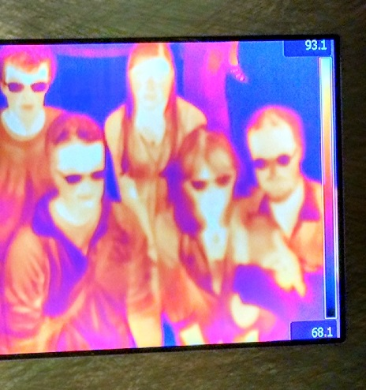
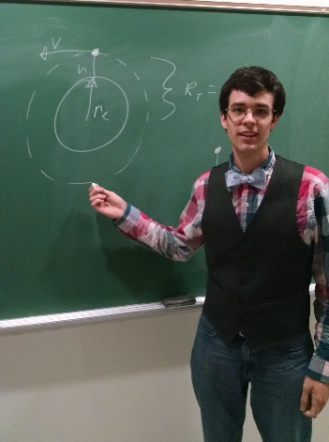
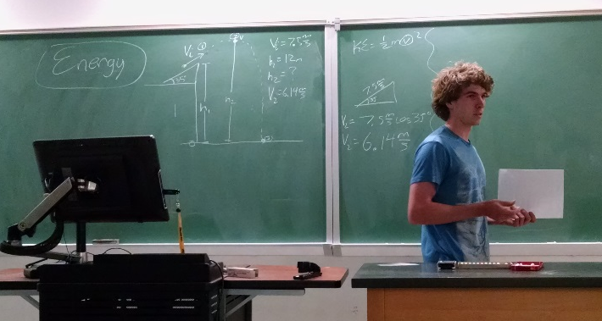
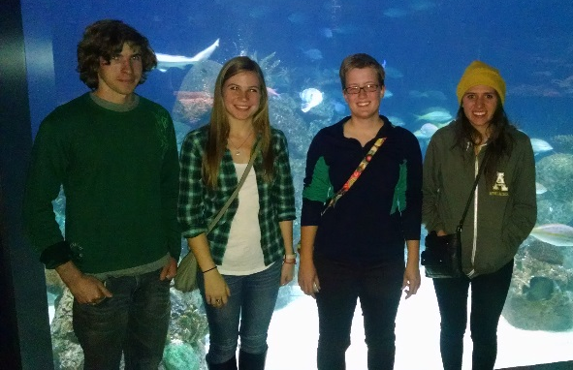
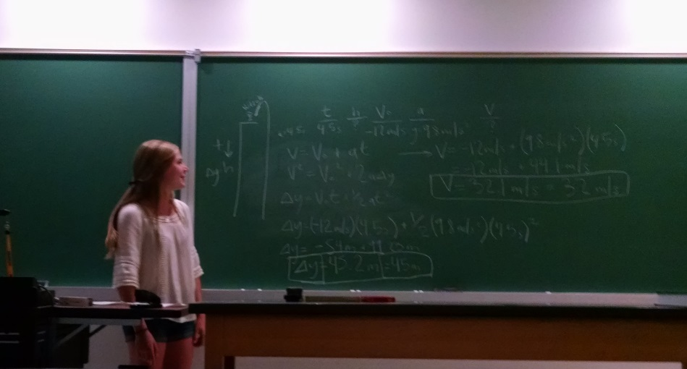
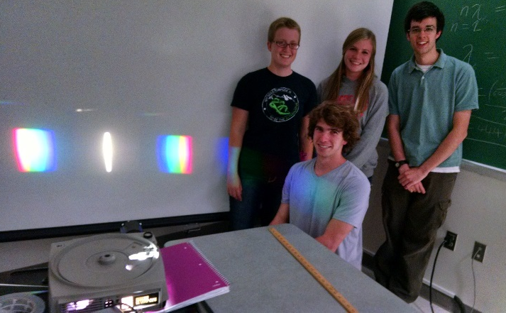

Some Highlights

Slide 9
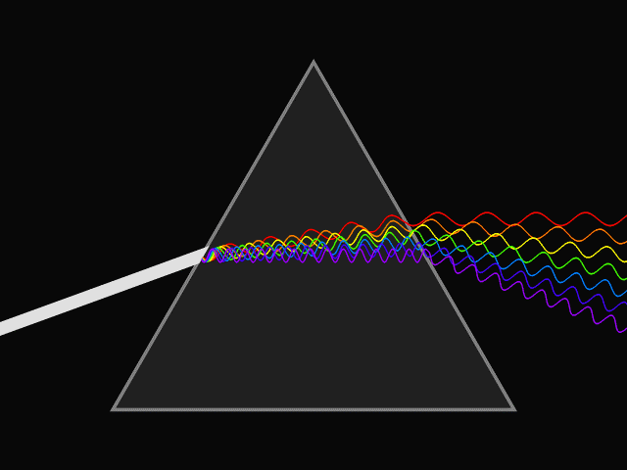
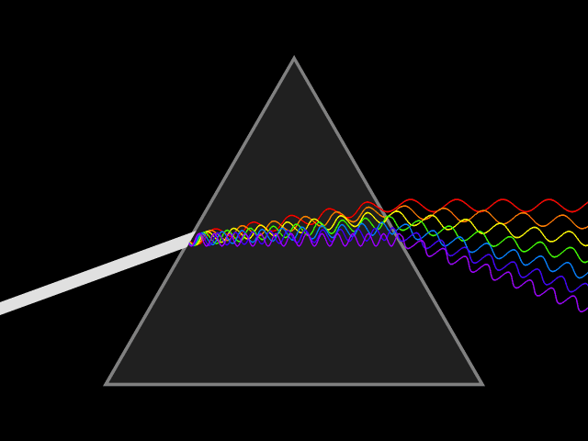
Summary
Learned a lot about myself as a teacher, scheduling, teaching in general, how to be more flexible and being able to adapt
Continue FBD in Round Robin
More hands-on activities and demos
Need to find a better approach at teaching curriculum design and assessment – weird because curriculum design is sort of my thing????
Potential TPT paper???
For the New Teacher column,
but from a student’s perspective

Slide 10

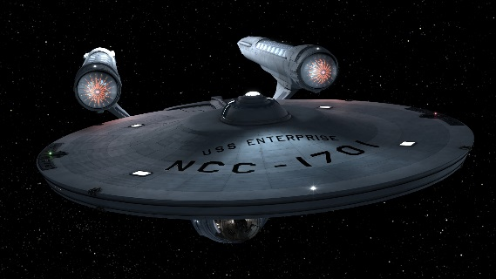
Acknowledgements
Appalachian State University
Department of Physics and Astronomy
PHY3400 students
AAPT
NCS-AAPT
Maureen Cathey, Dana Greene, Thomas Hefner,
Karl Mamola and Scott Thomas
Greensboro Science Center
Discovery Place
and of course you
folks for your time…

Slide 11
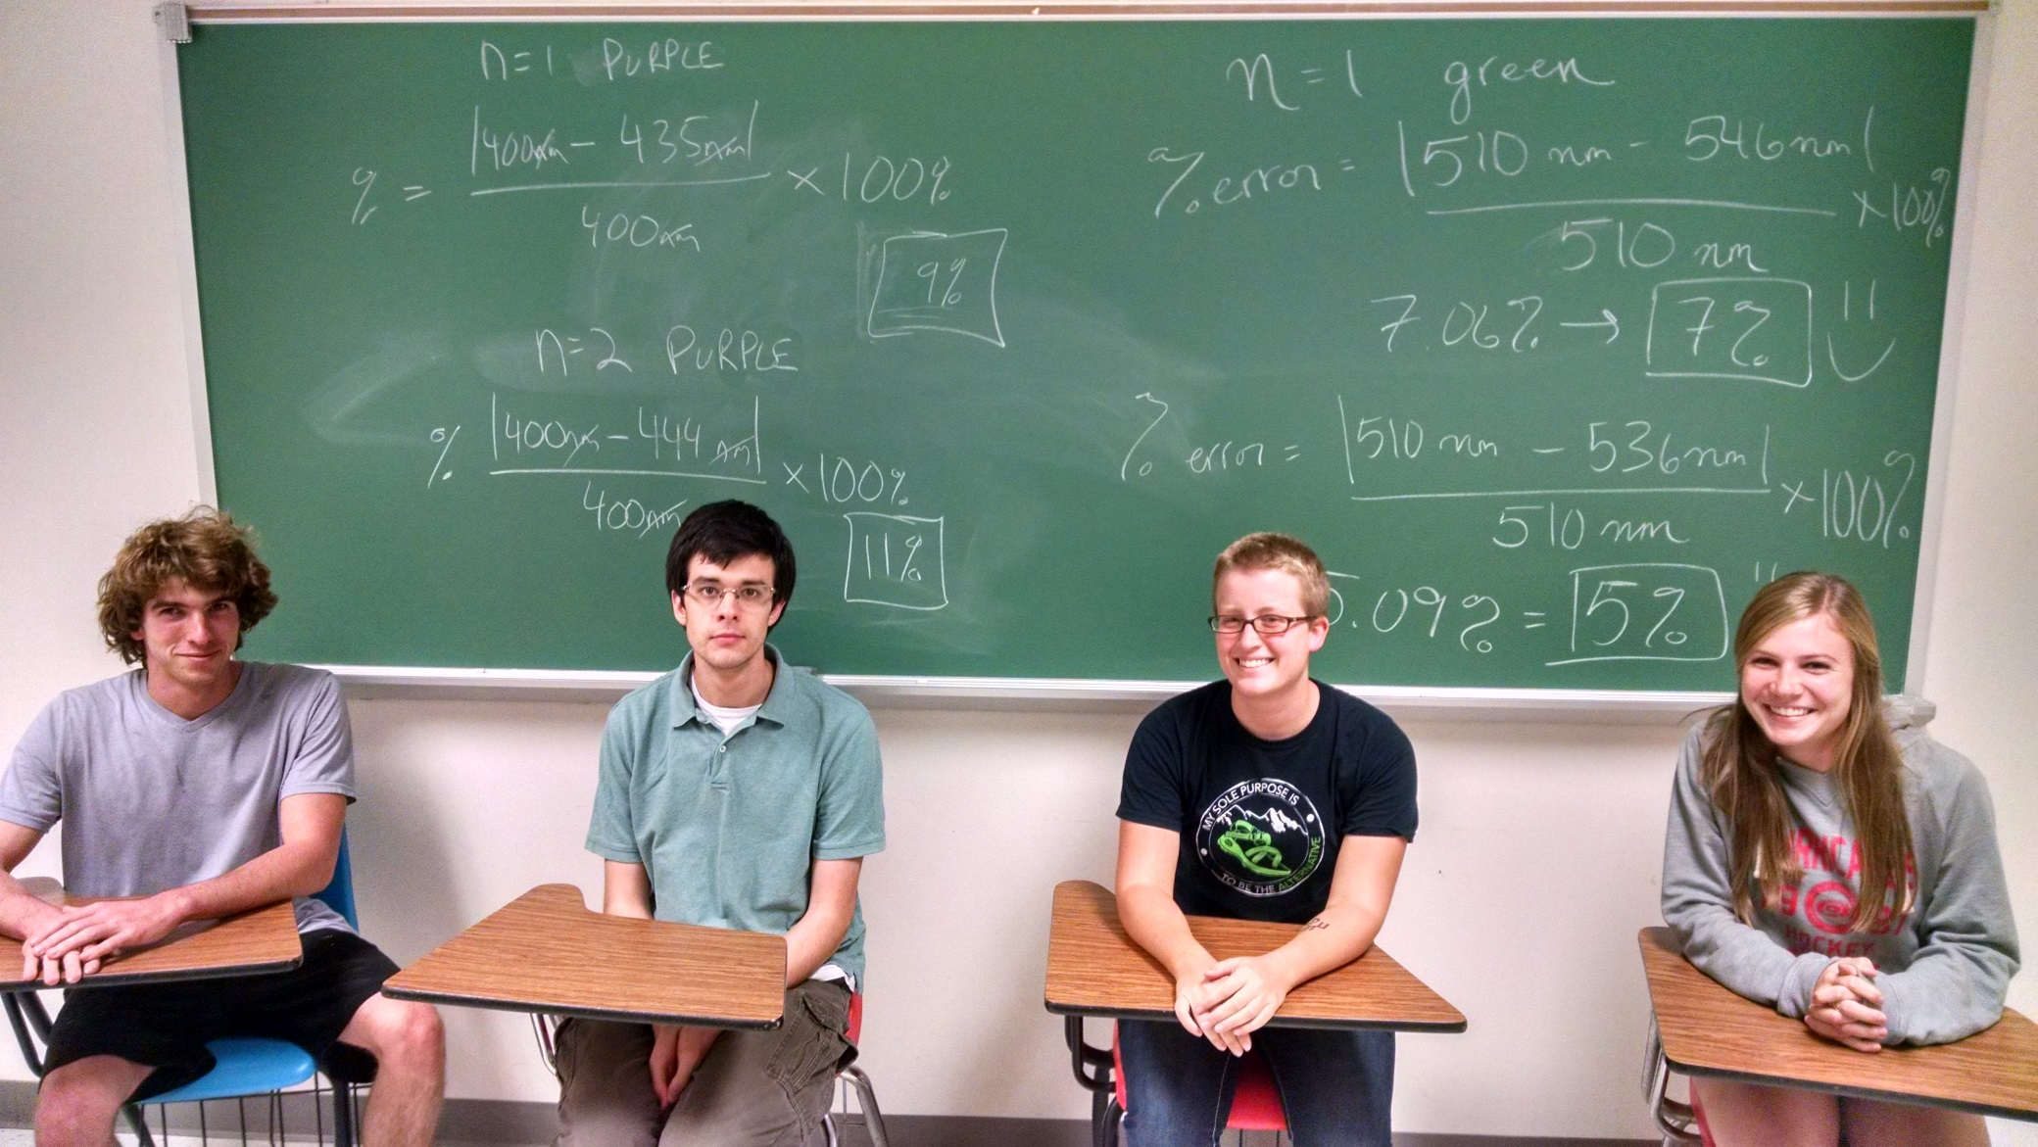
Questions, comments, ideas and suggestions welcomed

