Slide 1
Does the Classroom Matter?
AAPT Winter Meeting 2015
New Orleans, LA
Kaisa E. Young
Chadwick H. Young
Adam Beyer
Nicholls State University
Traditional Classroom vs. Auditorium: Student perceptions and success

Slide 2
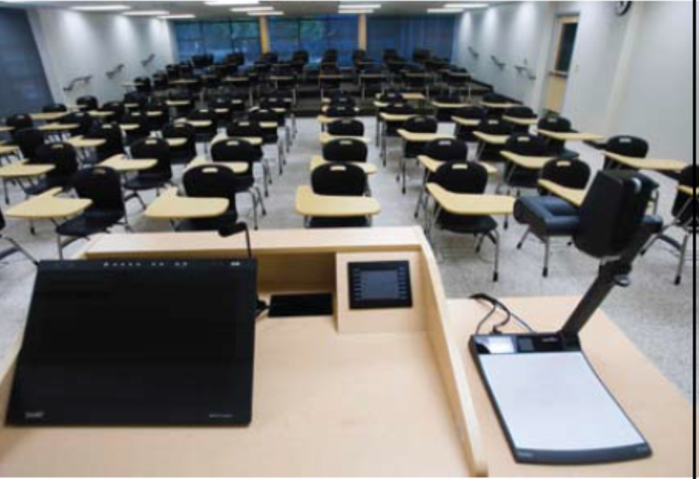
Which classroom would you choose?
Images: Misty McElroy
Traditional Classroom or Large Auditorium?

Slide 3
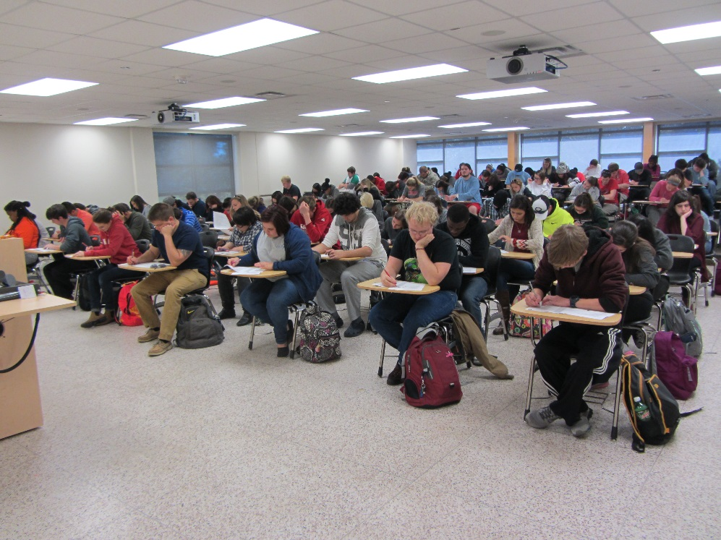
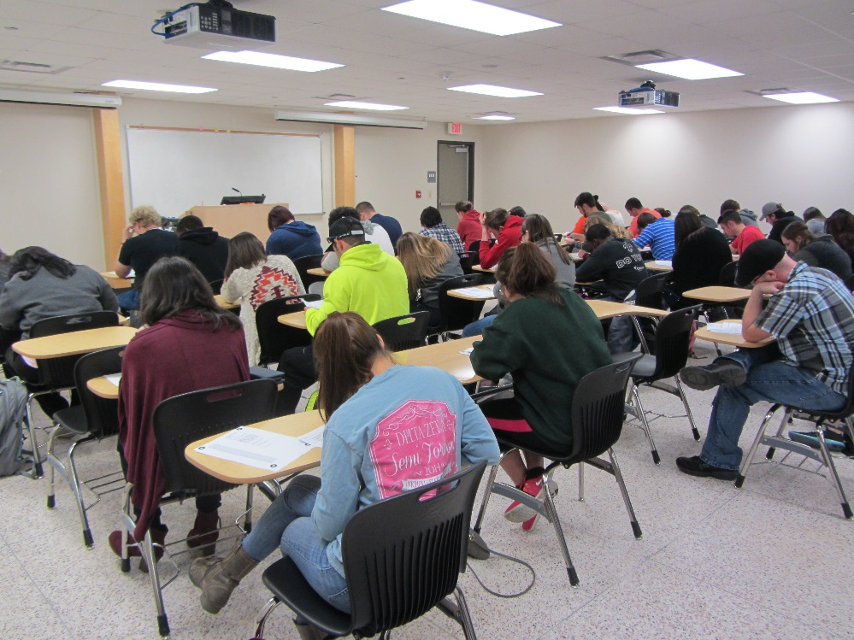
Traditional Classroom: Beauregard 104
100 Movable Desks
Stadium Seating in the Rear
2 Projection Screens
Smart Podium
Sound System with Microphone

Slide 4
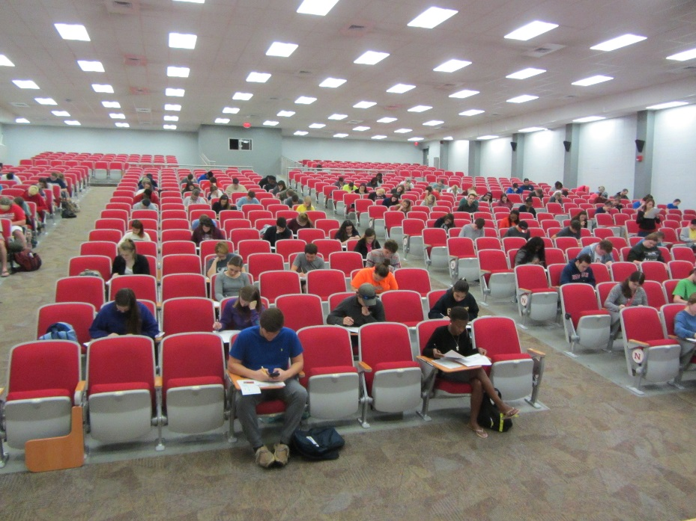
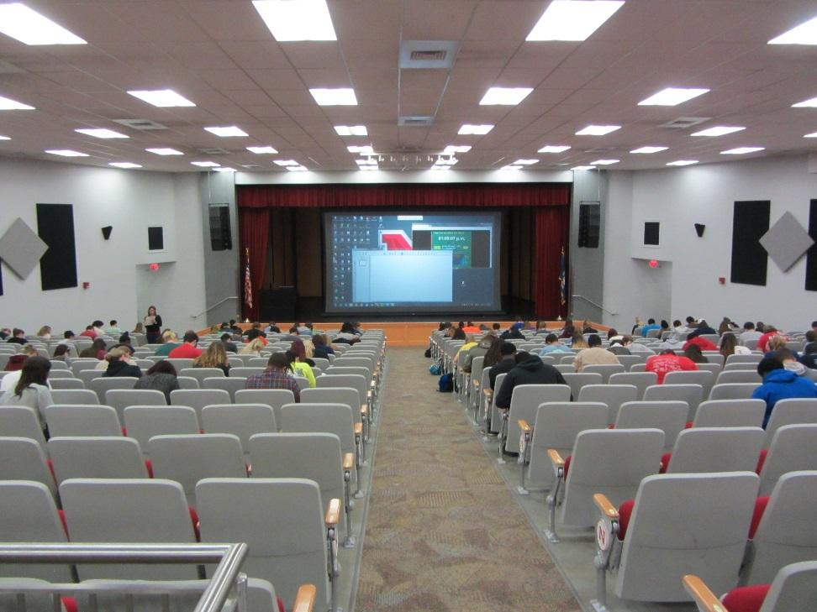
Large Auditorium: Peltier 101
Seats 775
300 Flip-up Desks
14 x 20 foot Rear Projection Screen
Smart Podium
Sound System with Microphone
Large Raised Stage

Slide 5
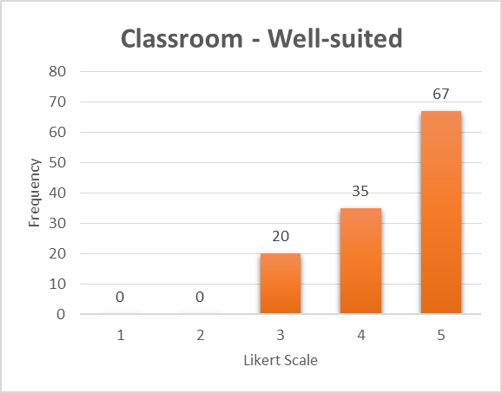
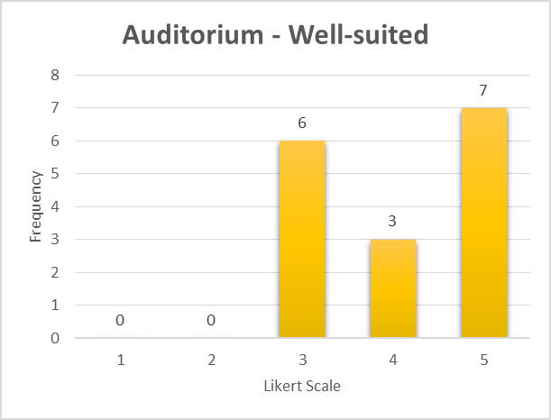
What do the students say?
Surveyed Astronomy, Physics, and Geology students
125 had a class in Beauregard Classroom, 16 in Peltier Auditorium
Likert-scale: 1 = Strongly Disagree, 5 = Strongly Agree
10 questions regarding comfort & ability to see, hear, and interact
Mean: 4.39 (0.75)
Mean: 4.13 (0.90)
“This room is well-suited to the daily lectures and activities in my class”

Slide 6
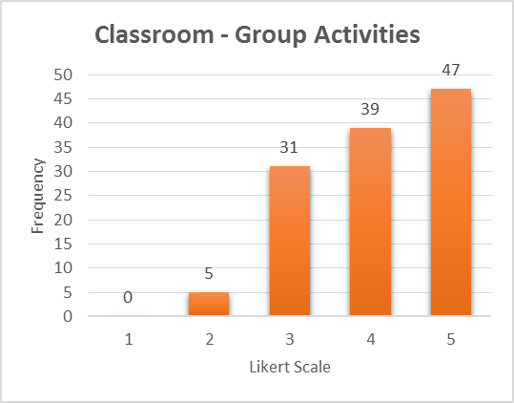
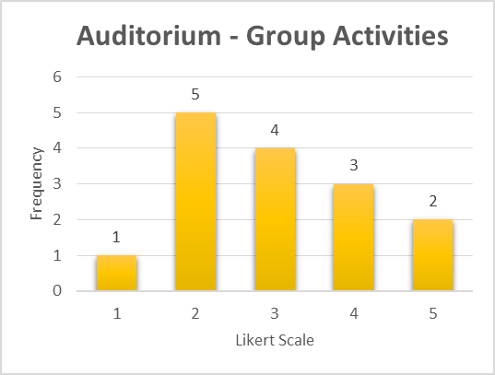
What about group activities?
“I can easily interact with other students during group activities”
Mean: 4.06 (0.90)
Mean: 3.00 (1.12)

Slide 7
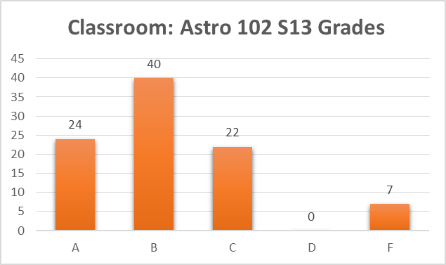
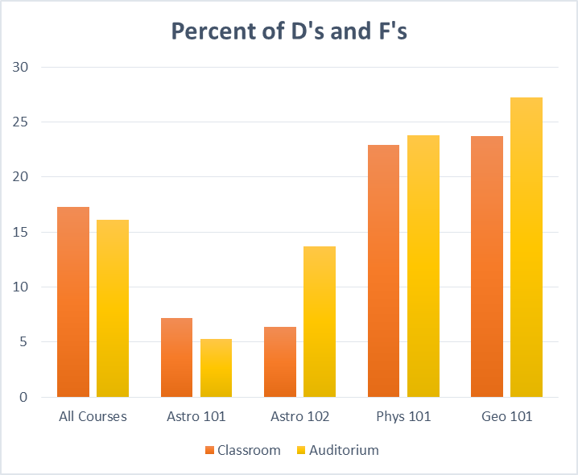
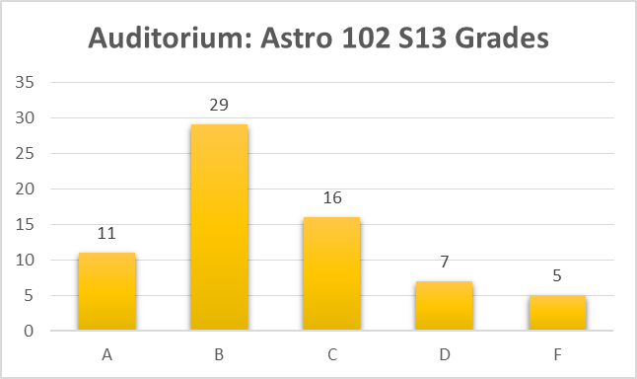
Does the classroom affect grades?
Nearly 1500 students in 4 courses during 7 semesters
  1035 in Classroom
  453 in Auditorium
Final Grade Distribution
Classroom Mean: 0.82 (0.14)
Auditorium Mean:
0.77 (0.19)
t test p-value:
0.080

Slide 8
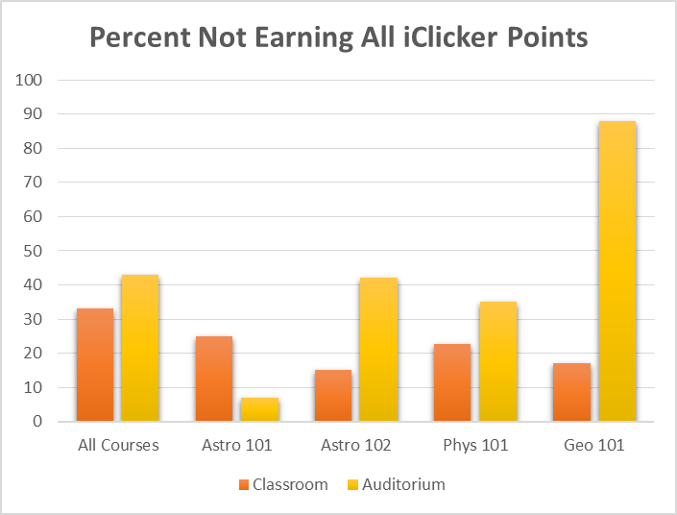
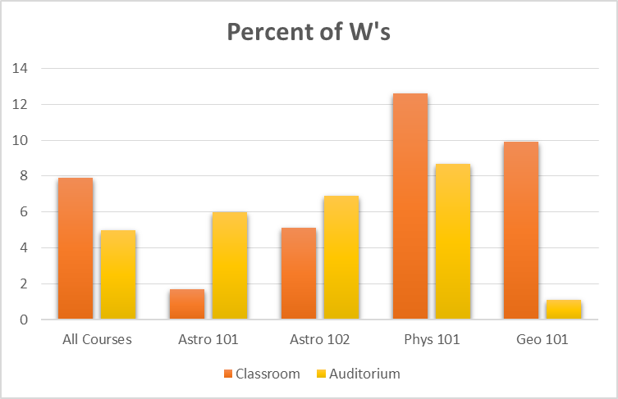
Does the classroom affect attendance and retention?
Weak Attendance
Dropped the course

Slide 9
Does the Classroom Matter?
Group activities and Interaction More Difficult in Auditorium
No Significant Difference in Final Grade Distribution or Failure Rate
Trend toward Weaker Attendance in Auditorium
Trend toward More Drops in Classroom
Take Away: More Intimate, Interactive Classroom may affect students’ approach and commitment to the course.

