Slide 1
Revised Curriculum for the Mechanics IPLS Course at Towson University
Katarzyna (Kate) Oldak, Lecturer
koldak@towson.edu
Dept. of Physics, Astronomy, Geosciences, and Science Education (PAGS)
Towson University, Towson, MD
Working with Dr. Dave Schaefer, Department Chair
dschaefer@towson.edu

Slide 2
Background:
What we did…
TU generally offers up to 12 sections (of 25 students each) of PHYS 211 (algebra-based mechanics for non physics majors) every semester
Problems:
Students struggle with problem solving
Students struggle with concepts
Students don’t see the relevance to their own field
We changed the lecture schedule
Notes: Momentum are gravitation are out! Drag Forces, non-conservative systems, and fluids are in!
We updated the lab manual
We introduced in-class activities to help with problem solving
We use “biology” related examples whenever possible
Before Fall 2014 |  | Fall 2014 and later
Unit 1 | Kinematics (1D and 2D) | Unit 1 | Kinematics (1D and 2D)
Unit 2 | Newton’s Laws and Forces | Unit 2 | Newton’s Laws and Forces (no friction)
 | Work, Energy, Energy Conservation |  | Circular Motion & Centripetal Force (no gravitation)
 |  |  | Torque
Unit 3 | Linear Momentum & Collisions | Unit 3 | Drag Force and Contact Friction
 | Circular Motion & Centripetal Force (includes gravitation) |  | Work, Energy, Energy Conservation, Emphasis on non-conservative examples
Unit 4 | Rotation (Torque, Angular Momentum Rotational Kinematics, Rotational Kinetic Energy) | Unit 4 | Fluids (Pressure, Buoyancy, Continuity, Bernoulli, Brownian Motion and Diffusion

Slide 3
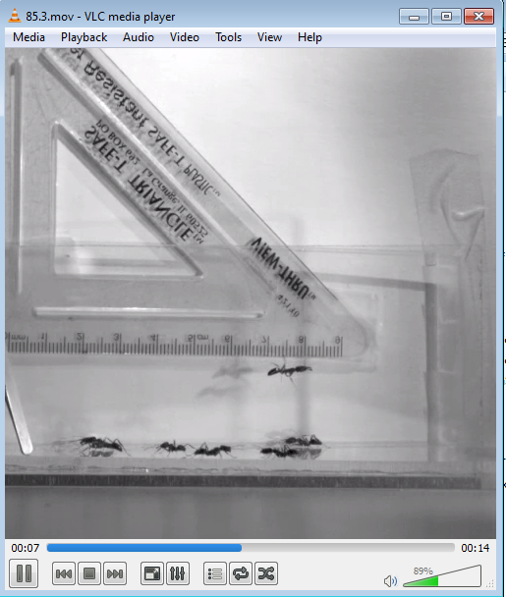
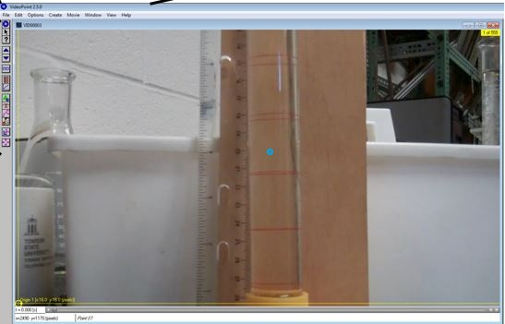
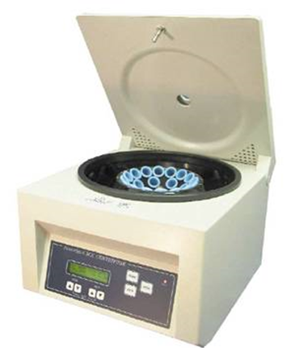
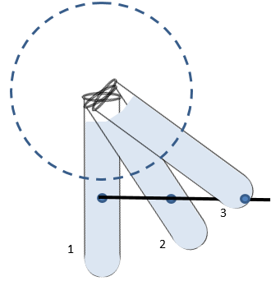
How did the labs change?
We went from a manual that generally had one “big” experiment per week to multiple of shorter hands-on activities, which let students explore and learn, rather than proving the lecture via experiment
Some high-lights of the labs include:
  Video analysis: tracking the projectile motion of an ant that launches itself into the air
  Using a centrifuge to separate materials based on density
  Incorporating air drag into free fall – using Euler’s method in Excel
  Video analysis: tracking a small bead falling through viscous fluid

Slide 4
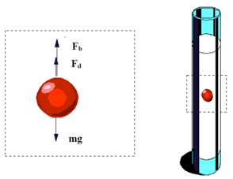
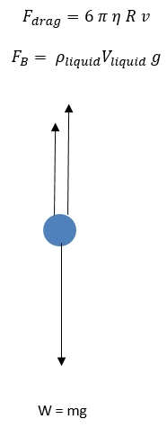
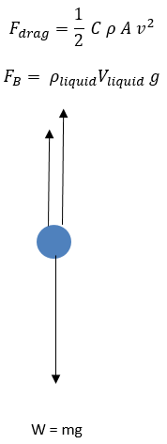
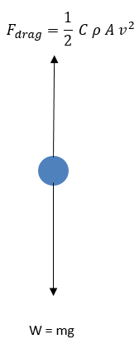
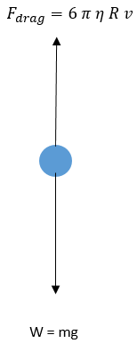
More details: Buoyancy and Viscosity Lab
Students drop a small bead into Wesson oil, videotape it, and track the video to measure its terminal velocity
They also calculate the theoretical terminal velocity taking into account the buoyant, drag, and gravitational forces acting it using 4 different methods before deciding which one matches data the best
Image credits: http://www.slideshare.net/MidoOoz/viscosity-stokes-law

Slide 5
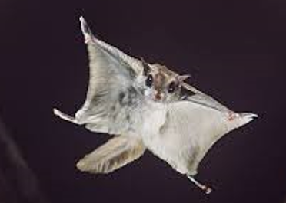

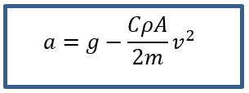
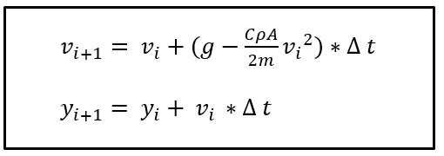
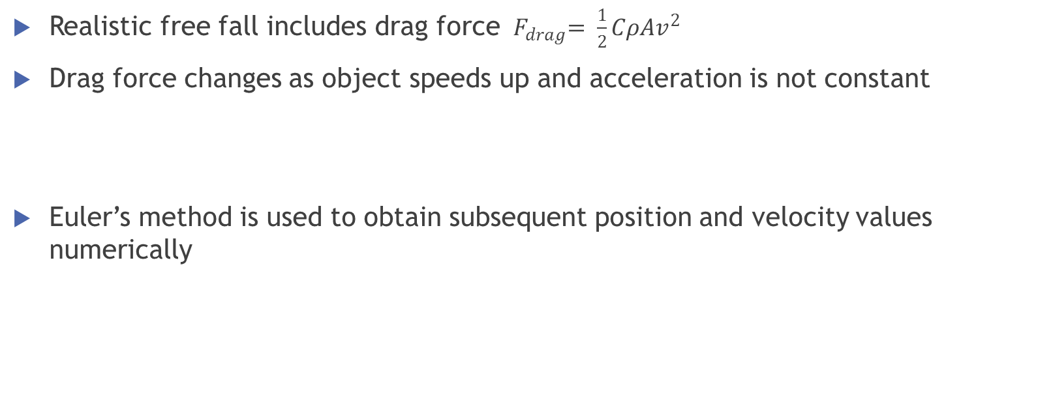
More details: Using Euler’s method in Excel to analyze realistic free fall
Realistic free fall includes drag force ${ F}_{drag}= \frac{1}{2}CρAv^{2}$
Drag force changes as object speeds up and acceleration is not constant
Euler’s method is used to obtain subsequent position and velocity values numerically
To help students use Excel throughout the semester, during the first week of class, they complete a tutorial that teaches them how to enter equations, lock cells, and repeat calculations by dragging down cells.
In this lab specifically, they also receive lots of guidance from the instructors

Slide 6
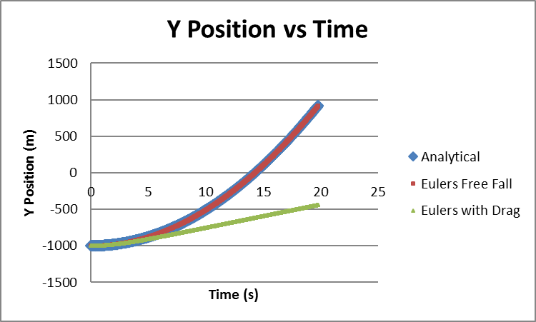
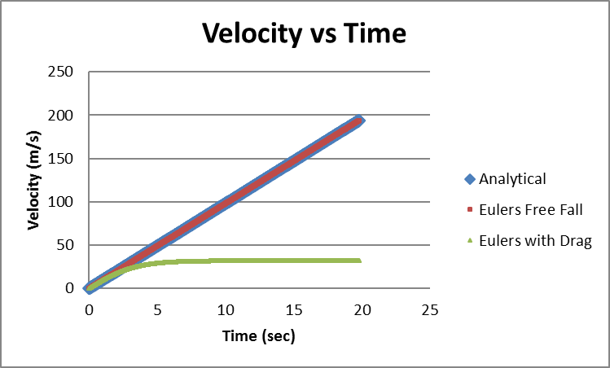
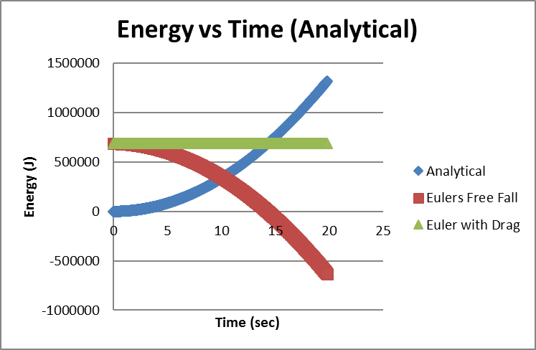
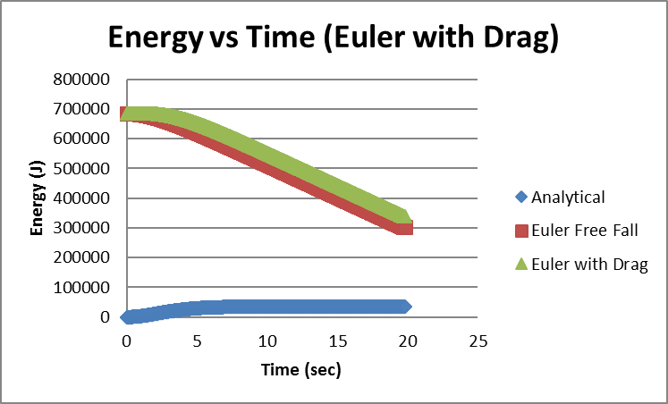
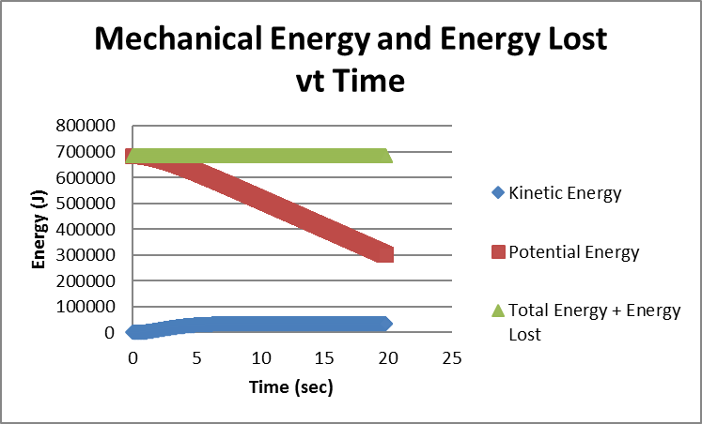
More details: Using Euler’s method in Excel to analyze realistic free fall - Results

Slide 7
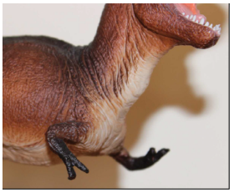
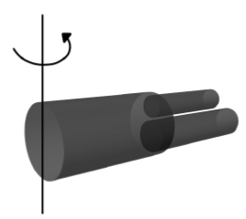
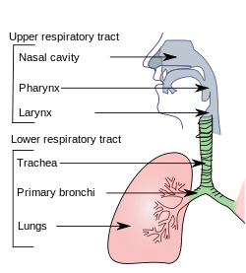
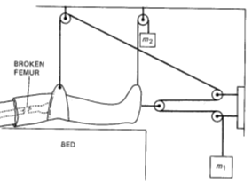
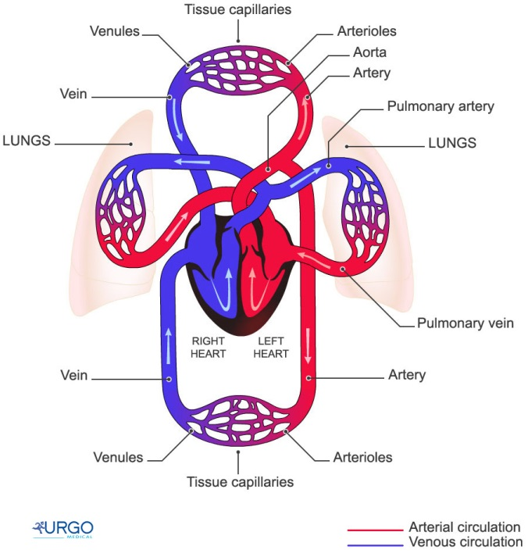
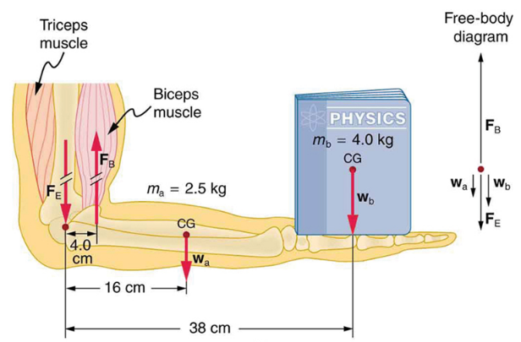
How did we address the problem solving?
Weekly in-class worksheets (done during the first hour of the lab section) to give students a chance to work on problems together before they see them on the homework
Students work in groups of 2-3 to solve problems. A TA or lab instructor circles around to give hints to the groups if they need them
As many examples with “biology” as we can come up with! (Animals for objects, traction mechanisms for forces in equilibrium, blood flow in arteries and veins, analyzing the forces and torques acting on human or animal joints)
Image credits: https://cnx.org/contents/Ax2o07Ul@9.72:1wOFPGOC@8/Forces-and-Torques-in-Muscles-

Slide 8
Why these changes?
Our changes were motivated by the work of prof. Edward Redish from Univ of MD, College Park https://umdphysics.umd.edu/people/faculty/current/item/424-redish.html#teaching
Also motivated by the work of prof. Tim McKay from Univ of Michigan https://rebuild.lsa.umich.edu/
We wanted to address the problems we were seeing ourselves (students struggle with problem solving, don’t see the relevance of the course, etc.)
Since Fall 2014, since have seen a significant increase in students wanting to register for the “physics for life science majors” sections.
(From spring 2015 to spring 2017, we have been offering “traditional” physics and “physics for life science majors” both listed as PHYS 211 and both taught using algebra-based methods. The “traditional” sections stuck to the previous lecture schedule and lab manual).

Slide 9
Ideas for Further Improvement
Students can work in groups to find a specific way that physics relates to their field of study and present their ideas to the class by doing PPT presentations
Combined lecture/lab sessions
Reaching out to the biology department to ask what topics in physics would benefit students the most
Anything else?
Questions?
We welcome any suggestions or questions, and are happy to share our materials developed so far
Kate Oldak, Lecturer, koldak@towson.edu
David Schaefer, Department Chair, dschaefer@towson.edu

